Slide 1
Welcome!
The training will begin shortly

Slide 2
BIE Science Benchmark
September 22, 2023

Slide 3
Housekeeping
All participants should remain on mute with their video off.
Post all questions to the chat.
Questions will be addressed at each section break.
Please add your name, email, and school to the chat.
This training will be recorded.
The recording will be posted to the Help & Support page, https://bie.onlinehelp.cognia.org/training.

Slide 4
Welcome & Introductions

Slide 5
Bureau of Indian Education (BIE)
Aurelia Shorty, Education Program Specialist, Project Manager for Science
Dr. Carmenia Becenti, Acting Chief Academic Officer
Donald Griffin, Section 504 Program Coordinator
Cognia
Mara Allaire, Program Manager
Sarah McCain, IT Project Manager II
eMetric
Aarti Jagtap, Project Manager III
Kaelee Harper, Senior Support Center Manager

Slide 6
Bureau of Indian Education Science Benchmark Assessment Fall 2023 ITC Training
Aarti Jagtap, eMetric
Kaelee Harper, eMetric

Slide 7
Agenda
Key Dates
Overview of System and Testing Process
User Management
Site Technology Preparation and Network Requirements
Technology Requirements
Features for Reliable and Secure Testing
Site Readiness Procedure
Additional Training Resources
Reminders

Slide 8
Science Benchmark Overview

Slide 9
Overview
Three grade levels – grade 5, middle school, high school
4 forms per grade level
Each form covers different content/standards
12–14 items per form
10–12 selected response
2 open ended response
Aligned to Next Generation Science Standards (NGSS)
Administer based on curriculum and pacing

Slide 10
Format
Available through eMetric Portal
Online
Students assess in kiosk
Paper
Available for download from administration home page

Slide 11
Key Dates
Test Preparation Key Dates
Portal Open & Kiosks available for download | Sep 11, 2023
BIE Roster Upload (only 5th, 8th, 11th grade students) | Sep 13, 2023
Tests available for scheduling in Portal | Sep 20, 2023
Science Benchmark Test Window Opens | Sep 21, 2023
Science Benchmark Test Window Closes | Mar 8, 2024

Slide 12
BIE Science Assessment
BIE Science Assessment Portal:
Online Test Administration System
https://bie.cognia.org
BIE Science Assessment Student Test Interface:
Student Test Delivery System

Slide 13
BIE Science Assessment Online System
Online System
Portal
Users
Administration
Test Delivery
Kiosk
Site Setup
Students
Classes
Test Sessions
Dashboard
Browser

Slide 14
Test Preparation Process
STC
Create user accounts
Add/edit/transfer students
Assign accessibility features & accommodations
ITC
Download and install kiosks/apps
Complete Site Readiness Test
STC or TA
Create classes
Schedule classes for test
Print/distribute log-in tickets
Students
Launch kiosk or browser
Log-in and test
TA
Score human scored items on tests
View results in Data Interaction
After testing…

Slide 15
Portal Access
Access
http://bie.cognia.org
Open all year, previous accounts can be used
For new School Test Coordinators, please contact BIE. Accounts will be created by Cognia & credentials will be emailed to you
STCs will create all new portal user accounts
Usernames must be unique
Your email address controls your account
New users will receive two automated emails, one with username and one with temporary password from bietechsupport@cognia.org
When an account is deactivated or reactivated, the user will receive an email

Slide 16
User Roles
User Role | Responsibilities
School Test Coordinator (STC) | Manage Users (add, edit, or deactivate) Access proctor password Edit student information & assign student accommodations Create, edit, and delete classes Schedule test sessions & print logins Manage & monitor test sessions Prepare IT network for student testing if there is no IT Coordinator
IT Coordinator (ITC) | Prepare IT network for student testing Conduct Site Readiness testing
Test Administrator (TA) | Create classes Create test sessions View their students and test sessions Print student login tickets for their test sessions Manage & monitor test sessions Assign test report codes Score human scored items for Benchmark tests View Benchmark results in Data Interaction
Report Access Only (RAO) | View Reports

Slide 17
Portal Log-in
Portal URL: https://bie.cognia.org/

Slide 18
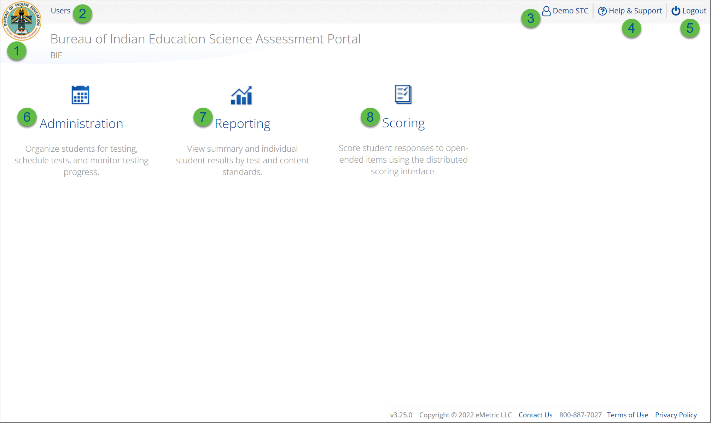
User Accounts & Access
Icon | Description
1 | BIE logo returns to portal home page
2 | Access User Management
3 | View & Edit user profile
4 | Access the BIE Help & Support Site
5 | Logout of the portal
6 | Access Administration Component
7 | Access Reporting
8 | Access Scoring (ONLY the TA Role will have access)
TA Only!

Slide 19
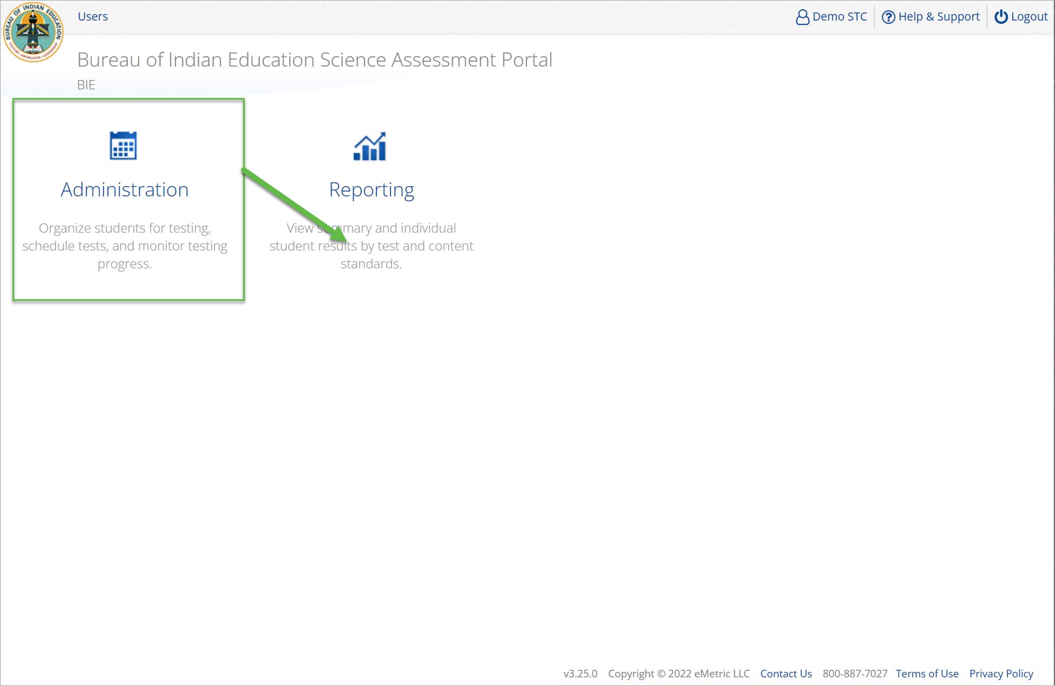
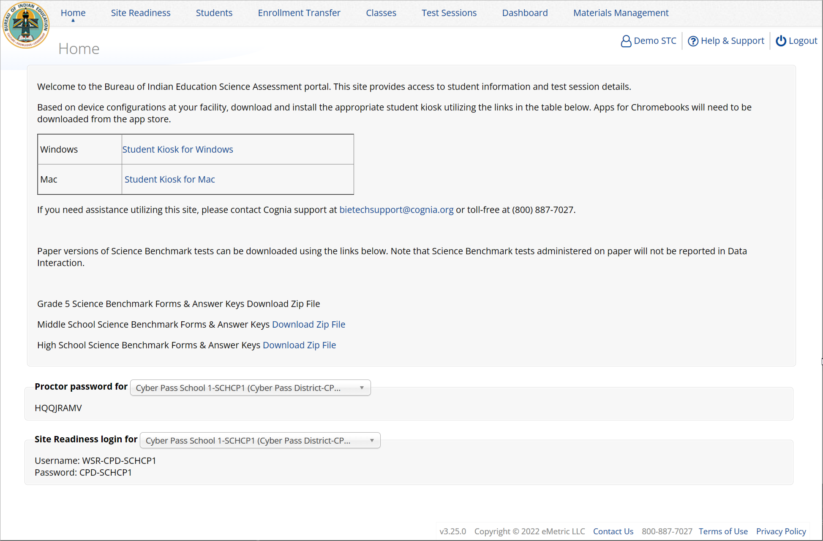
Administration

Slide 20
Administration Workflow
Students
Classes
Site Readiness
Test Sessions
Dashboard
Home
Notes:
The next component of the MEA Portal that we are going to go over is the Administration component.
The Administration component consists of 5-6 tabs depending on your account type.
Home – this is where you can view important announcements, access links for downloading the Kiosks, and attain the Proctor Password and Site Readiness log in credentials.
Site Readiness – this is where you can certify your site as ready for testing.
Students – this is where you can assign student accommodations.
Classes – this is where you can verify your rosters for testing.
Test Sessions – this is where you will schedule your classes for test sessions.
And, the Dashboard – this is where you can view helpful charts and data at the district level.

Slide 21
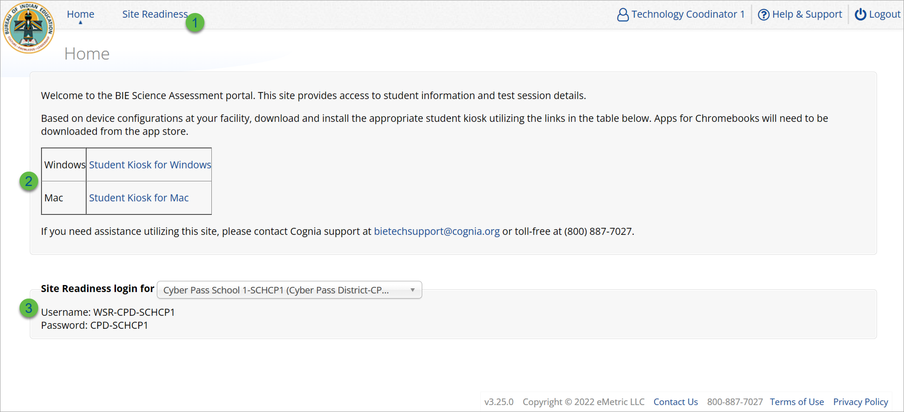
Administration: ITC Account
Icon | Description
1 | Site Readiness tab allows users to view devices that have been tested for site readiness and Site Certification information.
2 | Kiosk installers for Mac and Windows devices are available here.
3 | Site Readiness login credentials are available for each school.

Slide 22
Site Setup & Site Readiness
Installation
Download and install Kiosk and Mobile Apps
Conduct Site Readiness Testing
Site Readiness login credentials are available in the Portal
Run the test on each device configuration
Review Results
Details are available on the Site Readiness tab in the Portal
Site Certification
Certify your site as “Ready for Testing” in the Portal
Notes:
The first step for conducting Site Readiness testing is to download and install the Kiosks and Mobile Apps onto the devices that will be used for testing at your school.
Once you’ve downloaded and installed your Kiosks and Mobile Apps, log in to the Portal to retrieve the site readiness login credentials for your school.
Launch the kiosk or the app and login using the site readiness credentials.
Run the test on a handful of devices for each configuration.
Once you’ve successfully completed your Site Readiness testing, log back into the Portal and navigate to the Site Readiness tab within the Administration component. Here, you can view the details of the devices that you used for Site Readiness testing.
Finally, you’ll certify your site as ready for testing.
Each site has it’s own login credentials for Site Readiness. Each school needs to be certified as ready for testing.

Slide 23
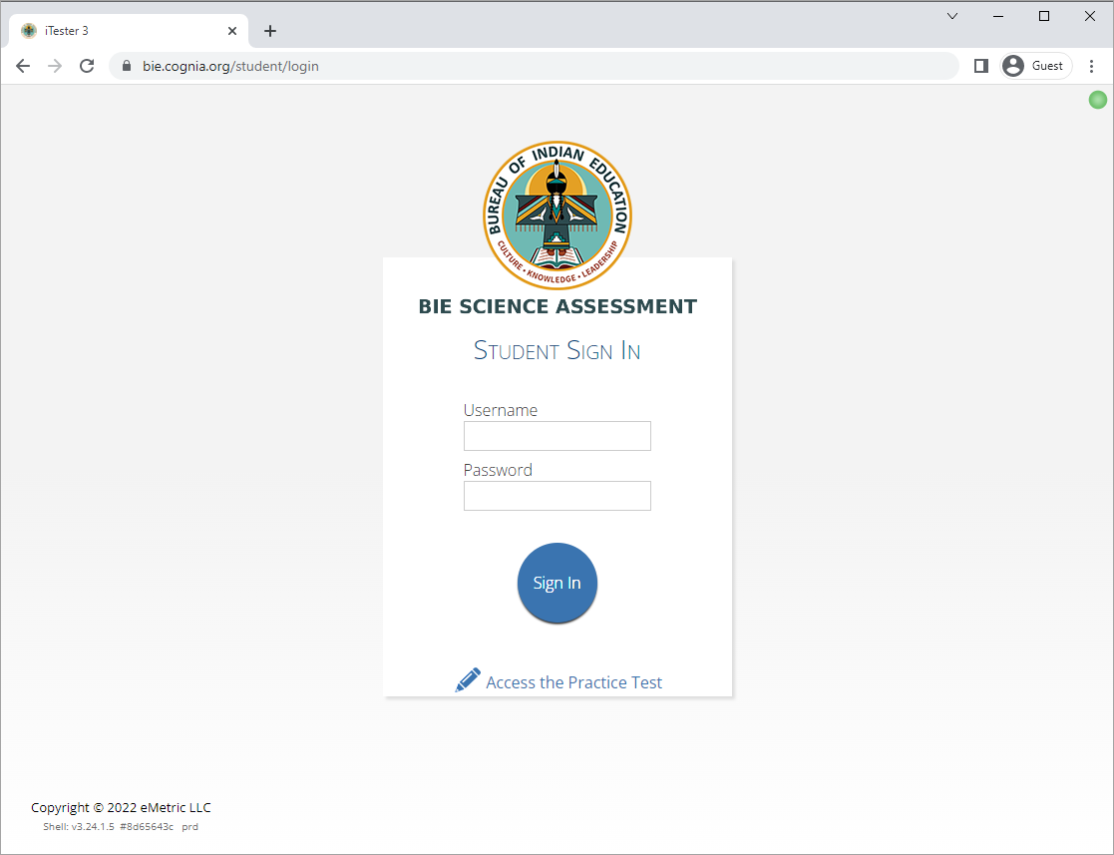
Site Technology Preparation
Browser Requirements
BIE Science Benchmark Assessment & Practice Tests
Available on Chrome, Safari, Firefox, and Microsoft Edge
Browser Student Testing Interface: https://bie.cognia.org/student
Ensure no network settings enforce private browsing or history/cache delete
Do not need to run Site Readiness

Slide 24
Site Technology Preparation
Kiosk Requirements
Windows and Mac Applications
Available to download in the Portal on 11 September 2023
Chromebook Application
Available in the Chrome Webstore
BIE Science Assessment
Add to Google Admin through App Store
Chrome App will update upon launch of the kiosk

Slide 25
Site Technology Preparation
System Requirements
System Requirements – All hardware
Connectivity | Student devices must be able to connect to the internet via wired or wireless networks.
Screen Size | 9.7” screen size or larger/ “10-inch class” tablets or larger
Screen Resolution | 1024 x 768 or larger
Headphones/Earphones/Ear Buds | Headphones/earphones/ear buds are required for students who have a text-to-speech accessibility feature
Browser Requirements (Portal & Practice Tests)
Chrome™ 115 or newer Firefox® 115 or newer Microsoft Edge™ 114 or newer Safari® 16 or newer

Slide 26
Site Technology Preparation
Student Device Requirements Desktop & Laptop
CPU | 1.3 GHz
Memory | 2 GB (4 GB is strongly recommended for best performance)
Input Device | Keyboard (wired or wireless)/Bluetooth mouse or touchpad
Windows® | 10 (21H2; 22H2) , 11 (21H2; 22H2)
Mac OS® | 12.6, 13.4 (64-bit only)
Chromebook Specific Requirements
Chromebook™ notebook computer* | Chrome OS™ LTS 108 Stable Channel 113, 114, 115
Updated Sep 13, 2023. Check the Cognia help and support site for more recent updates.

Slide 27
Technology Requirements
Important Reminders
The BIE Science Benchmark Assessment can be taken with a browser or by using the kiosk
Students testing on devices that do not meet the Student Workstation Specifications are likely to encounter performance-related issues during testing.
Technology Guidelines may be updated throughout the test administration window as new operating systems are released and tested.
Do not update your test device OS until the Technology Guidelines have been updated.

Slide 28
Technology Requirements
Windows
MSI for distribution using GPOs
Mac
We stopped supporting macOS 10.15 on 30 November 2022
Chrome
Students should launch app from App tray, they should NOT log in to the Chromebook
For managed Chromebooks, ensure “Do not erase all local data” is selected in Device Settings/User Data
For managed Chromebooks, ensure “Allow App to manage power” is disabled in Device Settings/App Management
Non-managed Chromebooks manufactured after 2017 will not run-in kiosk mode, you must use as managed device to test

Slide 29
Technology Requirements
Firewalls
Allow traffic through ports 80 and 443
Proxy and Content Filters Servers
List of URLs to whitelist on ports 80 and 443 available in Kiosk Installation Guide
Sandboxing Applications (e.g. Deep Freeze)
Choose network folder or local folder that is not touched by the sandboxing applications
Applicable for both stored response and kiosk installation folders
Thin Clients
Ensure there is enough memory, CPU, and bandwidth on the server to accommodate multiple student test sessions.
Client requires a minimum of 80 MB per Client session.

Slide 30
Site Readiness
1. Review the Kiosk Installation Guide
https://bie.onlinehelp.cognia.org/
2. Download & Install Kiosks
Download Windows or Mac kiosks from BIE Science Assessment Portal
Download Chrome app from appropriate app store
3. Conduct Site Readiness Testing
Run both tests on each device configuration
4. Certify Site
Certify your site as “Ready for Testing” in the Portal

Slide 31
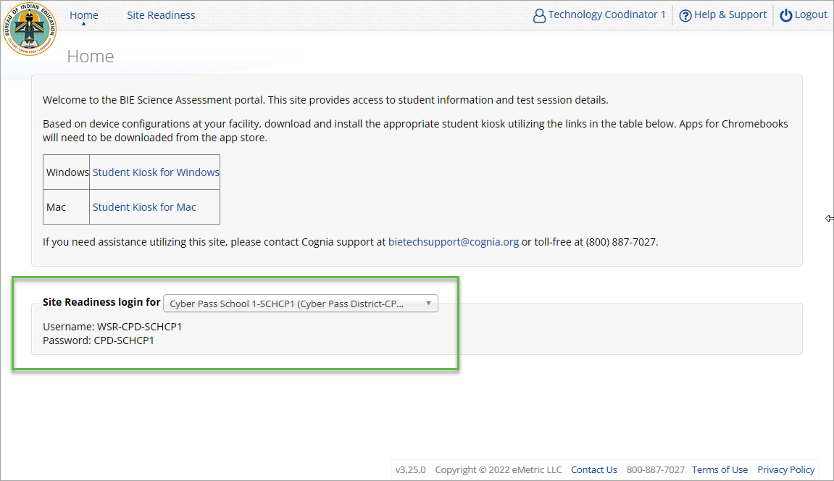
Site Readiness
Notes:
The first step for conducting Site Readiness testing is to download and install the Kiosks and Mobile Apps onto the devices that will be used for testing at your school.
Once you’ve downloaded and installed your Kiosks and Mobile Apps, log in to the Portal to retrieve the site readiness login credentials for your school.
Launch the kiosk or the app and login using the site readiness credentials.
Run the test on a handful of devices for each configuration.
Once you’ve successfully completed your Site Readiness testing, log back into the Portal and navigate to the Site Readiness tab within the Administration component. Here, you can view the details of the devices that you used for Site Readiness testing.
Finally, you’ll certify your site as ready for testing.
Each site has it’s own login credentials for Site Readiness. Each school needs to be certified as ready for testing.

Slide 32
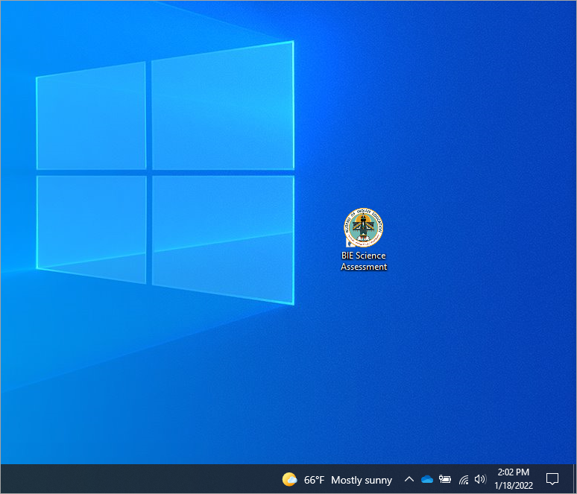
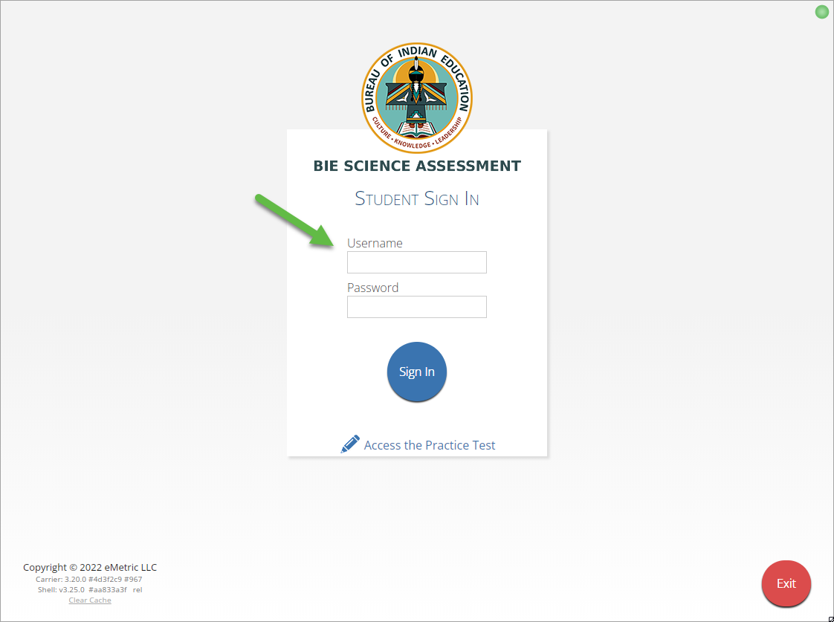
Site Readiness
Notes:
The first step for conducting Site Readiness testing is to download and install the Kiosks and Mobile Apps onto the devices that will be used for testing at your school.
Once you’ve downloaded and installed your Kiosks and Mobile Apps, log in to the Portal to retrieve the site readiness login credentials for your school.
Launch the kiosk or the app and login using the site readiness credentials.
Run the test on a handful of devices for each configuration.
Once you’ve successfully completed your Site Readiness testing, log back into the Portal and navigate to the Site Readiness tab within the Administration component. Here, you can view the details of the devices that you used for Site Readiness testing.
Finally, you’ll certify your site as ready for testing.
Each site has it’s own login credentials for Site Readiness. Each school needs to be certified as ready for testing.

Slide 33
Site Readiness

Slide 34
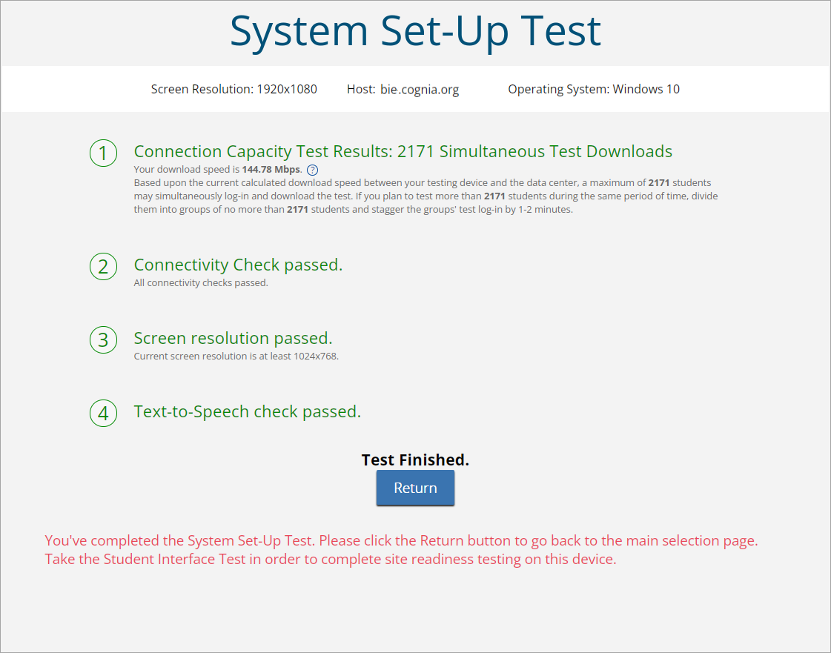
Site Readiness

Slide 35
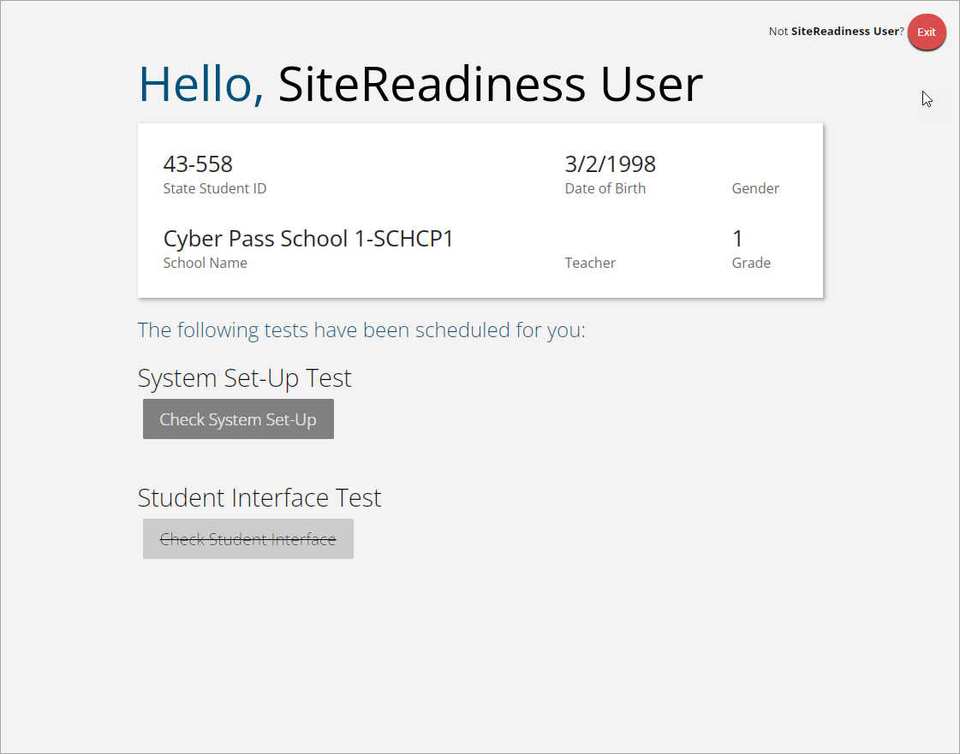
Site Readiness
Student Interface Test must be completed to log complete site readiness results in the portal.

Slide 36
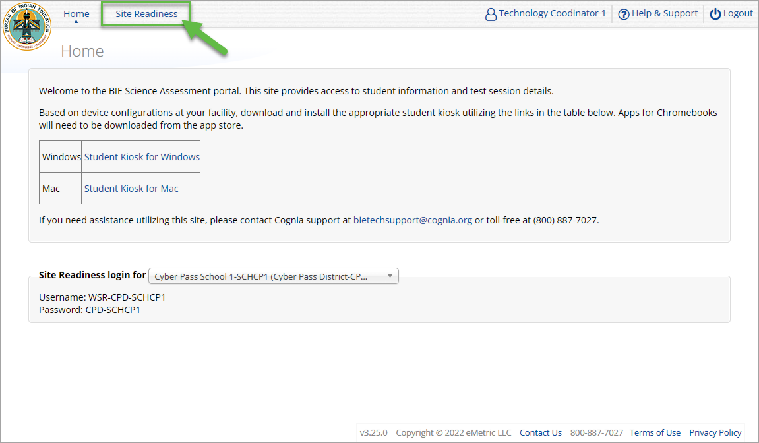
Site Readiness
Notes:
The first step for conducting Site Readiness testing is to download and install the Kiosks and Mobile Apps onto the devices that will be used for testing at your school.
Once you’ve downloaded and installed your Kiosks and Mobile Apps, log in to the Portal to retrieve the site readiness login credentials for your school.
Launch the kiosk or the app and login using the site readiness credentials.
Run the test on a handful of devices for each configuration.
Once you’ve successfully completed your Site Readiness testing, log back into the Portal and navigate to the Site Readiness tab within the Administration component. Here, you can view the details of the devices that you used for Site Readiness testing.
Finally, you’ll certify your site as ready for testing.
Each site has it’s own login credentials for Site Readiness. Each school needs to be certified as ready for testing.

Slide 37
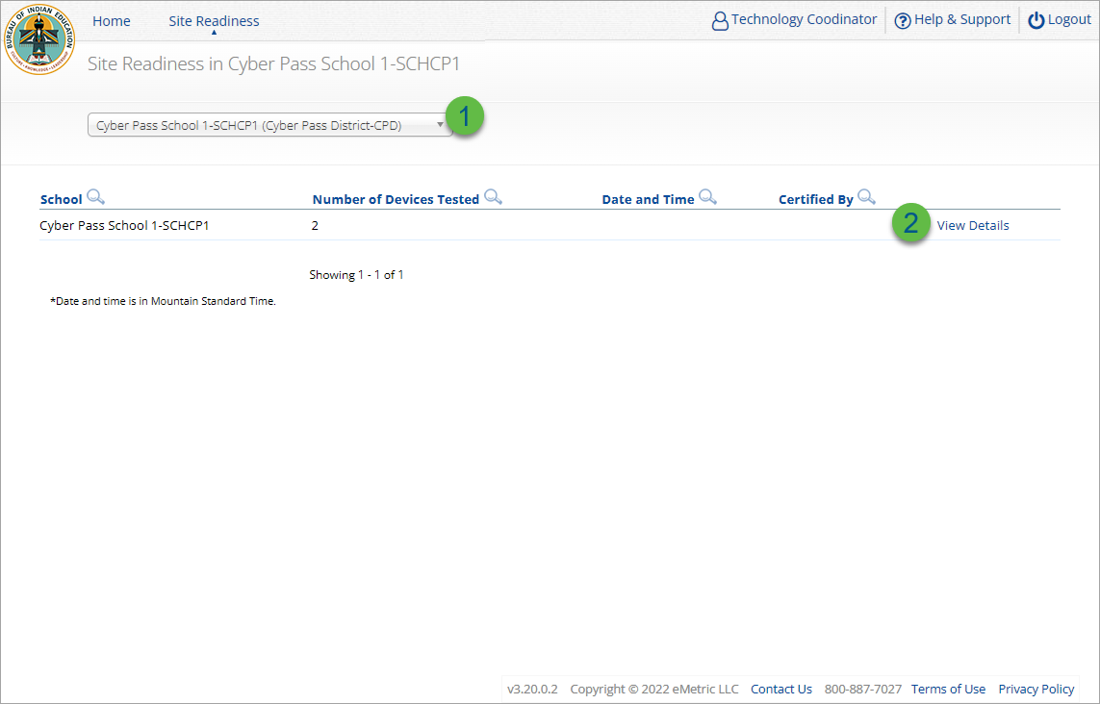
Site Readiness
Step | Description
1 | Select the organization.
2 | Click View Details to view the devices at the school.
Notes:
The first step for conducting Site Readiness testing is to download and install the Kiosks and Mobile Apps onto the devices that will be used for testing at your school.
Once you’ve downloaded and installed your Kiosks and Mobile Apps, log in to the Portal to retrieve the site readiness login credentials for your school.
Launch the kiosk or the app and login using the site readiness credentials.
Run the test on a handful of devices for each configuration.
Once you’ve successfully completed your Site Readiness testing, log back into the Portal and navigate to the Site Readiness tab within the Administration component. Here, you can view the details of the devices that you used for Site Readiness testing.
Finally, you’ll certify your site as ready for testing.
Each site has it’s own login credentials for Site Readiness. Each school needs to be certified as ready for testing.

Slide 38
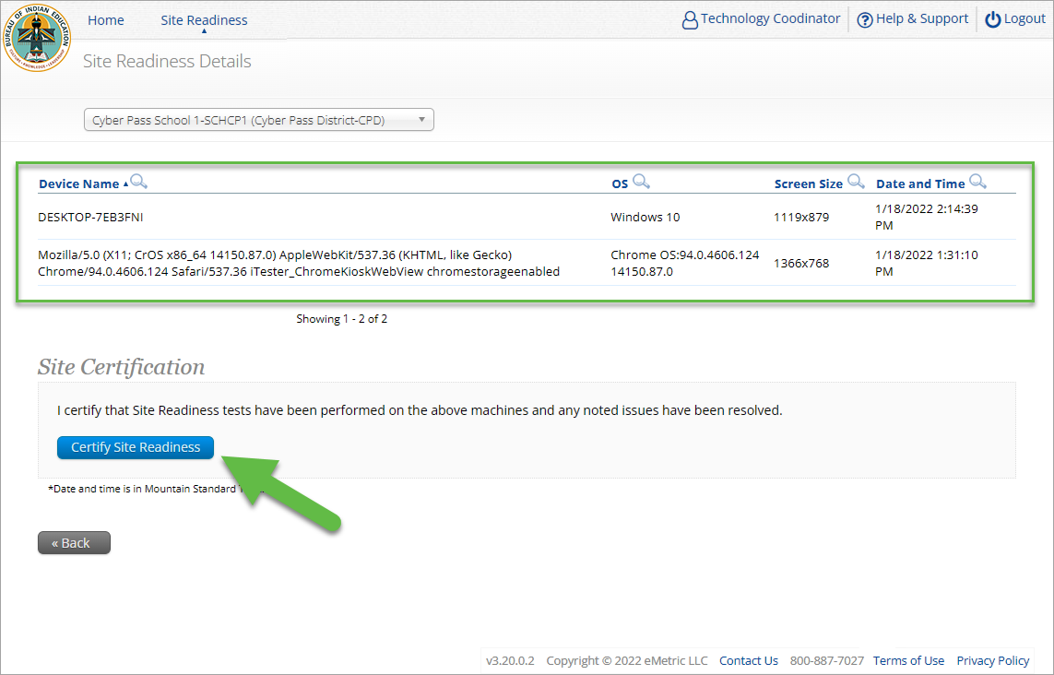
Site Readiness
Notes:
The first step for conducting Site Readiness testing is to download and install the Kiosks and Mobile Apps onto the devices that will be used for testing at your school.
Once you’ve downloaded and installed your Kiosks and Mobile Apps, log in to the Portal to retrieve the site readiness login credentials for your school.
Launch the kiosk or the app and login using the site readiness credentials.
Run the test on a handful of devices for each configuration.
Once you’ve successfully completed your Site Readiness testing, log back into the Portal and navigate to the Site Readiness tab within the Administration component. Here, you can view the details of the devices that you used for Site Readiness testing.
Finally, you’ll certify your site as ready for testing.
Each site has it’s own login credentials for Site Readiness. Each school needs to be certified as ready for testing.

Slide 39
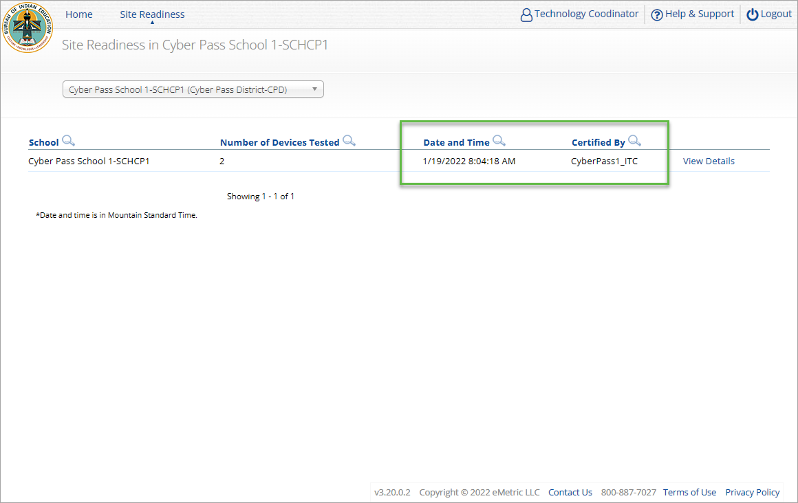
Site Readiness
Notes:
The first step for conducting Site Readiness testing is to download and install the Kiosks and Mobile Apps onto the devices that will be used for testing at your school.
Once you’ve downloaded and installed your Kiosks and Mobile Apps, log in to the Portal to retrieve the site readiness login credentials for your school.
Launch the kiosk or the app and login using the site readiness credentials.
Run the test on a handful of devices for each configuration.
Once you’ve successfully completed your Site Readiness testing, log back into the Portal and navigate to the Site Readiness tab within the Administration component. Here, you can view the details of the devices that you used for Site Readiness testing.
Finally, you’ll certify your site as ready for testing.
Each site has it’s own login credentials for Site Readiness. Each school needs to be certified as ready for testing.

Slide 40
Browser Requirements
Do not use browser in private or incognito mode
Do not delete browsing history or browser cache
Notes:
The first step for conducting Site Readiness testing is to download and install the Kiosks and Mobile Apps onto the devices that will be used for testing at your school.
Once you’ve downloaded and installed your Kiosks and Mobile Apps, log in to the Portal to retrieve the site readiness login credentials for your school.
Launch the kiosk or the app and login using the site readiness credentials.
Run the test on a handful of devices for each configuration.
Once you’ve successfully completed your Site Readiness testing, log back into the Portal and navigate to the Site Readiness tab within the Administration component. Here, you can view the details of the devices that you used for Site Readiness testing.
Finally, you’ll certify your site as ready for testing.
Each site has it’s own login credentials for Site Readiness. Each school needs to be certified as ready for testing.

Slide 41
Browser & Kiosk Requirements (network)
Beginning of Test:
Authenticate login
Download test content
End of Test:
1. Submit responses for scoring
What happens if a student loses network connection in the middle of a test?
Notes:
The first step for conducting Site Readiness testing is to download and install the Kiosks and Mobile Apps onto the devices that will be used for testing at your school.
Once you’ve downloaded and installed your Kiosks and Mobile Apps, log in to the Portal to retrieve the site readiness login credentials for your school.
Launch the kiosk or the app and login using the site readiness credentials.
Run the test on a handful of devices for each configuration.
Once you’ve successfully completed your Site Readiness testing, log back into the Portal and navigate to the Site Readiness tab within the Administration component. Here, you can view the details of the devices that you used for Site Readiness testing.
Finally, you’ll certify your site as ready for testing.
Each site has it’s own login credentials for Site Readiness. Each school needs to be certified as ready for testing.

Slide 42
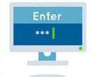
Browser & Kiosk Test Integrity
A
C
D
B
45-90sec
A
C
Browser Cache
Stored Response Folder (kiosk)
D
B

Slide 43
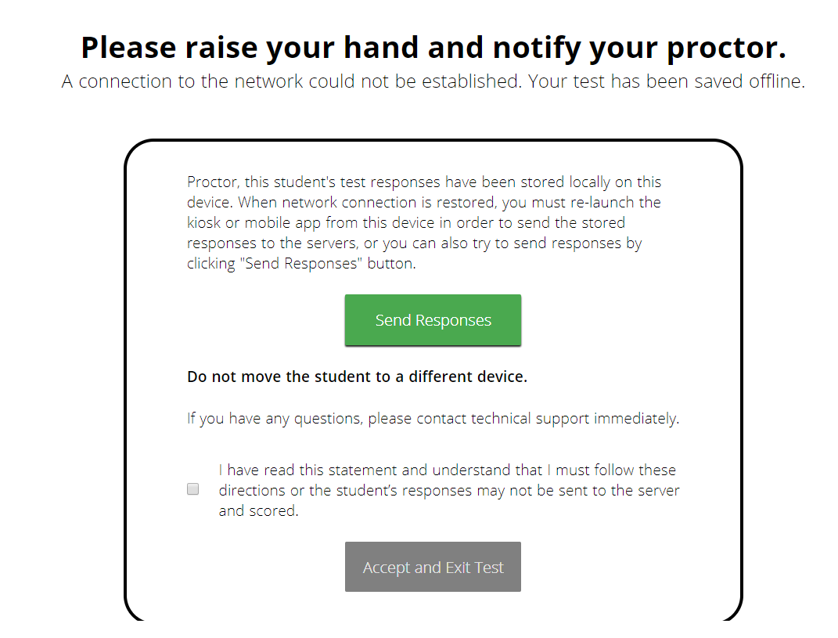
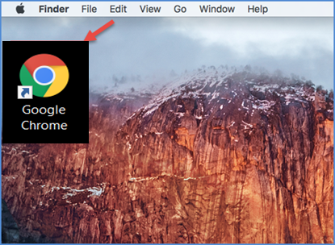
Browser & Kiosk Test Integrity
What if a student finishes a test but has no network connection?
A
C
A
B
C
D
B
C
D
A
B
C
D
A
B
C
D
A
B
D
Turn In
A
C
C
A
B
D
D
B
C
A
B
C
D
A
B
C
D
A
B
D

Slide 44
Browser & Kiosk Test Integrity
Loss of Network Connectivity Procedure Summary
If a student loses network connectivity in the middle of a test:
Keep testing on that device
Test content and responses are stored securely on the test device, either in the browser cache or the stored response folder
Responses will be sent when network is restored
If student finishes and is ready to turn in test prior to network being restored:
Allow student to turn in test
Student will see offline message, acknowledge offline message and exit
Student will be taken back to login page or receive no internet connection message
Restore network
Return to that exact device and relaunch the browser or relaunch the kiosk
(student can log-in to confirm session is done (session button will be greyed out)
If you are unsure of the status of the student responses, call the help desk

Slide 45
Additional Training Resources
Help Guides
Browser Testing User Guide
Kiosk Installation Guide
Portal User Guide
Kiosk User Guide
Testing with Third Party Accessibility Software
Tutorial Videos
https://bie.onlinehelp.cognia.org/
Support Desk
Call-in Information Sheet

Slide 46
Remember
ITCs:
Students can take the BIE Science Benchmark using a Browser
If using Kiosks, they do need to be downloaded and apps installed
Make sure network management tools don’t delete stored response folder
Communicate with Proctors/Test Administrators
Are there limits to number of students who should log in simultaneously?
Do they know the procedure for recovering stored responses?
Do they have basic information required by the support center if they call in?

Slide 47
Questions?

Slide 48
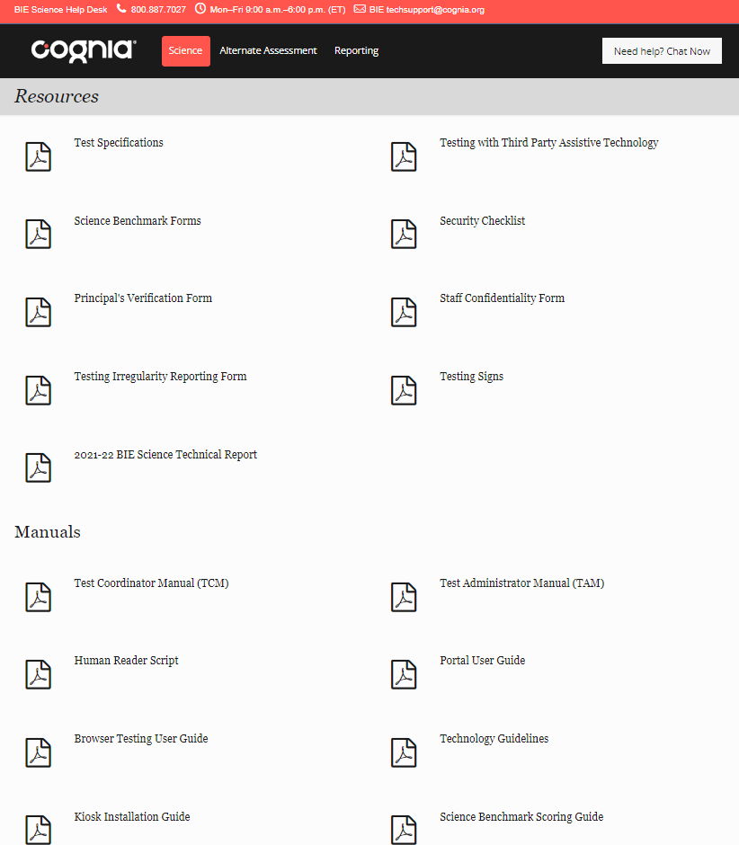
Help & Support Site General Education Science
https://bie.onlinehelp.cognia.org/science/
Resources will be posted throughout the year
Important dates
Manuals
Training videos
Practice tests
Access to CBT practice test and answer documents
Downloadable PDFs of the practice test
Reporting resources

Slide 49
BIE Science Help Desk
Hours
Monday–Friday from 9:00 a.m.–6:00 p.m. (ET)
Contact information
Phone: 800-887-7027
Email: BIETechSupport@cognia.org
Live Chat Link (available from the Help & Support site)

Slide 50
Thank you!

Slide 51
Knowledge is Opportunity
Cognia is a global nonprofit that has the knowledge to help schools improve outcomes for all learners.

