Slide 1
Welcome!
The training will begin shortly

Slide 2
Bureau of Indian Education Science Assessment
Administration Policies
Spring 2024

Slide 3
Housekeeping
All participants should remain on mute with their video off.
Post all questions to the chat.
Questions will be addressed at each section break.
Please add your name, email, and school to the chat.
This training will be recorded and available at the BIE Science Help & Support site.

Slide 4
Welcome & Introductions

Slide 5
Bureau of Indian Education (BIE)
Aurelia Shorty, Education Program Specialist (Assessment & Accountability)
Dr. Carmelia Becenti, Chief Academic Officer
Dr. Douglas Clauschee, Educational Research Analyst
Dr. BJ Howerton, CAO-Program Analyst
Don Griffin, Section 504 Program Coordinator
Cognia
Mara Allaire, Program Manager

Slide 6
Agenda
Assessment overview and key dates
What is new for 2023-2024?
Test security
Computer-based testing
Before, during, and after administration
Paper-based testing
Before, during, and after administration
Accommodated forms
Ordering additional materials
Returning paper test materials
Resources

Slide 7
Science Summative Assessment Overview
Grade 5, 8, and 11
Administered through both computer-based tests and paper-based tests
3 test sessions
Required for all BIE schools
Exceptions:
A signed waiver has been obtained by BIE and USDE
Permission has been obtained to participate in your local state assessment

Slide 8
Overview Accessing the Assessment
Portal: https://bie.cognia.org
School test coordinators (STCs)
IT coordinators (ITCs)
Test administrators (TAs)
Computer testers – BIE Science Assessment Kiosk
Access for students
Must be downloaded on school devices prior to testing

Slide 9
Key Dates Science Assessment
Task | Dates
Kiosk available for download | September 11, 2023
Science Benchmark administration window | September 18, 2023–March 8, 2024
Printed testing materials arrive in schools | February 26, 2024
Additional materials ordering window | February 26–April 12, 2024
Test administration window | March 11 – April 19, 2024
STC Post Online Testing clean-up window | April 22 – April 24, 2024
Return of secure materials | No later than April 26, 2024
Standards Validation meeting | April 30 – May 2, 2024
Online Data Files Available in DI | June 28, 2024
Static ISRs Download Available in DI | July 17, 2024
Print Reports in site for schools | August 7, 2024

Slide 10
What is new for 2023-2024? Human Reader
Human Reader is no longer an accessibility feature
Human Reader is an accommodation and must be indicated on the student’s IEP/504 plan

Slide 11
What is new for 2023-2024? Other Accommodations & Test Report Code
Moved Science TTS English from Accessibility to Accommodation
Added Extended Time Accommodation
Added Small Group Accommodation
Removed “09-COVID Exemption” Test Report Code

Slide 12
Test Security Forms
Principal’s Verification Form
Completed by the school principal
Used as a checklist and signed at the end of the administration
Staff Confidentiality Form
Completed by all staff handling secure materials
Appendix E of TAM: Forms & Signs
Security Checklist
Used to track materials in/out
Appendix C of TCM

Slide 13
Test Security Secure Materials
Security of test materials must be maintained before, during, and after administration.
Secure CBT test materials
Student login tickets
Periodic tables written on by students
Scratch paper written on by students
Human reader scripts written on by students (if applicable)
Secure PBT test materials
Test booklets (standard print and accommodated test forms)
Answer documents
Periodic tables written on by students
Scratch paper written on by students
Human reader scripts written on by students (if applicable)

Slide 14
Test Security Test Administrators
TAs must:
Be certified educators
Receive training on test security and administration
Complete the Confidentiality Agreement
Follow their school’s test schedule
Carry out standard examination procedures
Ensure test materials are returned to a secure location each day
Report any possible security breaches
TAs must not:
Administer the assessment to a family member
Allow students to use electronic devices

Slide 15
Test Security Testing Irregularities
Testing irregularities, such as potential cheating, and any suspected or actual breach of security must be reported immediately by the TA to the STC.
The STC must notify the BIE of a testing irregularity within three business days of the incident.
A Testing Irregularity Reporting Form must be submitted to the BIE within ten business days.

Slide 16
Test Security Users
If an educator no longer works at your school or will no longer be involved in the science assessment administration, be sure to deactivate their account in the portal.
Locate the user and click the “X” to the right to deactivate.

Slide 17
Questions?

Slide 18
Before, During and After Testing Administration
Computer-Based Testing and Paper-Based Testing

Slide 19
Computer-Based Testing Before Administration
Before the testing window, STCs should:
Assign accommodations and accessibility features to students
Create TA accounts
Create classes
Establish a testing schedule
Train all staff that will be involved in test administration

Slide 20
Computer-Based Testing Accommodations and Accessibility Features
Accommodations
Must be assigned to student
Only for students with IEP/504
In platform:
Science TTS English (Text-to-Speech)
Allow accessibility mode testing
Word prediction (embedded)
Outside of platform:
Accessibility Features
Must be assigned to student
In platform:
Color contrast
Outside of platform:
Headphones/Noise Buffer
Read aloud to self
Alternative setting
New
AT device
Word-to-word dictionary
Dual language glossary
Directions in native language
Extended time
Human reader
Human scribe
Human signer
Picture dictionary
Word-to-word translator
Small group
Speech-to-text
Tactile graphics
Full list of accommodations and accessibility features in Portal User Guide (p. 25)

Slide 21
Computer-Based Testing During Administration
During the testing window, STCs should:
Ensure there is at least one trained TA for every 25 students in a testing room
Ensure any TA or proctor is not assigned to a testing room in which a relative is being tested
Track all secure materials and ensure they are returned to a central, secure location each day
Monitor testing progress and completion

Slide 22
Computer-Based Testing After Administration
After the testing window, STCs should:
Invalidate test sessions and assign Test Report Codes as needed
Collect all secure materials (including used scratch paper and student login tickets) and securely destroy them at the school

Slide 23
Test Report Codes - Invalidating Tests
If a test session is invalidated, a Test Report Code must be assigned
Online Test Report Codes Display
Paper Test
Report Codes
Display
Absent
Medical Emergency
Non-Allowed Modification
Other Non-Completion
Participating in MSAA
Test Irregularities
Withdrew Before Test Completion

Slide 24
Paper-Based Testing Before Administration
Before the testing window, STCs should:
Establish a testing schedule
Train all staff that will be involved in test administration
Gather all test materials needed for administration
Test Administrator’s Manual (TAM)
Testing signs
Security checklist
Secure test materials

Slide 25
Paper-Based Testing During Administration
During the testing window, STCs should:
Ensure there is at least one trained TA for every 25 students in a testing room
Ensure any TA or proctor is not assigned to a testing room in which a relative is being tested
Track all secure materials and ensure they are returned to a central, secure location each day
Monitor testing progress and completion

Slide 26
Paper-Based Testing After Administration
After the testing window, STCs should:
Invalidate test sessions and assign a Test Report Code as needed
Noted on the next-to-last page of the PBT answer document
Void tests as needed (If student responses have been transcribed to a new answer document, the original document must be voided)
Write VOID in large, dark print on the front cover
Fill in box J of the biogrid
Pack the voided document with the used test materials

Slide 27
Accommodated Forms

Slide 28
Paper-Based Testing Large Print
Large-print test kits will include:
01
Large-print TA special instructions sheet
Large-print test booklet
Standard test booklet
Standard answer document
Recommend administering at tables that accommodate the test booklet’s size (11’x17’)
02
Directions and script should be read from the TAM the same way as for standard administration
03
Large-print periodic table for grade 11 only

Slide 29
Paper-Based Testing Large Print Responses
Only responses on the standard-sized answer document will be scored.
Student records responses in standard-sized answer document
Student records responses in large-print test booklet and scribe copies them exactly onto the answer document
Student types their responses with a word processor (without spelling or grammar check) if this accommodation is indicated in the student’s IEP/504 plan
Student uses a scribe to record oral responses if this accommodation is indicated in the student’s IEP/504 plan
All student responses must be transcribed verbatim into the student’s answer document

Slide 30
Paper-Based Testing Braille
Braille test kits will include:
Braille TA special instructions sheet
Braille test booklet with TA notes
Standard test booklet
Standard answer document
Directions and script should be read from the TAM the same way as for standard administration
TA may adjust specific directions as needed (e.g., tell student they do not need to read the copyright notice)
Have braille paper or other accommodation materials available
Other accommodation materials examples: Braille writers, slates and styluses, Cranmer modified abacuses, etc.
Must be furnished prior to the appropriate subtest.
Braille periodic table for grade 11 only

Slide 31
Paper-Based Testing Braille Responses
Only responses on the standard-sized answer document will be scored.
Student records responses on a separate Braille paper
Student records responses in Braille version of test booklet
Student construct their responses with a word processor (without spelling or grammar check)
Student uses a scribe to record oral responses
All student responses must be transcribed verbatim into the student’s answer document

Slide 32
Paper-Based Testing Human Reader
Human Reader test kits will include:
01
Human reader TA special instructions sheet
2 Standard test booklets
1 Standard answer document
Directions and script should be read from the Human Reader Script keeping in mind the special instructions given to the TA
03
Human reader script (excerpted from TAM)
Recommend administering to the students that have Human reader accommodation in their IEP/504 Plan and have been using it throughout the year in the classroom
02
Periodic table for grade 11 only

Slide 33
Paper-Based Testing Human Reader Responses
Only responses on the standard-sized answer document will be scored.
Student records responses in standard-sized answer document
Student records responses in large-print test booklet, if applicable, and scribe copies them exactly onto the answer document
Student types their responses with a word processor (without spelling or grammar check) if this accommodation is indicated in the student’s IEP/504 plan
Student uses a scribe to record oral responses if this accommodation is indicated in the student’s IEP/504 plan
All student responses must be transcribed verbatim into the student’s answer document

Slide 34
Questions?

Slide 35
Ordering Additional Materials
Additional Ordering Window: February 26 – April 12, 2024

Slide 36
Paper-Based Testing Ordering Additional Materials
If needed, order additional materials from the Materials Management tab in the Portal
Additional materials order window: February 26 – April 12, 2024

Slide 37
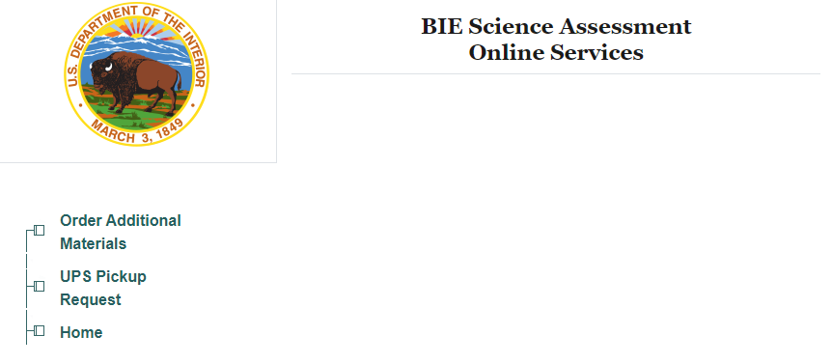
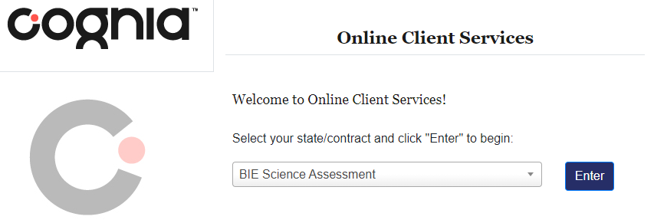
Paper-Based Testing Ordering Additional Materials
https://iservices.cognia.org

Slide 38
Paper-Based Testing Ordering Additional Materials
To order additional materials, you will need the MP Ship Code from your initial shipment.
If you did not receive an initial shipment, contact the BIE Science Help Desk to obtain a ship code.

Slide 39
Returning Paper Test Materials
UPS Pickup Window: March 18 – April 26, 2024

Slide 40
Return PBT Materials Preparing Materials for Return
Checking answer documents
Pre-ID labels
Confirm student information is accurate
Match the label with the name on the front cover
Apply to the bottom right corner on the back cover
If there is no label, ensure boxes A–F on the back cover are completed accurately

Slide 41
Return PBT Materials
Order of the paper materials placed in the box for return
Reminders
Return materials in the same Cognia box they were received
Special Handling – include a brief explanation
Contact the BIE Science Help Desk if any materials are contaminated with biohazardous materials
Seal the box and add the return shipping label provided with the shipment

Slide 42
Return PBT Materials Request a UPS Pick Up
Once all materials are packed and ready, schedule a UPS pick up from the Materials Management tab in the Portal
UPS pick up window: March 18 – April 26, 2024

Slide 43
Return PBT Materials Request a UPS Pick Up
https://iservices.cognia.org

Slide 44
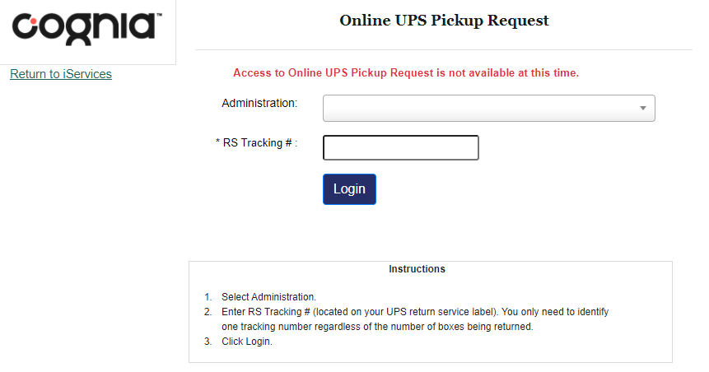
Return PBT Materials Request a UPS Pick Up

Slide 45
Resources

Slide 46
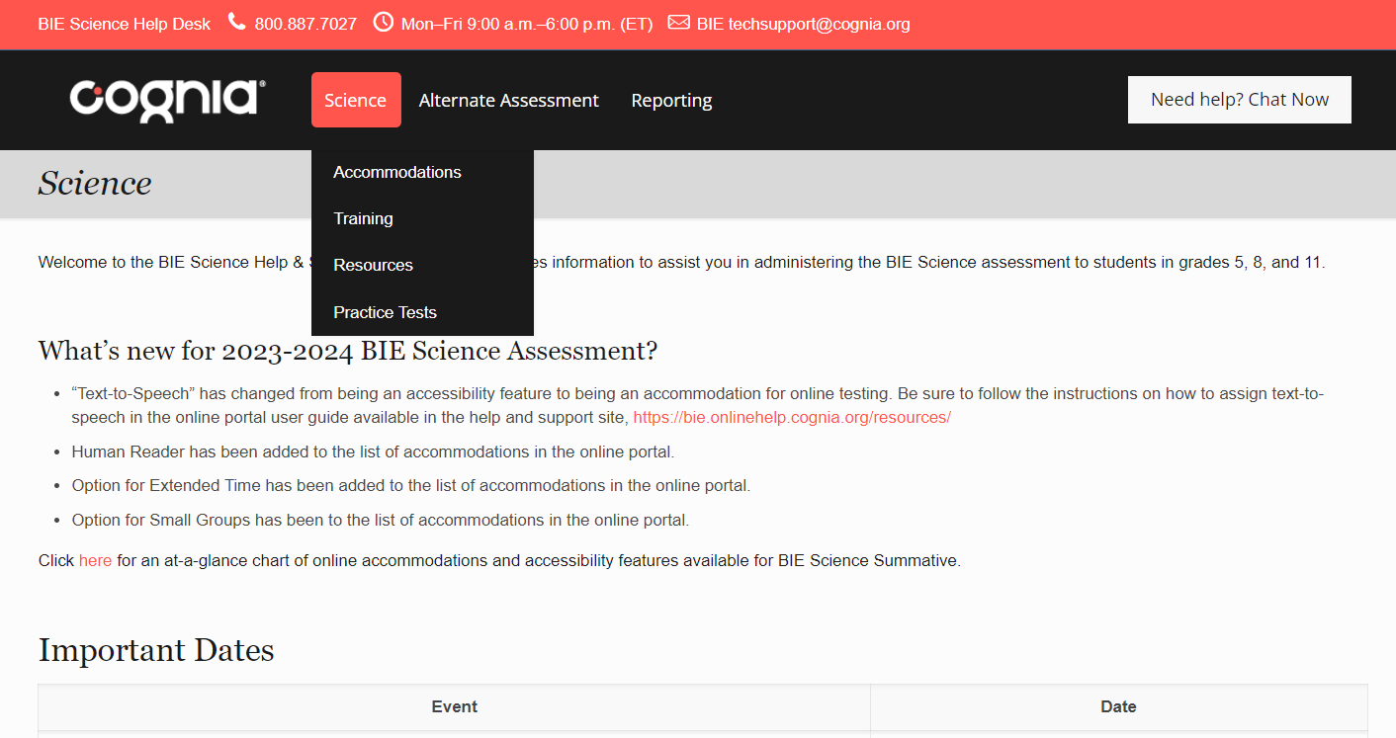
Help & Support Site General Education Science
https://bie.onlinehelp.cognia.org/science/
Resources will be posted throughout the year
Key dates
Manuals
Training videos
Practice tests
Access to CBT practice test and answer documents
Downloadable PDFs of the PBT practice test
Reporting resources

Slide 47
BIE Science Help Desk
Hours
Monday–Friday from 9:00 a.m.–6:00 p.m. (ET)
Contact information
Phone: 800-887-7027
Email: BIETechSupport@cognia.org
Chat (accessible from the BIE Science Help & Support site)

Slide 48
Questions?

Slide 49
Thank you!

