Slide 1
Welcome!
The training will begin shortly

Slide 2
Bureau of Indian Education Science Assessment
Installing the Kiosk & Site Readiness Testing
Spring 2024

Slide 3
Housekeeping
All participants should remain on mute with their video off.
Post all questions to the Q&A area.
Questions will be addressed at each section break.
Please add your name, email, and school to the chat.
This training will be recorded and available at the Help & Support site.

Slide 4
Welcome & Introductions

Slide 5
Bureau of Indian Education (BIE)
Aurelia Shorty, Education Program Specialist (Assessment & Accountability)
Dr. Carmelia Becenti, Chief Academic Officer
Dr. Douglas Clauschee, Educational Research Analyst
Dr. BJ Howerton, CAO-Program Analyst
Don Griffin, Section 504 Program Coordinator
Cognia
Mara Allaire, Program Manager
Sarah McCain, Project Manager
eMetric
Aarti Jagtap, Project Manager
Kaelee Harper, Senior Support Center Manager

Slide 6
Bureau of Indian Education Science Assessment Spring 2024 Kiosk Training

Slide 7
Agenda
Key Dates
Overview of System and Testing Process
User Management
Site Technology Preparation and Network Requirements
Technology Requirements
Site Readiness Procedure
Features for Reliable and Secure Testing
Additional Training Resources
Reminders

Slide 8
Key Dates
Test Preparation Key Dates
Practice tests live | All year
Portal opens & kiosks available for download | September 11, 2023
Science Benchmark administration window | September 18, 2023 – March 8, 2024
Tests available for scheduling in Portal | March 4, 2024
Science Summative test administration window | March 11 – April 19, 2024

Slide 9
BIE Science Assessment
BIE Science Assessment Portal:
Online Test Administration System
https://bie.cognia.org
BIE Science Assessment Student Test Interface:
Student Test Delivery System

Slide 10
BIE Science Assessment Online System
Online System
Portal
Users
Administration
Test Delivery
Kiosk
Site Setup
Students
Classes
Test Sessions
Dashboard
Mobile Apps

Slide 11
Test Preparation Process
STC
Create User Accounts
Add/edit/transfer students
Assign accessibility features & accommodations
Create classes
Schedule classes for test
ITC
Download and Install kiosks
Complete Site Readiness Test
STC & TA
Print/distribute log-in tickets
Students
Launch kiosk
Log-in and test
STC
If needed, add test report codes and invalidate tests
After testing…

Slide 12
Portal Access
Access
http://bie.cognia.org
Open all year, previous accounts can be used
For new School Test Coordinators (STCs), accounts will be created by BIE (Aurelia Shorty will create accounts for STCs).
Not a STC, don’t have an account?
STCs will create all new portal user accounts
Usernames must be unique
Your email address controls your account
New users will receive two automated emails, one with username and one with temporary password from bietechsupport@cognia.org
When an account is deactivated or reactivated, the user will receive an email
STCs should periodically audit and deactivate used accounts

Slide 13
User Roles
User Role | Responsibilities
School Test Coordinator (STC) | Manage Users (add, edit, or deactivate) Access proctor password Edit student information & assign student accommodations Create, edit, and delete classes Schedule test sessions & print logins Manage & monitor test sessions Prepare IT network for student testing if there is no IT Coordinator
IT Coordinator (ITC) | Prepare IT network for student testing Conduct Site Readiness testing
Test Administrator (TA) Note: TA must have access to the BIE Science program to work on Summative assessments | Create classes Create test sessions View their students and test sessions Print student login tickets for their test sessions Manage & monitor test sessions Assign test report codes
Report Access Only (RAO) | View Reports

Slide 14
Portal Log-in
Portal URL: https://bie.cognia.org/

Slide 15
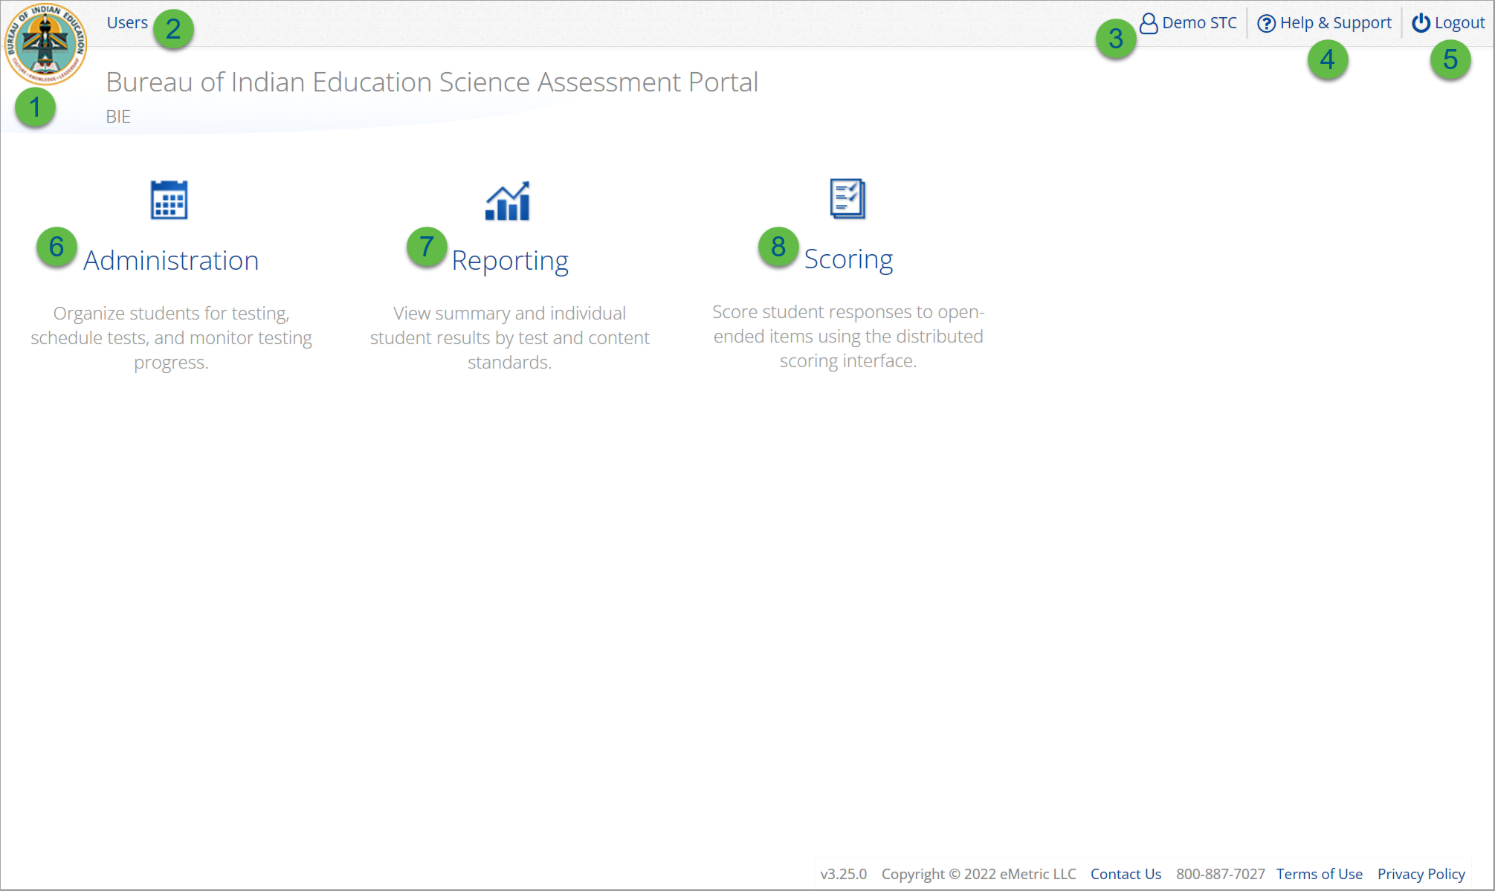
User Accounts & Access
Icon | Description
1 | BIE logo returns to portal home page
2 | Access User Management
3 | View & Edit user profile
4 | Access the BIE Help & Support Site
5 | Logout of the portal
6 | Access Administration Component
7 | Access Reporting
8 | Access Scoring (ONLY the TA Role will have access)
TA Only!

Slide 16
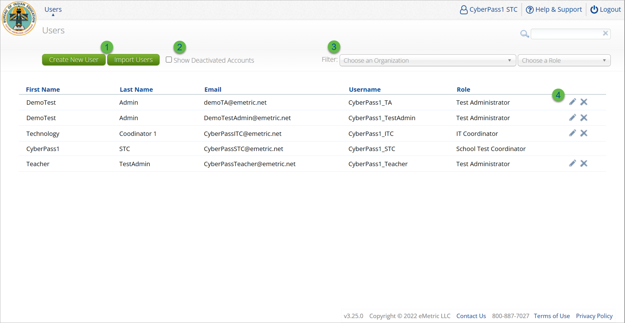
User Management
Icon | Description
1 | Add new user accounts one by one or by file upload
2 | User management table changes to deactivated user accounts
3 | Filter the user management table by school or role
4 | Edit or deactivate a user account

Slide 17
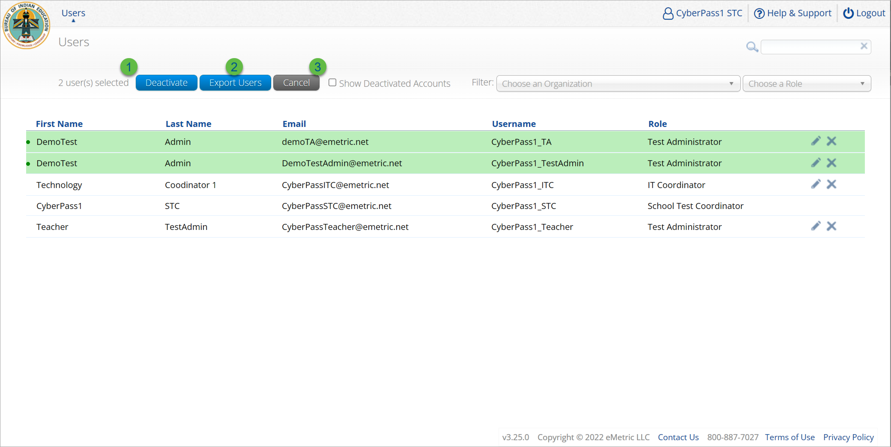
User Management
Icon | Description
1 | Deactivate selected user accounts in bulk
2 | Export selected user accounts
3 | Cancel clears the selection of the highlighted user account

Slide 18
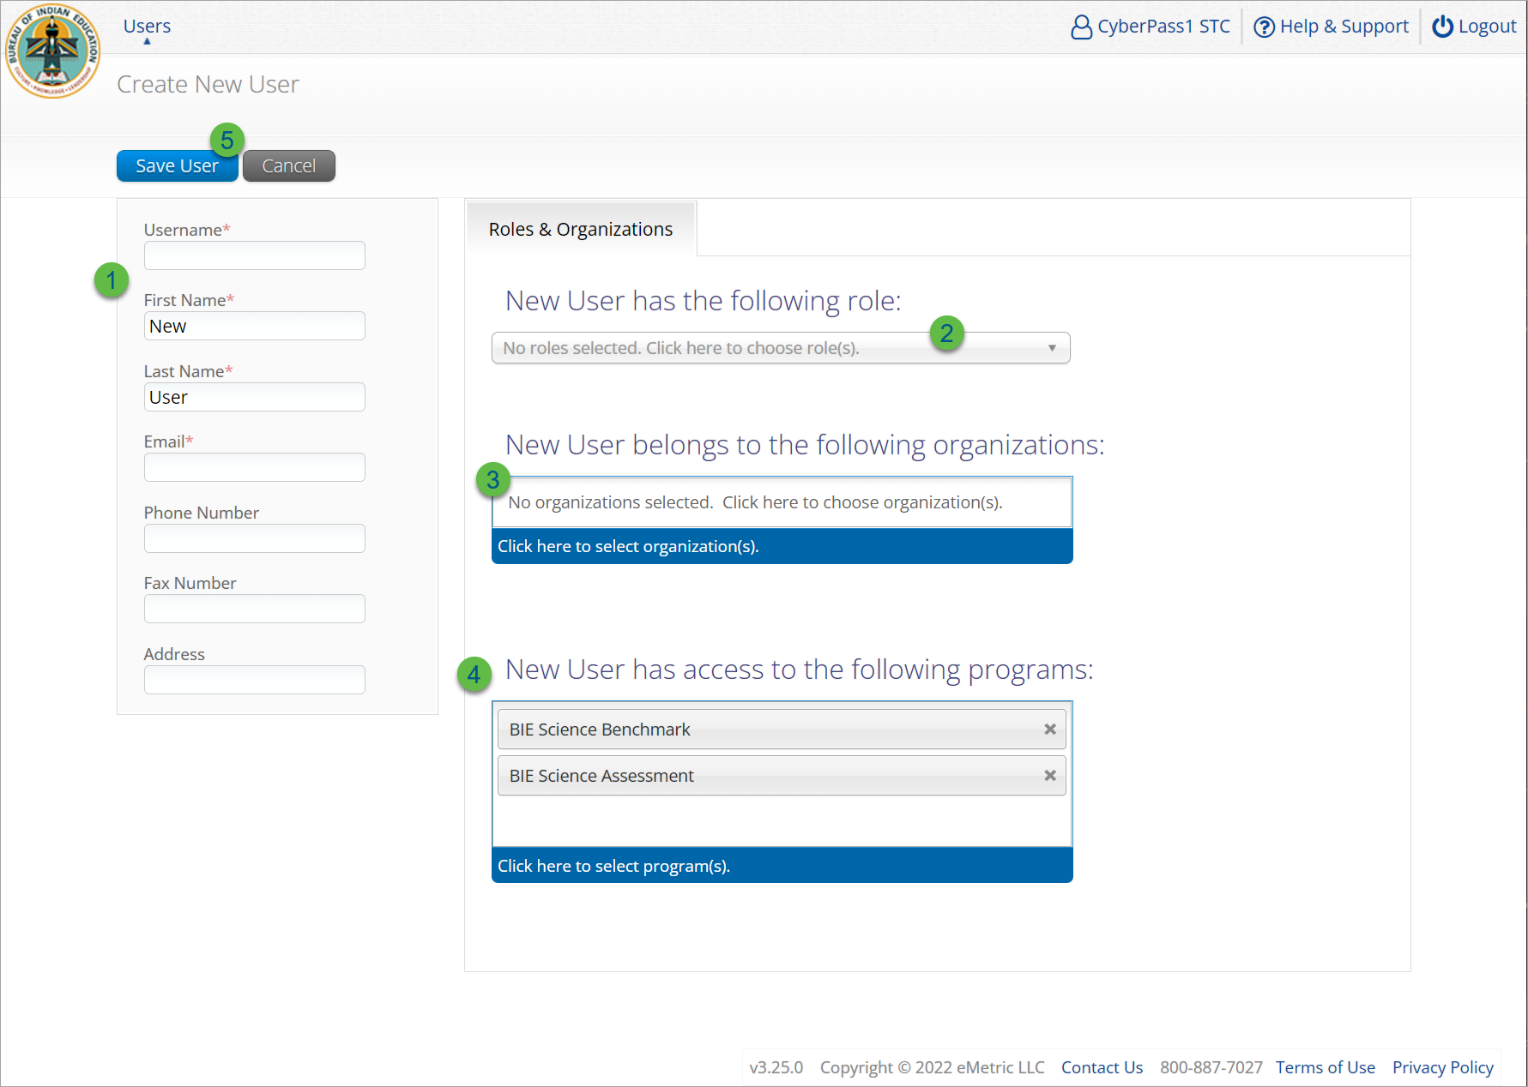
Create New User
Step | Description
1 | Populate the required information for the user account; username, first & last name, and valid email address.
2 | Select the role for the user account from the drop-down.
3 | Select the school for the user account.
4 | The program for the user account is set by default to BIE Science Benchmark and BIE Science Assessment.
5 | Click Save User, this action creates the user account and emails account information to new user.
Note: STC can create local accounts

Slide 19
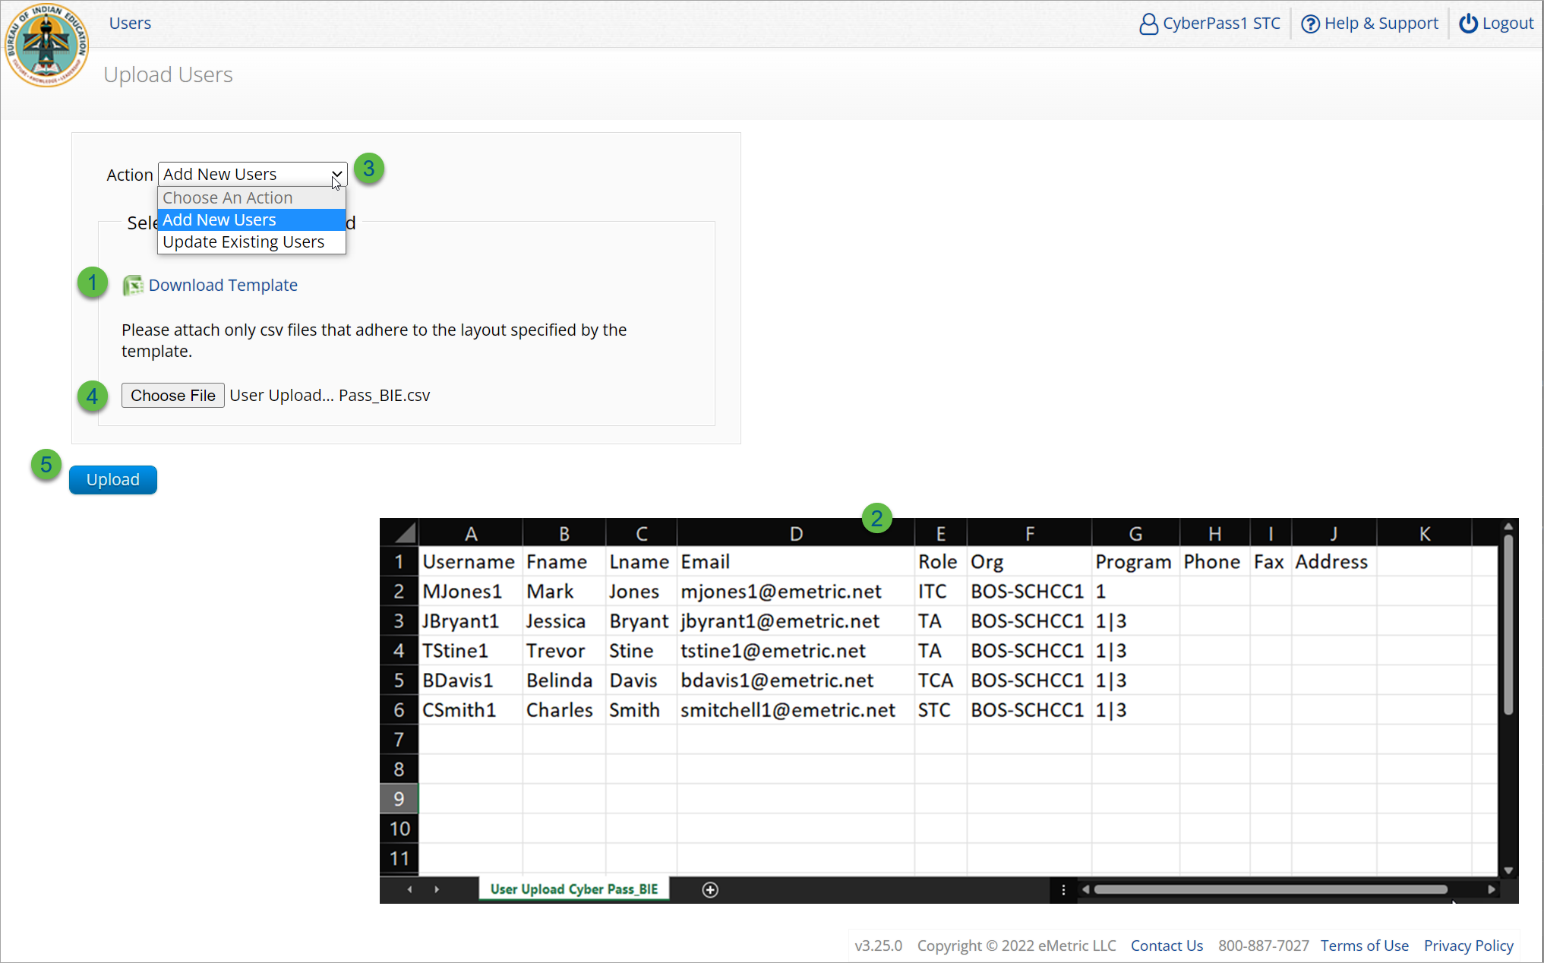
Import Users
Step | Description
1 | Download the User Upload template.
2 | Populate the upload template with valid values, the first six fields are required, and the file limit is 30 users.
3 | Select the action, add new users or update existing users.
4 | Choose the user upload file from your device.
5 | Click Upload, you will receive immediate results on accounts created and if any records have errors.
Program 1 = BIE Science Assessment
Program 3 = BIE Science Benchmark

Slide 20
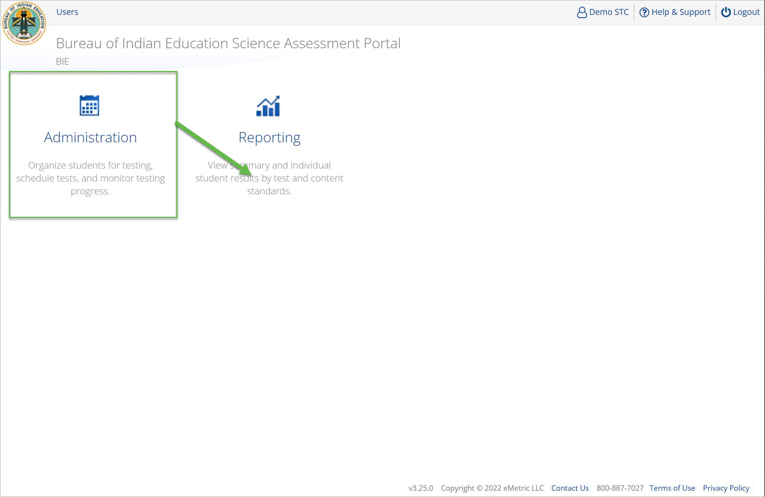
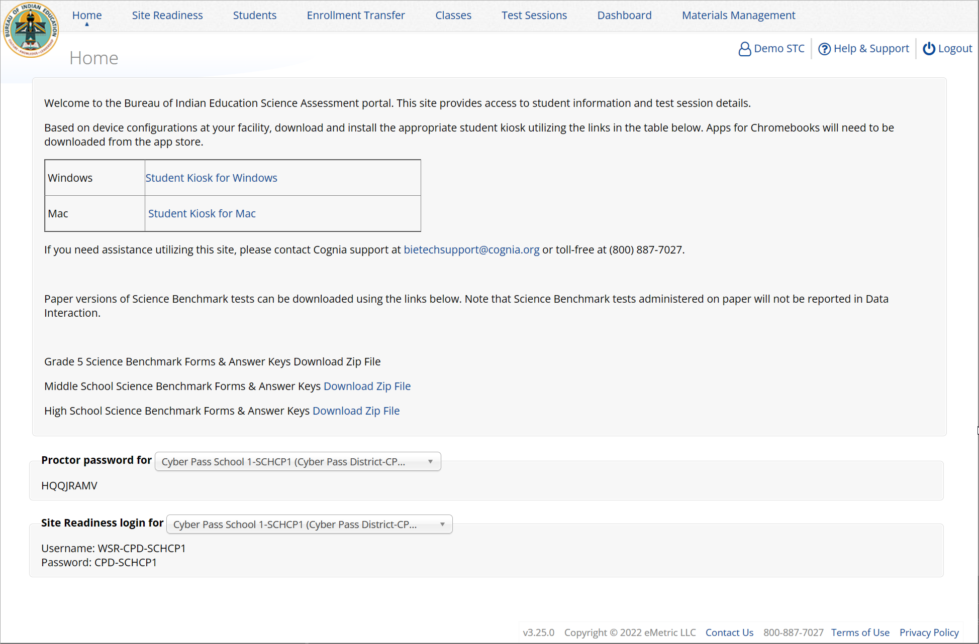
Administration

Slide 21
Site Technology Preparation

Slide 22
Administration Workflow
Students
Classes
Site Readiness
Test Sessions
Dashboard
Home
Notes:
The next component of the portal that we are going to go over is the Administration component.
The Administration component consists of 5-6 tabs depending on your account type.
Home – this is where you can view important announcements, access links for downloading the Kiosks, and attain the Proctor Password and Site Readiness log in credentials.
Site Readiness – this is where you can certify your site as ready for testing.
Students – this is where you can assign student accommodations.
Classes – this is where you can verify your rosters for testing.
Test Sessions – this is where you will schedule your classes for test sessions.
And, the Dashboard – this is where you can view helpful charts and data at the district level.

Slide 23
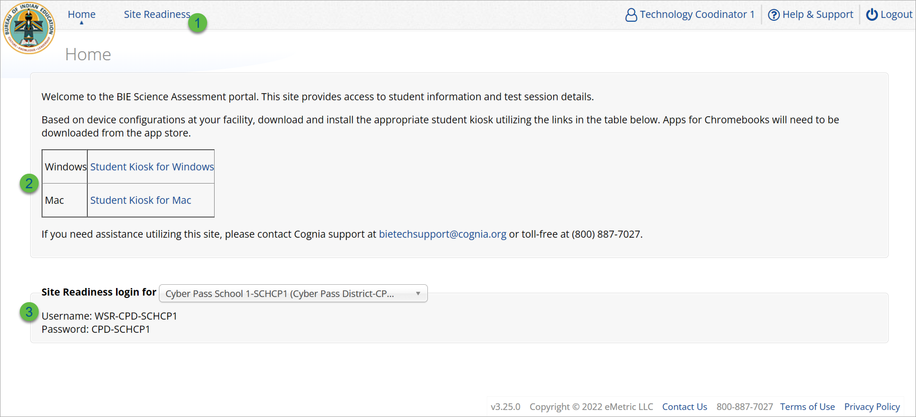
Administration: ITC Account
Icon | Description
1 | Site Readiness tab allows users to view devices that have been tested for site readiness and Site Certification information.
2 | Kiosk installers for Mac and Windows devices are available here.
3 | Site Readiness login credentials are available for each school.

Slide 24
Site Technology Preparation
Kiosk Requirements
Windows Application
Available to download in the Portal on 11 September 2023
Mac Application
Available to download in the Portal on 11 September 2023
Chromebook Application
Available in the Chrome Webstore
BIE Science Assessment
Add to Google Admin through App Store
Chrome App will update upon launch of the kiosk
Browser (practice test & benchmark only)
Available on Chrome, Safari, Firefox, and Microsoft Edge

Slide 25
Site Technology Preparation
System Requirements
System Requirements – All hardware
Connectivity | Student devices must be able to connect to the internet via wired or wireless networks.
Screen Size | 9.7” screen size or larger/ “10-inch class” tablets or larger
Screen Resolution | 1024 x 768 or larger
Headphones/Earphones/Ear Buds | Headphones/earphones/ear buds are required for students who have a text-to-speech accessibility feature
Browser Requirements (Portal & Practice Tests)
Chrome™ 121 or newer Firefox® 122 or newer Microsoft Edge™ 121 or newer Safari® 17 or newer

Slide 26
Site Technology Preparation
Student Device Requirements Desktop & Laptop
CPU | 1.3 GHz
Memory | 2 GB (4 GB is strongly recommended for best performance)
Input Device | Keyboard (wired or wireless)/Bluetooth mouse or touchpad
Windows® | 10 (21H2; 22H2) , 11 (21H2; 22H2)
macOS® | 12.7, 13.4, 14.3 (64-bit only)
Chromebook Specific Requirements
Chromebook™ notebook computer* | Chrome OS™ LTS 114 Chrome OS™ 120, 121 *Google releases new versions to the stable channel every four weeks and new versions to the Long-term Support (LTS) channel every six months. eMetric strongly recommends the use of the LTS channel. Devices on the LTS channel continue to receive frequent security fixes. See https://support.google.com/chrome/a/answer/11333726 for additional information..
Updated February 16th, 2024. The versions will be updated again on March 6th , check the Cognia help and support site for the recent updates.

Slide 27
Technology Requirements
Important Reminders
The BIE Science Assessment must be taken using the BIE Science Assessment Kiosk
Students testing on devices that do not meet the Student Workstation Specifications are likely to encounter performance-related issues during testing.
Do not update your test device OS until the Technology Guidelines have been updated.

Slide 28
Technology Requirements
Windows
MSI (Microsoft Software Installer) for distribution using GPOs (Group Policy Objects)
Chrome
Students should launch app from App tray, they should NOT log in to the Chromebook
For managed Chromebooks, ensure “Do not erase all local data” is selected in Device Settings/User Data
For managed Chromebooks, ensure “Allow App to manage power” is disabled in Device Settings/App Management
Non-managed Chromebooks manufactured after 2017 will not run-in kiosk mode, you must use as managed device to test

Slide 29
Technology Requirements
Firewalls
Allow traffic through ports 80 and 443
Proxy and Content Filters Servers
List of URLs to whitelist on ports 80 and 443 available in Kiosk Installation Guide
Sandboxing Applications (e.g. Deep Freeze)
Choose network folder or local folder that is not touched by the sandboxing applications
Applicable for both stored response and kiosk installation folders
Thin Clients
Ensure there is enough memory, CPU, and bandwidth on the server to accommodate multiple student test sessions.
Client requires a minimum of 80 MB per Client session.

Slide 30
Site Readiness
1. Review the Kiosk Installation Guide
https://bie.onlinehelp.cognia.org/
2. Download & Install Kiosks
Download Windows or Mac kiosks from BIE Science Assessment Portal
Download Chrome app from appropriate app store
3. Conduct Site Readiness Testing
Run both tests on each device configuration
4. Certify Site
Certify your site as “Ready for Testing” in the Portal

Slide 31
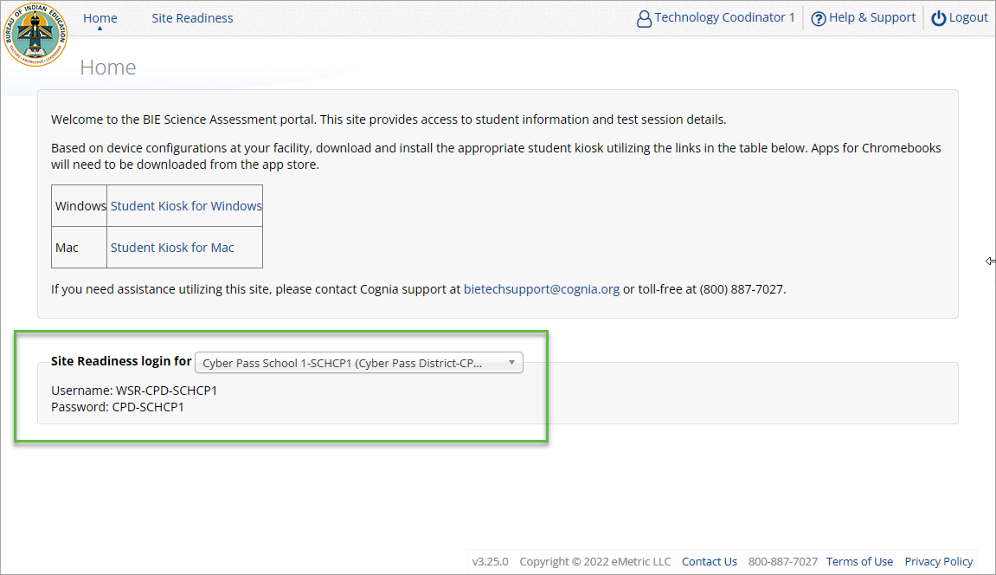
Site Readiness
Notes:
The first step for conducting Site Readiness testing is to download and install the Kiosks and Mobile Apps onto the devices that will be used for testing at your school.
Once you’ve downloaded and installed your Kiosks and Mobile Apps, log in to the Portal to retrieve the site readiness login credentials for your school.
Launch the kiosk or the app and login using the site readiness credentials.
Run the test on a handful of devices for each configuration.
Once you’ve successfully completed your Site Readiness testing, log back into the Portal and navigate to the Site Readiness tab within the Administration component. Here, you can view the details of the devices that you used for Site Readiness testing.
Finally, you’ll certify your site as ready for testing.
Each site has it’s own login credentials for Site Readiness. Each school needs to be certified as ready for testing.

Slide 32
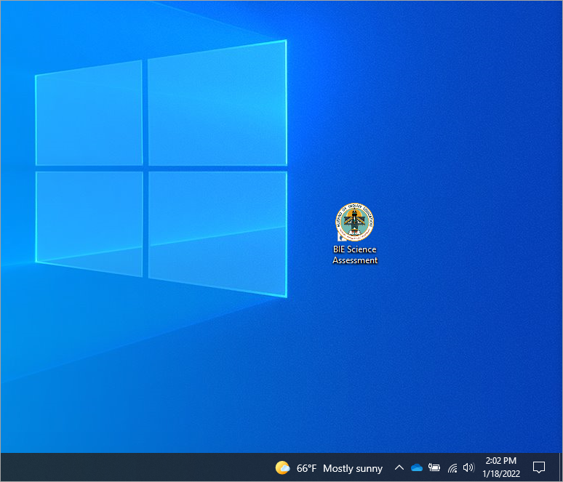
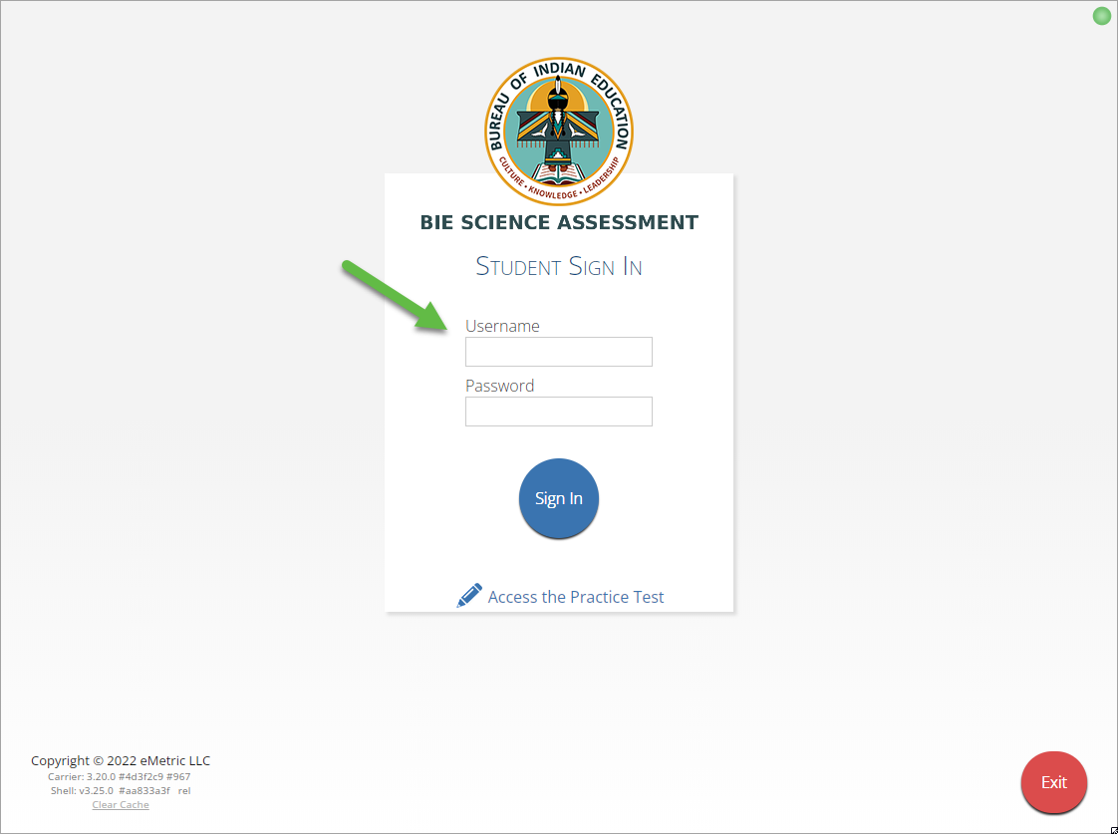
Site Readiness

Slide 33
Site Readiness

Slide 34
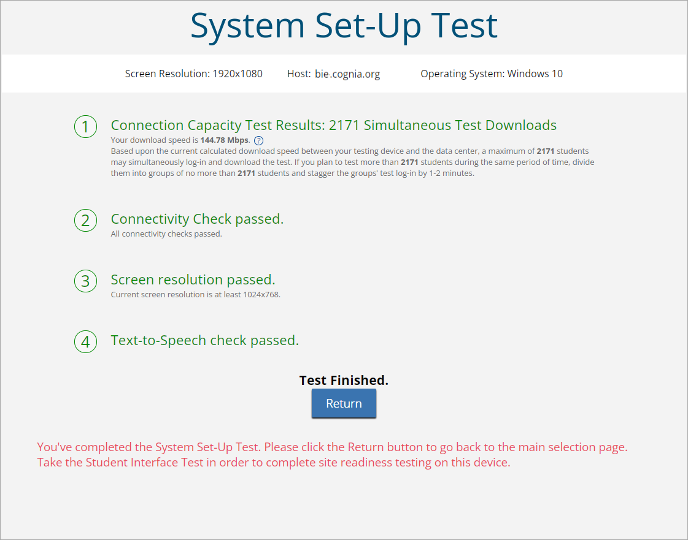
Site Readiness

Slide 35
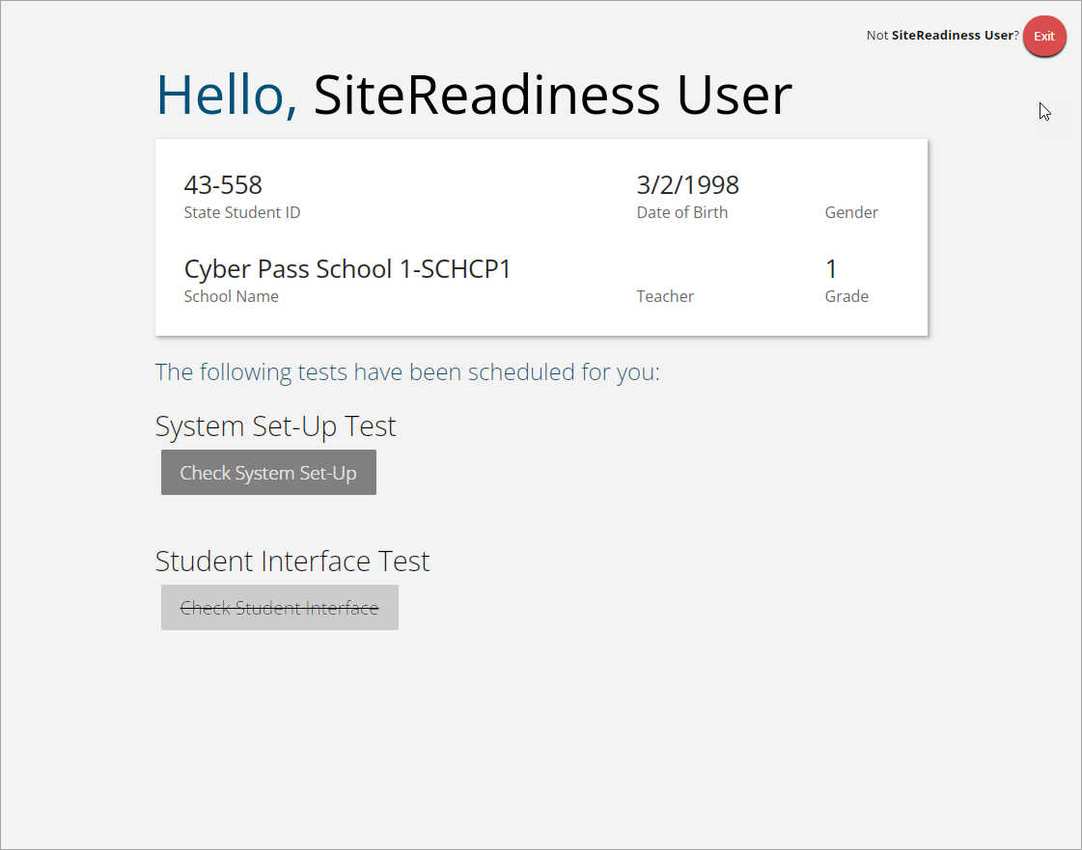
Site Readiness
Student Interface Test must be completed to log complete site readiness results in the portal.

Slide 36
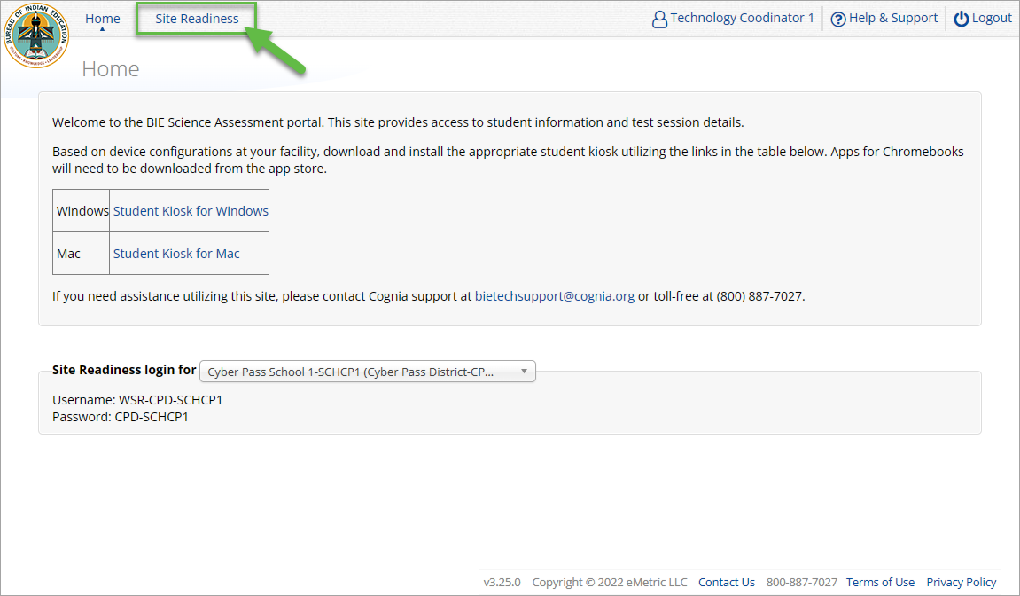
Site Readiness

Slide 37
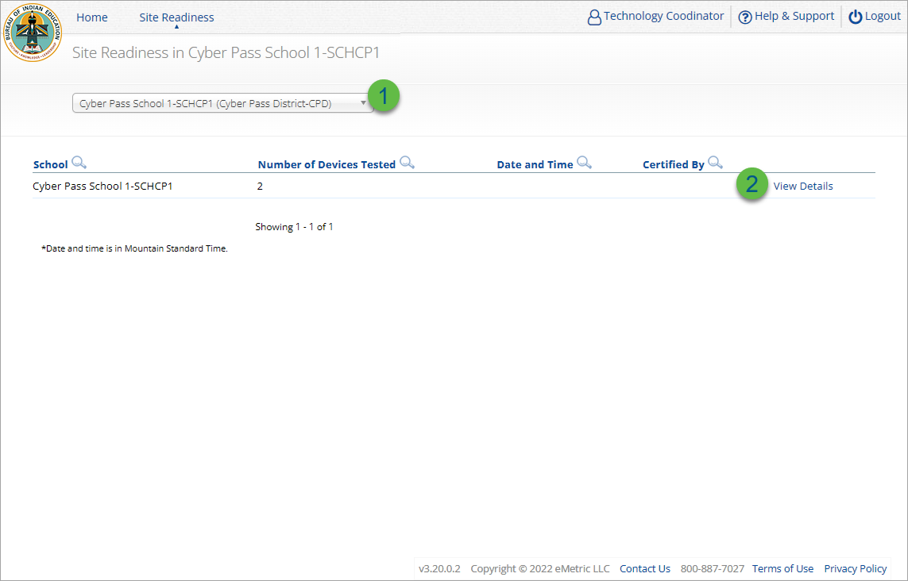
Site Readiness
Step | Description
1 | Select the organization.
2 | Click View Details to view the devices at the school.

Slide 38
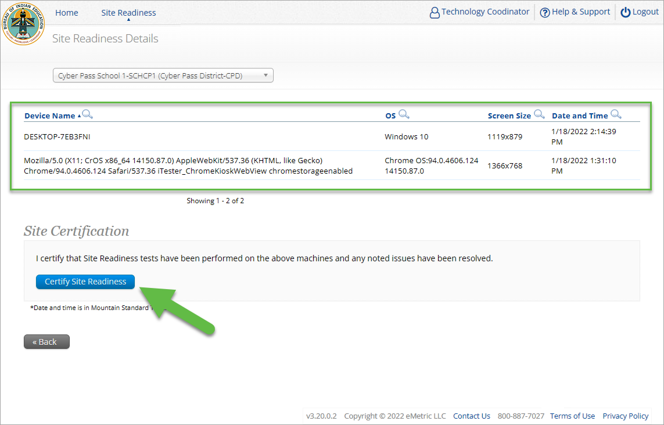
Site Readiness

Slide 39
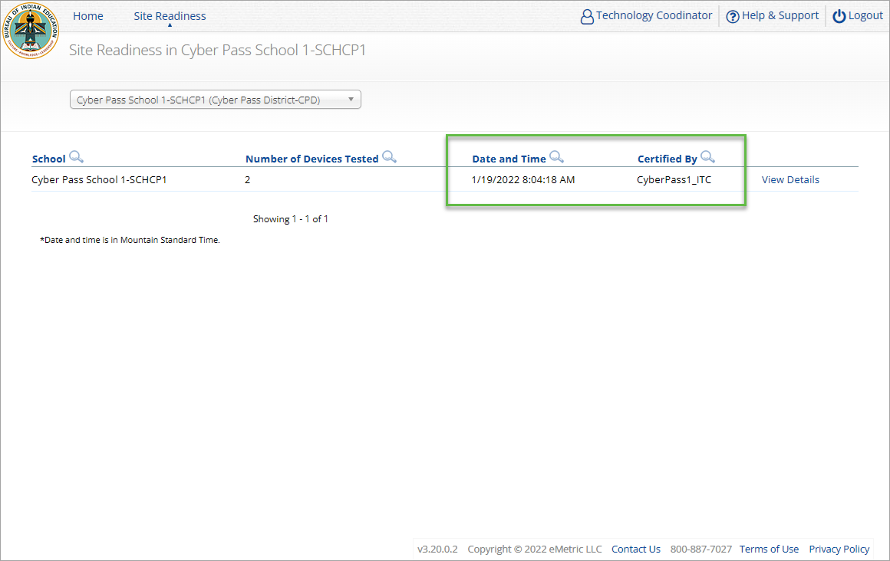
Site Readiness

Slide 40
Internet Connectivity
Beginning of Test:
Authenticate login
Download test content
End of Test:
1. Submit responses for scoring

Slide 41
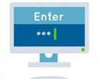
Kiosk Test Integrity
What happens if a student loses network connection in the middle of a test?
A
C
D
B
45-90sec
A
C
Stored Response Folder
D
B

Slide 42
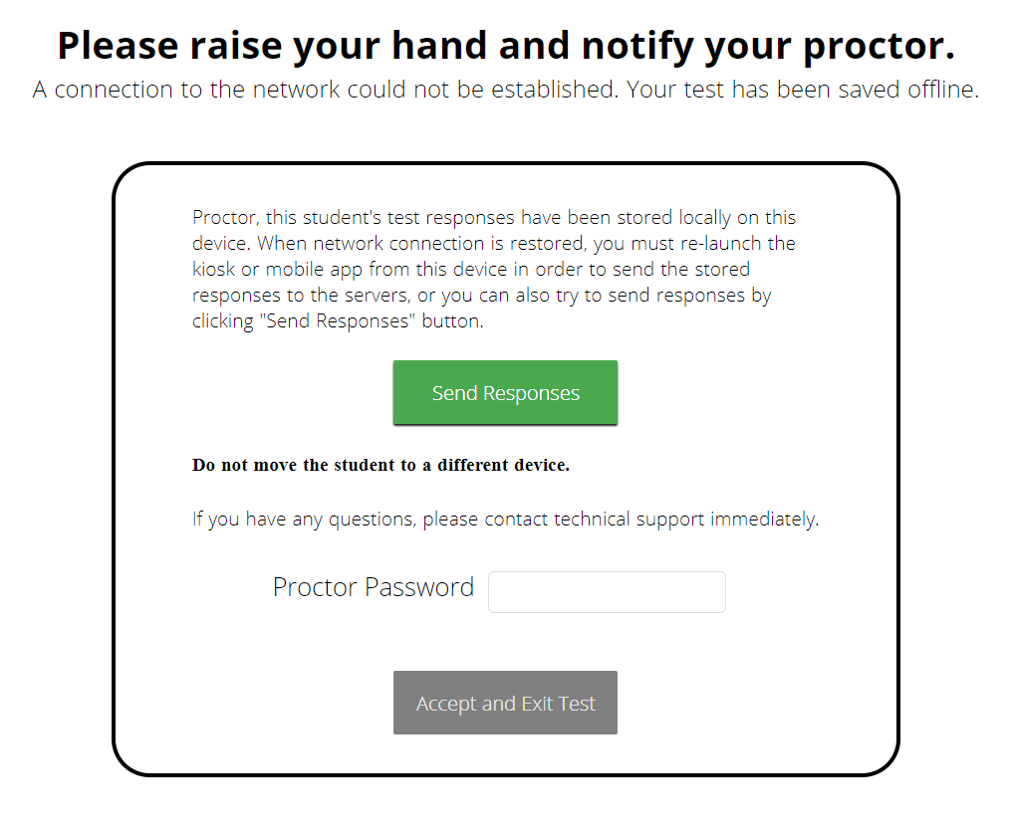
Kiosk Test Integrity
What if a student finishes a test but has no network connection?
A
C
A
B
C
D
B
C
D
A
B
C
D
A
B
C
D
A
B
D
Turn In
A
C
C
A
B
D
D
B
C
A
B
C
D
A
B
C
D
A
B
D

Slide 43
Kiosk Test Integrity
Loss of Network Connectivity Procedure Summary
If a student loses network connectivity in the middle of a test:
Keep testing on that device
Test content and responses are stored securely on the test device, either in the browser cache or the stored response folder
Responses will be sent when network is restored
If student finishes and is ready to turn in test prior to network being restored:
Allow student to turn in test
Student will see offline message, acknowledge offline message and exit
Student will be taken back to login page or receive no internet connection message
Restore network
Return to that exact device and relaunch the browser or relaunch the kiosk
(student can log-in to confirm session is done (session button will be greyed out)
If you are unsure of the status of the student responses, call the help desk

Slide 44
Additional Training Resources
Help Guides
Kiosk Installation Guide
Portal User Guide
Kiosk User Guide
Testing with Third Party Accessibility Software
Tutorial Videos
https://bie.onlinehelp.cognia.org/
Support Desk
Call-in Information Sheet

Slide 45
BIE Science Help & Support Site
https://bie.onlinehelp.cognia.org/resources/
Resources will be posted throughout the year
User Guides
Manuals
A central place to find resources related to BIE Science
Online System Tutorials
Technology Guidelines
Installation Guides
Etc.

Slide 46
Remember
ITCs:
Kiosks do need to be downloaded and apps installed
Make sure network management tools don’t delete stored response folder
Communicate with Proctors/Test Administrators
Are there limits to number of students who should log in simultaneously?
Do they know the procedure for recovering stored responses?
Do they have basic information required by the support center if they call in?

Slide 47
Questions?

