Slide 1
Welcome!
The training will begin shortly

Slide 2
Bureau of Indian Education Science Assessment
Managing Users and Assigning Tests
Spring 2024

Slide 3
Housekeeping
All participants should remain on mute with their video off.
Post all questions to the Q&A area.
Questions will be addressed at each section break.
Please add your name, email, and school to the chat.
This training will be recorded.

Slide 4
Welcome & Introductions

Slide 5
Bureau of Indian Education (BIE)
Aurelia Shorty, Education Program Specialist (Assessment & Accountability)
Dr. Carmelia Becenti, Chief Academic Officer
Dr. Douglas Clauschee, Educational Research Analyst
Dr. BJ Howerton, CAO-Program Analyst
Don Griffin, Section 504 Program Coordinator
Cognia
Mara Allaire, Program Manager
Sarah McCain, Project Manager
eMetric
Aarti Jagtap, Project Manager
Kaelee Harper, Senior Support Center Manager

Slide 6
Bureau of Indian Education Science Assessment Spring 2024 Portal Training

Slide 7
Agenda
Key Dates
Overview of system and testing process
School Test Coordinator tasks (STC)
Managing students and accommodations
Creating classes
Creating test sessions
Monitoring and completing testing
Students
Tools and accommodations
Launching the testing kiosk application and logging in
Navigating through the test and turning-in the test
Technology considerations
Additional training resources
Questions

Slide 8
Key Dates
Test Preparation Key Dates
Practice tests live | All year
Portal opens & kiosks available for download | September 11, 2023
Science Benchmark administration window | September 18, 2023 – March 8, 2024
Tests available for scheduling in Portal | March 4, 2024
Science Summative test administration window | March 11 – April 19, 2024
STC Post-test data clean up window in portal | April 22 – 24, 2024

Slide 9
The BIE Science Assessment Portal
Single portal (https://bie.cognia.org) used for
Science Summative assessment
Science Benchmark assessments (optional)
Access to Science Summative and Benchmark reports
Same student records will be used for Benchmark and spring BIE Summative Science
Summative | Benchmark (Formative)
School Test Coordinators (STC) manage testing | Teachers (TA) can manage testing using TA account
Students must use kiosk to access test | Students can access tests using a web browser or kiosk
Session access codes are used | Session access codes are NOT used
Machine or professionally scored tests with later reporting | Teachers score human scored items and receive near-real-time results

Slide 10
BIE Science Assessment Online System
Online System
Administration and Reporting Portal
https://bie.cognia.org
Users
Administration
Test Delivery
Student Test Interface
Kiosk
Site Setup
Students
Browser
Reporting
Classes
Test Sessions
Scoring
Enrollment Transfer

Slide 11
Test Preparation Process
STC
Create user accounts
Add/edit/transfer students
Assign accessibility features & accommodations
ITC
Download and install kiosks/apps (optional)
Complete Site Readiness Test
STC/TA
Create classes
Schedule classes for test
Print/distribute log-in tickets
Students
Launch kiosk or browser
Log-in and test
STC
Update test report codes and student records as needed
View results in Data Interaction (later this year)
After testing…

Slide 12
Portal Access
Access
http://bie.cognia.org
Open all year, previous accounts can be used this year
For new School Test Coordinators (STCs), accounts will be created by BIE (Aurelia Shorty will create accounts for STCs).
STCs will create all new portal user accounts
Usernames must be unique
Your email address controls your account
New users will receive two automated emails, one with username and one with temporary password from bietechsupport@cognia.org
When an account is deactivated or reactivated, the user will receive an email
STCs should periodically audit and deactivate used accounts

Slide 13
User Roles
User Role | Responsibilities
School Test Coordinator (STC) | Manage Users (add, edit, or deactivate) Access proctor password Edit student information & assign student accommodations Create, edit, and delete classes Schedule test sessions & print logins Manage & monitor test sessions Assign test report code Prepare IT network for student testing if there is no IT Coordinator
IT Coordinator (ITC) | Prepare IT network for student testing Conduct Site Readiness testing
Test Administrator (TA) Note: TA must have access to the BIE Science program to work on Summative assessments | Create classes Create test sessions View their students and test sessions Print student login tickets for their test sessions Manage & monitor test sessions Assign test report codes
Report Access Only (RAO) | View Reports

Slide 14
Test Administrator Permissions
A TA can add any student in their school to their class
A TA can only view the student record for any student in one of their classes
A TA cannot edit the student record
A TA can view, edit or delete any class to which they have been designated the TA
A TA can schedule their class to any program that that have access to
Programs: BIE Science Benchmark, BIE Science Assessment
A TA can view, edit or delete a test session if they are the TA for the class in the test session and they have access to the program (BIE Science Benchmark and/or BIE Science Assessment)
Only a TA can Score the human-scored items in Benchmark assessments
A TA can view Benchmark test results in Reporting for any class they are assigned to

Slide 15
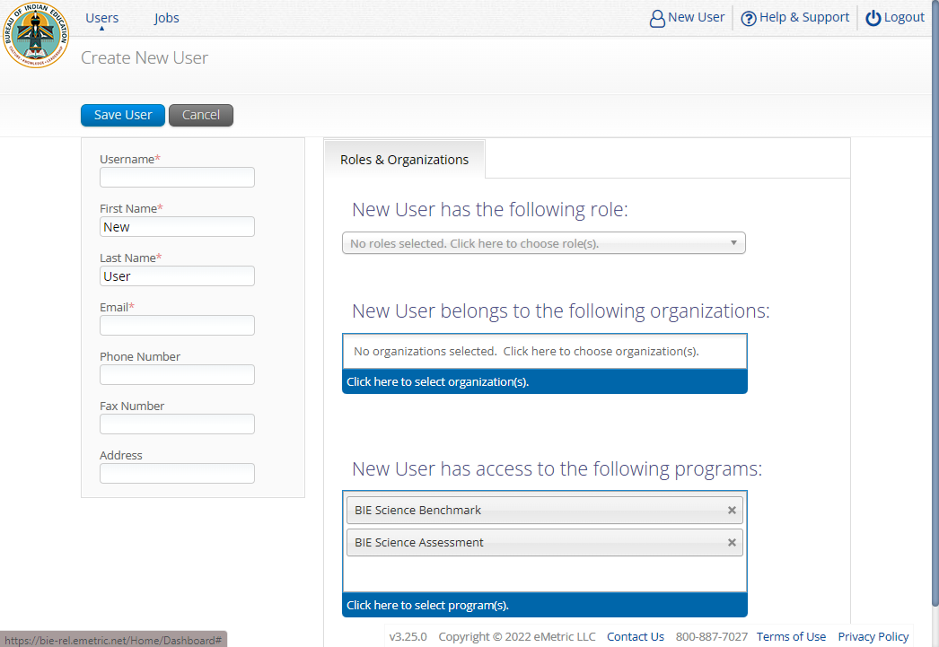
Program Access

Slide 16
Portal Log-in
Portal URL: https://bie.cognia.org/

Slide 17
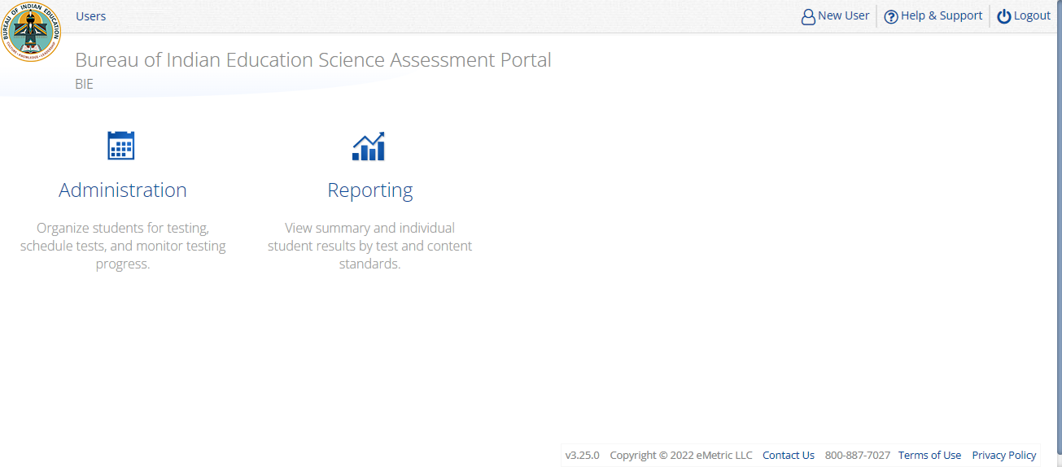
Portal Main Page (STC View)
1
2
3
4
5
Icon | Description
1 | BIE logo returns to portal home page
2 | Access User Management
3 | View & Edit user profile
4 | Access the BIE Help & Support Site
5 | Logout of the portal
6 | Access Administration Component
7 | Access Reporting
6
7

Slide 18
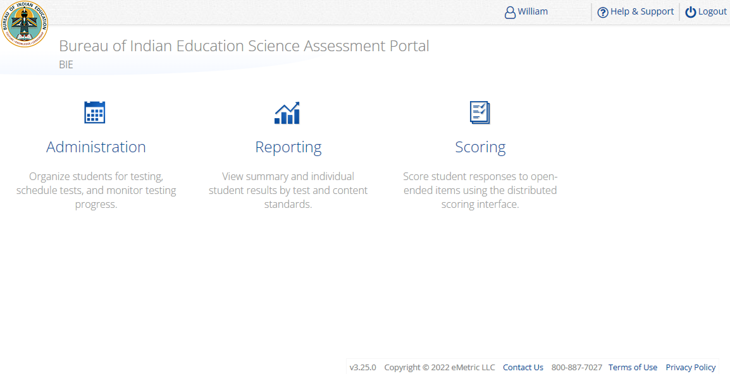
Portal Main Page (TA view)
1
2
3
4
Icon | Description
1 | BIE logo returns to portal home page
2 | View & Edit user profile
3 | Access the BIE Help & Support Site
4 | Logout of the portal
5 | Access Administration Component
6 | Access Reporting
7 | Access Scoring – TA user role ONLY for Benchmark program ONLY!
TA Only!
5
6
7

Slide 19
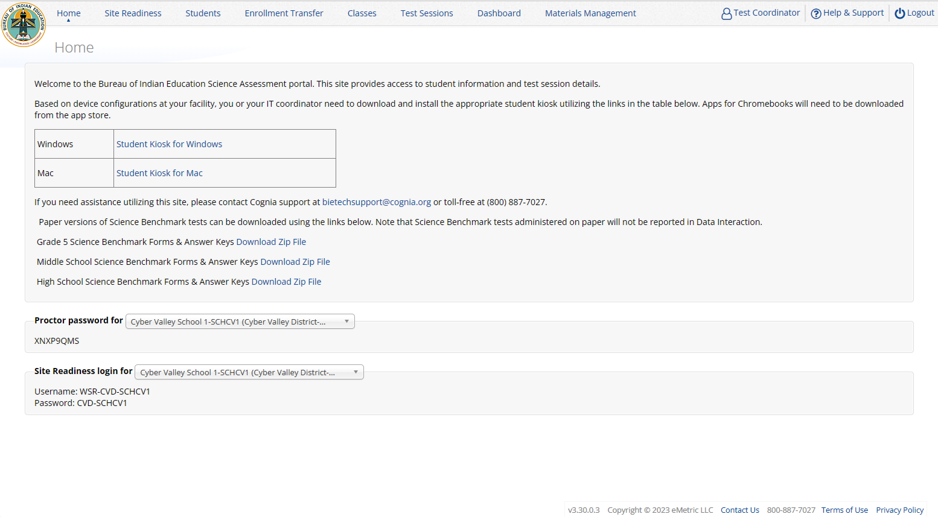
Administration Component (STC view)
1
2
Icon | Description
1 | BIE logo returns to portal home page
2 | Test Administration Menus
3 | Windows and Mac Kiosk Application Installers
4 | Science Benchmark paper test downloads
5 | Proctor Password
6 | Site Readiness Login
3
4
5
6

Slide 20
Administration Workflow
Students
Classes
Site Readiness
Test Sessions
Score and Report
Home
STC: update roster and student information, assign accommodations and accessibility features
STC or TA: make classes and test sessions
TA: score tests
STC and TA: view reports
Notes:
The next component of the portal that we are going to go over is the Administration component.
The Administration component consists of 5-6 tabs depending on your account type.
Home – this is where you can view important announcements, access links for downloading the Kiosks, and attain the Proctor Password and Site Readiness log in credentials.
Site Readiness – this is where you can certify your site as ready for testing.
Students – this is where you can assign student accommodations.
Classes – this is where you can verify your rosters for testing.
Test Sessions – this is where you will schedule your classes for test sessions.
And, the Dashboard – this is where you can view helpful charts and data at the district level.

Slide 21
Managing Students
BIE roster loaded 11 Sept 2023
Grades 5, 8 and 11 only
View your current student roster in the Student tab
Update rosters
STCs may request student transfer for students enrolled in other schools at any time
STCs may unenroll students from school at any time
STCs can add student individually at any time
Check/update individual student records
Demographic data
Add/remove accommodations and access to accessibility features
Tips:
State Student ID = NASIS ID
On Students tab: Download roster in csv at any time by selecting “Export Roster” under the “Exports” drop down (contains name, NASIS ID and Grade)
Can’t add student? They may be enrolled in different school – initiate transfer request
Cognia Customer Care desk can assist with student transfers

Slide 22
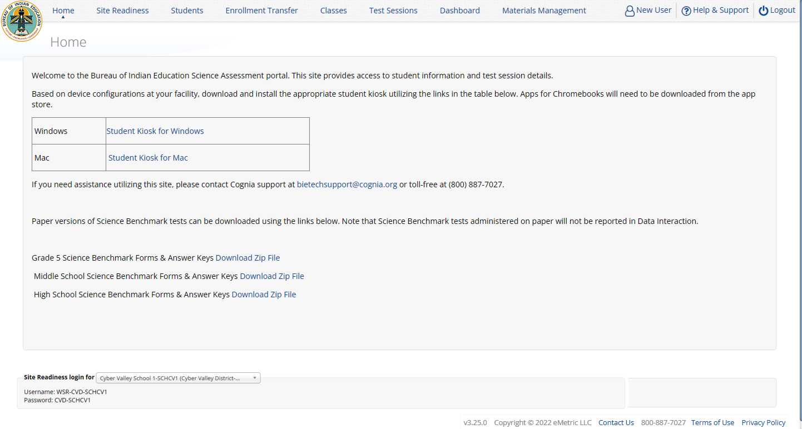
Managing Students

Slide 23
Managing Students
Icon | Description
1 | school selector
2 | search and sort
3 | view classes
4 | view test sessions
5 | unenroll student
6 | add new student
7 | bulk upload accommodations
8 | export list of students
9 | edit a student record
6
7
1
8
2
3
4
5
9

Slide 24
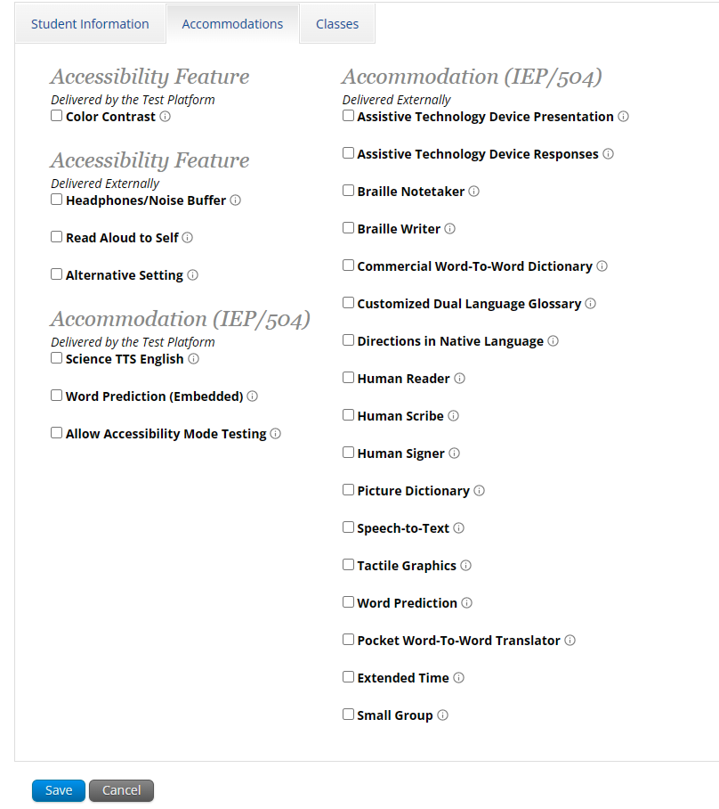
Add or Edit Student
New for 2023-2024:
Moved Science TTS English from Accessibility to Accommodation
Moved Human Reader from Accessibility to Accommodation
Added Extended Time accommodation
Added Small Group accommodation

Slide 25
Unenroll Student

Slide 26
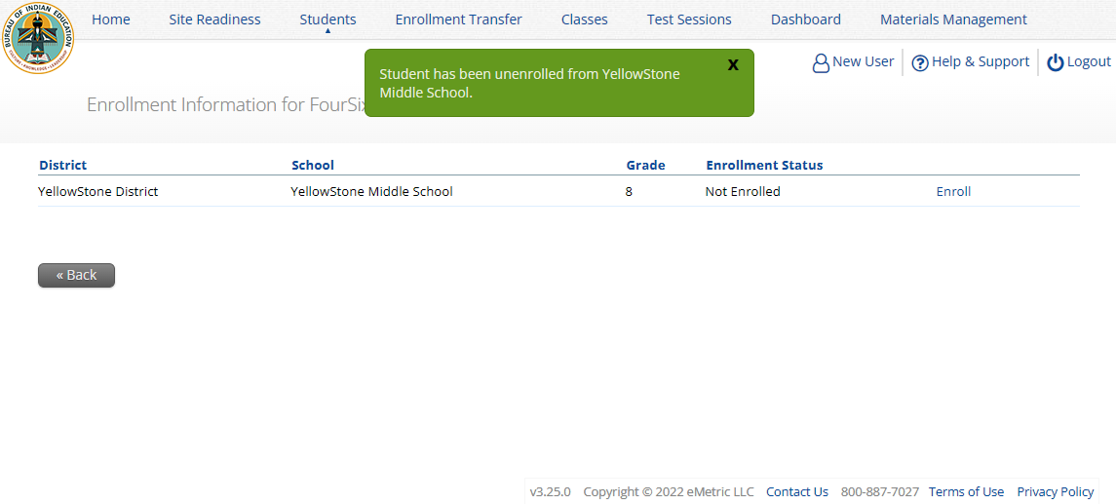
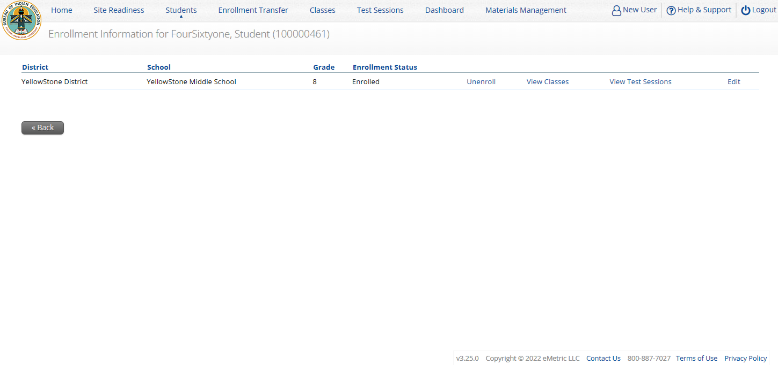
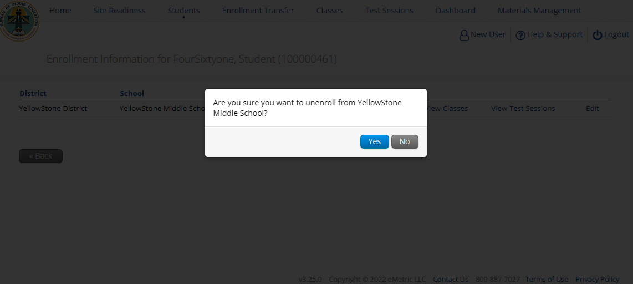
Unenroll Student

Slide 27
Student Transfer Request
Request to move student from another school into your school
Approve or reject requests to move students out of your school
Receive notification of requests by e-mail and in portal
If a student is unenrolled, the help desk will approve the transfer request
Test sessions do not transfer with the student!

Slide 28
Student Transfer Request
Status:
Pending
Canceled
Approved
Rejected
Your requests
Requests sent to you from other organizations

Slide 29
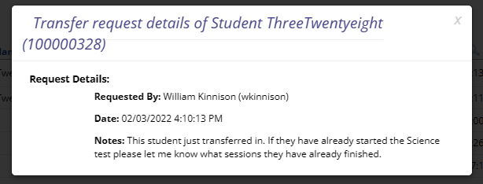
Student Transfer Request
Test sessions do not transfer with the student!
John Smith (JSmithSTC)

Slide 30
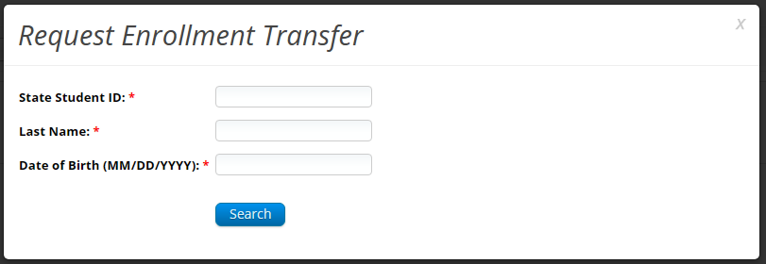
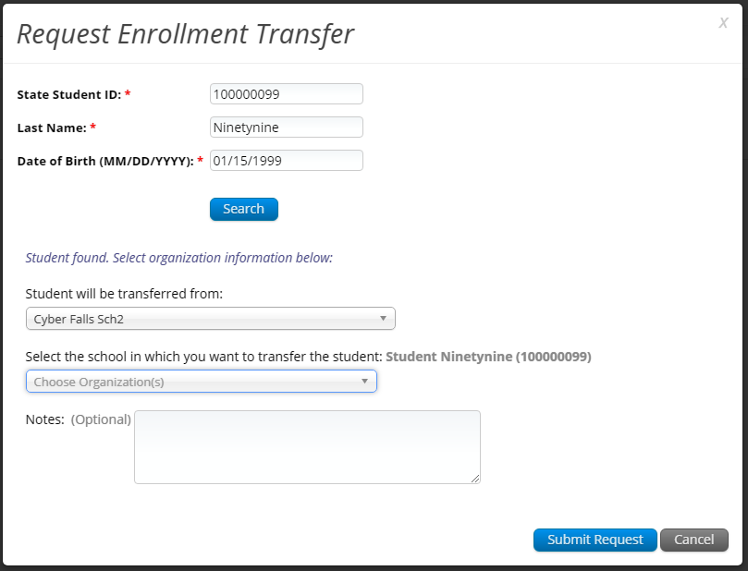
Student Transfer Request

Slide 31
Student Transfer Request
Enrollment request - requestor’s view
Enrollment request - receiver’s view

Slide 32
Student Accommodations
Check/edit accommodations
Accommodations are not included in BIE roster upload
Edit student accommodations individually or…
Use Upload Accommodations to edit accommodations on multiple student records at one time
You can use the Export Accommodations button to download list of all students and their currently assigned accommodations, edit that file and re-upload it using the Upload Accommodations menu
View the training video, available in the Help & Support site, https://bie.onlinehelp.cognia.org/resources/, for step-by-step instructions

Slide 33
Universal Tools, Accessibility Features, and Accommodations
Universal Tools
(Available to all students)
Platforms tools that are built in and automatically delivered during testing
Accessibility Features
(Available to some without IEP/ 504)
Must be pre-identified by DTC/STC prior to testing
Accommodations
(IEP, 504)

Slide 34
Accessibility Features, and Accommodations

Slide 35
Accessibility Features, and Accommodations
Student will be assigned a TTS-specific form
Student can use CoWriter© word-prediction; an additional file must download which may delay loading test by a minute
Windows only! Proctor must enter proctor password when student logs in to test.
Assign student accommodations PRIOR to scheduling the test for the student.
See the “Testing with Third Party Assistive Technology” guide for more information on using the test interface with screen readers, speech-to-text, text-to-speech and other assistive technologies.

Slide 36
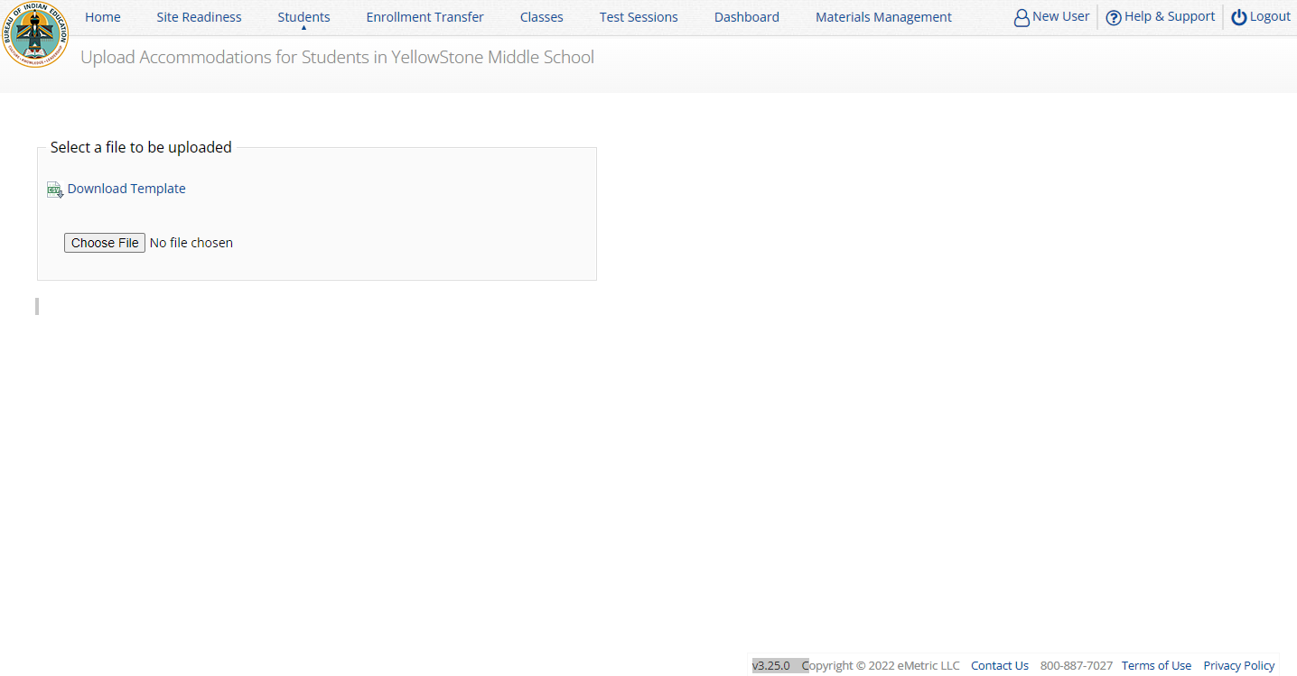
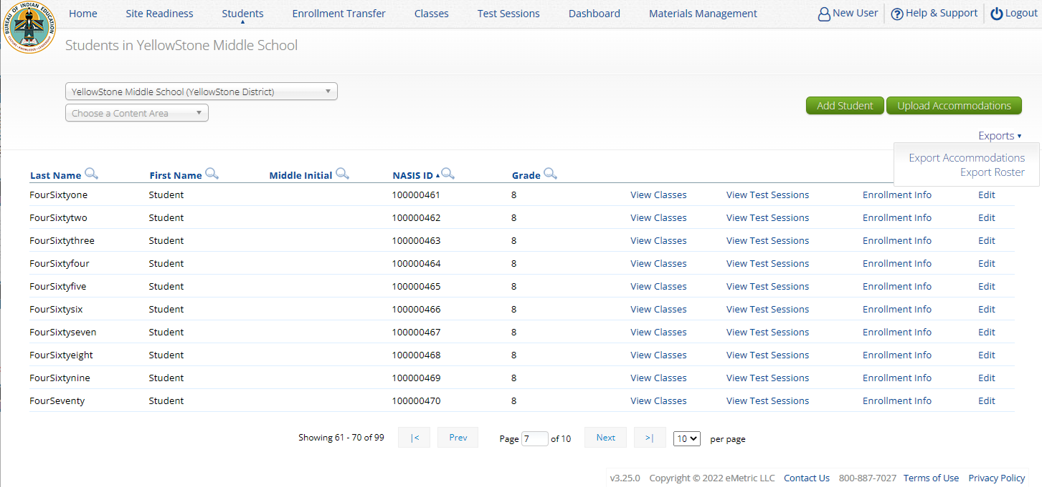
Student Upload Accommodations

Slide 37
Creating Classes
Groups of one or more students who will take a test
Create grade-level classes
Maximum number of student allowed in a class: 100
Class can be deleted if it has not been scheduled for a test
If test session scheduled and no student has logged in, delete test session, then class
Students can be assigned to more than one class
If any student needs to retake the test, you must either:
Create a new class and put the student(s) in that class and schedule that class for a test in a new test session, or…
Create a Test Subgroup (Benchmark Only!)

Slide 38
Creating Classes
STCs or TAs (Teachers) can create classes
Each class must have a TA assigned to the class
STCs can create classes and assign any TA
STCs can view or edit any class in their school
TAs can only assign themselves as TA for the classes they create
TAs can only view the classes if they are assigned as TA
TAs can put any student in the school in their class
Once a student is assigned to the TA’s class the TA can view the student record but cannot edit it.

Slide 39
Creating Classes

Slide 40
Creating Classes
Icon | Description
1 | class name
2 | TA name
3 | grade
4 | search/filter
5 | students in school
6 | students in class
7 | save class
1
TA name and grade will automatically be added to the class name!
3
2
4
5
6
7

Slide 41
Creating Classes

Slide 42
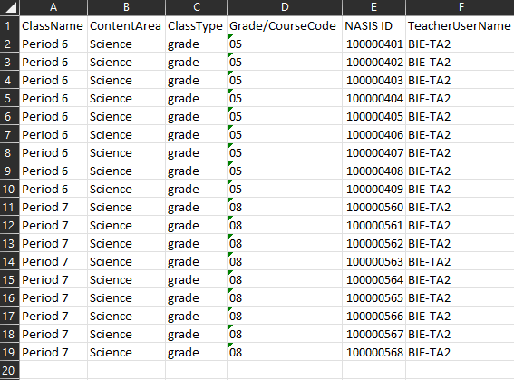
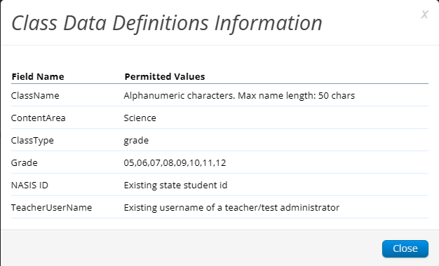
Creating Classes
Save as csv file type
Grade/course code must have leading zero 0 - make field type “text“

Slide 43
Scheduling Test Sessions
Schedule a test session (assign class to test)
Select test
Spring 2024 tests will be available for scheduling in the portal from March 4, 2024
Ensure you select BIE Science Assessment program
Select class to schedule for that test
Class must be same grade level as test and must not be previously scheduled for the test
Save the test session
Go to the Test Session Details page to:
Review students in the test session
Get session access codes (must be provided to the student to log into specific test session)
Check student forms (students with TTS accommodation should have TTS form)
Print test tickets with students’ usernames and passwords
Monitor test status
Student test tickets:
Can be downloaded as pdf or csv file
pdf can be printed with 1, 8 or 27 log-ins per page
pdf has cover sheet listing students and accommodation/accessibility feature assignments
Note:
Students do not have to test at the same time
Log-ins can be used at anytime during the test window as long as the student has not turned in the test
Test window is Monday - Friday, 5am – 8pm MST - times are displayed in Mountain time!
(6am – 9pm CST, 7am – 10pm EST, 4am – 7pm PST)

Slide 44
Scheduling Test Sessions
STCs or TAs (Teachers) can create test sessions from March 4, 2024, for scheduling the Spring 2024 tests
TA’s must have access to the program in their user profile to schedule classes for an assessment in that program
STCs can create test sessions for any TA
STCs can view or edit any test sessions in their school
TAs can only create test sessions for their classes
TAs can only view or edit test sessions for their classes

Slide 45
Scheduling Test Sessions

Slide 46
Scheduling Test Sessions
Icon | Description
1 | Test
2 | Class
3 | Test Window
4 | Save the test session
1
2
Class must be same grade level as test
If class has already been scheduled for a test, it cannot be scheduled again and will not show up in the classes list
Test window cannot be edited
3
4

Slide 47
Managing Test Sessions
Icon | Description
1 | Test session information
2 | Test window status
3 | Session access codes
4 | Students in test session
5 | Student Test Status (Not started, In Progress, Finished)
1
2
3
5
4

Slide 48
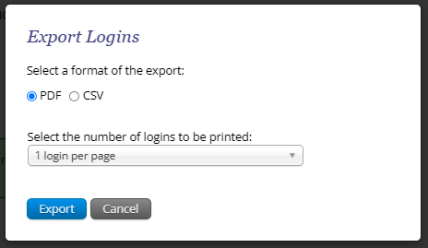
Managing Test Sessions

Slide 49
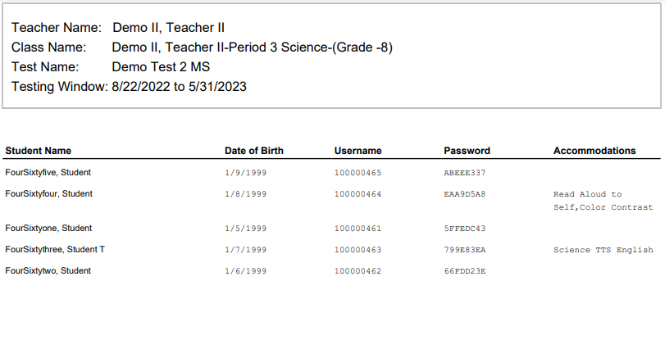
Managing Test Sessions

Slide 50
Monitoring Testing
Check student test status for tests “not started” or “in progress”
If test is “not started” or “in progress”, student can log in and finish it anytime during test window if they have log-in information unless the test has been invalidated
Once test in “finished” (or invalidated), student cannot log in to test
The help desk can re-open any test that was inadvertently turned-in before the student completed the test
Use the “Export Test Status” or the “Export Test Status for All Tests” download under “Exports” on the Test Session screen to download a list of student test sessions and their status
Use the “Export Students Not Scheduled” download under “Exports” on the Test Session screen to download a list of students not scheduled for a test

Slide 51
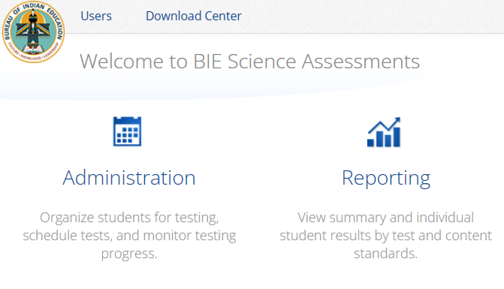
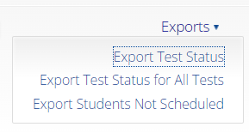
Export Test Status for All Tests
Notes:
After the Export Test Status for All Tests link is clicked (to download a file with the test status of all students for all tests in the selected school), a pop-up message will appear indicating that the downloaded file will be available in the Download Center. Once the file is ready, you will receive an email notification. You will then navigate to the Download Center from the Portal home page to access the file. A table will appear with the files available to download, click on Download Result to download the Export Test Status for All Tests file.

Slide 52
Test Report Codes
For students who cannot complete the test, invalidate using two-step process:
Enter a test report code
Select “invalidate” for each test session – invalidating the test prevents the student from logging into the test
If a student starts one session and the test is invalidated before they finish:
Invalidate the session and enter test report code
Put the student in a new class/test session and have them start from the first session
If a student finished one or more sessions in a test but one or more sessions is invalidated:
Leave the completed and valid test sessions alone
Invalidate the invalid test session(s) and enter test report code
Put the student in a new class/test session and have them complete only the test session(s) that were invalidated in the original test session. Cognia will link the valid test sessions during post test data clean-up
If a student does not start any test session:
Remove the student from the class, or…
Invalidate each session and enter test report code

Slide 53
Test Report Codes/Invalidating Tests
Icon | Description
1 | Click on the “+” to add a test report code
2 | Click on the “Invalidate” to invalidate the session
Note | Only STCs can re-validate (i.e., undo) an invalidated session
1
2

Slide 54
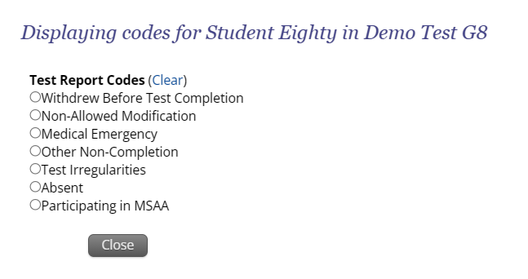
Test Report Codes/Invalidating Tests

Slide 55
Completing Testing
Check student test status for tests “Not Started” or “In Progress”
Use the “Export Test Status”, “Export Test Status for All Tests”, and “Export Students Not Scheduled” to help check students
Enter Test Report code/invalidations as needed
No other actions are needed to “close” testing
Following the completion of the test administration window, there will be a three-day “data clean-up” period when changes can be made to student demographics and test report codes/invalidations.
Monday, April 22–Wednesday, 24, 2024
After this window, students and test sessions will still show up in the portal but any further changes will not be reflected in reporting
In June, all students, test session data and tests will be removed from the portal

Slide 56
Test Administrator Access
STC View
TA View

Slide 57
Dashboard
Dashboard will be available on the second day of testing
Not live data, will display previous days statistics
Not to be used for accountability statistics
Statistics are by school
Statistics include
Number of tests scheduled
Number of tests in progress
Number of tests finished
Tests started by hour
Tests started by day
Operating systems used by testers

Slide 58
Materials Management
Order additional paper test materials from Cognia
Access to this menu and training on how to use it will be released later when the additional materials window opens on February 26, 2024

Slide 59
BIE Science Assessment
BIE Science Assessment Student Test Interface:
Student Test Delivery System

Slide 60
Universal Tools
Name | Tool Icon
Sketch Tool (not available for constructed response items)
Text Highlighter
Note Pad
Line Reader
Answer Eliminator
Reference Sheet
Pop-up Glossary

Slide 61
Universal Tools
Name | Tool Icon
Zoom View (magnifier)
Bookmark
Expand Passage
Answer Masking
Custom Masking
Reverse Contrast

Slide 62
Accessibility Features
Must be pre-identified before testing, but student does not need a legal plan to have accessibility features assigned to them for testing
Name | Tool Icon
Color Contrast

Slide 63
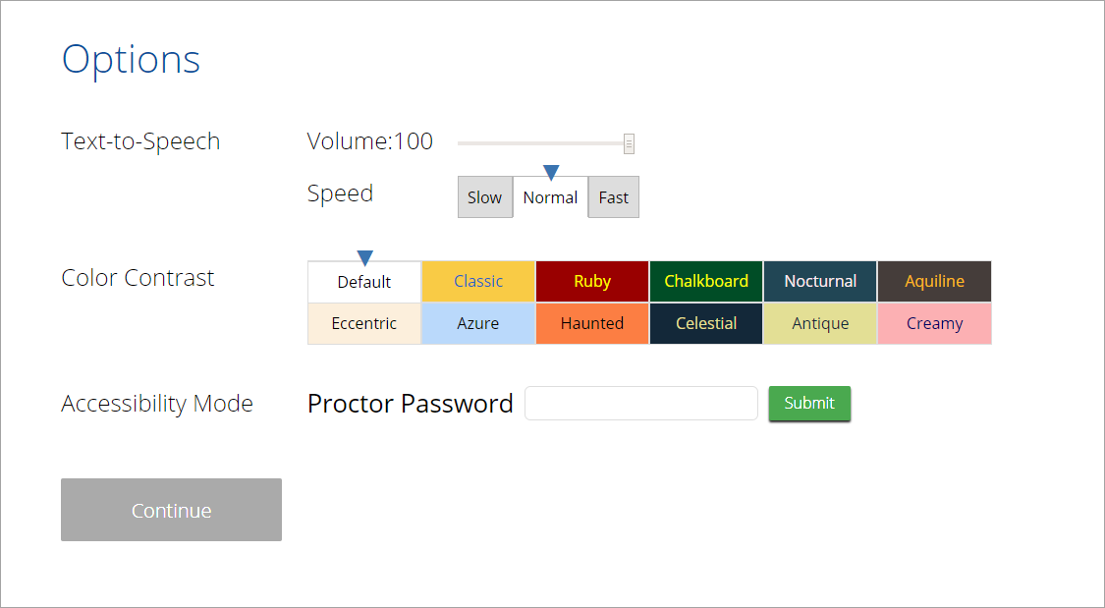
Accommodations
Must be pre-identified before testing and be apart of the students 504/IEP plan
Name | Tool Icon
Science Text-to-Speech English
Word Prediction (Embedded)
Allow Accessibility Mode Testing

Slide 64
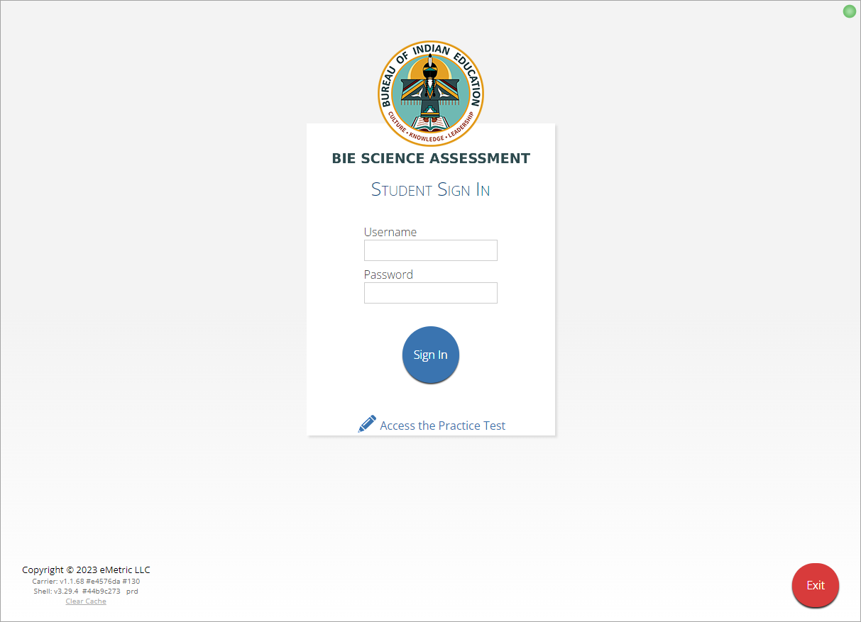
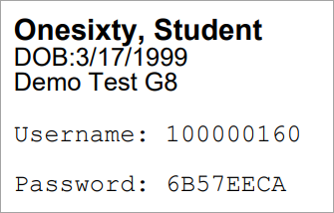
Logging in to a Test
Launch Kiosk
Login using the username and password from the student test ticket

Slide 65
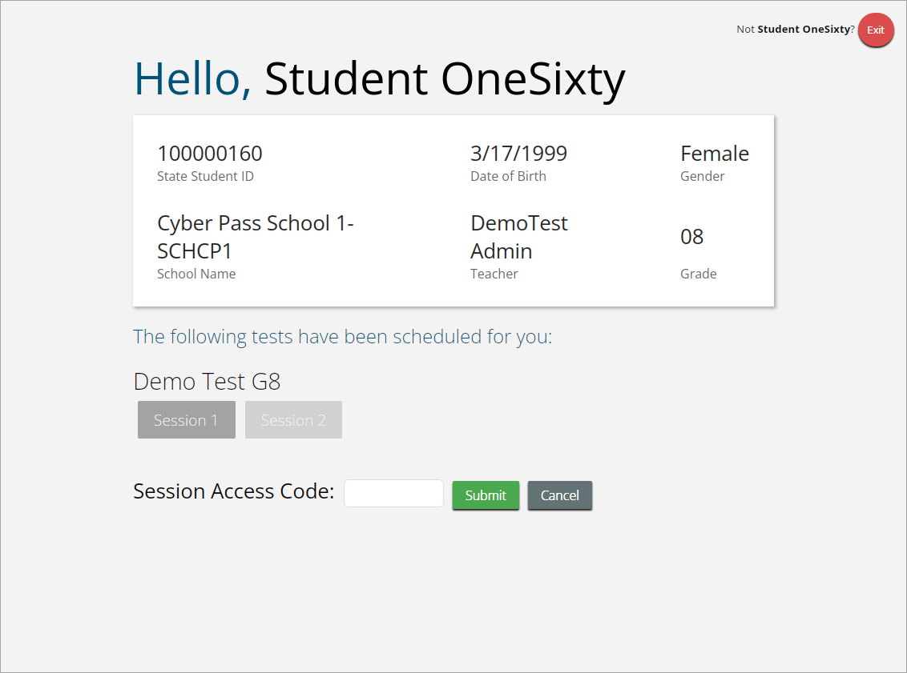
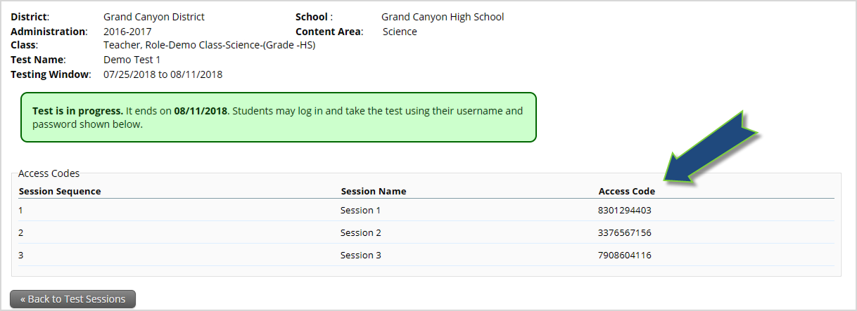
Logging in to a Test

Slide 66
Logging in to a Test

Slide 67
Logging in to a Test

Slide 68
Test Navigation

Slide 69
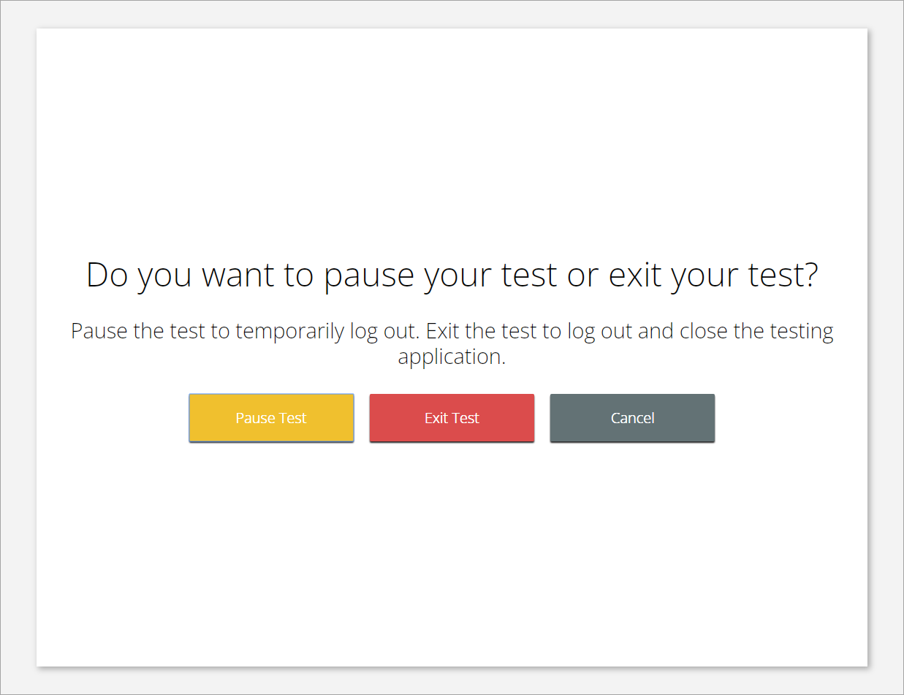
Test Navigation

Slide 70
Test Navigation
Pause and inactivity timeout is 45 mins.

Slide 71
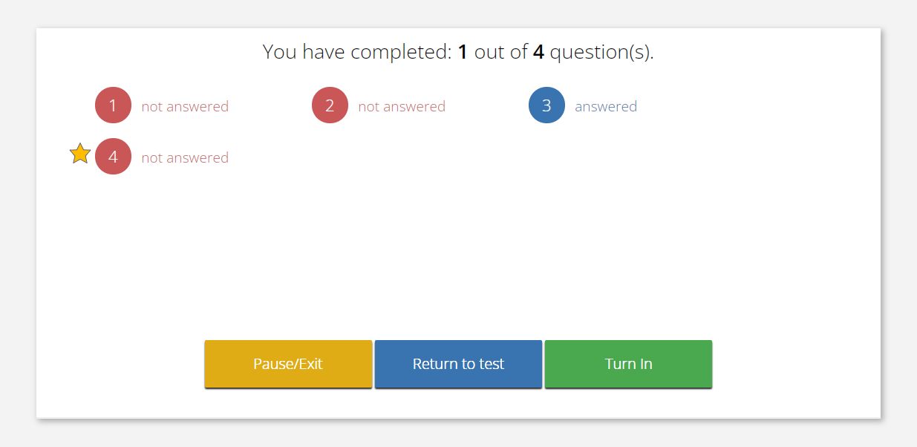
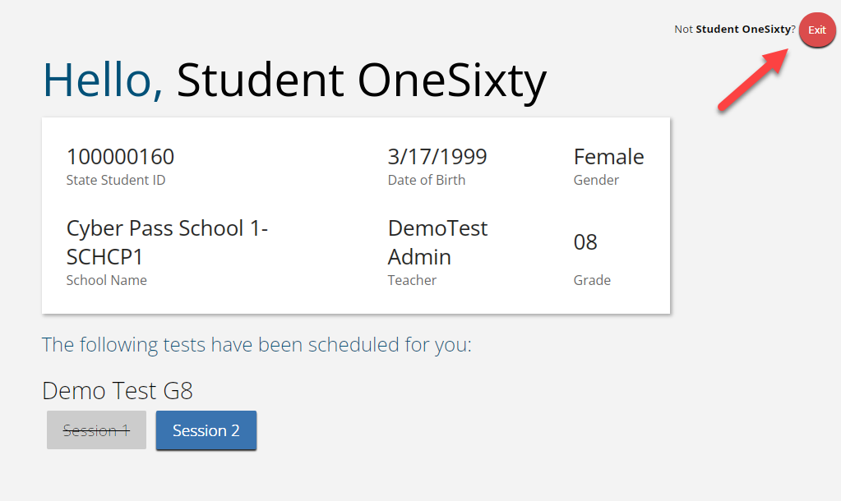
Test Turn In
Steps | Button to Click
On the last item, students click Finish.
On the test review screen, students click Turn In.
Below the confirmation question, students click Turn In.
Student returns to profile page and may select the next section or click Exit to exit the kiosk.

Slide 72
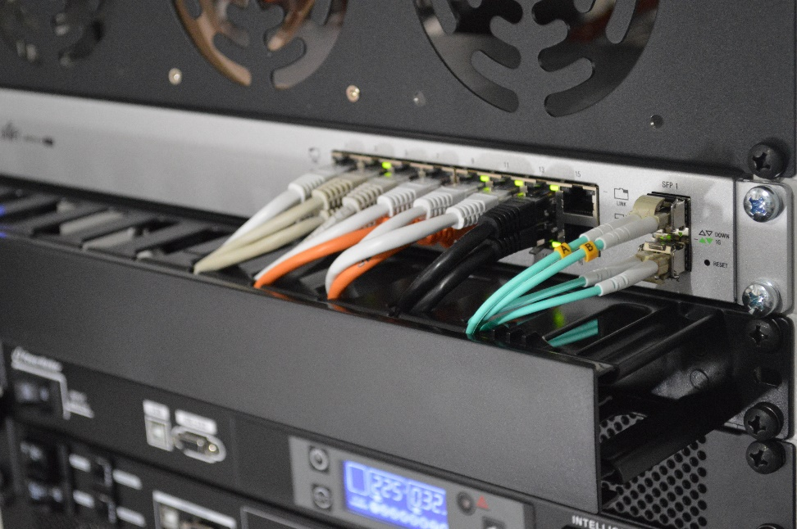
Site Technology Preparation
More information on Site Technology Preparation is provided in the Kiosk Training slides.

Slide 73
Practice Test Options
1. Use internet-based practice test with web browser
Best option for:
Practice testing with browser or on devices that do not have a testing kiosk installed
Note: all accommodations except allow accessibility mode and screen zoom are available
To access the practice test in web browser:
Launch Browser
Go to https://biepracticetest.cognia.org
Use the drop-down menu to select the practice test and click the “Go” button
2. Use internet-based practice test with student kiosk
Best option for:
Realistic practice testing in secure kiosk
Note: all accommodations except allow accessibility mode are available
To access the practice test in web browser:
Launch BIE Science Kiosk
Click on the “Access Practice Test” link
Use the drop-down menu to select the practice test and click the “Go” button

Slide 74
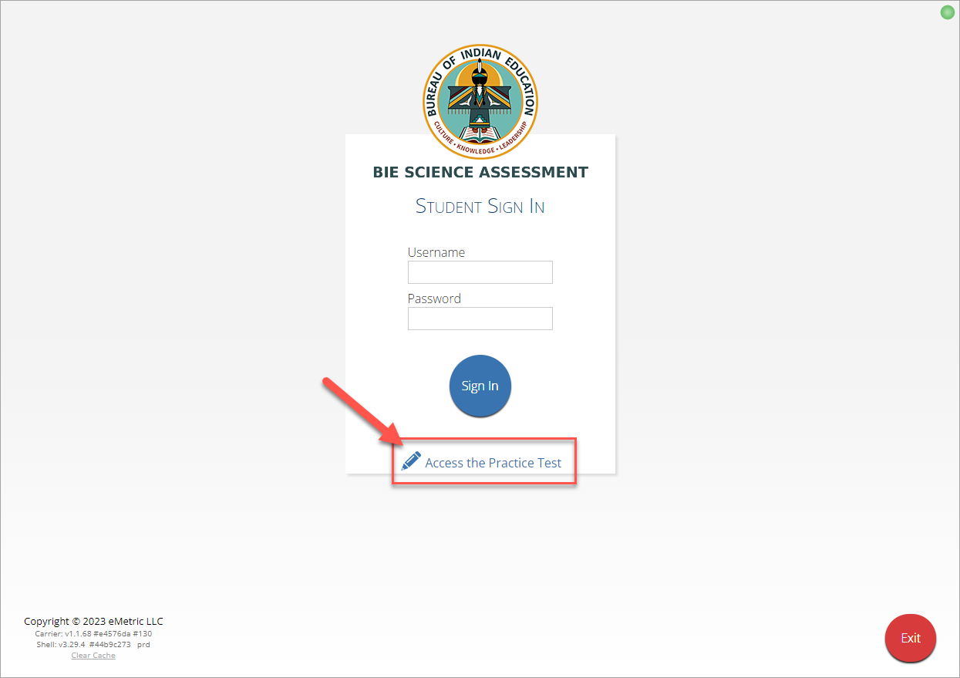
Practice Test

Slide 75
Additional Training Resources
Help Guides
Quick Starts: Creating Classes, Scheduling Tests, Printing Logins, Student Interface
Kiosk Installation Guide
Portal User Guide
Kiosk User Guide
Scoring Guide
Reporting Guide
Testing with Third Party Accessibility Software
Tutorial Videos
https://bie.onlinehelp.cognia.org/
Support Desk
Call-in Information Sheet

Slide 76
Remember
Deactivate unused accounts
Kiosks do need to be downloaded and apps installed – last year’s kiosks will not work
Check student demographics and add accommodations
Ensure students have TTS accommodation/form BEFORE they log in to the test
Make sure network management tools don’t delete stored response folder
Communicate with Proctors/Test Administrators
Are there limits to number of students who should log in simultaneously?
Do they know the procedure for recovering stored responses?
Do they have basic information required by the support center if they call in?

Slide 77
Help & Support Site General Education Science
https://bie.onlinehelp.cognia.org/
Resources will be posted throughout the year
Key dates
Manuals
Training videos
Practice tests
Access to CBT practice test and answer documents
Downloadable PDFs of the practice test
Reporting resources

Slide 78
BIE Science Help Desk
Hours
Monday–Friday from 9:00 a.m.–6:00 p.m. (ET)
Contact information
Phone: 800-887-7027
Email: BIETechSupport@cognia.org
Chat (accessible from the BIE Help & Support site)

Slide 79
Questions?

Slide 80
Thank you!
Notes:
Sara close

