Slide 1
Welcome!
The training will begin shortly

Slide 2
BIE Science Benchmark - ITCs
September 26, 2024

Slide 3
Housekeeping
All participants should remain on mute with their video off.
Post all questions to the chat. Questions will be addressed at each section break.
Please add your name, email, and school to the chat.
This training will be recorded.
The recording will be posted to the Help & Support page, https://bie.onlinehelp.cognia.org/training.

Slide 4
Welcome & Introductions

Slide 5
Bureau of Indian Education (BIE)
Aurelia Shorty, Education Program Specialist, Project Manager for Science
Carmelia Becenti, Chief Academic Officer
Donald Griffin, Section 504 Program Coordinator, Project Manager for MSAA

Slide 6
Cognia
Mara Allaire, Program Manager
Sarah McCain, IT Project Manager II

Slide 7
eMetric
Aarti Jagtap, Project Manager III
Kaelee Harper, Senior Support Center Manager

Slide 8
Bureau of Indian Education Science Benchmark Assessment Fall 2024 ITC Training
Aarti Jagtap, eMetric
Kaelee Harper, eMetric

Slide 9
Agenda
Benchmark Assessments Overview
Key Dates
Overview of System and Testing Process
User Management
Site Technology Preparation and Network Requirements
Technology Requirements
Features for Reliable and Secure Testing
Site Readiness Procedure
Additional Training Resources
Reminders

Slide 10
Science Benchmark Overview

Slide 11
Overview
Three grade levels – elementary school, middle school, high school
Elementary School: grade 4, grade 5
Middle School: grades 6-8
High School: grades 9-12
8 forms per grade level
Each form covers different content/standards
For available forms indicating their content topic/focus, and tested Performance Expectations (PEs), visit https://bie.onlinehelp.cognia.org/benchmark-administration/ on the BIE Science Help & Support site
12–14 items per form
10–12 selected response
2 open-ended response
Aligned to Next Generation Science Standards (NGSS)
Administer based on curriculum and pacing

Slide 12
Format
Available through eMetric Portal
Online
Students assess in kiosk or browser
Paper
PDFs available for download from portal STC’s administration home page, https://bie.Cognia.org
https://bie.cognia.org/

Slide 13
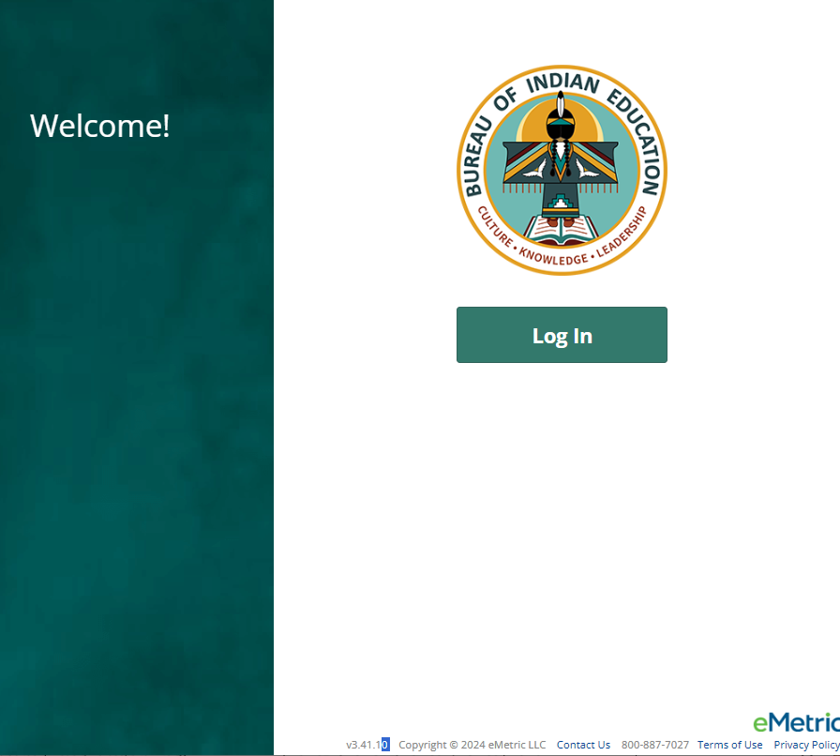
Downloading the PBT forms from the Portal
Log in to the Portal
From the Homepage, select the Administration icon
There you will see the links for downloading the paper-based test forms by grade level
You must download G5, Grade 4 forms are named as Grade 5, Forms 5,6,7,8…Middle School and High School tests separately
Elementary School (Grades 4, 5)
Middle School (Grades 6-8)
High School (Grades 9-12)
Notes:
Note/Reminder: remind participants that if they take the paper version, no reporting will be available in Data Interaction; therefore, they should keep track of those testers and scores on their own.

Slide 14
Science Benchmark Key Dates

Slide 15
Key Dates
Test Preparation Key Dates
Student Roster Upload by BIE (only 5th, 8th, 11th grade students, field can manually add off-grade students as desired) | August 21, 2024
Portal Open & Kiosks available for download | Sep 9, 2024
Tests available for scheduling in Portal | Sep 23, 2024
Science Benchmark Test Window Opens | Sep 23, 2024
Science Benchmark Test Window Closes | Mar 7, 2025

Slide 16
Science Benchmark Overview of System and Testing Process

Slide 17
BIE Science Assessment
BIE Science Assessment Portal:
Online Test Administration System
https://bie.cognia.org
BIE Science Assessment Student Test Interface:
Student Test Delivery System

Slide 18
BIE Science Assessment Online System
Online System
Portal
Users
Administration
Test Delivery
Kiosk
Site Setup
Students
Classes
Test Sessions
Dashboard
Browser

Slide 19
Test Preparation Process
STC
Create user accounts
Add/edit/transfer students
Assign accessibility features & accommodations
ITC
Download and install kiosks/apps
Complete Site Readiness Test
STC or TA
Create classes
Schedule classes for test
Print/distribute log-in tickets
Students
Launch kiosk or browser
Log-in and test
TA
Score human scored items on tests
View results in Data Interaction
After testing…

Slide 20
Portal Access
Access
http://bie.cognia.org
Open all year, previous accounts can be used
If you are a new School Test Coordinator, please contact BIE. Upon account creation, a welcome email will be sent from the portal.
STCs will create all new portal user accounts
Usernames must be unique
Your email address controls your account
New users will receive two automated emails, one with username and one with temporary password from bietechsupport@cognia.org
When an account is deactivated or reactivated, the user will receive an email

Slide 21
User Roles
User Role | Responsibilities
School Test Coordinator (STC) | Manage Users (add, edit, or deactivate) Access proctor password Edit student information & assign student accommodations Create, edit, and delete classes Schedule test sessions & print logins Manage & monitor test sessions Prepare IT network for student testing if there is no IT Coordinator
IT Coordinator (ITC) | Prepare IT network for student testing Conduct Site Readiness testing
Test Administrator (TA) | Create classes Create test sessions View their students and test sessions Print student login tickets for their test sessions Manage & monitor test sessions Assign test report codes Score human scored items for Benchmark tests View Benchmark results in Data Interaction
Report Access Only (RAO) | View Reports

Slide 22
Portal Log-in
Portal URL: https://bie.cognia.org/

Slide 23
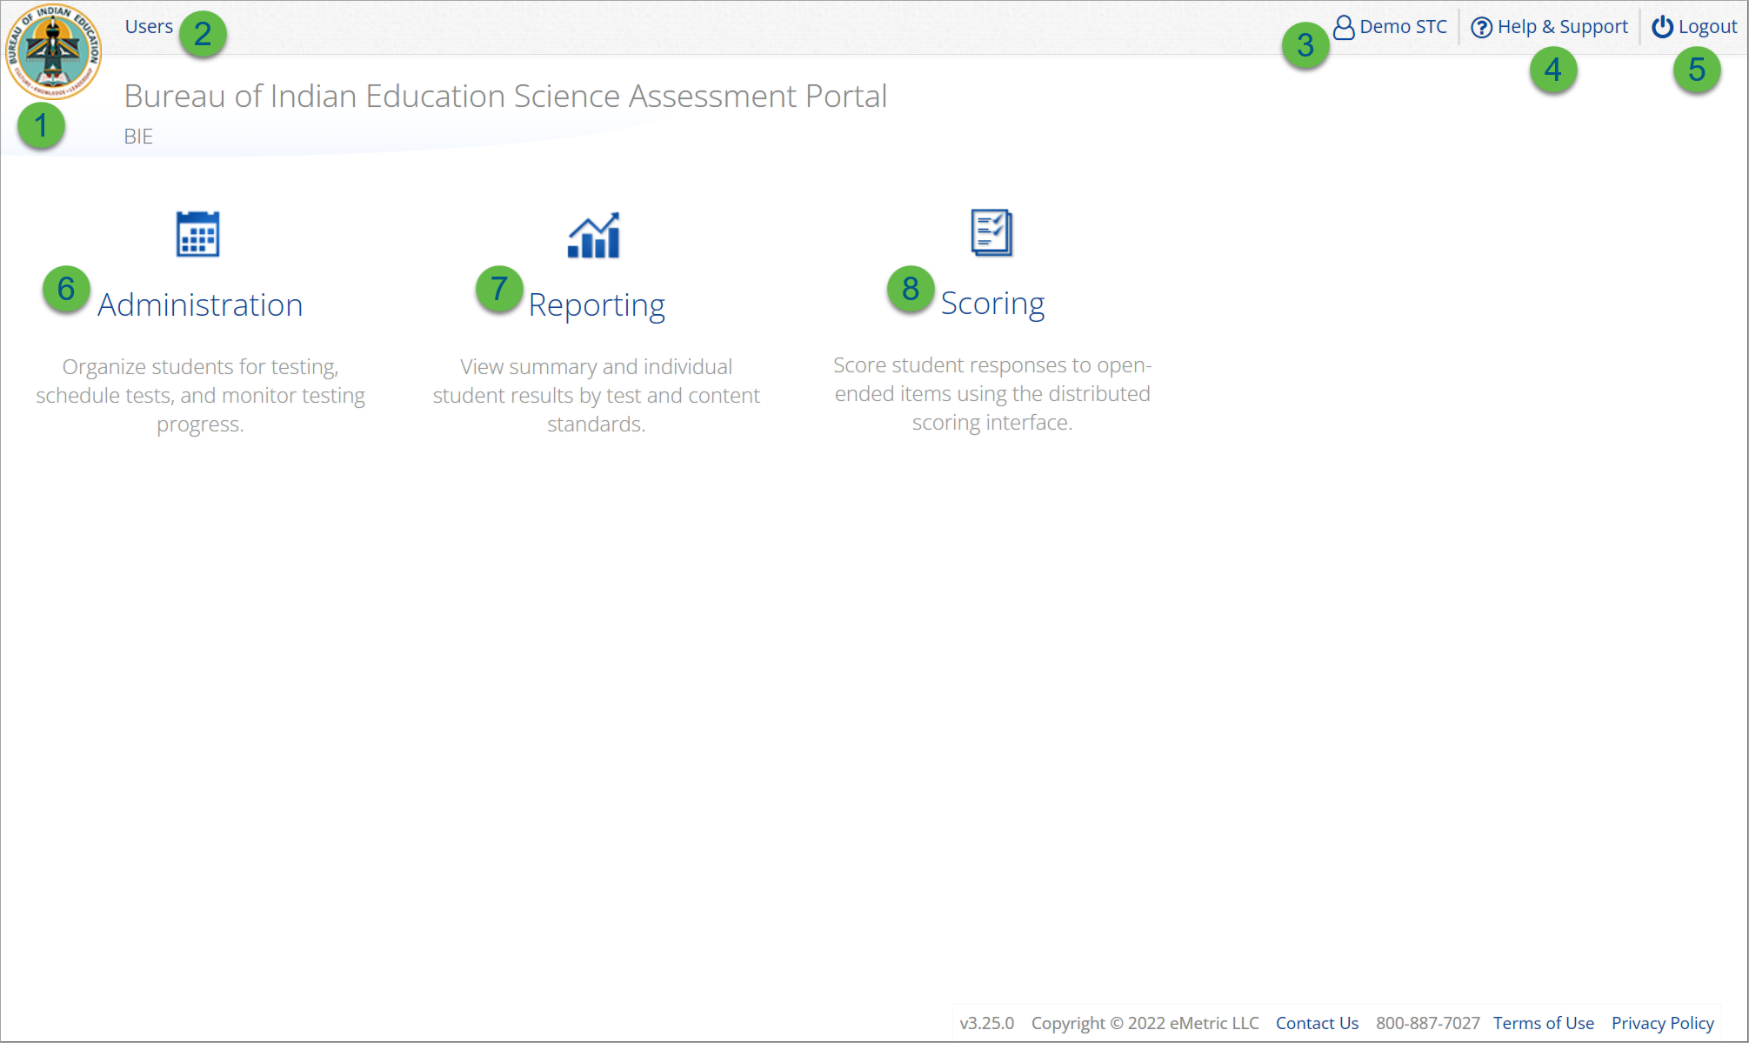
User Accounts & Access
Icon | Description
1 | BIE logo returns to portal home page
2 | Access User Management
3 | View & Edit user profile
4 | Access the BIE Help & Support Site
5 | Logout of the portal
6 | Access Administration Component
7 | Access Reporting
8 | Access Scoring (ONLY the TA Role will have access)
TA Only!

Slide 24
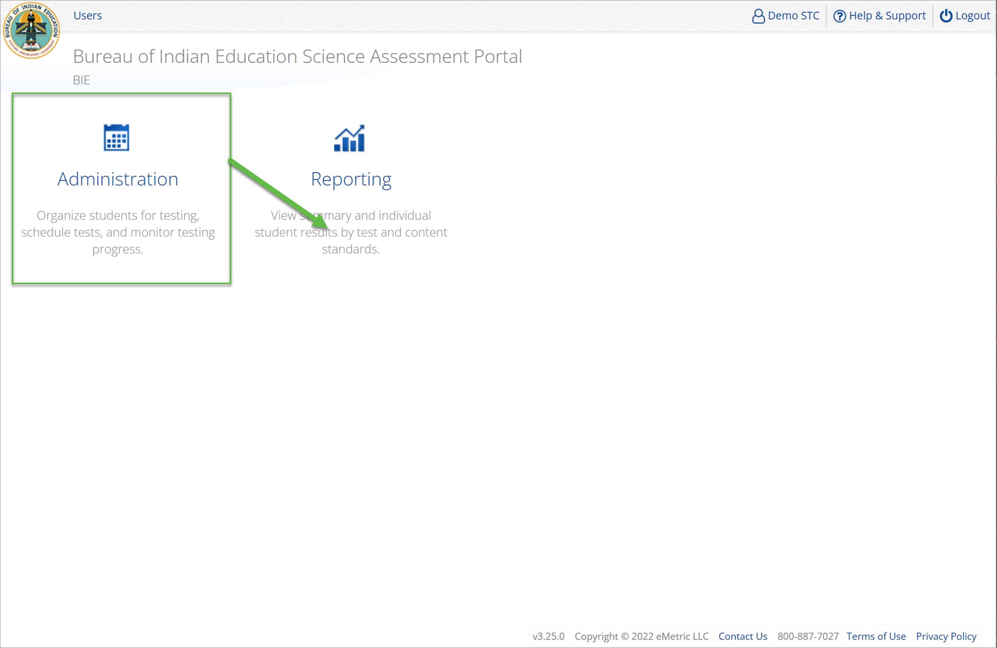
Administration

Slide 25
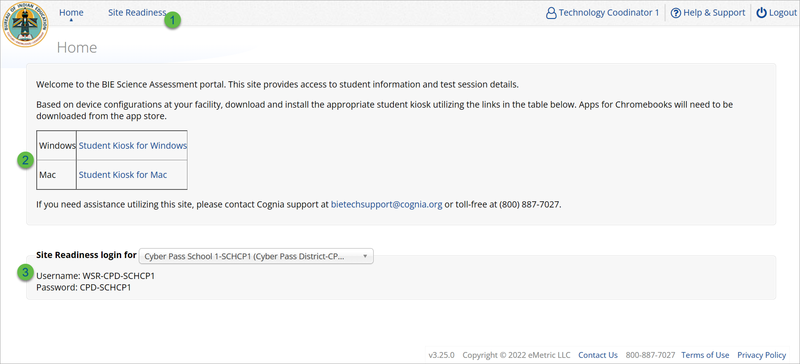
Administration: ITC Account
Icon | Description
1 | Site Readiness tab allows users to view devices that have been tested for site readiness and Site Certification information.
2 | Kiosk installers for Mac and Windows devices are available here.
3 | Site Readiness login credentials are available for each school.

Slide 26
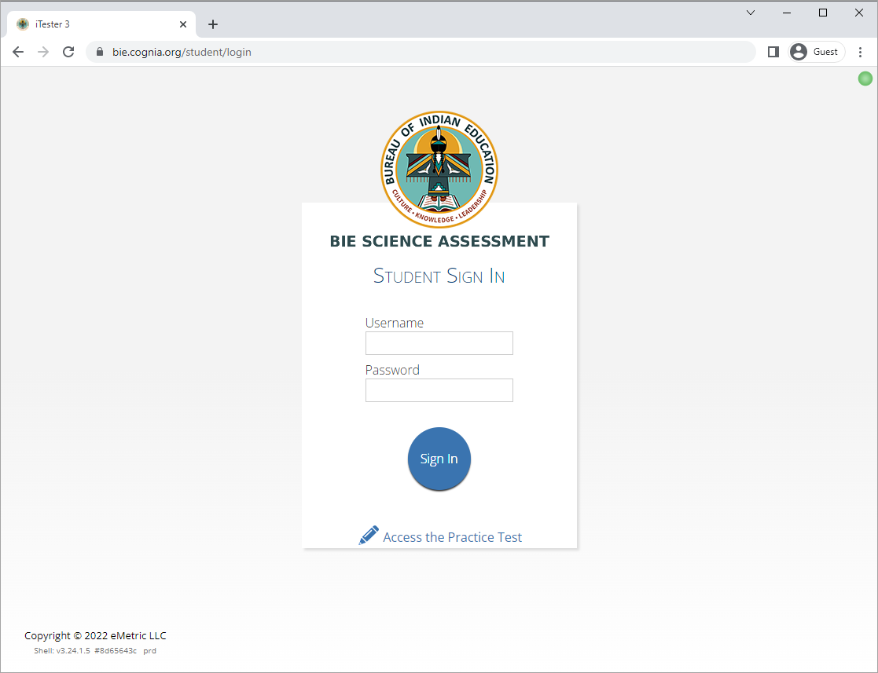
Site Technology Preparation
Browser Requirements
BIE Science Benchmark Assessment & Practice Tests
Available on Chrome, Safari, Firefox, and Microsoft Edge
Browser Student Testing Interface: https://bie.cognia.org/student
Ensure no network settings enforce private browsing or history/cache delete
Do not need to run Site Readiness

Slide 27
Site Technology Preparation
Kiosk Requirements
Windows and Mac Applications
Available to download in the Portal on September 9, 2024
Chromebook Application
Available in the Chrome Webstore
BIE Science Assessment
Add to Google Admin through App Store
Chrome App will update upon launch of the kiosk

Slide 28
Site Technology Preparation
System Requirements
System Requirements – All hardware
Connectivity | Student devices must be able to connect to the internet via wired or wireless networks.
Screen Size | 9.7” screen size or larger/ “10-inch class” tablets or larger
Screen Resolution | 1024 x 768 or larger
Headphones/Earphones/Ear Buds | Headphones/earphones/ear buds are required for students who have a text-to-speech accessibility feature
Browser Requirements (Portal & Practice Tests)
Chrome™ 127 or newer Firefox® 128 or newer Microsoft Edge™ 127 or newer Safari® 17 or newer

Slide 29
Site Technology Preparation
Student Device Requirements Desktop & Laptop
CPU | 1.3 GHz
Memory | 2 GB (4 GB is strongly recommended for best performance)
Input Device | Keyboard (wired or wireless)/Bluetooth mouse or touchpad
Windows® | 10 (21H2; 22H2) , 11 (22H2; 23H2)
Mac OS® | 13.4, 14.6 (64-bit only)
Chromebook Specific Requirements
Chromebook™ notebook computer* | Chrome OS™ LTS 120 Stable Channel 125, 126, 127
Updated Aug 9, 2024. Check the Cognia help and support site for more recent updates.

Slide 30
Technology Requirements
Important Reminders
The BIE Science Benchmark Assessment can be taken with a browser or by using the kiosk.
Students testing on devices that do not meet the Student Workstation Specifications are likely to encounter performance-related issues during testing.
Technology Guidelines may be updated throughout the test administration window as new operating systems are released and tested.
Do not update your test device OS until the Technology Guidelines have been updated.

Slide 31
Technology Requirements
Chrome
Students should launch app from App tray, they should NOT log in to the Chromebook
For managed Chromebooks, ensure “Do not erase all local data” is selected in Device Settings/User Data
For managed Chromebooks, ensure “Allow App to manage power” is disabled in Device Settings/App Management
Non-managed Chromebooks manufactured after 2017 will not run-in kiosk mode, you must use as managed device to test

Slide 32
Technology Requirements
Firewalls
Allow traffic through ports 80 and 443
Proxy and Content Filters Servers
List of URLs to whitelist on ports 80 and 443 available in Kiosk Installation Guide
Sandboxing Applications (e.g. Deep Freeze)
Choose network folder or local folder that is not touched by the sandboxing applications
Applicable for both stored response and kiosk installation folders
Thin Clients
Ensure there is enough memory, CPU, and bandwidth on the server to accommodate multiple student test sessions.
Client requires a minimum of 80 MB per Client session.

Slide 33
Administration Workflow
Students
Classes
Site Readiness
Test Sessions
Dashboard
Home
Notes:
The next component of the BIE Science Portal that we are going to go over is the Administration component.
The Administration component consists of 5-6 tabs depending on your account type.
Home – this is where you can view important announcements, access links for downloading the Kiosks, and attain the Proctor Password and Site Readiness log in credentials.
Site Readiness – this is where you can certify your site as ready for testing.
Students – this is where you can assign student accommodations.
Classes – this is where you can verify your rosters for testing.
Test Sessions – this is where you will schedule your classes for test sessions.
And, the Dashboard – this is where you can view helpful charts and data at the district level.

Slide 34
Site Readiness
1. Review the Kiosk Installation Guide
https://bie.onlinehelp.cognia.org/
2. Download & Install Kiosks
Download Windows or Mac kiosks from BIE Science Assessment Portal
Download Chrome app from appropriate app store
3. Conduct Site Readiness Testing
Run both tests on each device configuration
4. Certify Site
Certify your site as “Ready for Testing” in the Portal

Slide 35
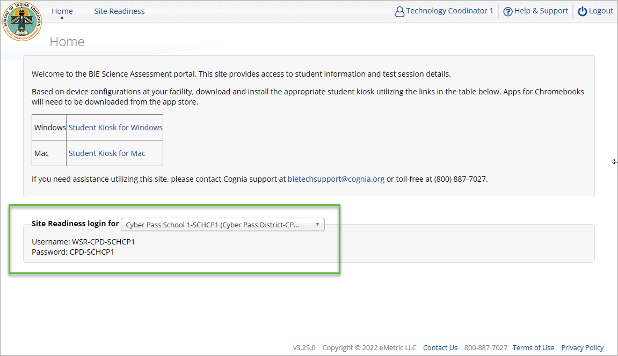
Site Readiness
Notes:
The first step for conducting Site Readiness testing is to download and install the Kiosks and Mobile Apps onto the devices that will be used for testing at your school.
Once you’ve downloaded and installed your Kiosks and Mobile Apps, log in to the Portal to retrieve the site readiness login credentials for your school.
Launch the kiosk or the app and login using the site readiness credentials.
Run the test on a handful of devices for each configuration.
Once you’ve successfully completed your Site Readiness testing, log back into the Portal and navigate to the Site Readiness tab within the Administration component. Here, you can view the details of the devices that you used for Site Readiness testing.
Finally, you’ll certify your site as ready for testing.
Each site has it’s own login credentials for Site Readiness. Each school needs to be certified as ready for testing.

Slide 36
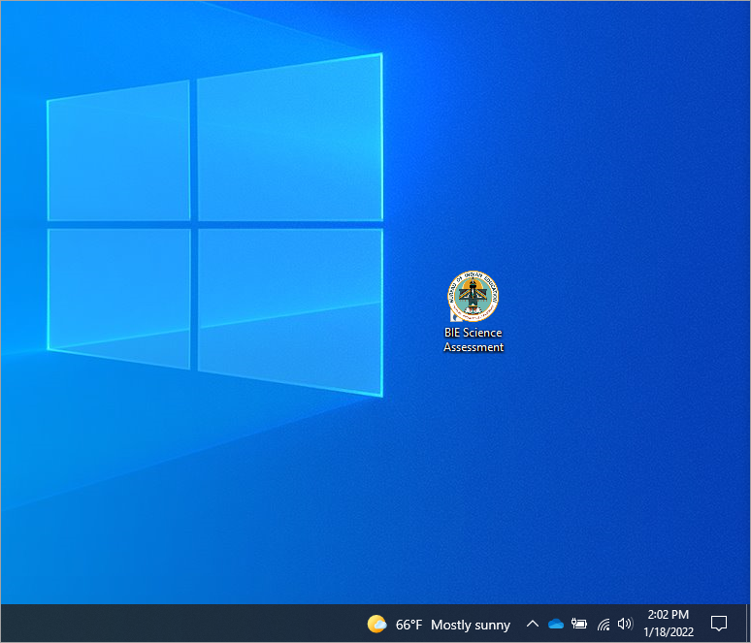
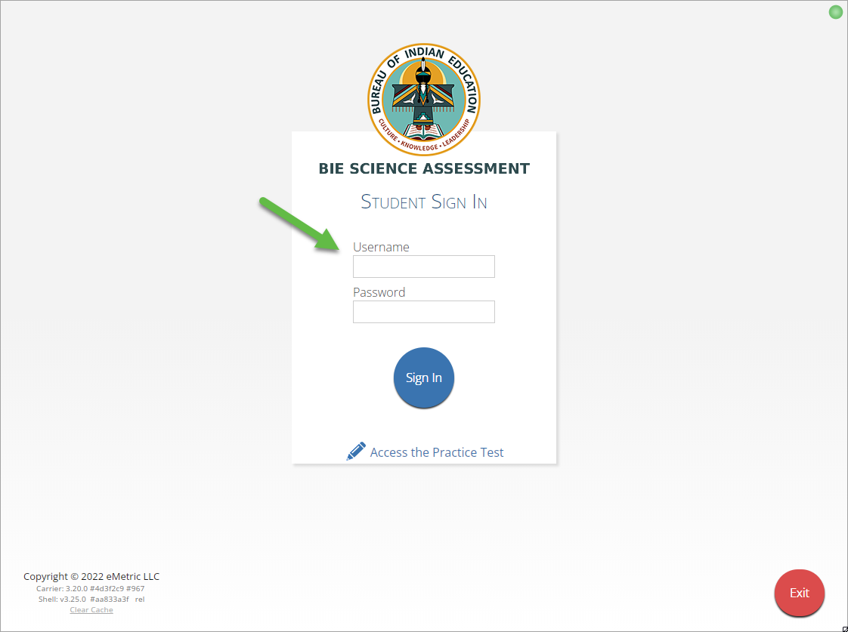
Site Readiness
Notes:
The first step for conducting Site Readiness testing is to download and install the Kiosks and Mobile Apps onto the devices that will be used for testing at your school.
Once you’ve downloaded and installed your Kiosks and Mobile Apps, log in to the Portal to retrieve the site readiness login credentials for your school.
Launch the kiosk or the app and login using the site readiness credentials.
Run the test on a handful of devices for each configuration.
Once you’ve successfully completed your Site Readiness testing, log back into the Portal and navigate to the Site Readiness tab within the Administration component. Here, you can view the details of the devices that you used for Site Readiness testing.
Finally, you’ll certify your site as ready for testing.
Each site has it’s own login credentials for Site Readiness. Each school needs to be certified as ready for testing.

Slide 37
Site Readiness

Slide 38
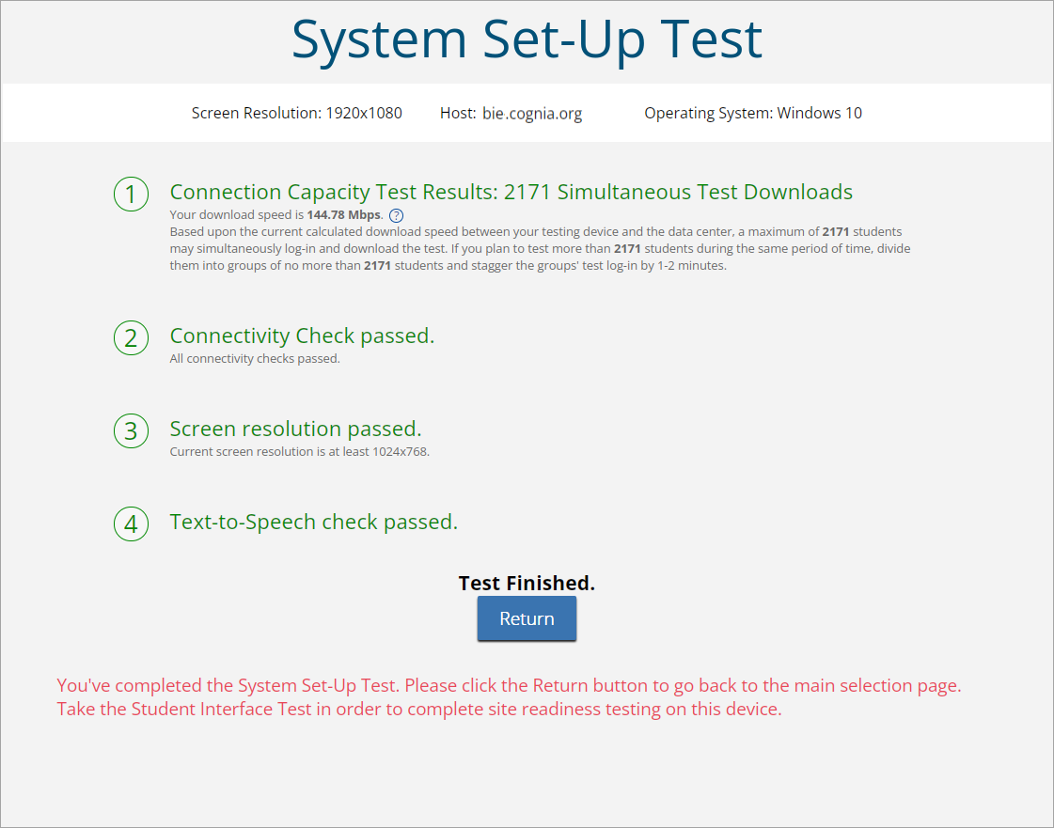
Site Readiness

Slide 39
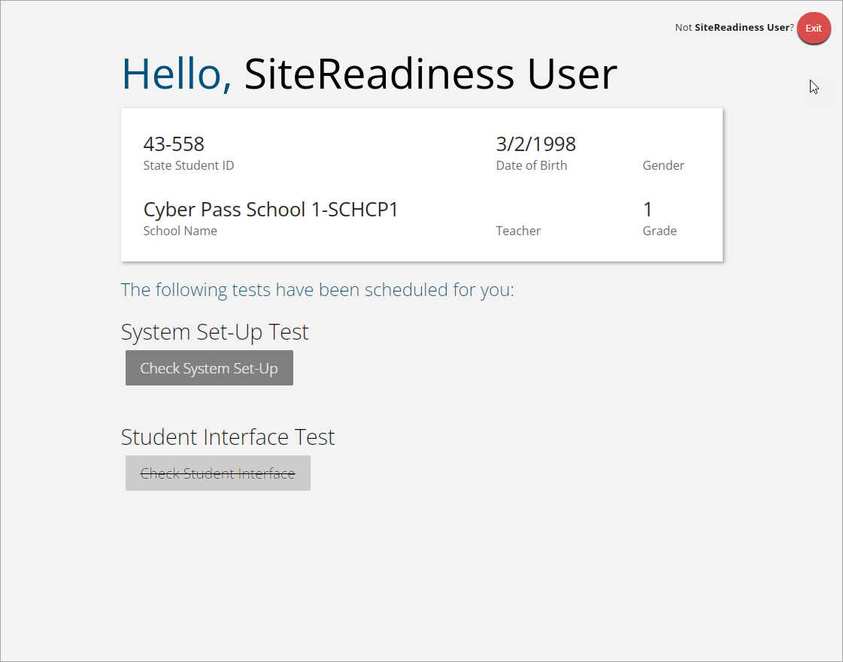
Site Readiness
Student Interface Test must be completed to log complete site readiness results in the portal.

Slide 40
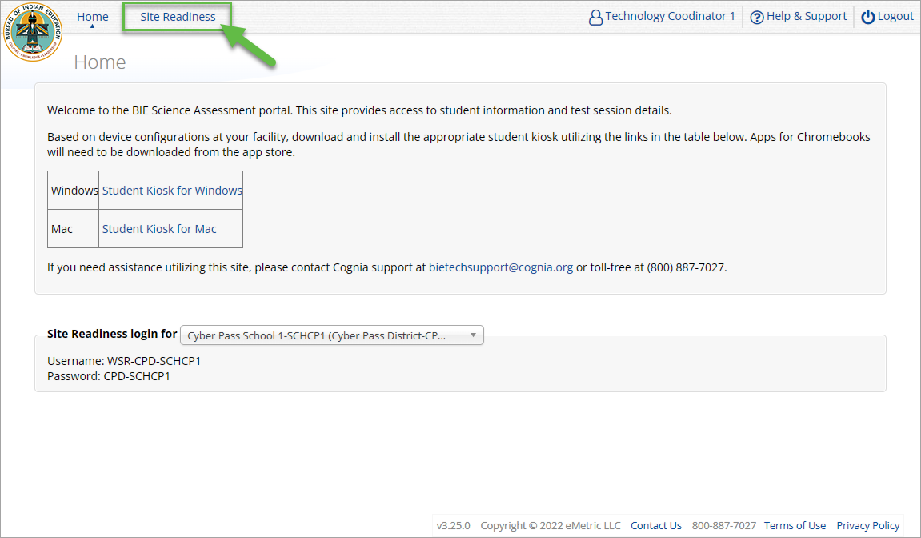
Site Readiness
Notes:
The first step for conducting Site Readiness testing is to download and install the Kiosks and Mobile Apps onto the devices that will be used for testing at your school.
Once you’ve downloaded and installed your Kiosks and Mobile Apps, log in to the Portal to retrieve the site readiness login credentials for your school.
Launch the kiosk or the app and login using the site readiness credentials.
Run the test on a handful of devices for each configuration.
Once you’ve successfully completed your Site Readiness testing, log back into the Portal and navigate to the Site Readiness tab within the Administration component. Here, you can view the details of the devices that you used for Site Readiness testing.
Finally, you’ll certify your site as ready for testing.
Each site has it’s own login credentials for Site Readiness. Each school needs to be certified as ready for testing.

Slide 41
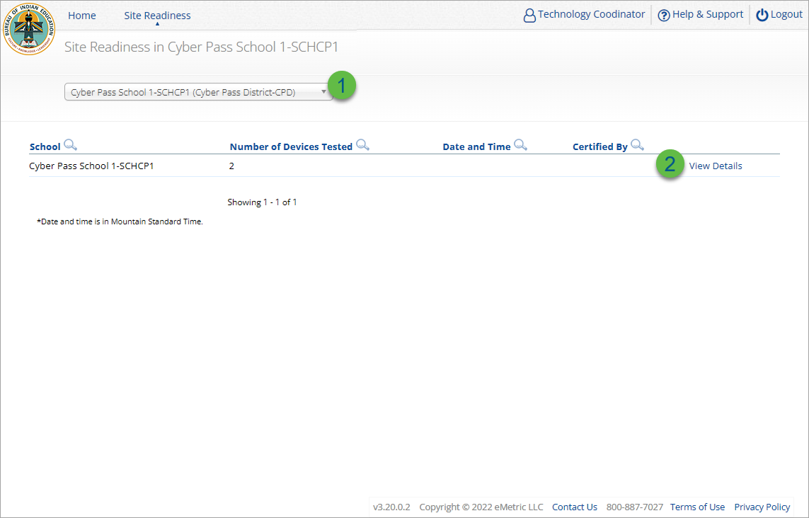
Site Readiness
Step | Description
1 | Select the organization.
2 | Click View Details to view the devices at the school.
Notes:
The first step for conducting Site Readiness testing is to download and install the Kiosks and Mobile Apps onto the devices that will be used for testing at your school.
Once you’ve downloaded and installed your Kiosks and Mobile Apps, log in to the Portal to retrieve the site readiness login credentials for your school.
Launch the kiosk or the app and login using the site readiness credentials.
Run the test on a handful of devices for each configuration.
Once you’ve successfully completed your Site Readiness testing, log back into the Portal and navigate to the Site Readiness tab within the Administration component. Here, you can view the details of the devices that you used for Site Readiness testing.
Finally, you’ll certify your site as ready for testing.
Each site has it’s own login credentials for Site Readiness. Each school needs to be certified as ready for testing.

Slide 42
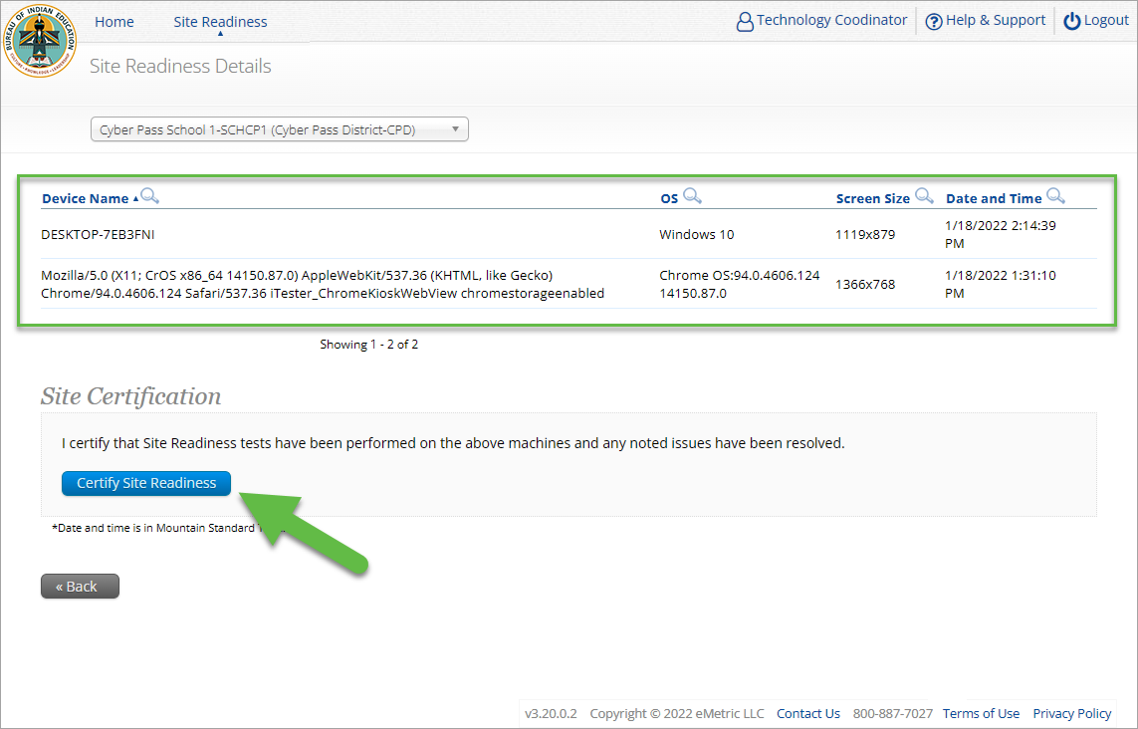
Site Readiness
Notes:
The first step for conducting Site Readiness testing is to download and install the Kiosks and Mobile Apps onto the devices that will be used for testing at your school.
Once you’ve downloaded and installed your Kiosks and Mobile Apps, log in to the Portal to retrieve the site readiness login credentials for your school.
Launch the kiosk or the app and login using the site readiness credentials.
Run the test on a handful of devices for each configuration.
Once you’ve successfully completed your Site Readiness testing, log back into the Portal and navigate to the Site Readiness tab within the Administration component. Here, you can view the details of the devices that you used for Site Readiness testing.
Finally, you’ll certify your site as ready for testing.
Each site has it’s own login credentials for Site Readiness. Each school needs to be certified as ready for testing.

Slide 43
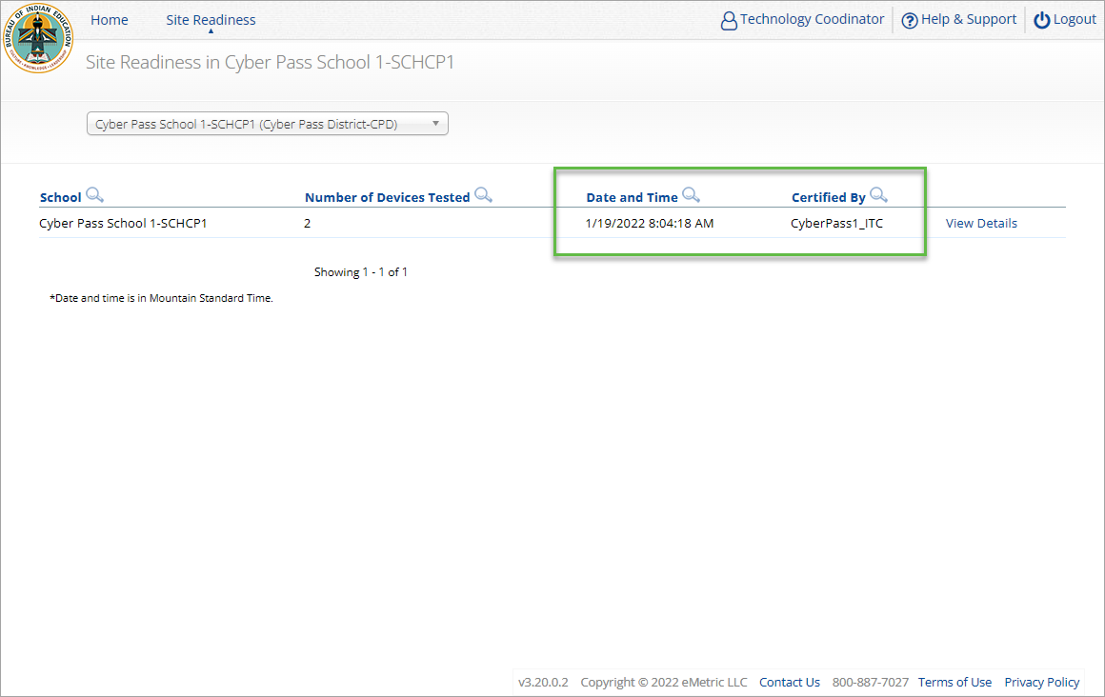
Site Readiness
Notes:
The first step for conducting Site Readiness testing is to download and install the Kiosks and Mobile Apps onto the devices that will be used for testing at your school.
Once you’ve downloaded and installed your Kiosks and Mobile Apps, log in to the Portal to retrieve the site readiness login credentials for your school.
Launch the kiosk or the app and login using the site readiness credentials.
Run the test on a handful of devices for each configuration.
Once you’ve successfully completed your Site Readiness testing, log back into the Portal and navigate to the Site Readiness tab within the Administration component. Here, you can view the details of the devices that you used for Site Readiness testing.
Finally, you’ll certify your site as ready for testing.
Each site has it’s own login credentials for Site Readiness. Each school needs to be certified as ready for testing.

Slide 44
Browser Requirements
Do not use browser in private or incognito mode
Do not delete browsing history or browser cache
Notes:
The first step for conducting Site Readiness testing is to download and install the Kiosks and Mobile Apps onto the devices that will be used for testing at your school.
Once you’ve downloaded and installed your Kiosks and Mobile Apps, log in to the Portal to retrieve the site readiness login credentials for your school.
Launch the kiosk or the app and login using the site readiness credentials.
Run the test on a handful of devices for each configuration.
Once you’ve successfully completed your Site Readiness testing, log back into the Portal and navigate to the Site Readiness tab within the Administration component. Here, you can view the details of the devices that you used for Site Readiness testing.
Finally, you’ll certify your site as ready for testing.
Each site has it’s own login credentials for Site Readiness. Each school needs to be certified as ready for testing.

Slide 45
Browser & Kiosk Requirements (network)
Beginning of Test:
Authenticate login
Download test content
End of Test:
1. Submit responses for scoring
Notes:
The first step for conducting Site Readiness testing is to download and install the Kiosks and Mobile Apps onto the devices that will be used for testing at your school.
Once you’ve downloaded and installed your Kiosks and Mobile Apps, log in to the Portal to retrieve the site readiness login credentials for your school.
Launch the kiosk or the app and login using the site readiness credentials.
Run the test on a handful of devices for each configuration.
Once you’ve successfully completed your Site Readiness testing, log back into the Portal and navigate to the Site Readiness tab within the Administration component. Here, you can view the details of the devices that you used for Site Readiness testing.
Finally, you’ll certify your site as ready for testing.
Each site has it’s own login credentials for Site Readiness. Each school needs to be certified as ready for testing.

Slide 46
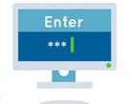
Browser & Kiosk Test Integrity
What happens if a student loses network connection in the middle of a test?
A
C
D
B
45-90sec
A
C
Browser Cache
Stored Response Folder (kiosk)
D
B

Slide 47
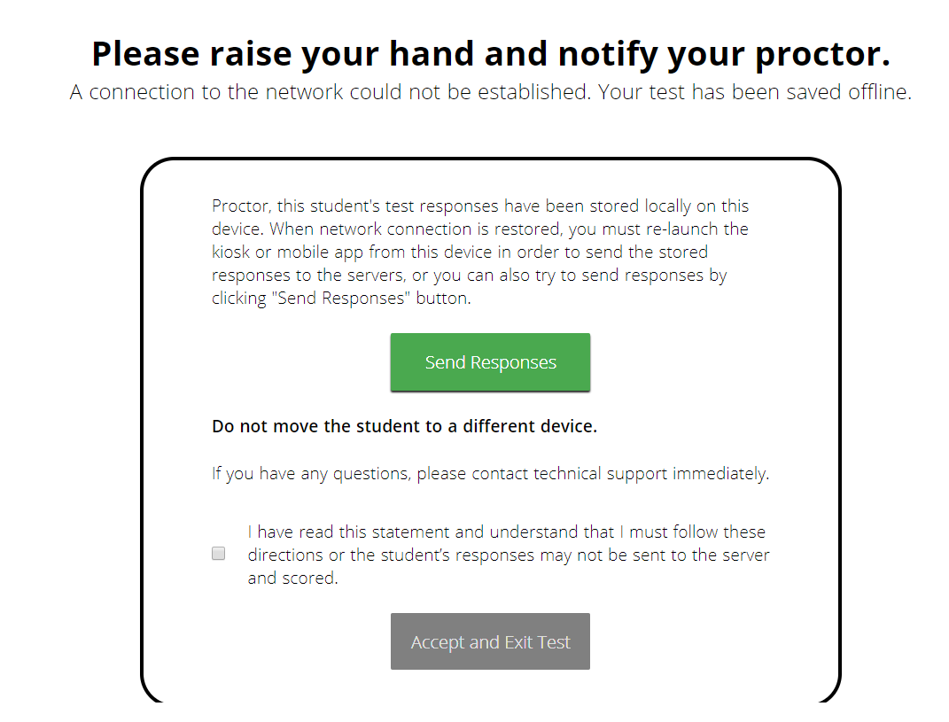
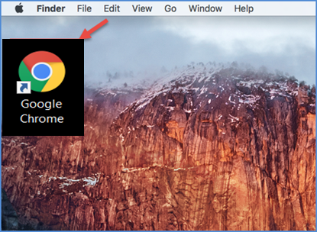
Browser & Kiosk Test Integrity
What if a student finishes a test but has no network connection?
A
C
A
B
C
D
B
C
D
A
B
C
D
A
B
C
D
A
B
D
Turn In
A
C
C
A
B
D
D
B
C
A
B
C
D
A
B
C
D
A
B
D

Slide 48
Browser & Kiosk Test Integrity
Loss of Network Connectivity Procedure Summary
If a student loses network connectivity in the middle of a test:
Keep testing on that device
Test content and responses are stored securely on the test device, either in the browser cache or the stored response folder
Responses will be sent when network is restored
If student finishes and is ready to turn in test prior to network being restored:
Allow student to turn in test
Student will see offline message, acknowledge offline message and exit
Student will be taken back to login page or receive no internet connection message
Restore network
Return to that exact device and relaunch the browser or relaunch the kiosk
(student can log-in to confirm session is done (session button will be greyed out)
If you are unsure of the status of the student responses, call the help desk

Slide 49
Additional Training Resources
Help Guides
Browser Testing User Guide
Kiosk Installation Guide
Portal User Guide
Kiosk User Guide
Testing with Third Party Accessibility Software
Tutorial Videos
https://bie.onlinehelp.cognia.org/
Support Desk
Call-in Information Sheet

Slide 50
Remember
ITCs:
Students can take the BIE Science Benchmark using a browser.
If using Kiosks, they do need to be downloaded, and apps installed.
Make sure network management tools don’t delete stored response folder.
Communicate with Proctors/Test Administrators
Are there limits to number of students who should log in simultaneously?
Do they know the procedure for recovering stored responses?
Do they have basic information required by the support center if they call in?

Slide 51
Questions?

Slide 52
Cognia Help & Support Page

Slide 53
Help & Support Site General Education Science Page
A page specifically dedicated to BIE Science Summative Assessment
https://bie.onlinehelp.cognia.org/science/
Key Dates
Testing Accommodations
Online System Tutorials
Practice Tests
Paper (PBT)
Online (CBT)
Resources
Training
Manuals, Online User Guides, Quickstart Guides, Technical Report. Reporting Resources, Forms, Score Interpretation Guides, etc.
Webinars Recordings and Slides
Quick video tutorials explaining specific tasks
Paper based testing braille, large print, & human reader kits special instructions sheets
High level important dates for 2024-25SY
Online based testing universal tools, accessibility features & accommodations chart

Slide 54
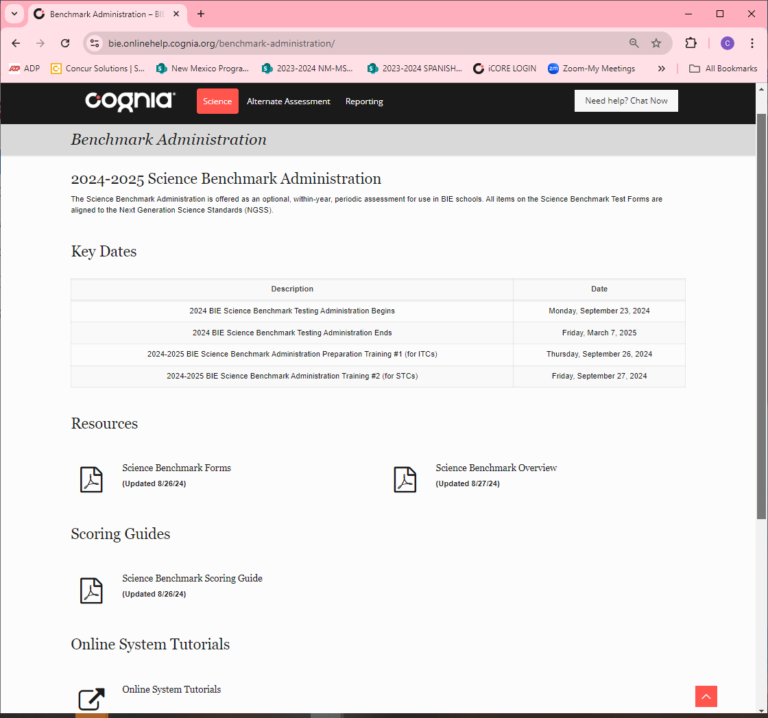
Help & Support Site Science Benchmark Page
A page specifically dedicated to Science Benchmark Administration:
https://bie.onlinehelp.cognia.org/benchmark-administration/
Key Dates
Scoring Guides
Online System Tutorials

Slide 55
BIE Science Help Desk
Hours
Monday–Friday from 9:00 a.m.–6:00 p.m. (ET)
Contact information
Phone: 800-887-7027
Email: BIETechSupport@cognia.org
Live Chat Link (available from the Help & Support site)

Slide 56
Thank you!

Slide 57
Knowledge is Opportunity
Cognia is a global nonprofit that has the knowledge to help schools improve outcomes for all learners.

