Slide 1
Welcome!
The training will begin shortly

Slide 2
BIE Science Benchmark – STCs, TAs
September 27, 2024

Slide 3
Housekeeping
All participants should remain on mute with their video off.
Post all questions to the chat. Questions will be addressed at each section break.
Please add your name, email, and school to the chat.
This training will be recorded.
The recording will be posted to the Help & Support page, https://bie.onlinehelp.cognia.org/training.

Slide 4
Welcome & Introductions

Slide 5
Bureau of Indian Education (BIE)
Aurelia Shorty, Education Program Specialist, Project Manager for Science
Carmelia Becenti, Chief Academic Officer
Donald Griffin, Section 504 Program Coordinator, Project Manager for MSAA

Slide 6
Cognia
Mara Allaire, Program Manager
Sarah McCain, IT Project Manager II

Slide 7
eMetric
Aarti Jagtap, Project Manager III
Kaelee Harper, Senior Support Center Manager

Slide 8
Bureau of Indian Education Science Assessment Fall 2024 STC & TA Training
Aarti Jagtap, eMetric
Kaelee Harper, eMetric

Slide 9
Agenda
Benchmark Assessments Overview
Key Dates
Overview of system and testing process
School Test Coordinator tasks (STC)
Managing students and accommodations
Test Administrator (Teacher) or STC tasks
Creating classes
Creating test sessions
Monitoring and completing testing
Scoring tests
Viewing results
Students
Tools and accommodations
Launching the testing kiosk application and logging in
Navigating through the test and turning-in the test
Technology considerations
Additional training resources
Questions

Slide 10
Science Benchmark Overview

Slide 11
Overview
Three grade levels – elementary school, middle school, high school
Elementary School: grade 4, grade 5
Middle School: grades 6-8
High School: grades 9-12
8 forms per grade level
Each form covers different content/standards
For available forms indicating their content topic/focus, and tested Performance Expectations (PEs), visit https://bie.onlinehelp.cognia.org/benchmark-administration/ on the BIE Science Help & Support site
12–14 items per form
10–12 selected response
2 open-ended response
Aligned to Next Generation Science Standards (NGSS)
Administer based on curriculum and pacing

Slide 12
Format
Available through eMetric Portal
Online
Students assess in kiosk or browser
Paper
PDFs available for download from portal STC’s administration home page, https://bie.Cognia.org
https://bie.cognia.org/

Slide 13
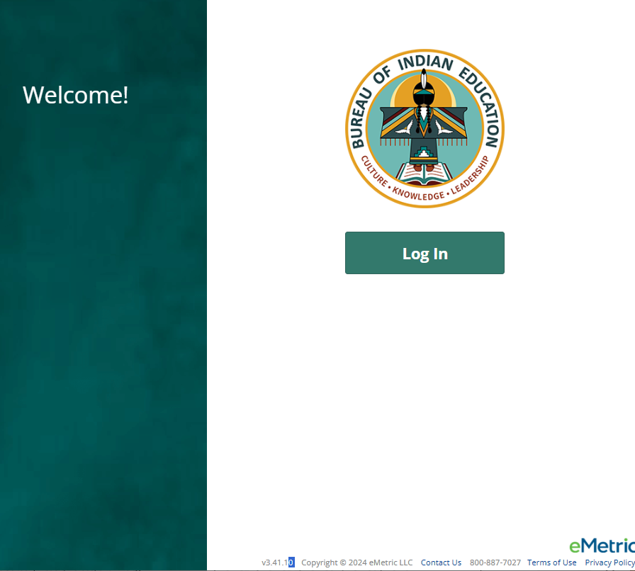
Downloading the PBT forms from the Portal
Log in to the Portal
From the Homepage, select the Administration icon
There you will see the links for downloading the paper-based test forms by grade level
You must download G5, Grade 4 forms are named as Grade 5, Forms 5,6,7,8…Middle School and High School tests separately
Elementary School (Grades 4, 5)
Middle School (Grades 6-8)
High School (Grades 9-12)
Notes:
Note/Reminder: remind participants that if they take the paper version, no reporting will be available in Data Interaction; therefore, they should keep track of those testers and scores on their own.

Slide 14
Science Benchmark Key Dates

Slide 15
Key Dates
Test Preparation Key Dates
Practice test live (summative) | All year
Student Roster Upload by BIE (only 5th, 8th, 11th grade students, field can manually add off –grade students as desired) | August 21, 2024
Portal Open & Kiosks available for download | Sep 9, 2024
Tests available for scheduling in Portal | Sep 23, 2024
Science Benchmark Test window opens | Sep 23, 2024
Online Test Registration Window (after second pre-ID upload for summative) | Dec 9, 2024-Jan 14, 2025
Science Benchmark Test window closes | Mar 7, 2025

Slide 16
Science Benchmark Overview of System and Testing Process

Slide 17
Benchmark Assessment
Same portal used for spring BIE Summative Science assessment administration (https://bie.cognia.org)
Portal provides access to Cognia assessments reporting (MSAA and GenEd Science)
You will use the same account that was used for Spring BIE Summative Science
Same student records will be used for Benchmark and Spring BIE Summative Science
Summative | Benchmark
School Test Coordinators (STC) manage testing | Teachers (TA) can manage testing using TA account
Students must use kiosk to access test | Students can access tests using a web browser or kiosk
Session access codes and proctor passwords are used | Session access codes and proctor passwords are NOT used
Machine or professionally scored tests with later reporting | Teachers score human scored (open-ended) items and receive near-real-time results

Slide 18
BIE Science Assessment Online System
Online System
Administration and Reporting Portal
https://bie.cognia.org
Users
Administration
Test Delivery
Student Test Interface
Kiosk
Site Setup
Students
Browser
Reporting
Classes
Test Sessions
Scoring
Enrollment Transfer

Slide 19
Test Preparation Process
STC
Create user accounts
Add/edit/transfer students
Assign accessibility features & accommodations
ITC
Download and install kiosks/apps
Complete Site Readiness Test
STC or TA
Create classes
Schedule classes for test
Print/distribute log-in tickets
Students
Launch kiosk or browser
Log-in and test
TA
Score human scored items on tests
View results in Data Interaction
After testing…

Slide 20
Portal Access
Access
http://bie.cognia.org
Open all year, previous accounts can be used this year
If you are a new School Test Coordinator, please contact BIE. Upon account creation, a welcome email will be sent from the portal.
STCs will create all new portal user accounts
Usernames must be unique
Your email address controls your account
New users will receive two automated emails, one with username and one with temporary password from bietechsupport@cognia.org
When an account is deactivated or reactivated, the user will receive an email
STCs should periodically audit and deactivate used accounts

Slide 21
User Roles
User Role | Responsibilities
School Test Coordinator (STC) | Manage Users (add, edit, or deactivate) Access proctor password Edit student information & assign student accommodations Create, edit, and delete classes Schedule test sessions & print logins Manage & monitor test sessions Assign test report code Prepare IT network for student testing if there is no IT Coordinator
IT Coordinator (ITC) | Prepare IT network for student testing Conduct Site Readiness testing
Test Administrator (TA) | Create classes Create test sessions View their students and test sessions Print student login tickets for their test sessions Manage & monitor test sessions Assign test report codes Score human scored items for Benchmark tests View Benchmark results in Data Interaction
Report Access Only (RAO) | View Reports

Slide 22
Test Administrator Permissions
A TA can add any student in their school to their class
A TA can only view the student record for any student in one of their classes
A TA cannot edit the student record
A TA can view, edit or delete any class to which they have been designated the TA
A TA can schedule their class to any program that that have access to
Programs: BIE Science Benchmark, BIE Science Assessment
A TA can view, edit or delete a test session if they are the TA for the class in the test session and they have access to the program (BIE Science Benchmark and/or BIE Science Assessment)
Only a TA can Score the human-scored items
A TA can view Benchmark test results in Reporting for any class they are assigned to

Slide 23
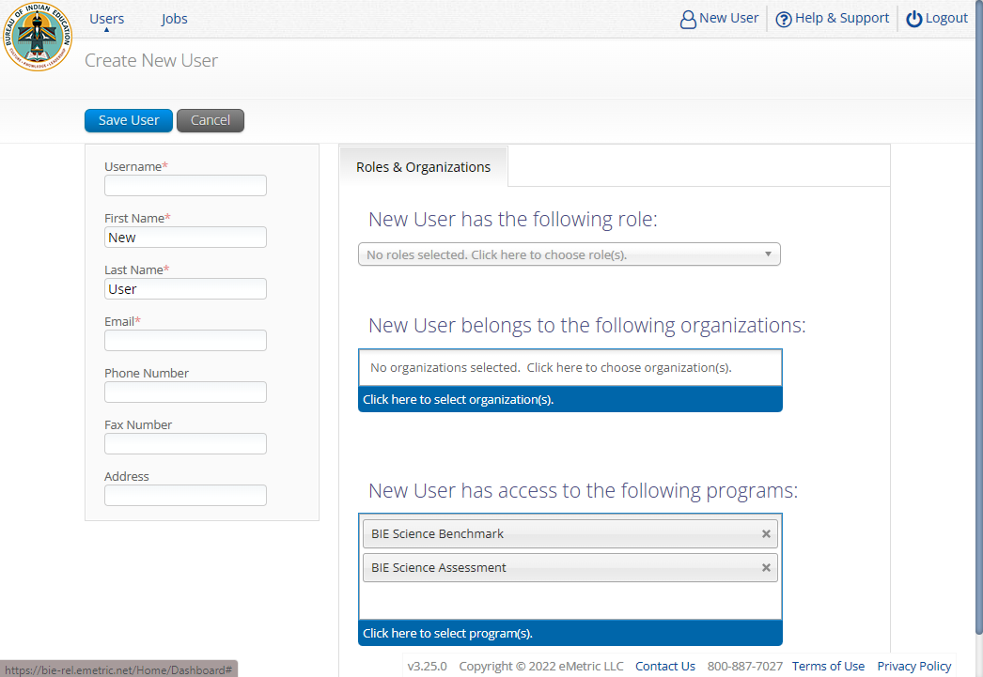
Program Access

Slide 24
Portal Log-in
Portal URL: https://bie.cognia.org/

Slide 25
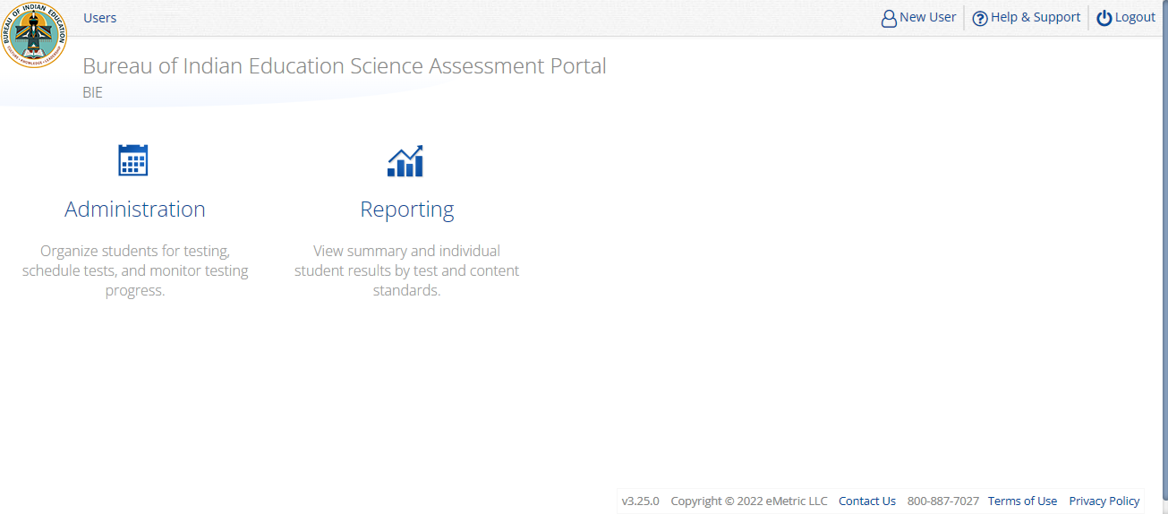
Portal Main Page (STC View)
1
2
3
4
5
Icon | Description
1 | BIE logo returns to portal home page
2 | Access User Management
3 | View & Edit user profile
4 | Access the BIE Help & Support Site
5 | Logout of the portal
6 | Access Administration Component
7 | Access Reporting
6
7

Slide 26
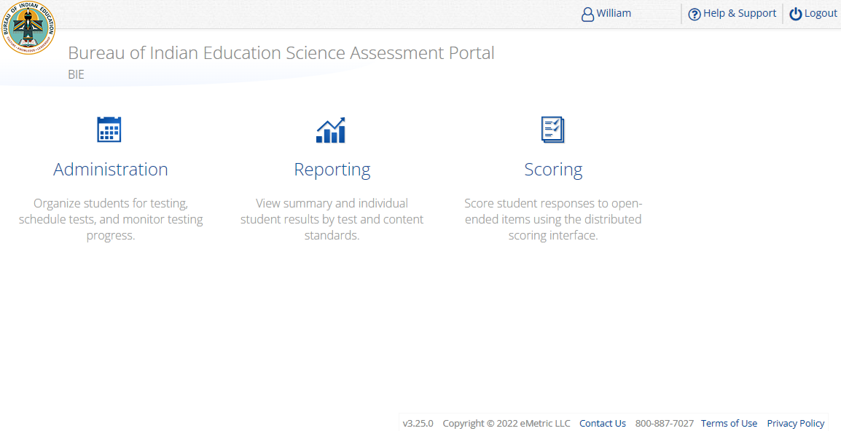
Portal Main Page (TA view)
1
2
3
4
Icon | Description
1 | BIE logo returns to portal home page
2 | View & Edit user profile
3 | Access the BIE Help & Support Site
4 | Logout of the portal
5 | Access Administration Component
6 | Access Reporting
7 | Access Scoring – TA user role ONLY!
TA Only!
5
6
7

Slide 27
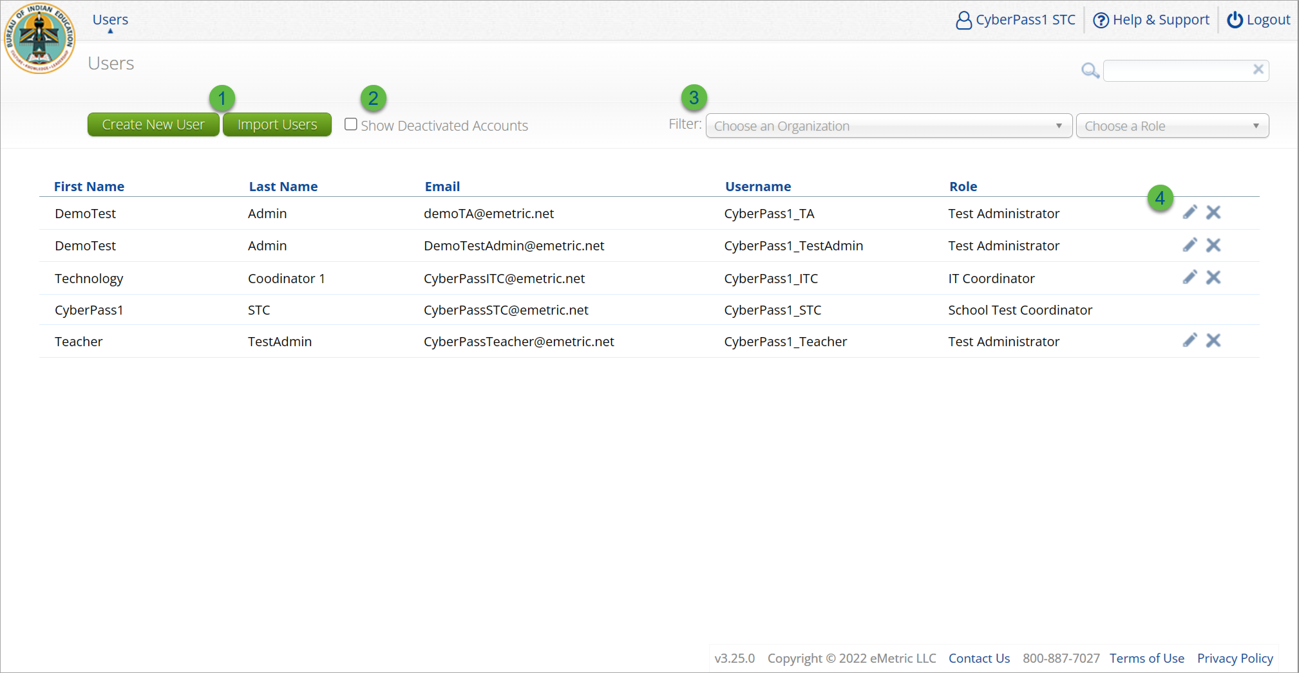
User Management
Icon | Description
1 | Add new user accounts one by one or by file upload
2 | User management table changes to deactivated user accounts
3 | Filter the user management table by school or role
4 | Edit or deactivate a user account

Slide 28
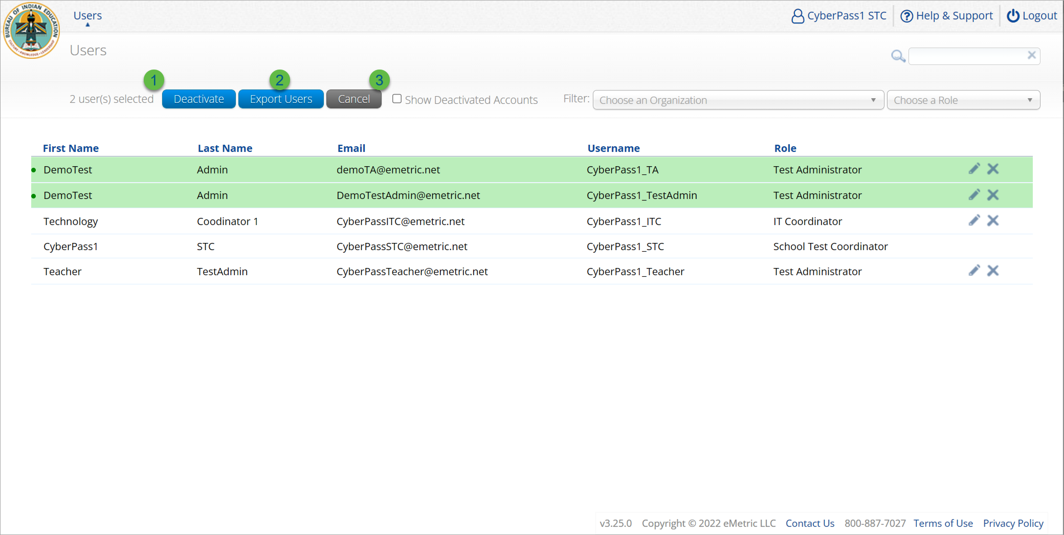
User Management
Icon | Description
1 | Deactivate selected user accounts in bulk
2 | Export selected user accounts
3 | Cancel clears the selection of the highlighted user account

Slide 29
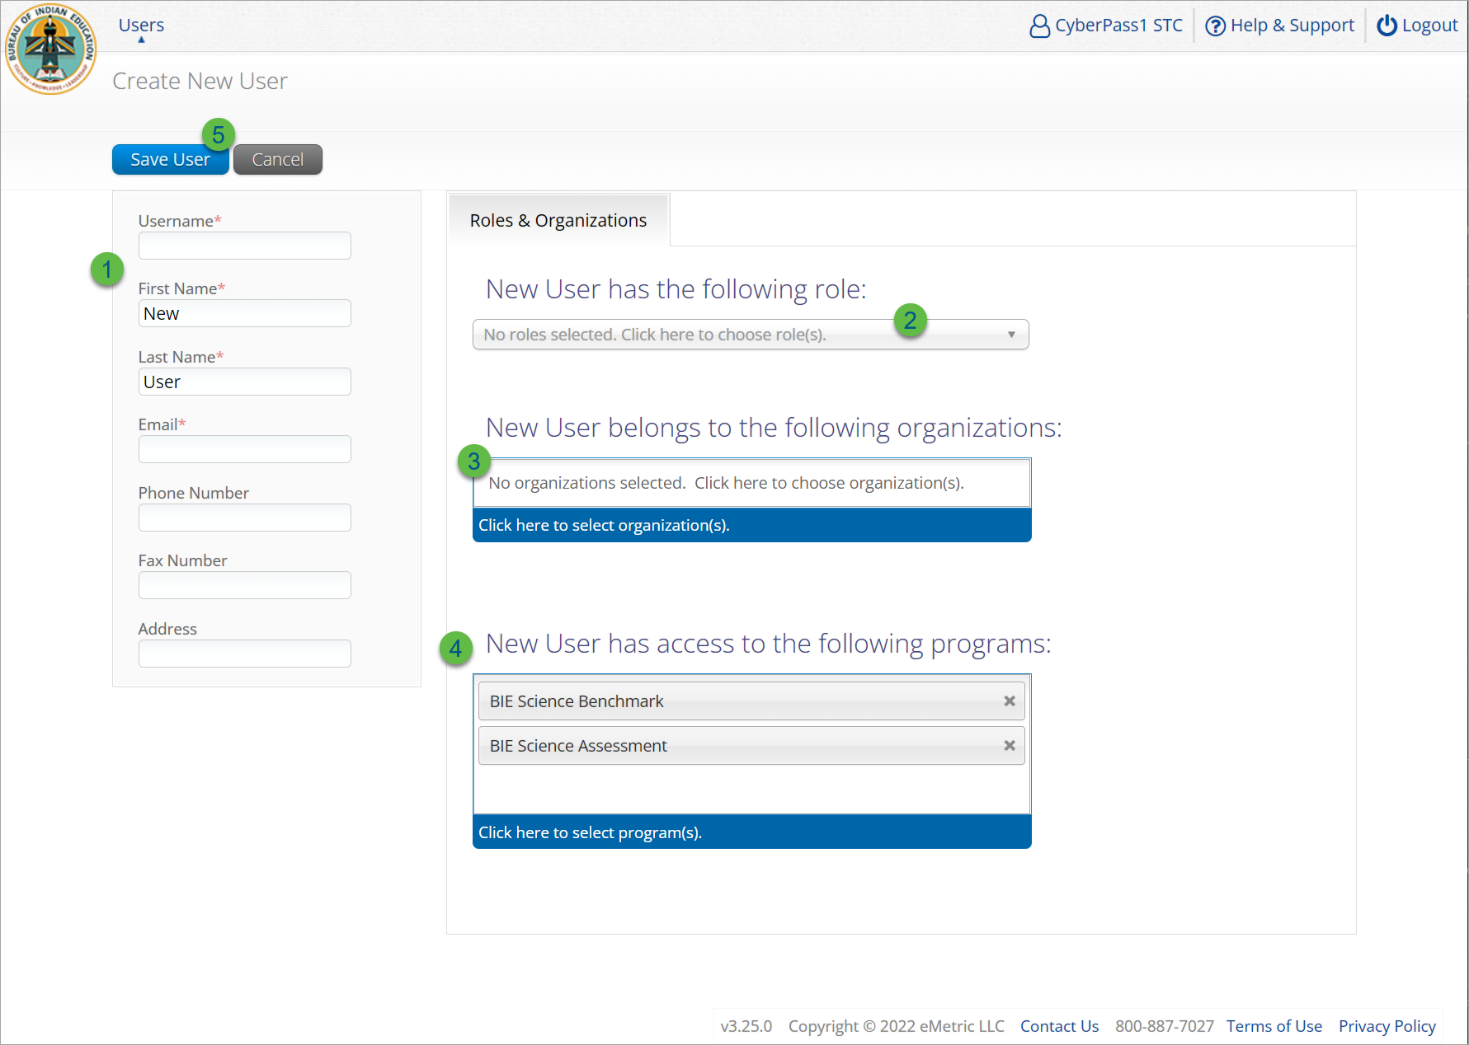
Create New User
Step | Description
1 | Populate the required information for the user account; username, first & last name, and valid email address.
2 | Select the role for the user account from the drop-down.
3 | Select the school for the user account.
4 | The program for the user account is set by default to BIE Science Benchmark and BIE Science Assessment.
5 | Click Save User, this action creates the user account and emails account information to new user.

Slide 30
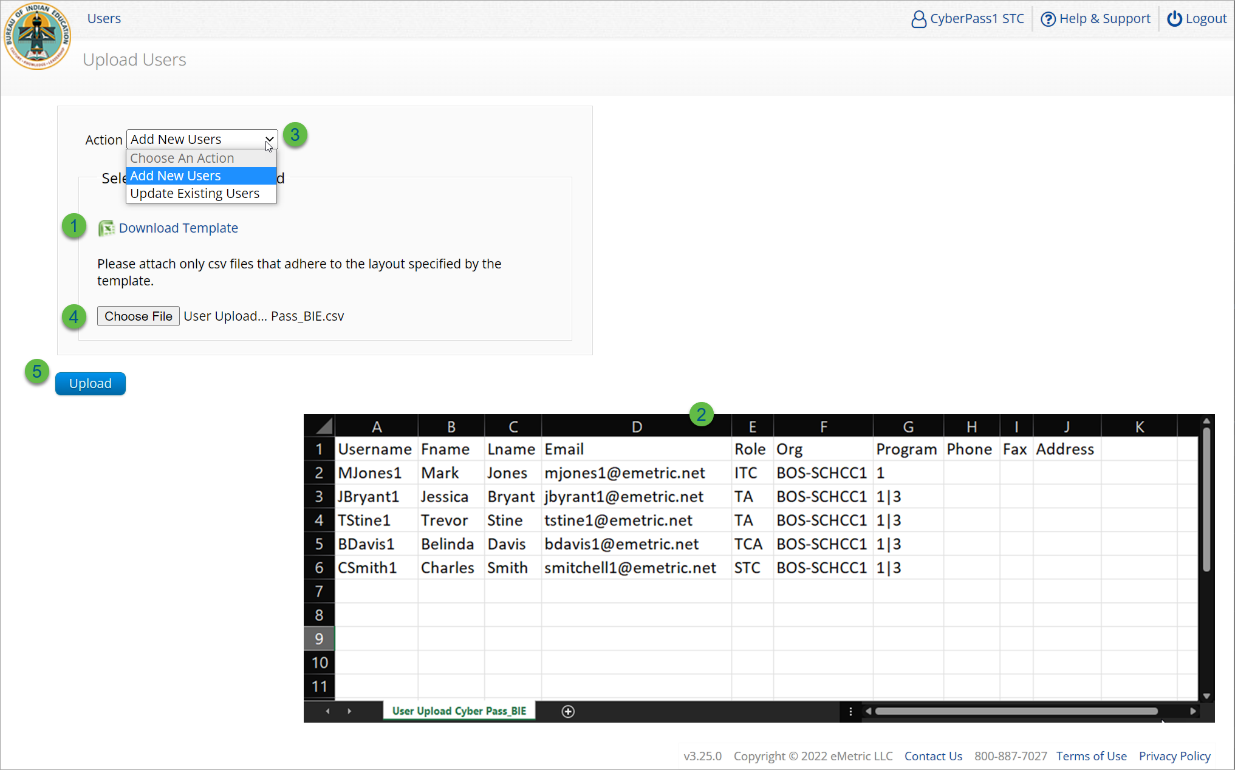
Import Users
Step | Description
1 | Download the User Upload template.
2 | Populate the upload template with valid values, the first six fields are required, and the file limit is 30 users.
3 | Select the action, add new users or update existing users.
4 | Choose the user upload file from your device.
5 | Click Upload, you will receive immediate results on accounts created and if any records have errors.
Program 1 = BIE Science Assessment
Program 3 = BIE Science Benchmark

Slide 31
Portal Main Page (STC View)

Slide 32
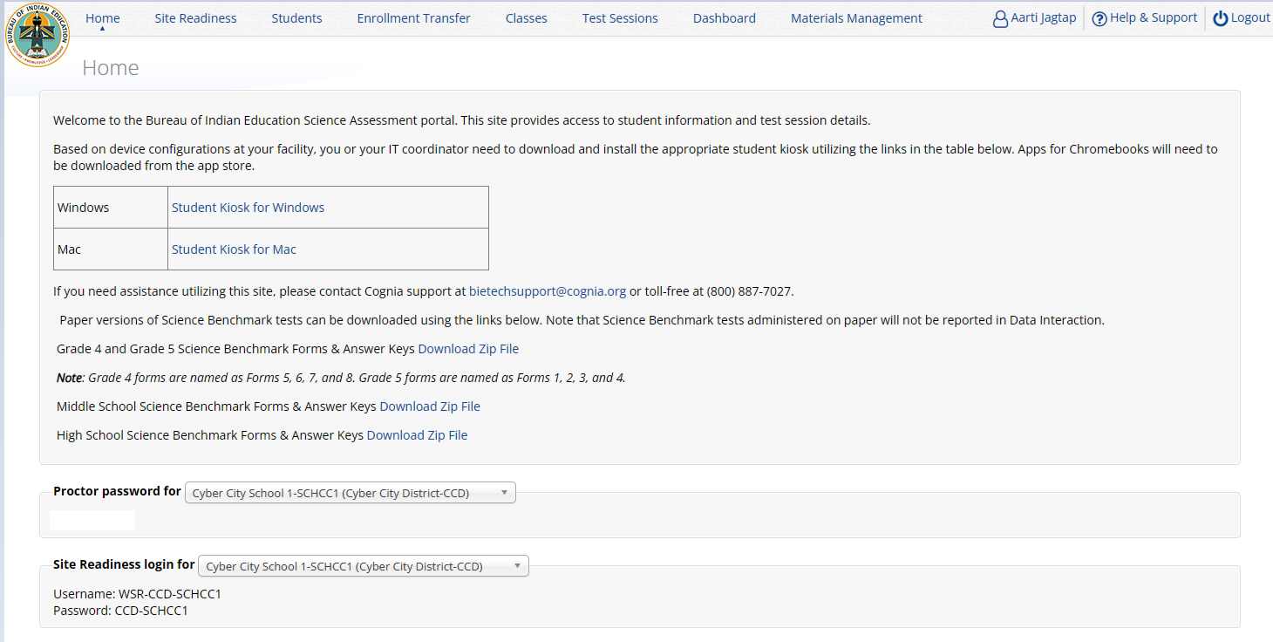
Administration Component (STC view)
1
2
Icon | Description
1 | BIE logo returns to portal home page
2 | Test Administration Menus
3 | Windows and Mac Kiosk Application Installers
4 | Science Benchmark paper test downloads
5 | Proctor Password Log-in
6 | Site Readiness Log-in
3
4
5
6

Slide 33
Administration Workflow
Students
Classes
Site Readiness
Test Sessions
Score and Report
Home
STC: update roster and student information, assign accommodations and accessibility features
STC or TA: make Benchmark classes and test sessions
TA: score tests
STC and TA: view reports
Notes:
The next component of the BIE Science Portal that we are going to go over is the Administration component.
The Administration component consists of 5-6 tabs depending on your account type.
Home – this is where you can view important announcements, access links for downloading the Kiosks, and attain the Proctor Password and Site Readiness log in credentials.
Site Readiness – this is where you can certify your site as ready for testing.
Students – this is where you can assign student accommodations.
Classes – this is where you can verify your rosters for testing.
Test Sessions – this is where you will schedule your classes for test sessions.
And, the Dashboard – this is where you can view helpful charts and data at the district level.

Slide 34
Managing Students
BIE roster loaded August 21, 2024
Grades 5, 8 and 11 only
Add students in other middle school or high school grades manually
View your current students in the student’s tab
Update rosters
STCs may request student transfer for students enrolled in other schools at any time
STCs may unenroll students from school at any time
STCs can add student individually at any time
Check/update individual student records
Demographic data
Add/remove accommodations and access to accessibility features

Slide 35
Managing Students: Tips & Update
Tips:
State Student ID = NASIS ID
In student’s tab: Download roster in csv at any time by selecting “Export Roster” under the “Exports” drop down (contains name, NASIS ID and Grade)
Can’t add student? They may be enrolled in different school – initiate transfer request
Cognia Customer Care desk can assist with student transfers
NEW!
This year BIE will be doing a second supplemental student import closer to the summative admin window to add any missing students in Grades 5, 8, & 11.
Following this second student upload to the Portal, schools will have a window (12/9/24-1/14/25) to review student rosters and identify their paper testers (test mode in student profile).

Slide 36
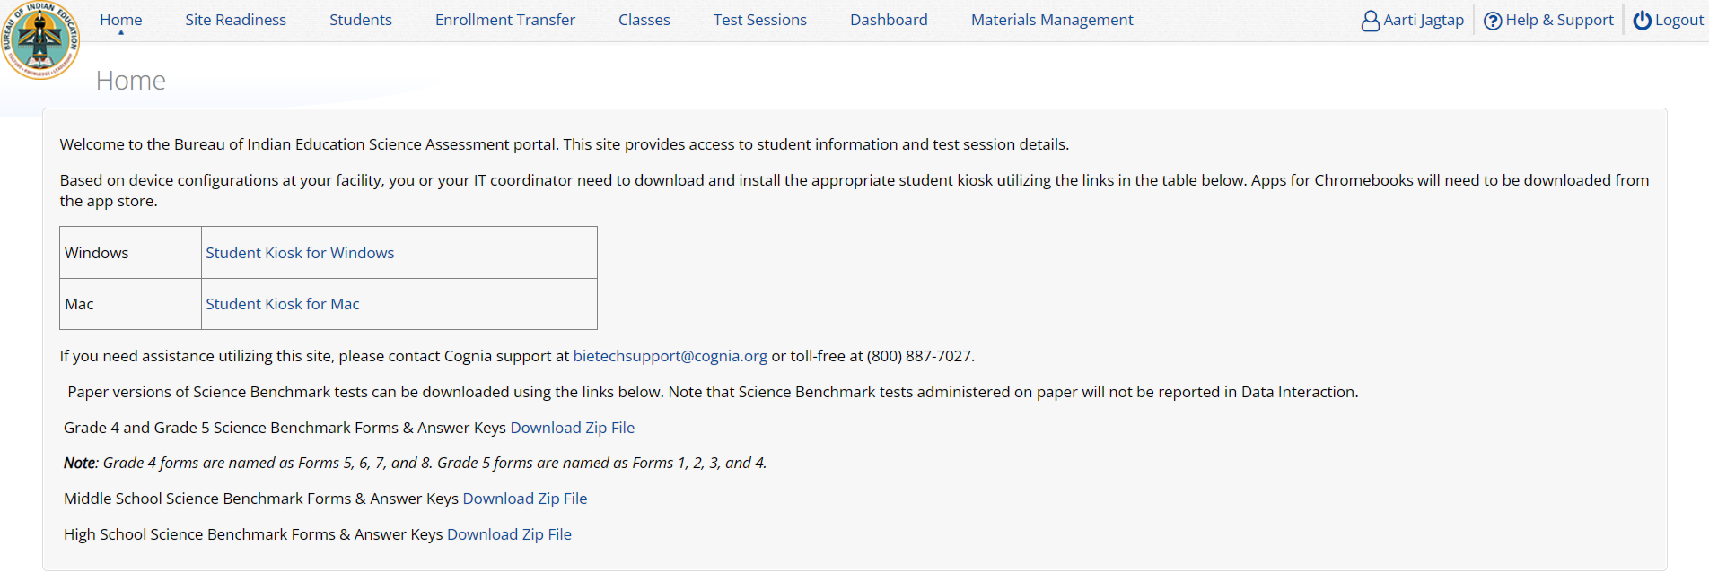
Managing Students

Slide 37
Managing Students
Icon | Description
1 | school selector
2 | search and sort
3 | view classes
4 | view test sessions
5 | unenroll student
6 | add new student
7 | bulk upload accommodations
8 | export list of students
9 | edit a student record
6
7
1
8
2
3
4
5
9

Slide 38
Unenroll Student

Slide 39
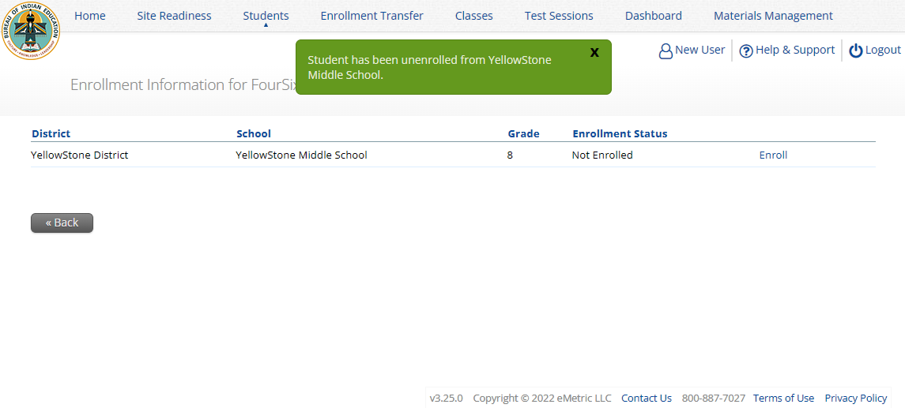
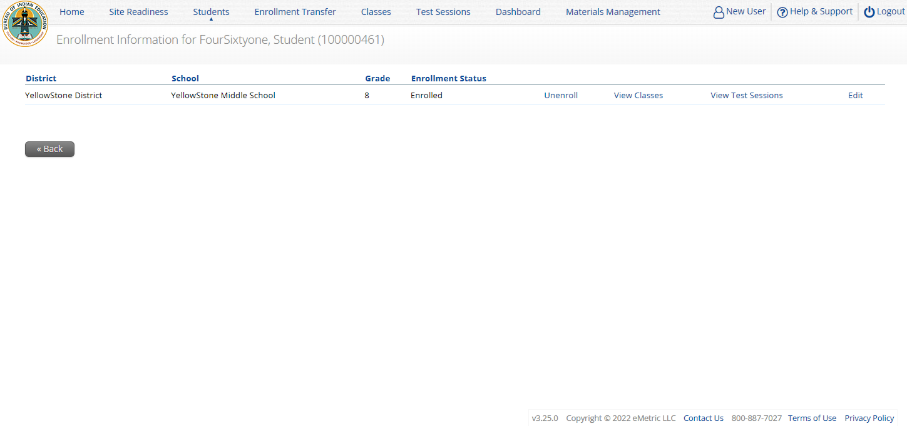
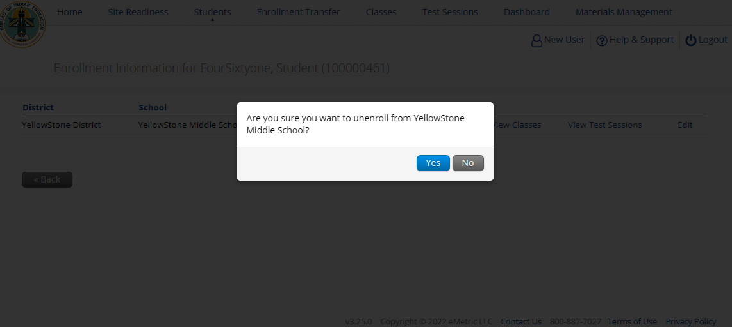
Unenroll Student

Slide 40
Unenroll Student

Slide 41
Student Transfer Request
Request to move student from another school into your school
Approve or reject requests to move students out of your school
Receive notification of requests by e-mail and in portal
If a student is unenrolled, the help desk will approve the requests
Test sessions do not transfer with the student!

Slide 42
Student Transfer Request
Status:
Pending
Canceled
Approved
Rejected
Your requests
Requests sent to you from other organizations

Slide 43
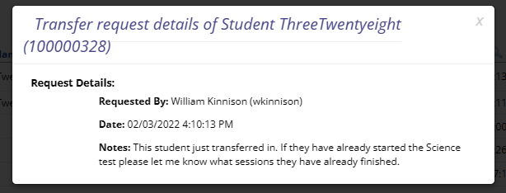
Student Transfer Request
Test sessions do not transfer with the student!
John Smith (JSmithSTC)

Slide 44
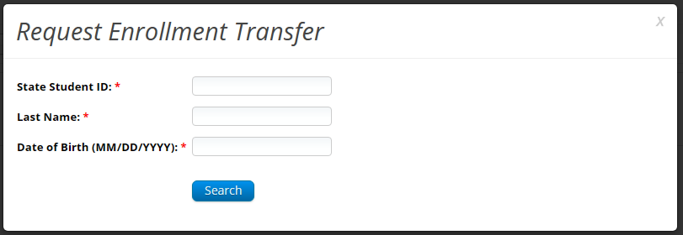
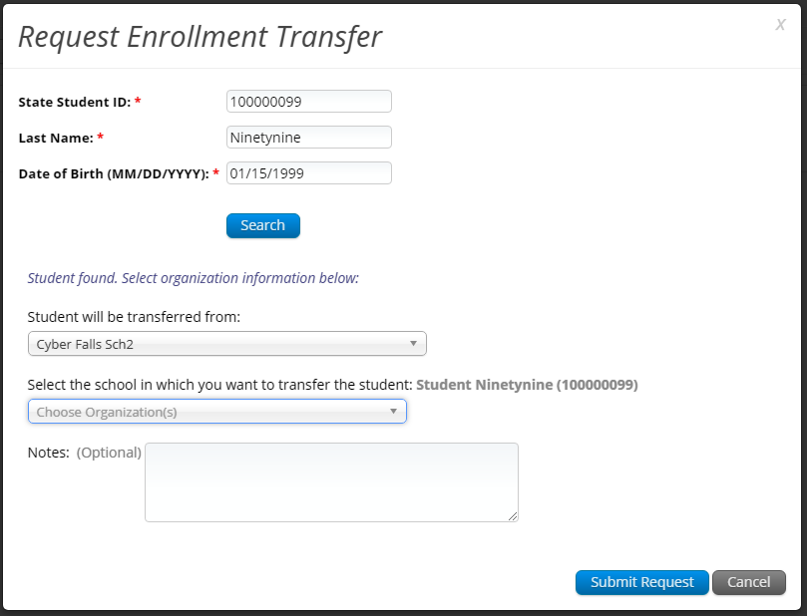
Student Transfer Request

Slide 45
Student Transfer Request
Enrollment request - requestor’s view
Enrollment request - receiver’s view

Slide 46
Student Accommodations
Check/edit accommodations
Accommodations not included in BIE roster upload
Edit student accommodations individually or…
Use Upload Accommodations to edit accommodations on multiple student records at one time
Note: will not be available during testing administration hours (7am-9pm)
You can use the Export Accommodations button to download list of all students and their currently assigned accommodations, edit that file and re-upload it using the Upload Accommodations menu

Slide 47
Universal Tools, Accessibility Features, and Accommodations
Universal Tools
(Available to all students)
Platform tools that are built in and automatically delivered during testing
Accessibility Features
(Available to some without IEP/ 504)
Must be pre-identified by DTC/STC prior to testing
Accommodations
(IEP, 504)

Slide 48
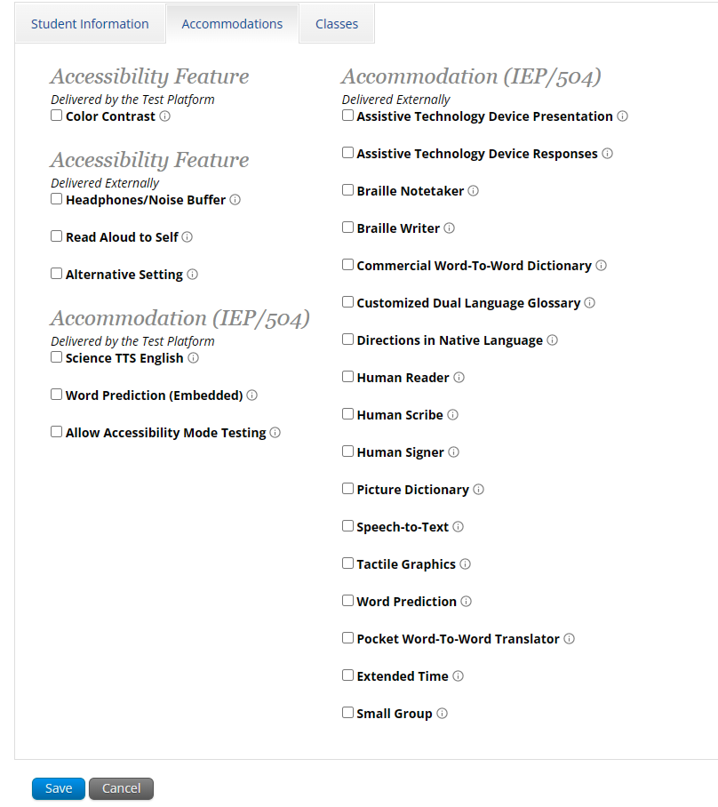
Accessibility Features, and Accommodations
Student will be assigned a TTS-specific form
Student can use CoWriter© word-prediction; an additional file must download which may delay loading test by a minute
Windows only! Proctor must enter proctor password when student logs in to test.
See the “Testing with Third Party Assistive Technology” guide for more information on using the test interface with screen readers, speech-to-text, text-to-speech and other assistive technologies.

Slide 49
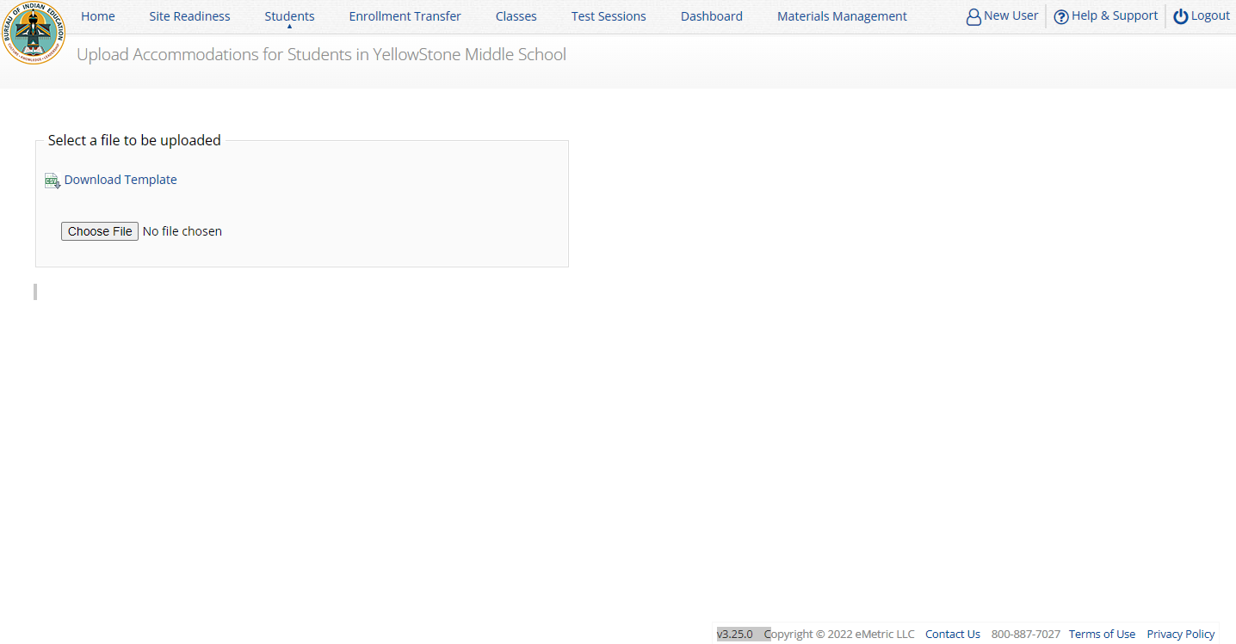
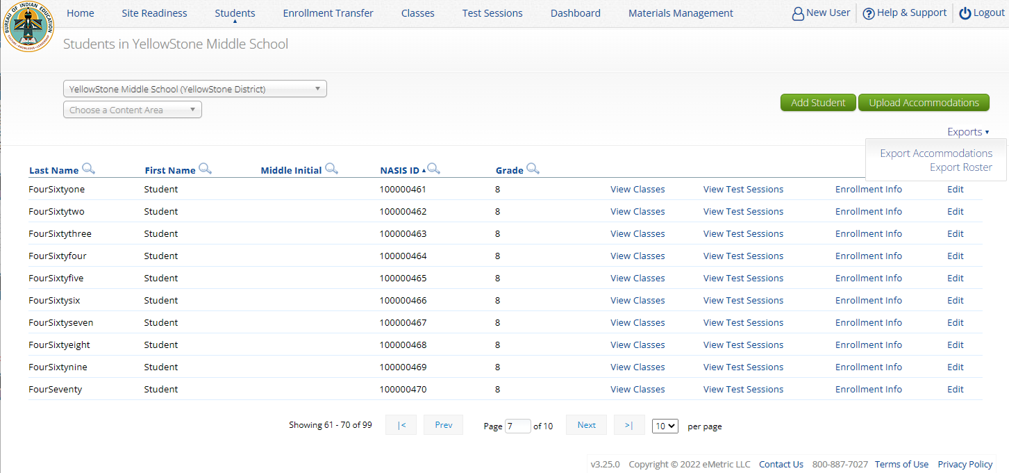
Student Accommodations

Slide 50
Creating Classes
Groups of one or more students who will take a test
Create grade-level classes
Maximum number of student allowed in a class: 100
Class can be deleted if it has not been scheduled for a test
If test session scheduled and no student has logged in, delete test session, then class
Students can be assigned to more than one class
If any student needs to retake the test, you must either:
Create a new class and put the student(s) in that class and schedule that class for a test in a new test session, or…
Create a Test Subgroup (Benchmark Only!)

Slide 51
Creating Classes
STCs or TAs (Teachers) can create classes
Each class must have a TA assigned to the class
STCs can create classes and assign any TA
STCs can view or edit any class in their school
TAs can only assign themselves as TA for the classes they create
TAs can only view the classes if they are assigned as TA
TAs can put any student in the school in their class
Once a student is assigned to the TA’s class the TA can view the student record but cannot edit it.

Slide 52
Creating Classes

Slide 53
Creating Classes
Icon | Description
1 | class name
2 | TA name
3 | grade
4 | search/filter
5 | students in school
6 | students in class
7 | save class
1
TA name and grade will automatically be added to the class name!
3
2
4
5
6
7

Slide 54
Creating Classes

Slide 55
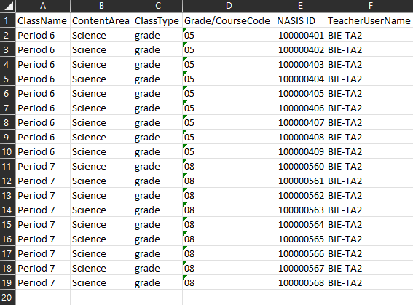
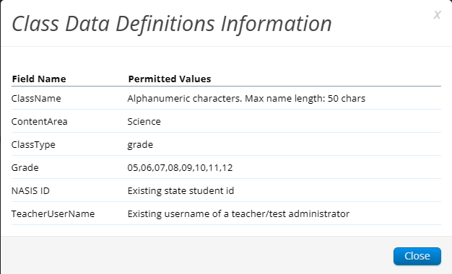
Creating Classes
Save as csv file type
Grade/course code must have leading zero 0 - make field type “text“

Slide 56
Scheduling Test Sessions

Slide 57
Scheduling Test Sessions
Icon | Description
1 | Test
2 | Class
3 | Test Window
4 | Save the test session
1
Class must be same grade level as test
Grade 5 forms are named: Form 1, 2, 3, 4
For Grade 4, please use the PBT forms that are downloadable
Middle School (Grade 6, 7, 8)
High School (Grade 9, 10, 11, 12)
If class has already been scheduled for a test, it cannot be scheduled again and will not show up in the classes list
Test window cannot be edited
2
3
4

Slide 58
Scheduling Test Sessions
STCs or TAs (Teachers) can create test sessions
TA’s must have access to the Benchmark program in their user profile to schedule classes for the Benchmark assessment
STCs can create test sessions for any TA
STCs can view or edit any test sessions in their school
TAs can only create test sessions for their classes
TAs can only view or edit test sessions for their classes

Slide 59
Managing Test Sessions

Slide 60
Managing Test Sessions
Icon | Description
1 | Test session information
2 | Test window status
3 | Students in test session
4 | Student Test Status (Not started, In Progress, Finished)
1
2
4
3

Slide 61
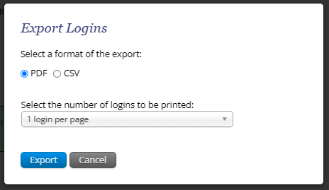
Managing Test Sessions

Slide 62
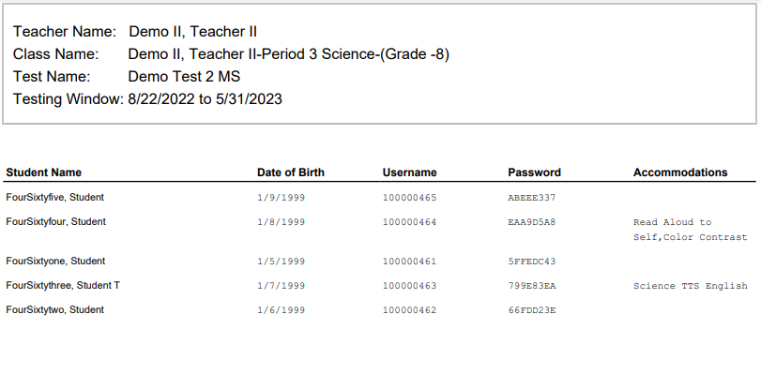
Managing Test Sessions

Slide 63
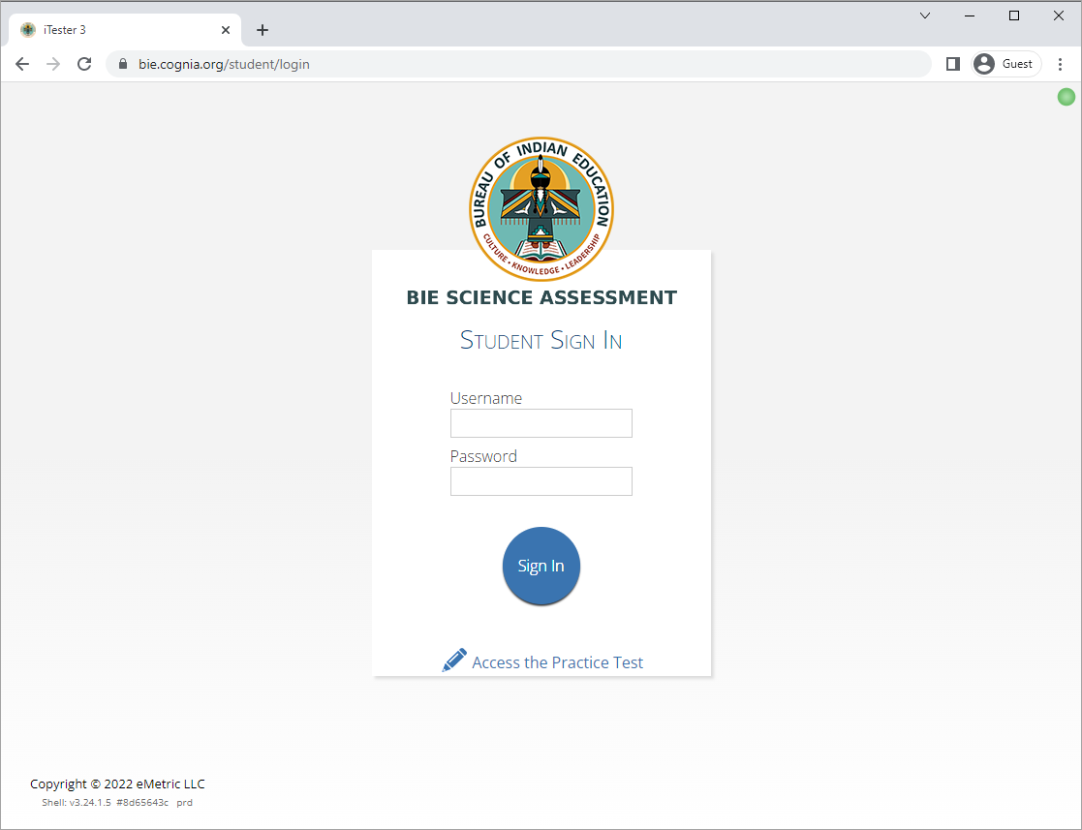
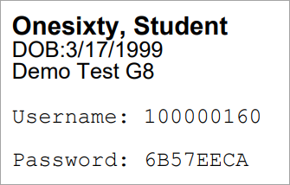
Logging in to a Test
Launch web browser (or Kiosk)
Navigate to https://bie.cognia.org/student
Login using the username and password from the student test ticket

Slide 64
Monitoring Testing
Check student test status for tests “not started” or “in progress”
If test is “not started” or “in progress”, student can log in and finish it anytime during test window if they have log-in information unless the test has been invalidated
Once test in “finished”, student cannot log in to test
The teacher (TA) can re-open any test that was inadvertently turned-in
Use the “Export Test Status” download under “Exports” on the Test Session screen to download a list of student test sessions and their status
Use the “Export Students Not Scheduled” download under “Exports” on the Test Session screen to download a list of students not scheduled for a test

Slide 65
Test Report Codes
For students who cannot complete the test, invalidate using two-step process:
Enter a test report code
Select “invalidate” for each test session to prevent the student form logging in
Test invalidation: not reported in Benchmark science reports
Test report code assigned: student will be listed in report with NO SCORE
Student not started or in progress: will not be reported unless they have test report code assigned in which case they will be reported with no score

Slide 66
Test Report Codes/Re-activating test
Icon | Description
1 | Click on ”Reactivate” to re-open the session; the student can then log in and access the session
2 | Click on the “+” to add a test report code
3 | Click on the “Invalidate” to invalidate the session
Note | Only STCs can re-validate (i.e., undo) an invalidated session
2
1
3

Slide 67
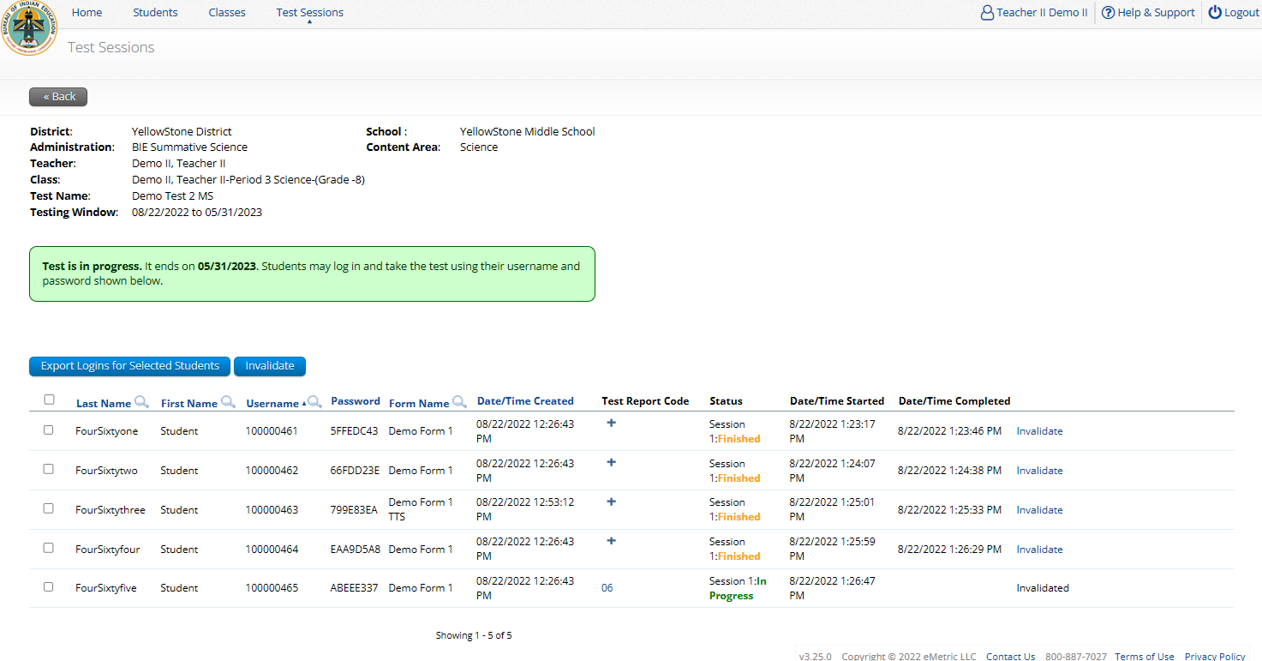
Test Report Codes

Slide 68
Scoring the Test

Slide 69
Scoring the Test
1
Human scored item(s)
Icon | Description
1 | Tests ready to score
2 | Select the test and class
3 | Each response to score is listed in this table
4 | When all items have been scored, submit them from scoring here
2
3
4

Slide 70
Scoring the Test
Icon | Description
1 | Prompt
2 | Student response
3 | Student and item information
4 | Score menu Drop down to choose points Cognia score guide
5 | Submit score or print copy of student response
6 | View item as student would see it in the test
1
3
2
4
5
6

Slide 71
Scoring the Test

Slide 72
Viewing Scores in Reporting
Wait 10-15 Minutes!

Slide 73
Benchmark Reporting
1
Icon | Description
1 | Program
2 | Report type: Student List Data Analysis
3 | School
4 | Test
2
4
3

Slide 74
Benchmark Reporting (STC View)
1. Student’s total points earned in test
4. Each MC item in the test with student’s response
2. Maximum number of points in test
5. Open ended item and points awarded
3. Student’s percent correct for test
1
2
3
5
4

Slide 75
Benchmark Reporting (STC View)
Switch between Roster (“Student List”) and ISR
3
2
1
4
1 - Select student’s last name to view Individual Student Report (ISR)
2 - Click on Score for data summary options
3 – Hover over Item for item standards. Click on Item to see the summary statistics (response analysis) and item preview.
4 - Select item response (letters in color) to view item and student’s response. The color of the response is determined as follows: black = correct response, red = incorrect response, pink = partially correct response.

Slide 76
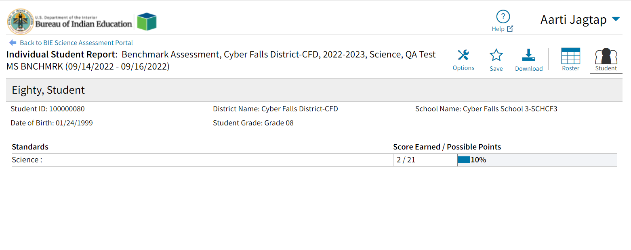
Benchmark Reporting

Slide 77
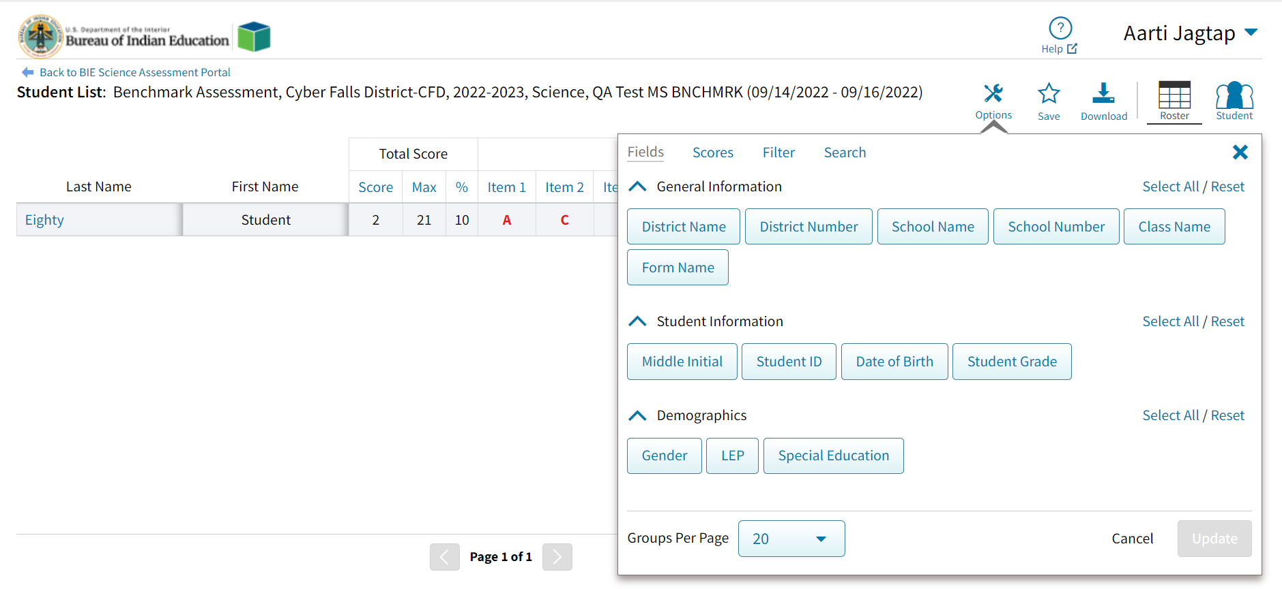
Benchmark Reporting

Slide 78
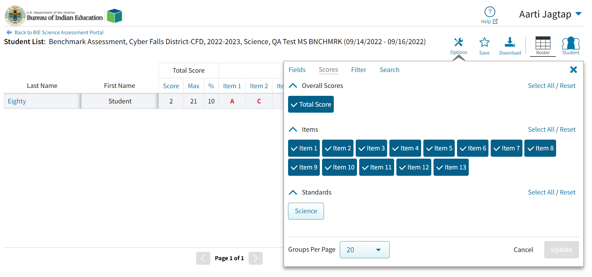
Benchmark Reporting

Slide 79
Benchmark Reporting

Slide 80
Benchmark Reporting

Slide 81
Benchmark Reporting

Slide 82
Using Benchmark Student Results

Slide 83
Using Benchmark Data
Supporting Instruction
How does performance on this assessment compare to performance on classroom assessments?
Look at means, range of scores – overall level of understanding for the class? for specific students?
Look at performance across the assessed standards – patterns in SEPs, DCIs, CCCs?
Particular items that most students got right, most students got wrong – patterns in item type, complexity, standard?
Are there core ideas and practices that I want to emphasize and/or incorporate in my next unit of instruction to support mastery?
Notes:
Now that you’ve seen all the kinds of information you can get in DI, we want to give you a few examples of what kinds of things you might think about to interpret your students’ results and consider next steps in instruction, as well as talk about how the benchmark forms have coherence in BIE’s assessment system.
When you look at your benchmark results, one of the first things to consider would be how students’ performance on the benchmark assessment compares to what kind of performance you have been seeing on classroom tests. Is the performance what you would expect?
You could start by looking at the score totals – looking at the summary information about mean and min. and max. scores, as well as looking across your student list and the range of scores you see across your students. How does this compare to what you were expecting? Was classroom assessment performance high and the benchmark results are generally also high?
If the results were not as you expected or at the level of performance you wanted for your students, then you could dig into comparing the standards assessed on the benchmark form and the possible points to see if that emphasis was similar or different than what you had done in your instruction for the unit. Did the benchmark form have more emphasis on certain DCIs or SEPs or CCCs that were not the same as what you had emphasized in teaching? Were there standards included that you did not teach or emphasize because they come up in a different unit for your school’s scope and sequence?
You can also drill into some particular items, either based on your analysis of performance on various standards, or patterns of items that a lot of students got right or got wrong. For example, are scores on the machine-scored items generally good (not a lot of blank, red incorrect, or purple partial) but the scores on the open-ended items are a lot of 0s or 1s? Perhaps students need more practice with written responses. Or if there are three items in the listing that most students got incorrect, when you click on and look at those specific items, maybe they are all 2-part items that require inference or evidence and high order thinking? Or they all involve reading a graph and you may need to have students work on that skill more?
By drilling into score totals and patterns of answers and standards and then looking at the content of some of the items, you can consider if your class seems to have adequate mastery of the standards they’ve just been taught, or if there are certain core ideas and practices or even response types to demonstrate their understanding that you may want to emphasize as you move into your next unit of instruction – and perhaps even if you want to consider some differentiated instruction based on variation in students’ performance.

Slide 84
Using Benchmark Data
Coherence Value with Summative Assessment
Monitor performance on application of learned content
Familiarity with item types on the summative assessment – clusters, open-ended items
EOY
(summative)
Benchmark
Formative
Notes:
In addition to helping monitor student learning throughout the year, the benchmark assessments also have coherence in the system of assessments available for BIE schools.
Standards assessed on the benchmark assessment forms are also eligible to be assessed on the summative assessment. In monitoring progress toward mastery, it is helpful to see if students can apply the core ideas, practices, and crosscutting concepts they have learned to new phenomena and problems that may not be quite as familiar to them – just like they will do on the summative assessment.
And by design, the benchmark assessments contain item types that are used on the summative assessment. The item cluster format and the open-ended item format comprise a large portion of the summative test design. The benchmark forms set up similar expectations between benchmark and summative testing for how students demonstrate their science learning.

Slide 85
Rescoring

Slide 86
Rescoring
You can score student(s) who did not finish after submitting a test for scoring
You can change a student score
You can retest a sub-set of a class’s students
Retesting, rescoring ONLY applies to benchmark assessments

Slide 87
Rescoring

Slide 88
Re-testing in Student Groups

Slide 89
Re-testing with Student Subgroups

Slide 90
Re-testing with Student Subgroups

Slide 91
Re-testing with Student Subgroups

Slide 92
Re-testing with Student Subgroups

Slide 93
Scoring Student Subgroups

Slide 94
Benchmark Reporting
To view test group only:
1. Click on Score
2. Summarize by
3. Class Name
4. Click on number in Population column
5. Select Drill to Roster, Student List

Slide 95
Questions?

Slide 96
Student Test Interface

Slide 97
BIE Science Assessment
BIE Science Assessment Student Test Interface:
Student Test Delivery System

Slide 98
Universal Tools
Name | Tool Icon
Sketch Tool (not available for constructed response items)
Text Highlighter
Note Pad
Line Reader
Answer Eliminator
Reference Sheet
Pop-up Glossary

Slide 99
Universal Tools
Name | Tool Icon
Zoom View (magnifier)
Bookmark
Expand Passage
Answer Masking
Custom Masking
Reverse Contrast

Slide 100
Accessibility Features
Must be pre-identified before testing, but student does not need a legal plan to have accessibility features assigned to them for testing
Name | Tool Icon
Color Contrast

Slide 101
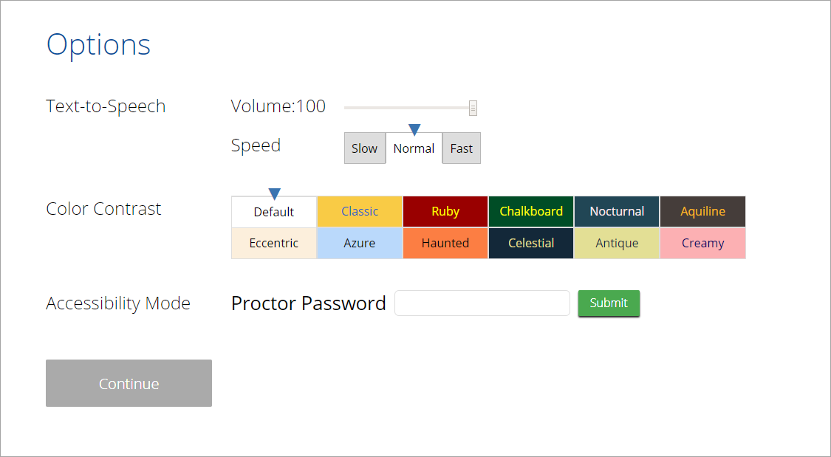
Accommodations
Accommodations
Must be pre-identified before testing and be apart of the students 504/IEP plan
Name | Tool Icon
Science Text-to-Speech
Word Prediction (embedded)
Allow Accessibility Mode Testing

Slide 102
Logging in to a Test
Launch web browser (or Kiosk)
Navigate to https://bie.cognia.org/student
Login using the username and password from the student test ticket

Slide 103
Logging in to a Test

Slide 104
Logging in to a Test

Slide 105
Logging in to a Test

Slide 106
Test Navigation

Slide 107
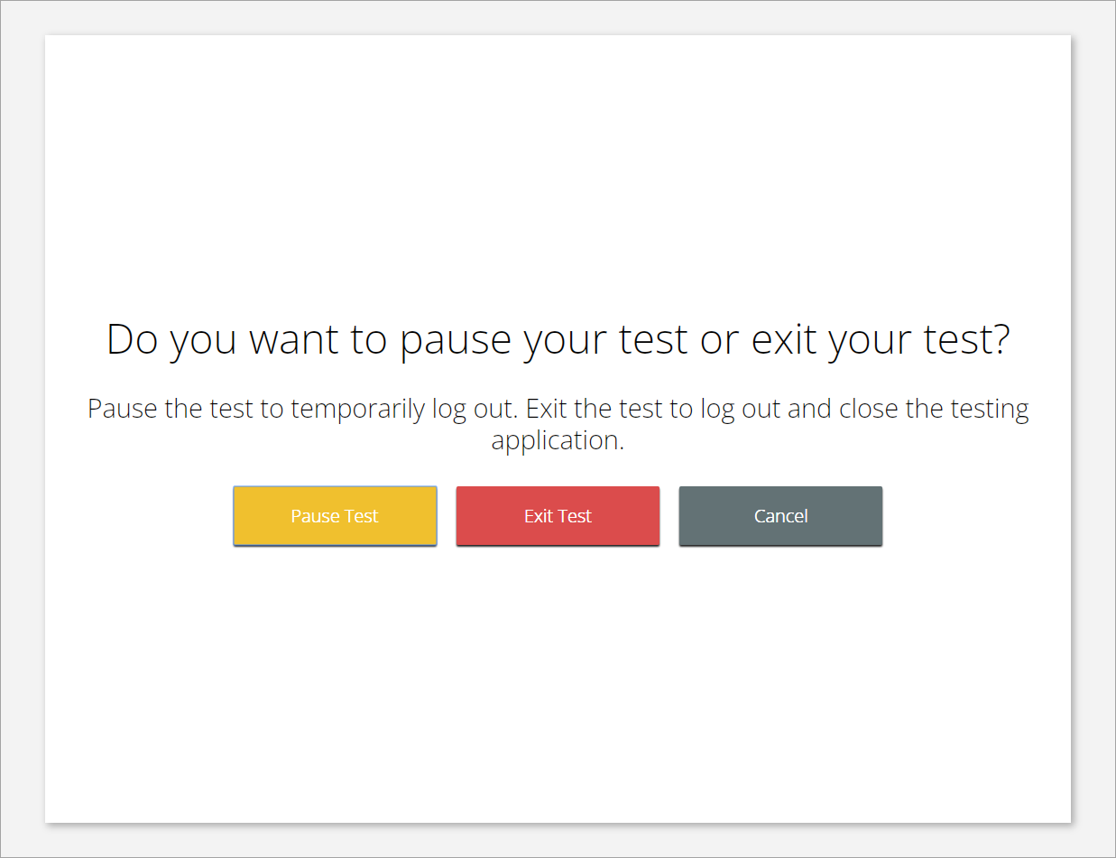
Test Navigation

Slide 108
Test Navigation
Pause and inactivity timeout is 45 min

Slide 109
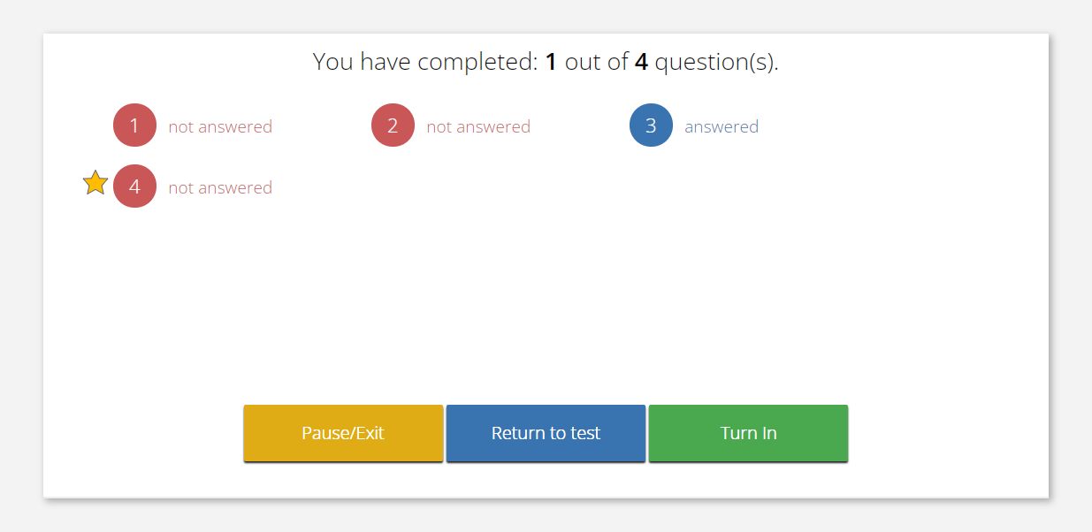
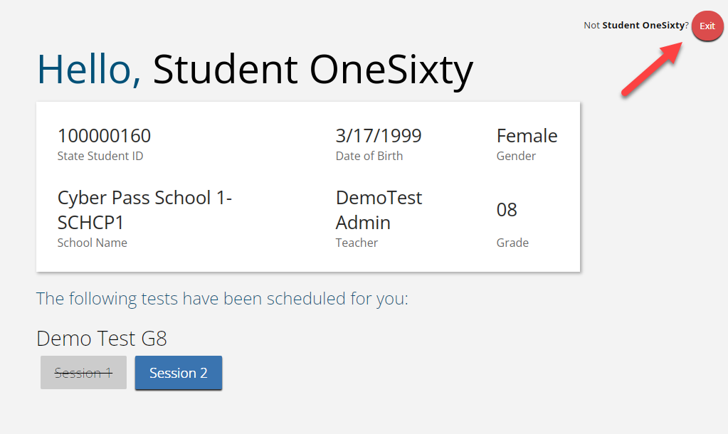
Test Turn In
Steps | Button to Click
On the last item, students click Finish.
On the test review screen, students click Turn In.
Below the confirmation question, students click Turn In.
Student returns to profile page and may select the next section or click Exit to exit the kiosk.

Slide 110
Technology Requirements
Important Reminders
The BIE Science Benchmark Assessment can be taken with a browser or by using the kiosk
Students testing on devices that do not meet the Student Workstation Specifications are likely to encounter performance-related issues during testing.
Technology Guidelines may be updated throughout the test administration window as new operating systems are released and tested.
Do not update your test device OS until the Technology Guidelines have been updated.

Slide 111
Browser Requirements
Do not use browser in private or incognito mode
Do not delete browsing history or browser cache
Notes:
The first step for conducting Site Readiness testing is to download and install the Kiosks and Mobile Apps onto the devices that will be used for testing at your school.
Once you’ve downloaded and installed your Kiosks and Mobile Apps, log in to the Portal to retrieve the site readiness login credentials for your school.
Launch the kiosk or the app and login using the site readiness credentials.
Run the test on a handful of devices for each configuration.
Once you’ve successfully completed your Site Readiness testing, log back into the Portal and navigate to the Site Readiness tab within the Administration component. Here, you can view the details of the devices that you used for Site Readiness testing.
Finally, you’ll certify your site as ready for testing.
Each site has it’s own login credentials for Site Readiness. Each school needs to be certified as ready for testing.

Slide 112
Browser & Kiosk Requirements (network)
Beginning of Test:
Authenticate login
Download test content
End of Test:
1. Submit responses for scoring
Notes:
The first step for conducting Site Readiness testing is to download and install the Kiosks and Mobile Apps onto the devices that will be used for testing at your school.
Once you’ve downloaded and installed your Kiosks and Mobile Apps, log in to the Portal to retrieve the site readiness login credentials for your school.
Launch the kiosk or the app and login using the site readiness credentials.
Run the test on a handful of devices for each configuration.
Once you’ve successfully completed your Site Readiness testing, log back into the Portal and navigate to the Site Readiness tab within the Administration component. Here, you can view the details of the devices that you used for Site Readiness testing.
Finally, you’ll certify your site as ready for testing.
Each site has it’s own login credentials for Site Readiness. Each school needs to be certified as ready for testing.

Slide 113
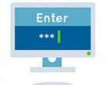
Browser & Kiosk Test Integrity
What happens if a student loses network connection in the middle of a test?
A
C
D
B
45-90sec
A
C
Browser Cache
Stored Response Folder (kiosk)
D
B

Slide 114
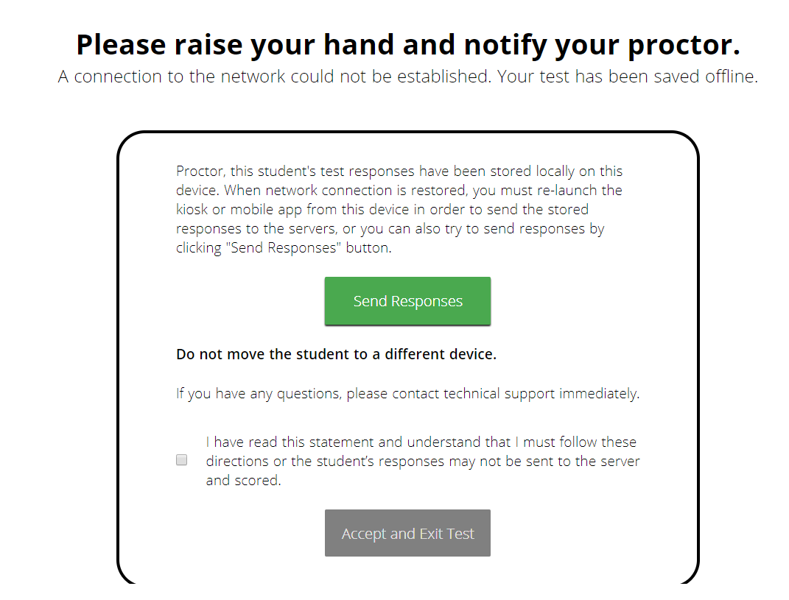
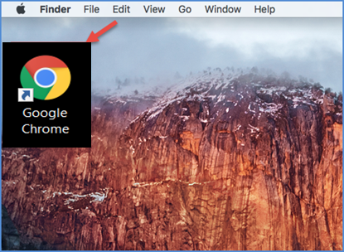
Browser & Kiosk Test Integrity
What if a student finishes a test but has no network connection?
A
C
A
B
C
D
B
C
D
A
B
C
D
A
B
C
D
A
B
D
Turn In
A
C
C
A
B
D
D
B
C
A
B
C
D
A
B
C
D
A
B
D

Slide 115
Browser & Kiosk Test Integrity
Loss of Network Connectivity Procedure Summary
If a student loses network connectivity in the middle of a test:
Keep testing on that device
Test content and responses are stored securely on the test device, either in the browser cache or the stored response folder
Responses will be sent when network is restored
If student finishes and is ready to turn in test prior to network being restored:
Allow student to turn in test
Student will see offline message, acknowledge offline message and exit
Student will be taken back to login page or receive no internet connection message
Restore network
Return to that exact device and relaunch the browser or relaunch the kiosk
(student can log-in to confirm session is done (session button will be greyed out)
If you are unsure of the status of the student responses, call the help desk

Slide 116
Practice Test Options
1. Use a web browser
Best option for:
Practice testing with browser or on devices that do not have a testing kiosk installed
Note: all accommodations except allow accessibility mode and screen zoom are available
To access the practice test in web browser:
Launch Browser
Go to https://biepracticetest.cognia.org
Use the drop-down menu to select the practice test and click the “Go” button
2. Use a student kiosk
Best option for:
Realistic practice testing in secure kiosk
Note: all accommodations except allow accessibility mode are available
To access the practice test in kiosk:
Launch BIE Science Kiosk
Click on the “Access Practice Test” link
Use the drop-down menu to select the practice test and click the “Go” button

Slide 117
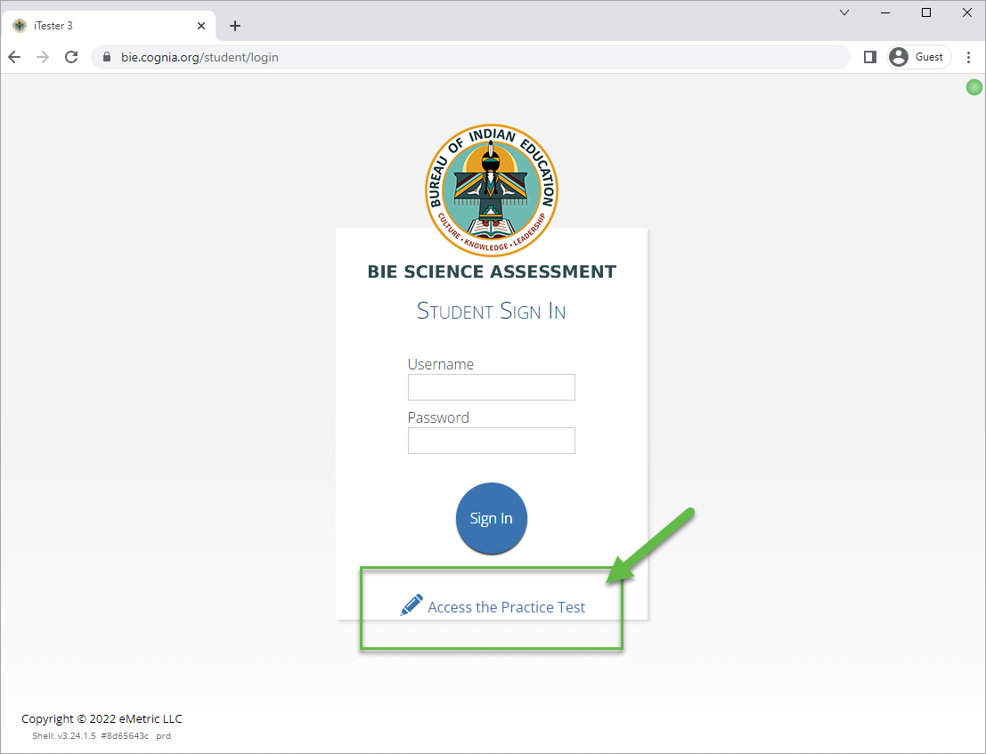
Practice Test

Slide 118
Additional Training Resources
Help Guides
Quick Starts: Creating Classes, Scheduling Tests, Printing Logins, Student Interface
Browser Testing User Guide
Kiosk Installation Guide
Portal User Guide
Kiosk User Guide
Testing with Third Party Accessibility Software
Tutorial Videos
https://bie.onlinehelp.cognia.org/
Example: BIE Data Interaction Reporting Basics
Support Desk
Call-in Information Sheet

Slide 119
Remember
Deactivate unused accounts
Students can take the BIE Science Benchmark using a Browser
Kiosks do need to be downloaded and apps installed
Check student demographics and add accommodations
Make sure network management tools don’t delete stored response folder
Communicate with Proctors/Test Administrators
Are there limits to number of students who should log in simultaneously?
Do they know the procedure for recovering stored responses?
Do they have basic information required by the support center if they call in?
Ensure students have TTS accommodation/form BEFORE they log in to the test

Slide 120
Questions?

Slide 121
Cognia Help & Support Page

Slide 122
Help & Support Site General Education Science Page
A page specifically dedicated to BIE Science Summative Assessment
https://bie.onlinehelp.cognia.org/science/
Key Dates
Testing Accommodations
Online System Tutorials
Practice Tests
Paper (PBT)
Online (CBT)
Resources
Training
Manuals, Online User Guides, Quickstart Guides, Technical Report. Reporting Resources, Forms, Score Interpretation Guides, etc.
Webinars Recordings and Slides
Quick video tutorials explaining specific tasks
Paper based testing braille, large print, & human reader kits special instructions sheets
High level important dates for 2024-25SY
Online based testing universal tools, accessibility features & accommodations chart

Slide 123
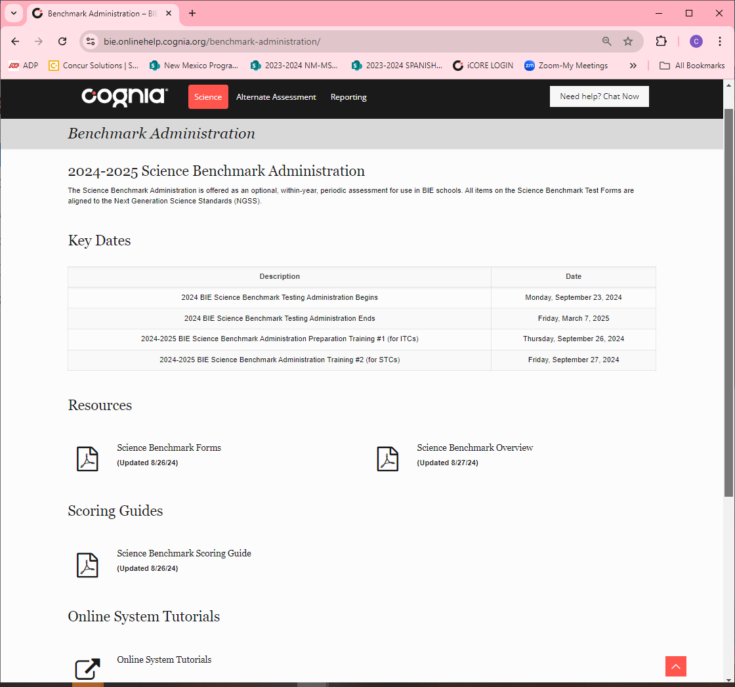
Help & Support Site Science Benchmark Page
A page specifically dedicated to Science Benchmark Administration:
https://bie.onlinehelp.cognia.org/benchmark-administration/
Key Dates
Scoring Guides
Online System Tutorials

Slide 124
BIE Science Help Desk
Hours
Monday–Friday from 9:00 a.m.–6:00 p.m. (ET)
Contact information
Phone: 800-887-7027
Email: BIETechSupport@cognia.org
Live Chat Link (available from the Help & Support site)

Slide 125
Thank you!

Slide 126
Knowledge is Opportunity
Cognia is a global nonprofit that has the knowledge to help schools improve outcomes for all learners.

