Slide 1


WELCOME!
The training will begin shortly

Slide 2

BIE Science Benchmark – STCs, TAs
September 26, 2025

Slide 3
Table of Contents
Housekeeping Tips
Welcome and Introductions
Online Testing Portal Training for STCs and TAs
  Science Benchmark Overview
  Key Dates
  Online System and Testing Process
  Scoring and Reporting Process
  Using Benchmark Student Results
Questions
Cognia Help and Support Site
  Gen-Ed Science Page
  Science Benchmark Page
Adjourn

Slide 4
Housekeeping
All participants should remain on mute with their video off.
Post all questions to the chat.
Questions will be addressed at each section break.
Please add your name, email, and school to the chat.
This training will be recorded.
The recording will be posted to the Help & Support page, https://bie.onlinehelp.cognia.org/training.

Slide 5
Welcome & Introductions

Slide 6

Bureau of Indian Education (BIE)
Dr. Carmelia Becenti, Chief Academic Officer
Aurela Shorty, Education Program Specialist (Assessment & Accountability)
Donald Griffin, Section 504 Program Coordinator, MSAA Project Manager

Slide 7

Cognia
Sarah McCain, IT Project Manager II
Mara Allaire, Program Manager
Jill Stepanek, Manager Content Development

Slide 8

eMetric
Gerry retzloff, Project Manager
Kaelee Harper, Senior Support Center Manager

Slide 9
Online Testing Portal Presentation for STCs and TAs

Slide 10

Bureau of Indian Education Science Assessment
Fall 2025 STC & TA Training
Gerry Retzloff, eMetric
Kaelee Harper, eMetric

Slide 11
Agenda
Benchmark Assessments Overview
Key Dates
Overview of Online System and Testing Process
School Test Coordinator (STCs) Tasks
  Managing students and accommodations
Test Administrator (Teacher) or STC tasks
  Creating Classes
  Scheduling and Managing Test Sessions
  Monitoring and Completing Testing
  Scoring Tests
  Viewing Results and Reports
Using Benchmark Student Results
Rescoring, Re-testing, and Reporting
Questions
Students Test Interface
  Tools and Accommodations
  Launching the Testing Kiosk Application and Logging in
  Navigating through the Test and Turning-in the Test
  Technology Requirements and Considerations
Practice Test
Demo
Reminders
Additional Training Resources
What’s New for SY2025-2026?
Questions
Cognia Help & Support Site

Slide 12
Science Benchmark Overview

Slide 13

Overview
Three grade band levels – elementary school, middle school, high school
Elementary School: grades 3-5
Middle School: grades 6-8
High School: grades 9-12
12 forms per grade level
Each form covers different content/standards
For available forms indicating their content topic/focus, tested Performance Expectations (PEs), and by NGSS standards visit https://bie.onlinehelp.cognia.org/benchmark-administration/ on the BIE Science Help & Support site
12–14 items per form
10–12 selected response
2 open-ended response
Aligned to Next Generation Science Standards (NGSS)
Administer based on curriculum and pacing

Slide 14
Format
Available through eMetric Portal
Online
Students assess in kiosk or browser
Paper
PDFs available for download from portal STC’s administration home page, https://bie.Cognia.org
https://bie.cognia.org

Slide 15

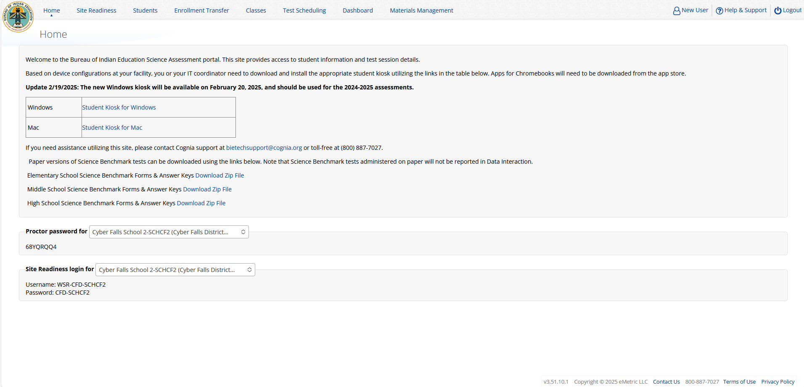
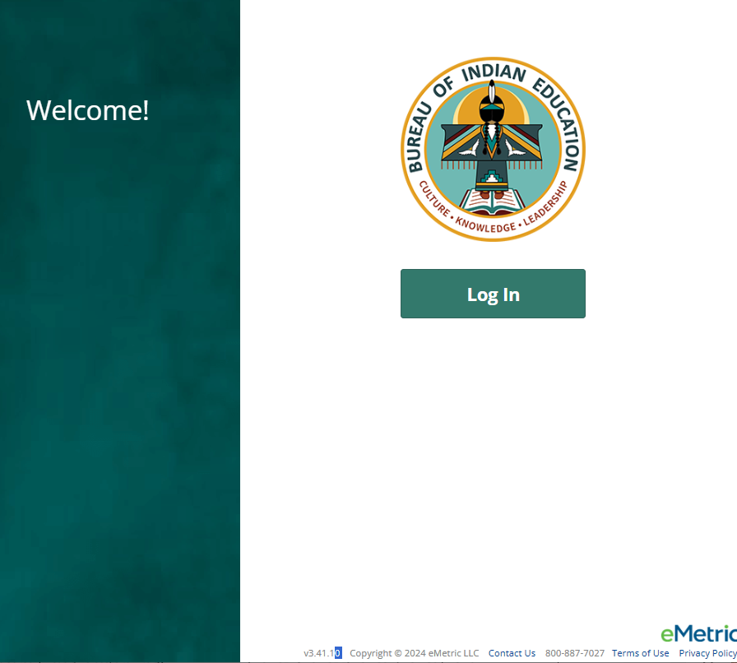
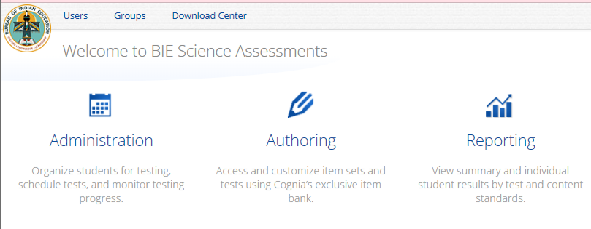
Downloading the PBT forms from the Portal
Log in to the Portal
From the Homepage, select the Administration icon
There you will see the links for downloading the paper-based test forms by grade level
You must download Elementary School, Middle School and High School tests separately
The “Download Zip File” links will be enabled by the start of Benchmark administration.
Click the links to start the file downloads.
After the file downloads, you may need to unzip the files to view the forms. Right-clicking on the file and select “Extract All…”
https://bie.cognia.org
Notes:
Note/Reminder: remind participants that if they take the paper version, no reporting will be available in Data Interaction; therefore, they should keep track of those testers and scores on their own.

Slide 16

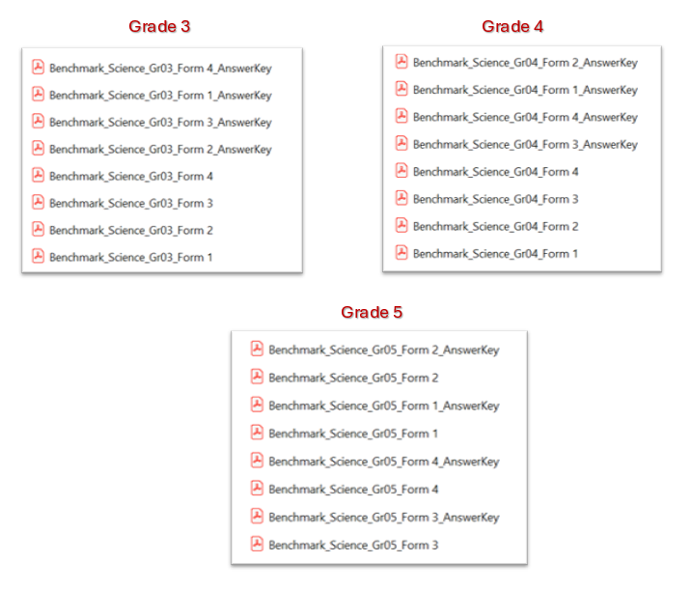
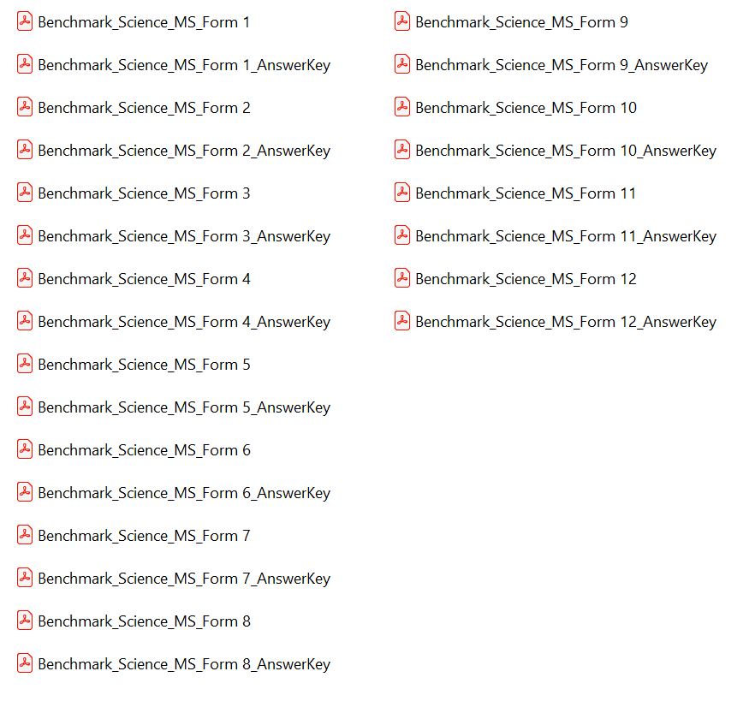
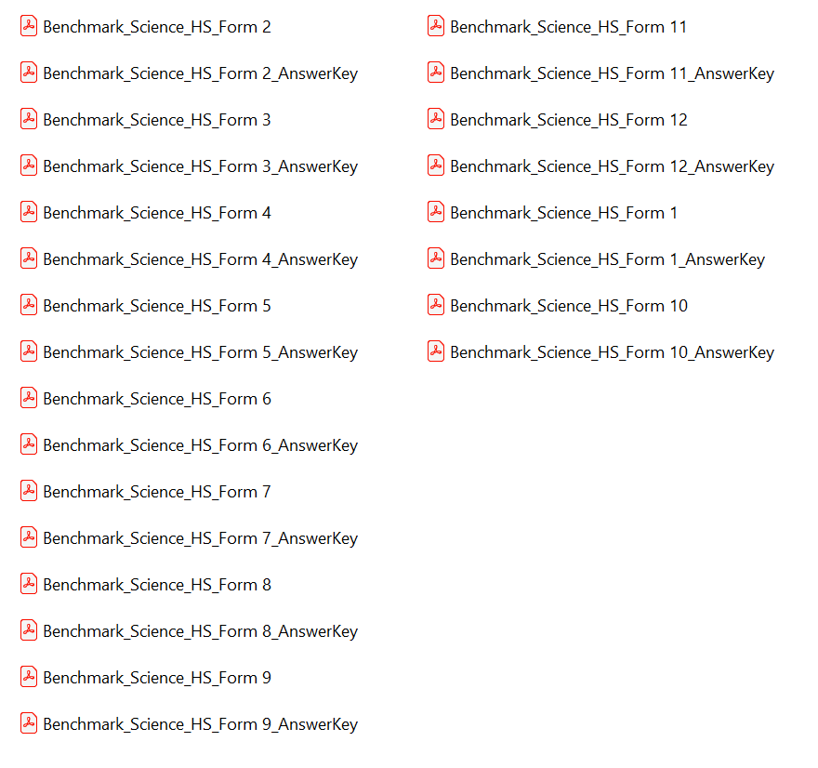
Downloading the PBT forms from the Portal
You must download Elementary School, Middle School and High School tests separately
  Elementary School (Grades 3-5)
Middle School (Grades 6-8)
High School (Grades 9-12)
https://bie.Cognia.org
Notes:
Reminder: The science benchmark assessments cover grades 3-12
Note/Reminder: remind participants that if they take the paper version, no reporting will be available in Data Interaction; therefore, they should keep track of those testers and scores on their own.

Slide 17
Science Benchmark Key Dates

Slide 18
Key Dates
Test Preparation Key Dates
Practice test live (summative) | All year
Student Roster Upload by BIE (only 5th, 8th, 11th grade students, field can manually add off –grade students as desired) | August 20, 2025
Portal Open & Kiosks available for download | Sep 8, 2025
Tests available for scheduling in Portal | Sep 22, 2025
Science Benchmark Test window opens | Sep 22, 2025
Online Test Registration Window (after second pre-ID upload for summative) | Dec 8, 2025-Jan 13, 2026
Science Benchmark Test window closes | Mar 6, 2026

Slide 19
Science Benchmark Overview of Online System and Testing Process

Slide 20
Benchmark Assessment
Same portal used for spring BIE Summative Science assessment administration (https://bie.cognia.org)
Portal provides access to Cognia assessments reporting (MSAA and GenEd Science)
You will use the same account that was used for Spring BIE Summative Science
Same student records will be used for Benchmark and Spring BIE Summative Science
Summative | Benchmark
School Test Coordinators (STC) manage testing | Teachers (TA) can manage testing using TA account
Students must use kiosk to access test | Students can access tests using a web browser or kiosk
Session access codes and proctor passwords are used | Session access codes and proctor passwords are NOT used
Machine or professionally scored tests with later reporting | Teachers score human scored (open-ended) items and receive near-real-time results

Slide 21
BIE Science Assessment Online System
Online System
Administration and Reporting Portal
https://bie.cognia.org
Users
Administration
Test Delivery
Student Test Interface
Kiosk
Site Setup
Students
Browser
Reporting
Classes
Test Sessions
Scoring
Enrollment Transfer

Slide 22


Test Preparation Process
STC
Create user accounts
Add/edit/transfer students
Assign accessibility features & accommodations
ITC
Download and install kiosks/apps
Complete Site Readiness Test
STC or TA
Create classes
Schedule classes for test
Print/distribute log-in tickets
Students
Launch kiosk or browser
Log-in and test
TA
Score human scored items on tests
View results in Data Interaction
After testing…

Slide 23

Portal Access
Access
http://bie.cognia.org
Open all year, previous accounts can be used
If you are a new School Test Coordinator, please contact BIE. Upon account creation, a welcome email will be sent from the portal.
  STCs will create all new portal user accounts
  Usernames must be unique
  Your email address controls your account
  New users will receive two automated emails, one with username and one with temporary password from bietechsupport@cognia.org
    New users will soon be receiving only one automated email, (starting Sept. 19)
When an account is deactivated or reactivated, the user will receive an email
STCs should periodically audit and deactivate user accounts
New

Slide 24
User Roles
User Role | Responsibilities
School Test Coordinator (STC) | Manage Users (add, edit, or deactivate) Access proctor password Edit student information & assign student accommodations Create, edit, and delete classes Schedule test sessions & print logins Manage & monitor test sessions Assign test report code Prepare IT network for student testing if there is no IT Coordinator
IT Coordinator (ITC) | Prepare IT network for student testing Conduct Site Readiness testing
Test Administrator (TA) | Create classes Create test sessions View their students and test sessions Print student login tickets for their test sessions Manage & monitor test sessions Assign test report codes Score human scored items for Benchmark tests View Benchmark results in Data Interaction
Report Access Only (RAO) | View Reports

Slide 25
Test Administrator Permissions
A TA can add any student in their school to their class
A TA can only view the student record for any student in one of their classes
  A TA cannot edit the student record
A TA can view, edit or delete any class to which they have been designated the TA
A TA can schedule their class to any program that that have access to
  Programs: BIE Science Benchmark, BIE Science Assessment
A TA can view, edit or delete a test session if they are the TA for the class in the test session and they have access to the program (BIE Science Benchmark and/or BIE Science Assessment)
Only a TA can Score the human-scored items
A TA can view Benchmark test results in Reporting for any class they are assigned to
https://bie.cognia.org

Slide 26
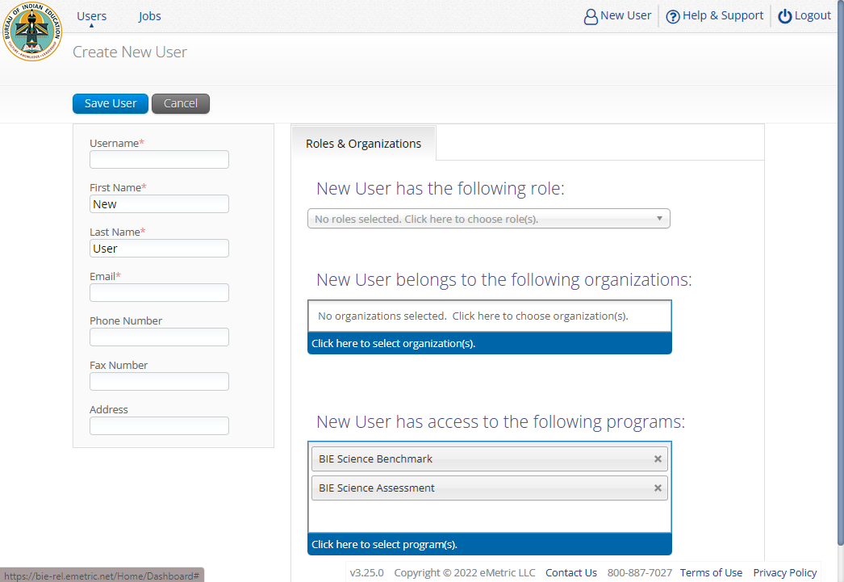
Program Access

Slide 27
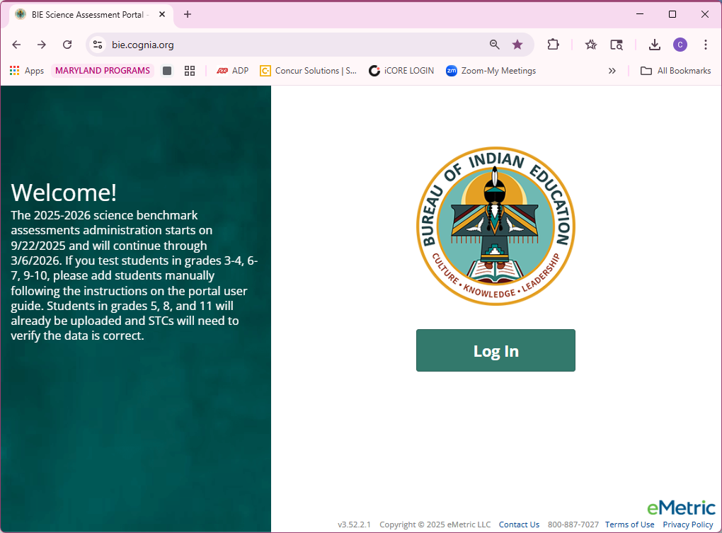
Portal Log-in
Portal URL: https://bie.cognia.org

Slide 28
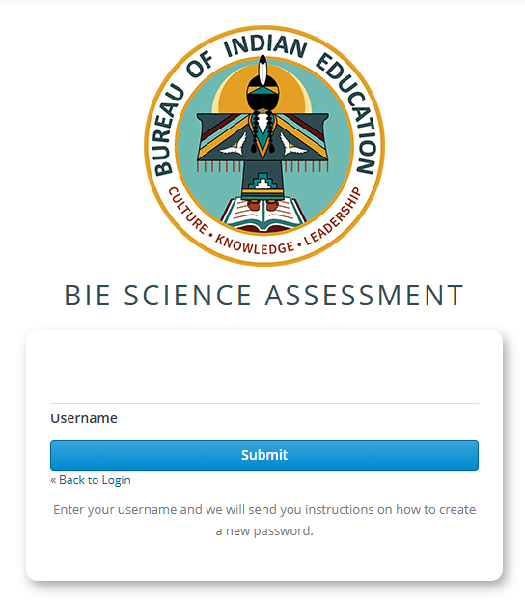
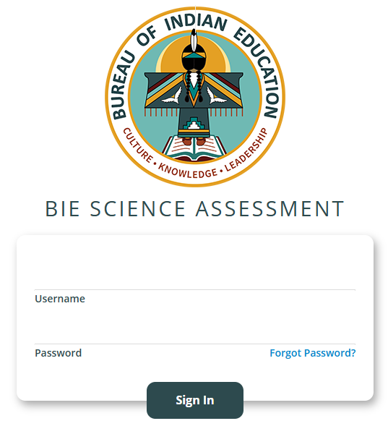
Forgot Password
REMINDER
Type in your Username and Password as indicated in the screenshot below and click the Sign In button to enter the portal.
If you have forgotten your password, select Forgot Password? and enter your Username as indicated in the screenshot below. Click the Submit button. The system will send an email to the email address associated with the account, providing instructions to reset your password.
https://bie.cognia.org

Slide 29
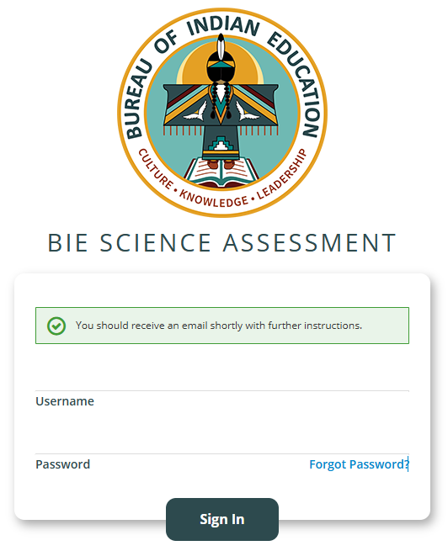
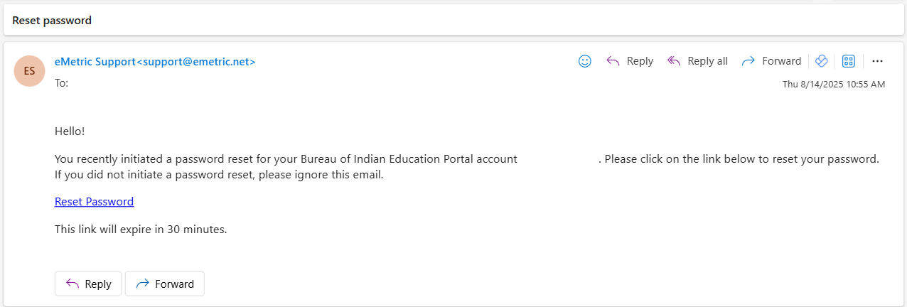
Reset Password – 1 of 2
When you submit your Username into the Forgot Password tool, you will be prompted with a green massage to check your email for further instructions. Please check your spam or junk folder if you do not see the email in your inbox.
The email will come from eMetric Support<support@emetric.net>
REMINDER
https://bie.cognia.org

Slide 30
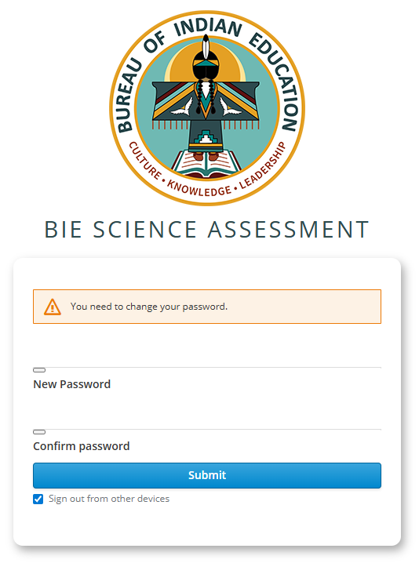
Reset Password – 2 of 2
When you click the Reset Password link from the email, you will see this screen to create a New Password and to Confirm password, the click Submit.
(Note: This will sign you out of other devices).
REMINDER
https://bie.cognia.org

Slide 31
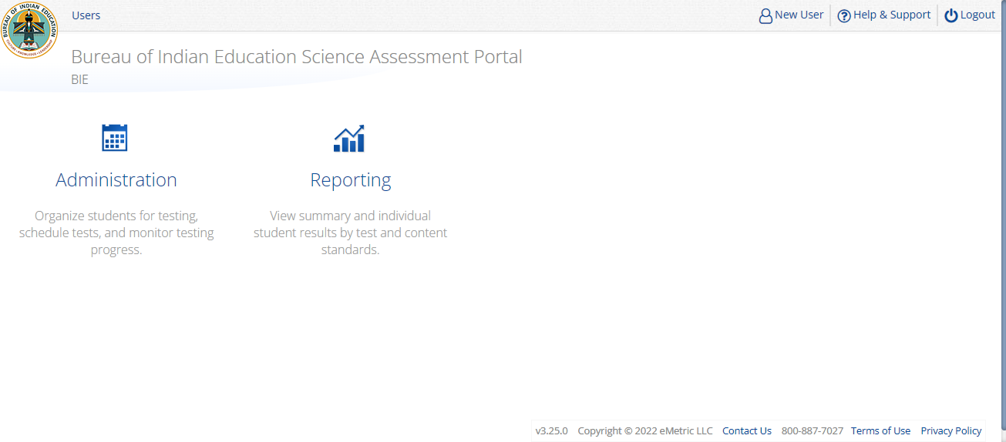
Portal Main Page (STC View)
1
2
3
4
5
Icon | Description
1 | BIE logo returns to portal home page
2 | Access User Management
3 | View & Edit user profile
4 | Access the BIE Help & Support Site
5 | Logout of the portal
6 | Access Administration Component
7 | Access Reporting
6
7
https://bie.cognia.org

Slide 32
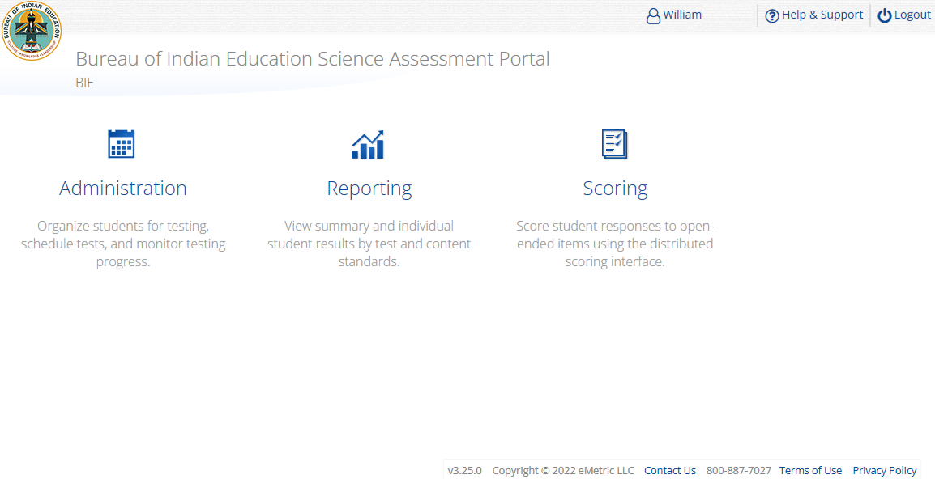
Portal Main Page (TA view)
1
2
3
4
Icon | Description
1 | BIE logo returns to portal home page
2 | View & Edit user profile
3 | Access the BIE Help & Support Site
4 | Logout of the portal
5 | Access Administration Component
6 | Access Reporting
7 | Access Scoring – TA user role ONLY!
TA Only!
5
6
7
https://bie.cognia.org

Slide 33
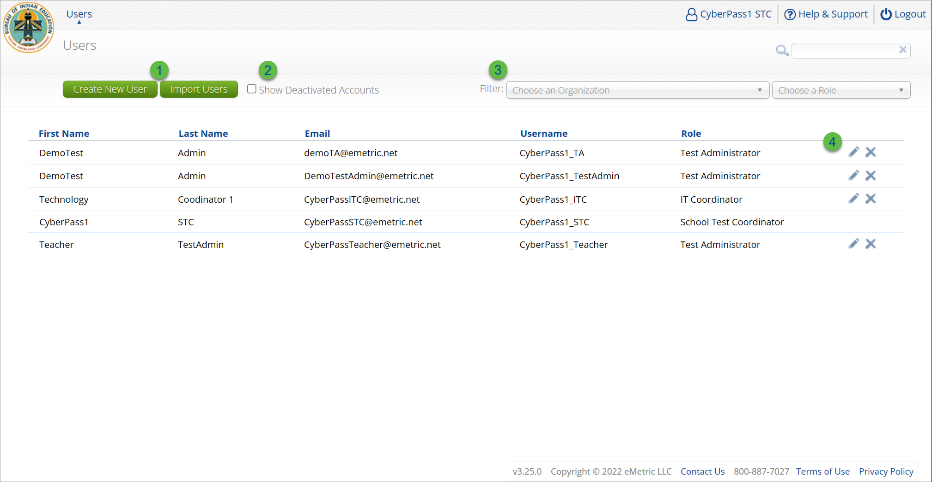
User Management
Icon | Description
1 | Add new user accounts one by one or by file upload
2 | User management table changes to deactivated user accounts
3 | Filter the user management table by school or role
4 | Edit or deactivate a user account
https://bie.cognia.org

Slide 34
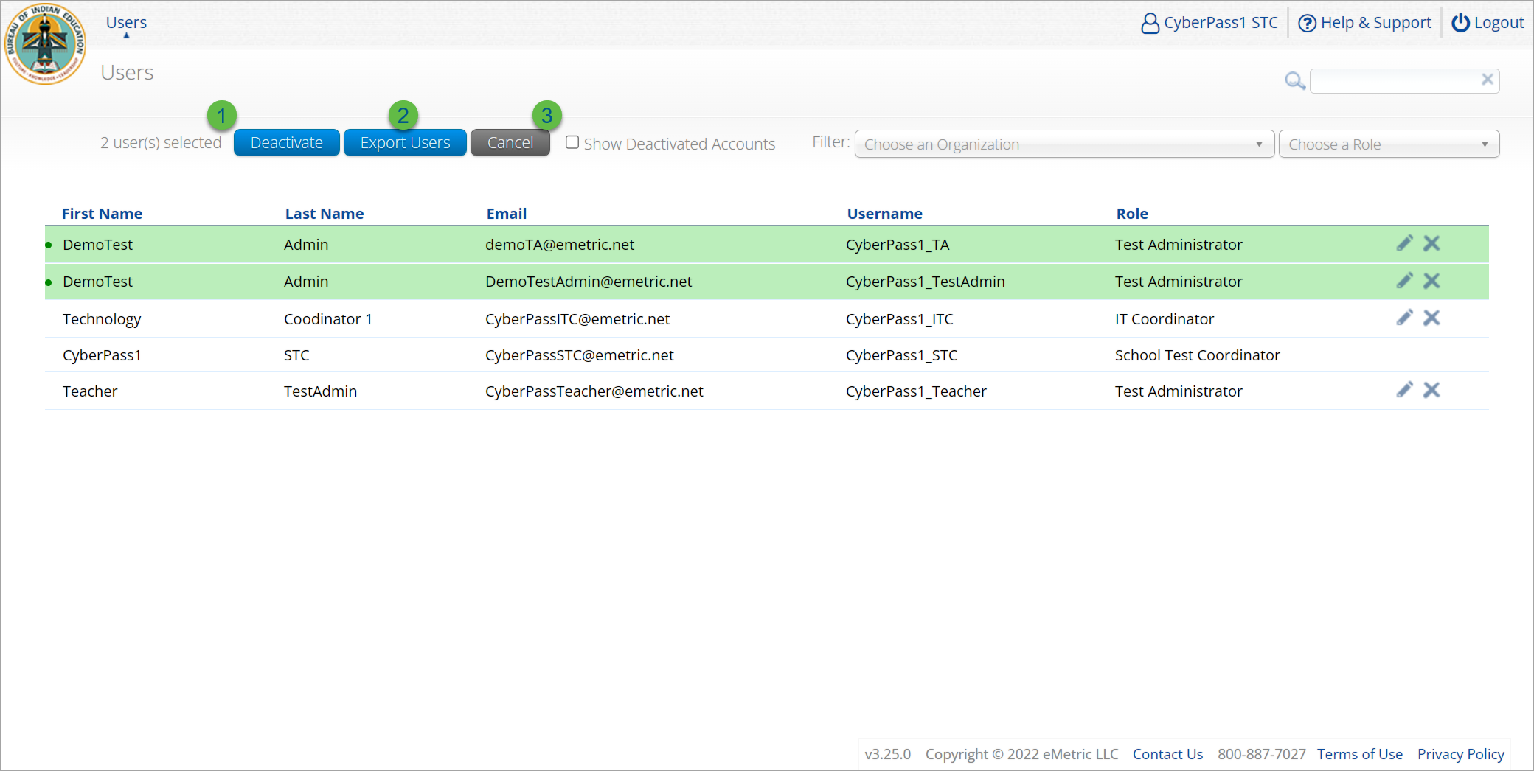
User Management
Icon | Description
1 | Deactivate selected user accounts in bulk
2 | Export selected user accounts
3 | Cancel clears the selection of the highlighted user account
https://bie.cognia.org

Slide 35
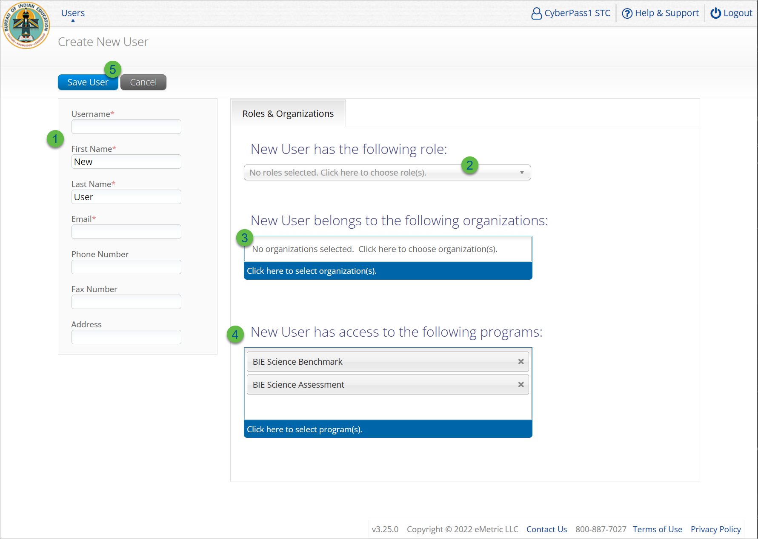
Create New User
Step | Description
1 | Populate the required information for the user account; username, first & last name, and valid email address.
2 | Select the role for the user account from the drop-down.
3 | Select the school for the user account.
4 | The program for the user account is set by default to BIE Science Benchmark and BIE Science Assessment.
5 | Click Save User, this action creates the user account and emails account information to new user.
https://bie.cognia.org

Slide 36
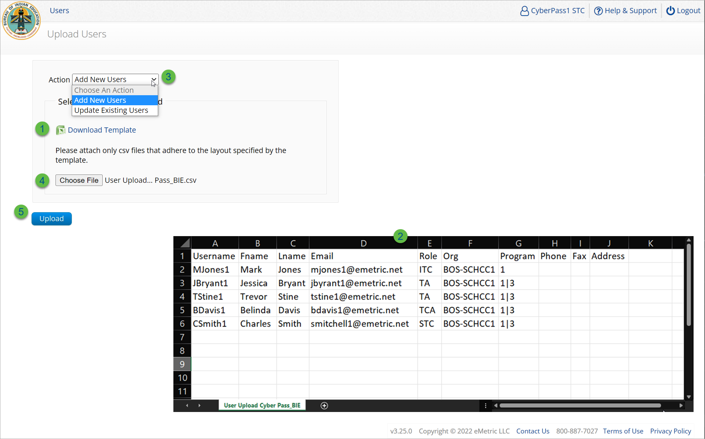
Import Users
Step | Description
1 | Download the User Upload template.
2 | Populate the upload template with valid values, the first six fields are required, and the file limit is 30 users.
3 | Select the action, add new users or update existing users.
4 | Choose the user upload file from your device.
5 | Click Upload, you will receive immediate results on accounts created and if any records have errors.
Program 1 = BIE Science Assessment
Program 3 = BIE Science Benchmark
https://bie.cognia.org

Slide 37
Portal Main Page (STC View)
https://bie.cognia.org

Slide 38
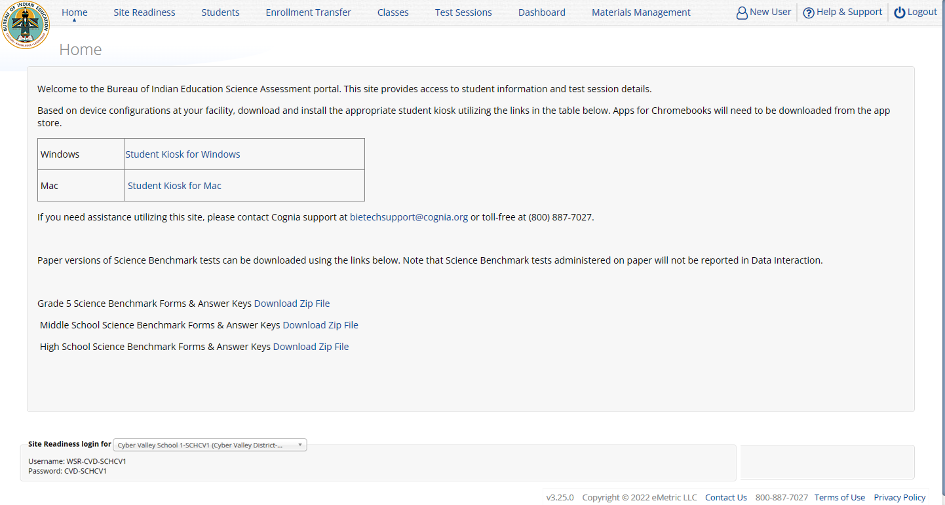
Administration Component (STC view)
1
2
Icon | Description
1 | BIE logo returns to portal home page
2 | Test Administration Menus
3 | Windows and Mac Kiosk Application Installers
4 | Science Benchmark paper test downloads
5 | Site Readiness Log-in
3
4
5
https://bie.cognia.org

Slide 39
Administration Workflow
Students
Classes
Site Readiness
Test Sessions
Score and Report
Home
STC: update roster and student information, assign accommodations and accessibility features
STC or TA: make Benchmark classes and test sessions
TA: score tests
STC and TA: view reports
https://bie.cognia.org
Notes:
The next component of the BIE Science Portal that we are going to go over is the Administration component.
The Administration component consists of 5-6 tabs depending on your account type.
Home – this is where you can view important announcements, access links for downloading the Kiosks, and attain the Proctor Password and Site Readiness log in credentials.
Site Readiness – this is where you can certify your site as ready for testing.
Students – this is where you can assign student accommodations.
Classes – this is where you can verify your rosters for testing.
Test Sessions – this is where you will schedule your classes for test sessions.
And, the Dashboard – this is where you can view helpful charts and data at the district level.

Slide 40

Managing Students - 1 of 5
  BIE roster loaded August 20, 2025
    Grades 5, 8 and 11 only
    Add students in other elementary school, middle school, or high school grades manually
  View your current students in the student’s tab
  Update rosters
    STCs may request student transfer for students enrolled in other schools at any time
    STCs may unenroll students from school at any time
    STCs can add student individually at any time
  Check/update individual student records
    Demographic data
    Add/remove accommodations and access to accessibility features
https://bie.cognia.org

Slide 41
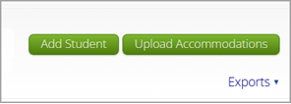
Managing Students – 2 of 5
To manually Add a Student, follow the steps below:
From the Students page, click the Add New Student button above the student table on the right.
The Student Information tab will be displayed. Fill in the student’s demographic information, fields with a red asterisk are required. Take care when filling in the State ID Number, Last Name, First Name, Middle Initial, Grade, and Date of Birth. Once the form is saved, you cannot edit the State Student ID.
https://bie.cognia.org

Slide 42
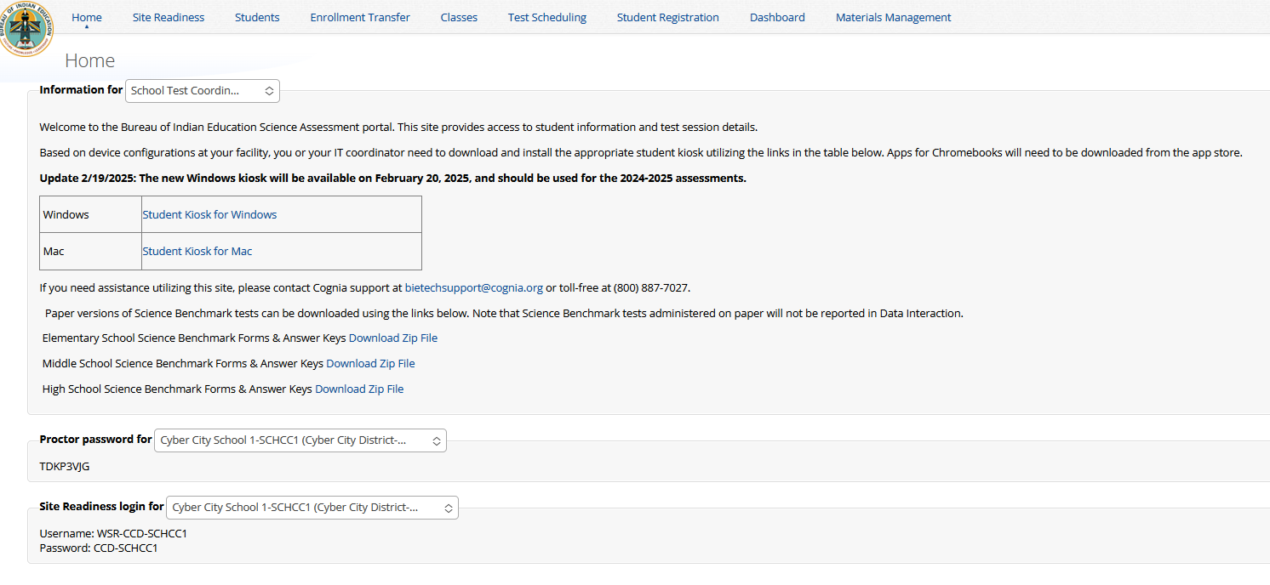
Managing Students – 3 of 5

Slide 43
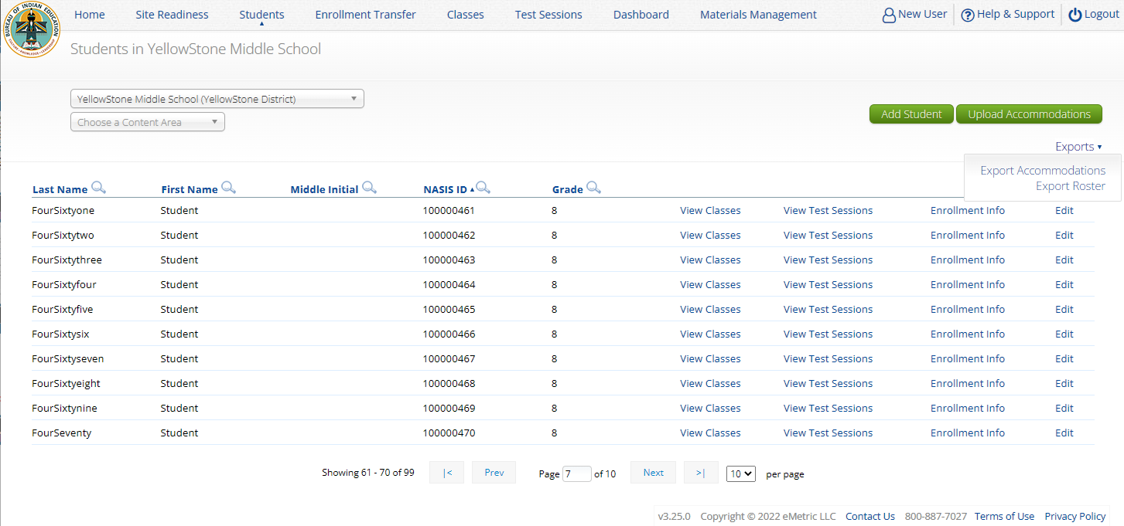
Managing Students – 4 of 5
Icon | Description
1 | school selector
2 | search and sort
3 | view classes
4 | view test sessions
5 | unenroll student
6 | add new student
7 | bulk upload accommodations
8 | export list of students
9 | edit a student record
6
7
1
8
2
3
4
5
9
https://bie.cognia.org

Slide 44
Managing Students: Tips & Update – 5 of 5
  Tips:
    State Student ID = NASIS ID
    In student’s tab: Download roster in csv at any time by selecting “Export Roster” under the “Exports” drop down (contains name, NASIS ID and Grade)
    Can’t add student? They may be enrolled in different school – initiate transfer request
    Cognia Customer Care desk can assist with student transfers
REMINDER
This year BIE will be doing a second supplemental student import closer to the summative admin window to add any missing students in Grades 5, 8, & 11.
Following this second student upload to the Portal, schools will have a window (12/8/25-1/13/26) to review student rosters and identify their paper testers (test mode in student profile).
https://bie.cognia.org

Slide 45
Unenroll Student – 1 of 4
https://bie.cognia.org

Slide 46
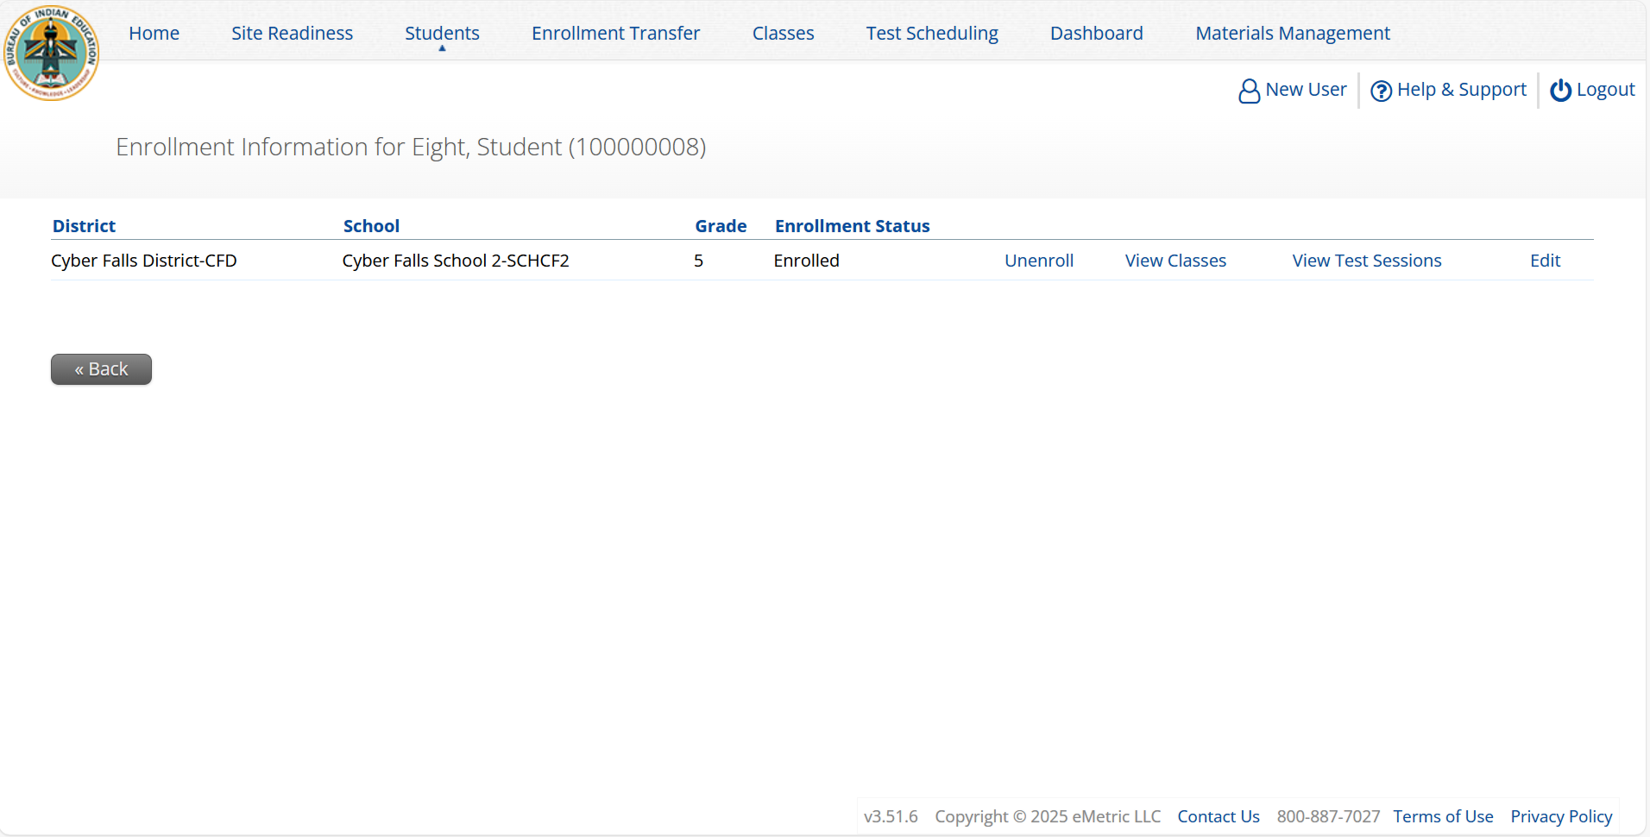
Unenroll Student – 2 of 4
https://bie.cognia.org

Slide 47
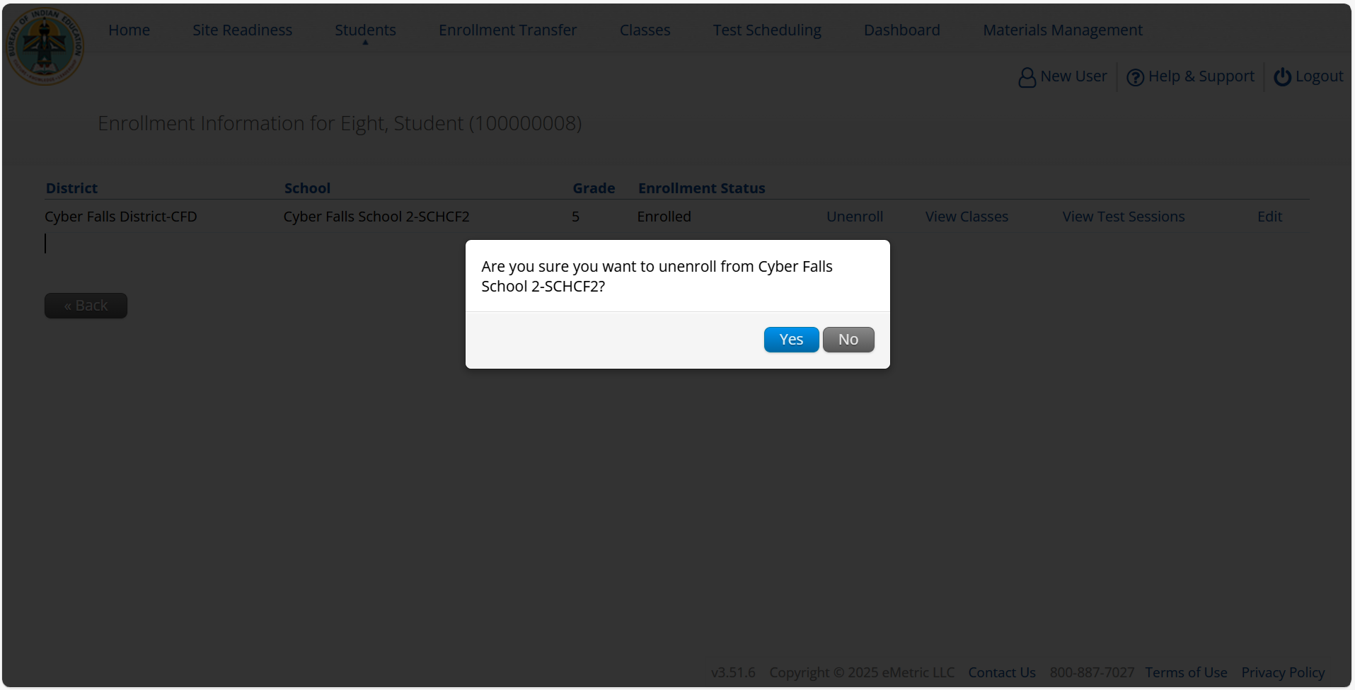
Unenroll Student – 3 of 4

Slide 48
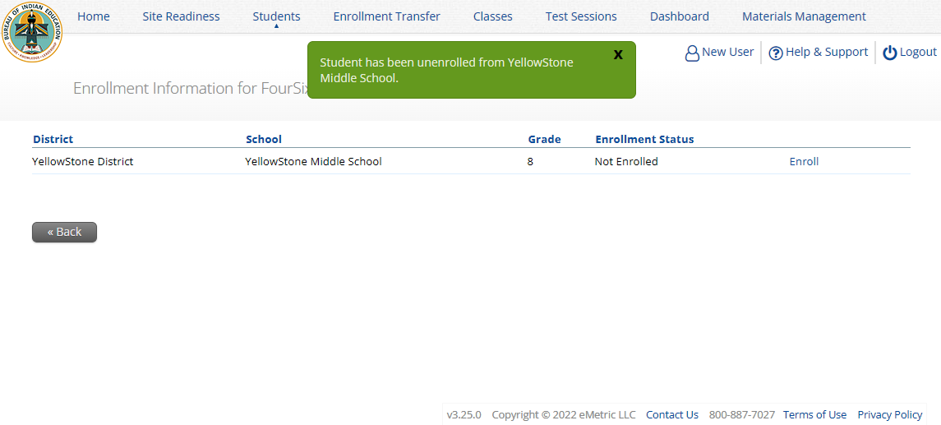
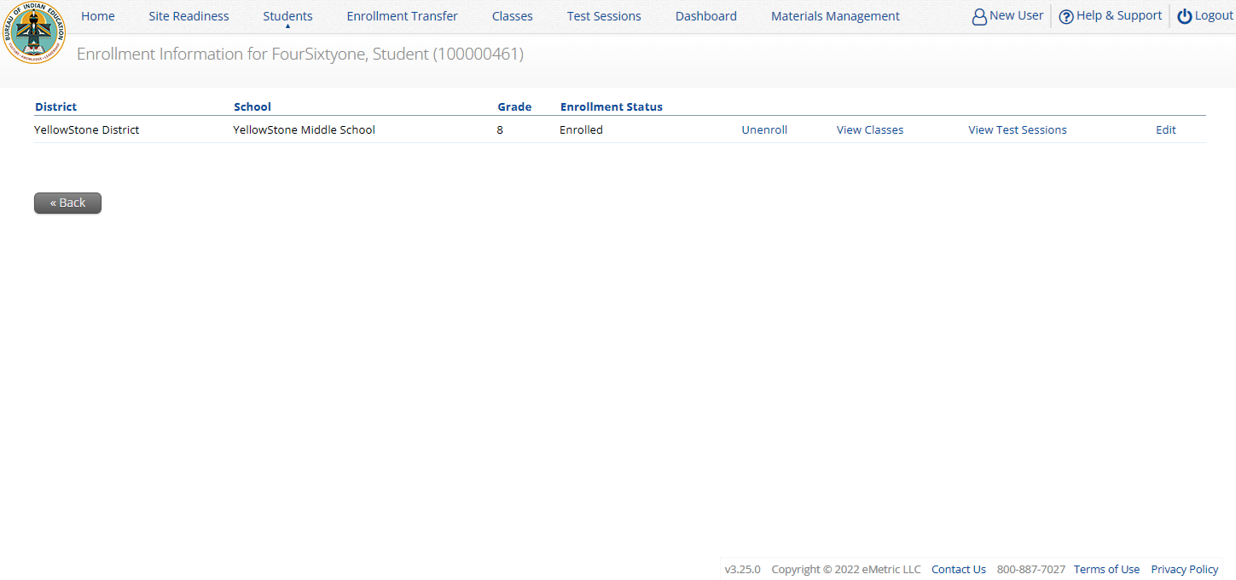
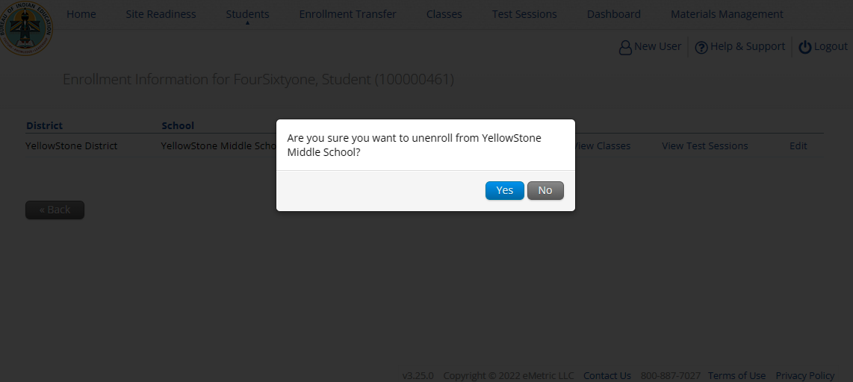
Unenroll Student – 4 of 4
https://bie.cognia.org

Slide 49
Student Transfer Request – 1 of 5
Request to move student from another school into your school
Approve or reject requests to move students out of your school
  Receive notification of requests by e-mail and in portal
If a student is unenrolled, the Cognia BIE Science help desk will approve the requests
Test sessions do not transfer with the student!
https://bie.cognia.org

Slide 50

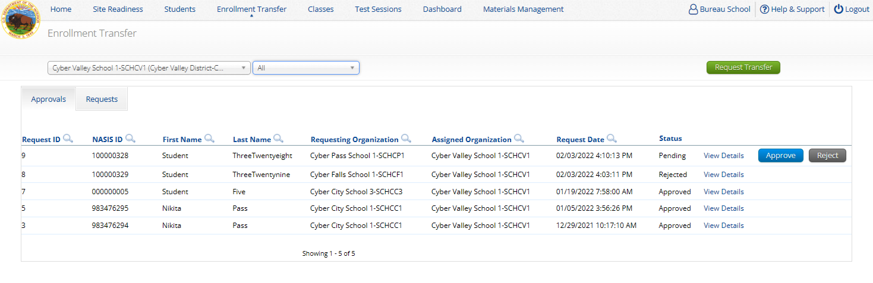
Student Transfer Request – 2 of 5
Status:
Pending
Canceled
Approved
Rejected
Your requests
Requests sent to you from other organizations
https://bie.cognia.org

Slide 51
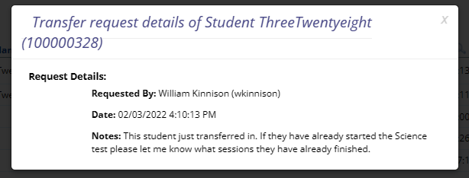
Student Transfer Request – 3 of 5
Test sessions do not transfer with the student!
John Smith (JSmithSTC)
https://bie.cognia.org

Slide 52
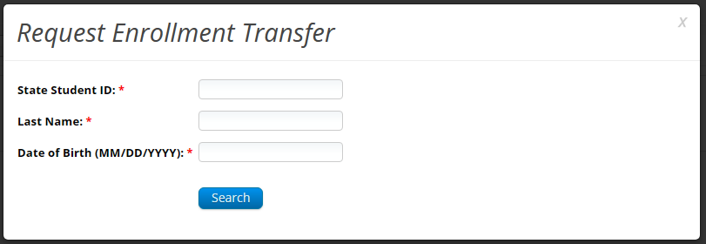
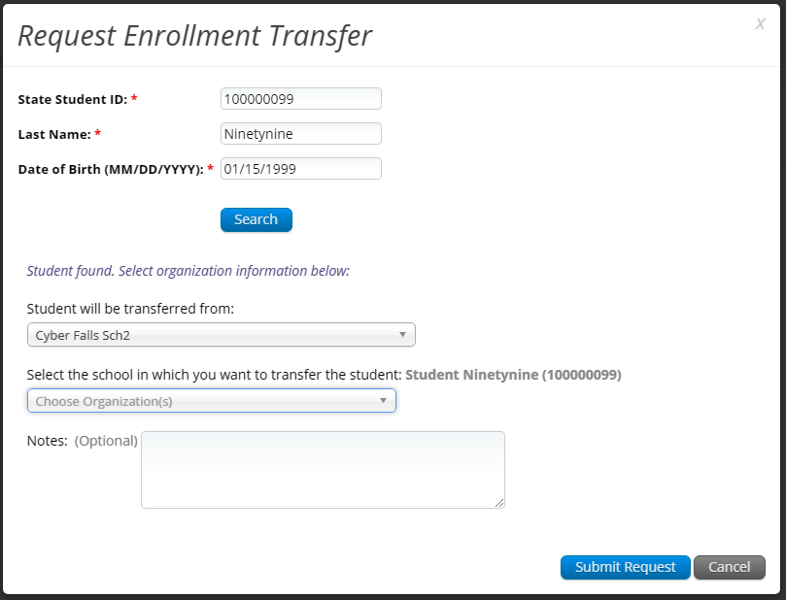
Student Transfer Request – 4 of 5
https://bie.cognia.org

Slide 53
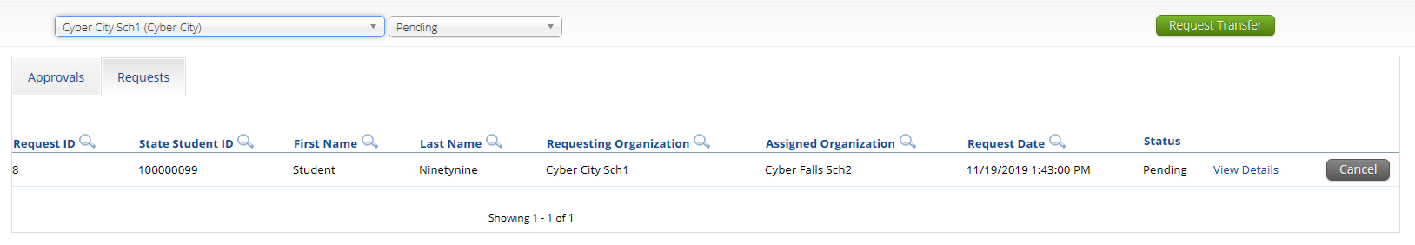
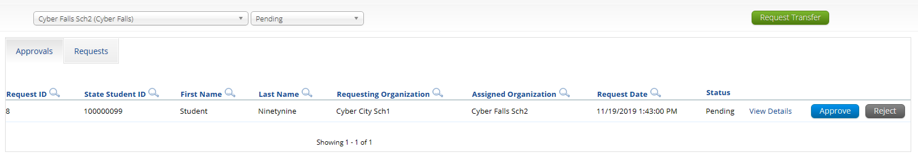
Student Transfer Request – 5 of 5
Enrollment request - requestor’s view
Enrollment request - receiver’s view
https://bie.cognia.org

Slide 54
Student Accommodations
  Check/edit accommodations
    Accommodations not included in BIE roster upload
    Edit student accommodations individually or…
    Use Upload Accommodations to edit accommodations on multiple student records at one time
      Note: will not be available during testing administration hours (7am-9pm)
    You can use the Export Accommodations button to download list of all students and their currently assigned accommodations, edit that file and re-upload it using the Upload Accommodations menu
https://bie.cognia.org

Slide 55
Universal Tools, Accessibility Features, and Accommodations
Universal Tools
(Available to all students)
Platform tools that are built in and automatically delivered during testing
Accessibility Features
(Available to some without IEP/ 504)
Must be pre-identified by STC prior to testing
Accommodations
(IEP, 504, EL)

Slide 56
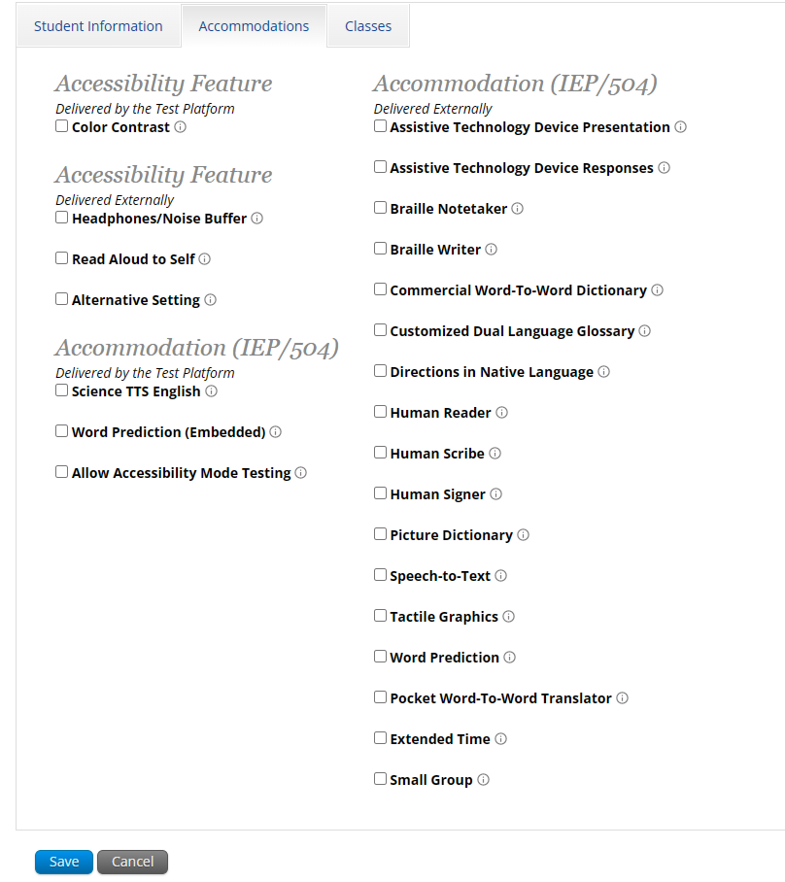
Accessibility Features, and Accommodations
Student will be assigned a TTS-specific form
Student can use CoWriter© word-prediction; an additional file must download which may delay loading test by a minute
Windows only! Proctor must enter proctor password when student logs in to test.
See the “Testing with Third Party Assistive Technology” guide for more information on using the test interface with screen readers, speech-to-text, text-to-speech and other assistive technologies.
https://bie.cognia.org

Slide 57
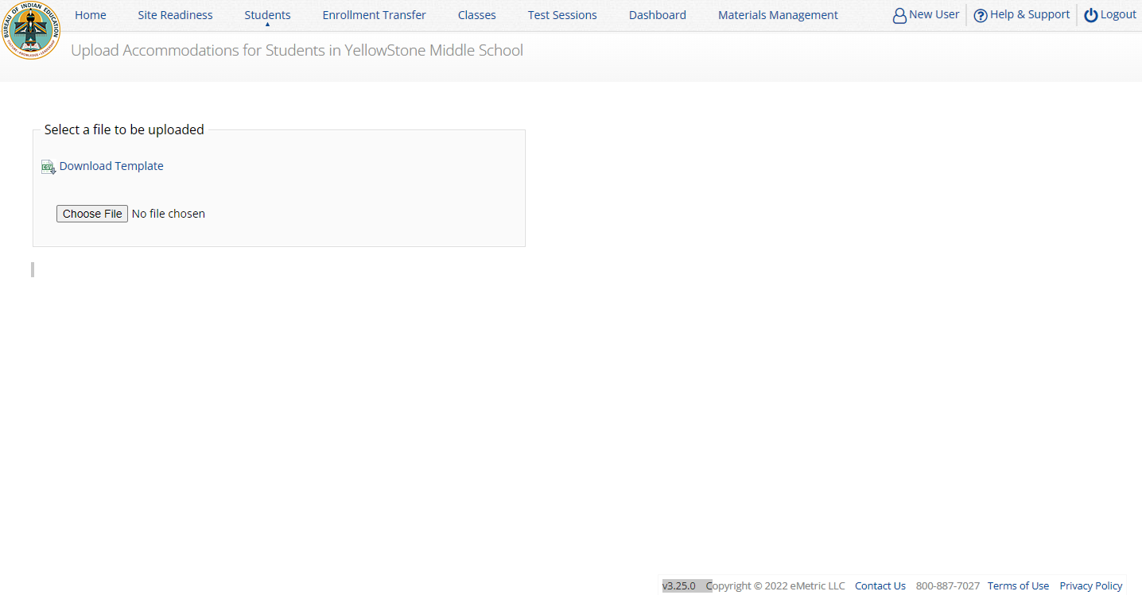
Upload Student Accommodations
https://bie.cognia.org

Slide 58
Creating Classes – 1 of 6
Groups of one or more students who will take a test
Create grade-level classes
  Maximum number of student allowed in a class: 100
  Class can be deleted if it has not been scheduled for a test
  If test session scheduled and no student has logged in, delete test session, then class
Students can be assigned to more than one class
If any student needs to retake the test, you must either:
  Create a new class and put the student(s) in that class and schedule that class for a test in a new test session, or…
  Create a Test Subgroup (Benchmark Only!)
https://bie.cognia.org

Slide 59
Creating Classes – 2 of 6
STCs or TAs (Teachers) can create classes
Each class must have a TA assigned to the class
STCs can create classes and assign any TA
STCs can view or edit any class in their school
TAs can only assign themselves as TA for the classes they create
TAs can only view the classes if they are assigned as TA
TAs can put any student in the school in their class
Once a student is assigned to the TA’s class the TA can view the student record but cannot edit it.
https://bie.cognia.org

Slide 60
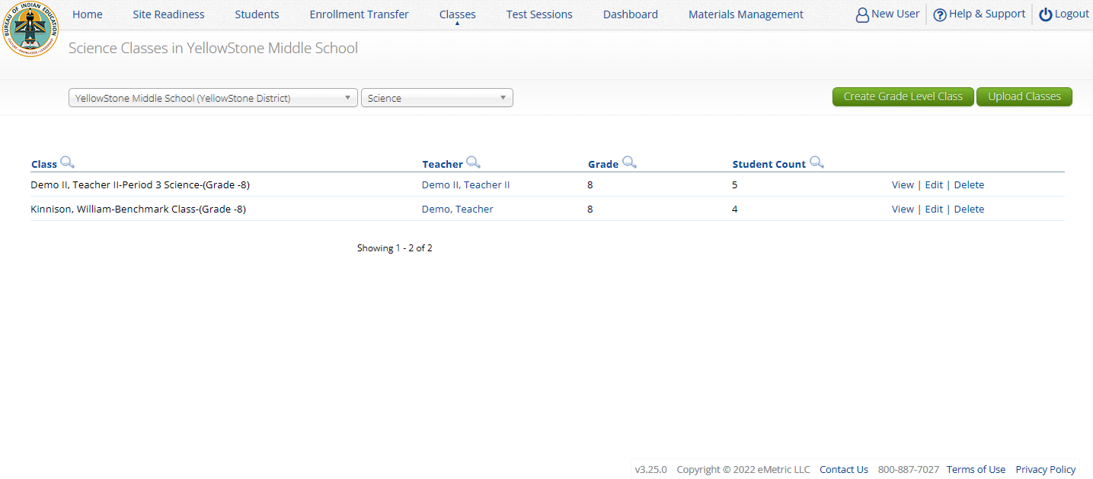
Creating Classes – 3 of 6
https://bie.cognia.org

Slide 61
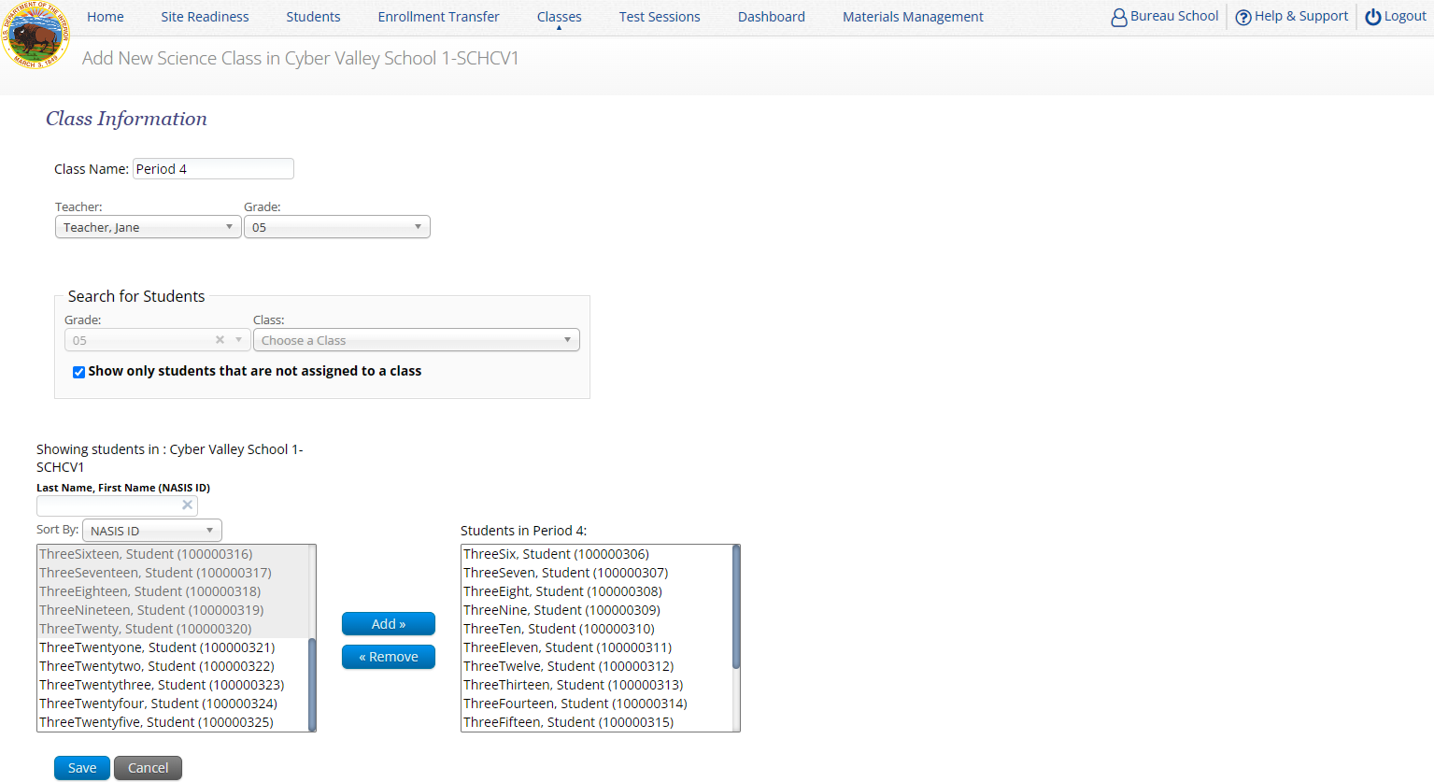
Creating Classes – 4 of 6
Icon | Description
1 | class name
2 | TA name
3 | grade
4 | search/filter
5 | students in school
6 | students in class
7 | save class
1
TA name and grade will automatically be added to the class name!
3
2
4
5
6
7
https://bie.cognia.org

Slide 62
Creating Classes – 5 of 6
https://bie.cognia.org

Slide 63
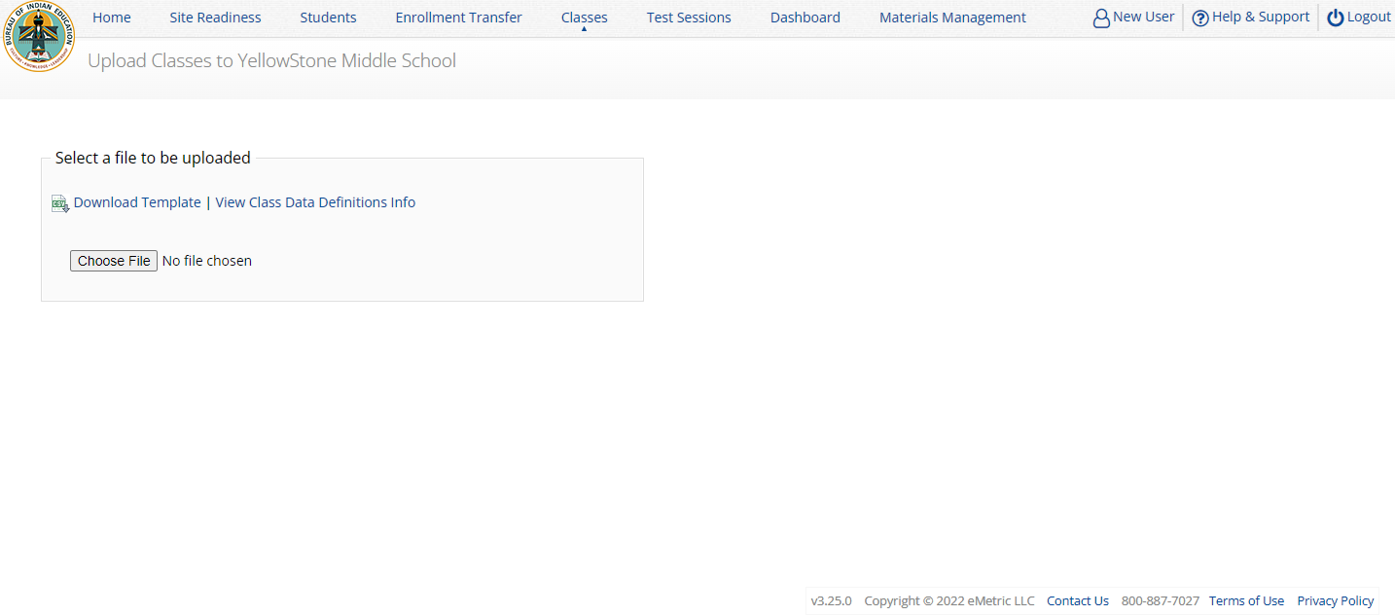
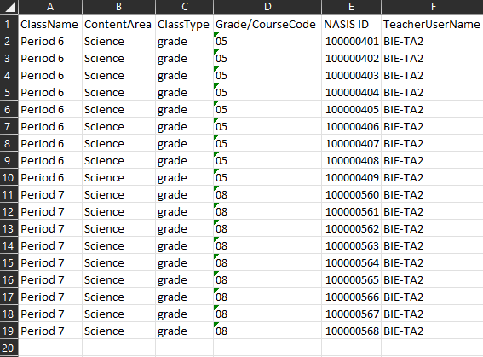
Creating Classes – 6 of 6
Save as csv file type
Grade/course code must have leading zero 0 - make field type “text“
https://bie.cognia.org

Slide 64
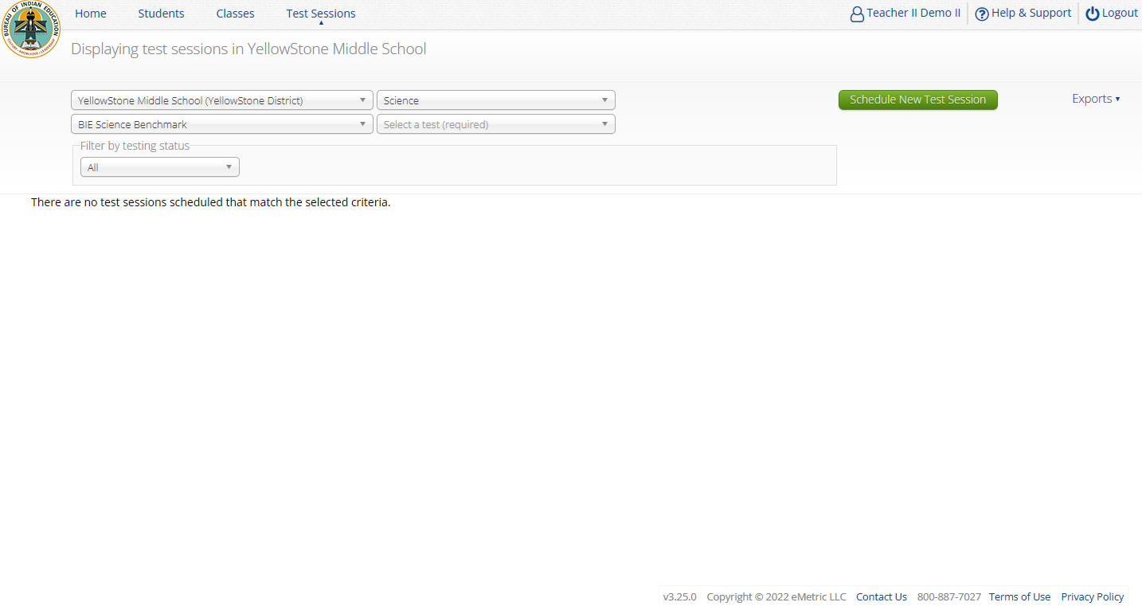
Scheduling Test Sessions – 1 of 3
https://bie.cognia.org

Slide 65
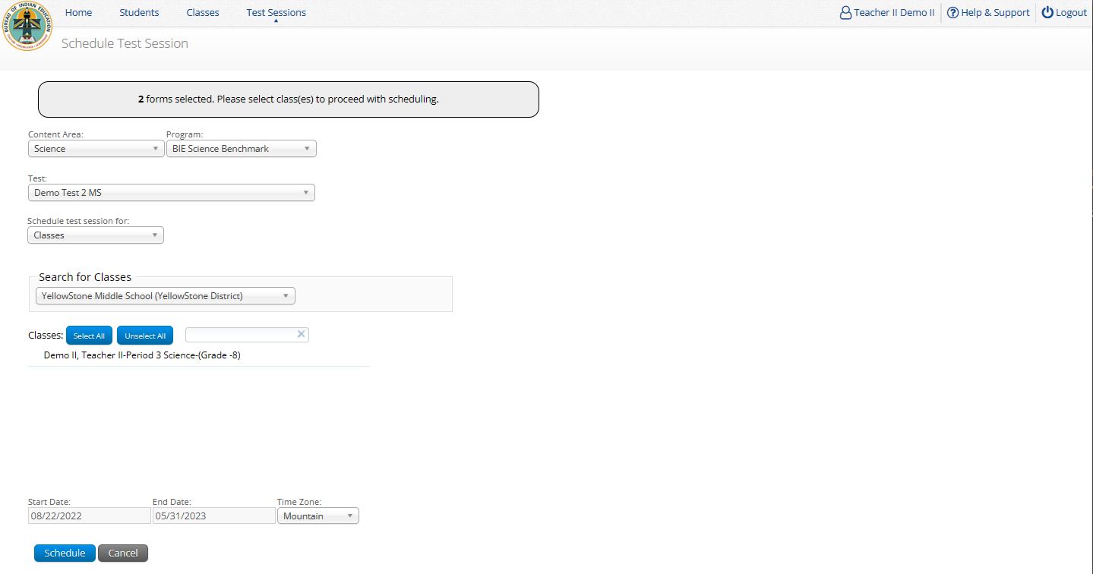
Scheduling Test Sessions – 2 of 3
Icon | Description
1 | Test
2 | Class
3 | Test Window
4 | Save the test session
1
Class must be same grade level as test
Elementary School grade band covers grades 3, 4, 5
Middle School grade band covers grade 6, 7, 8
High School grade band covers grades 9, 10, 11, 12
If class has already been scheduled for a test, it cannot be scheduled again and will not show up in the classes list
Test window cannot be edited
2
3
4
https://bie.cognia.org
Notes:
Remind participants that the test forms are by grade band (Elementary School: grades 3-5, Middle School: grades 6-8, High School: grades 9-12), and they can select the grade the students are in based on whether they have covered the respective standards in instruction. Refer them to the resources available on the H&S site, https://bie.onlinehelp.cognia.org/benchmark-administration. These test forms are tied to content topics; it would depend on instructional topics that are being taught and assessed. The forms are not dependent on the other; so, they would be scored individually.

Slide 66
Scheduling Test Sessions – 3 of 3
STCs or TAs (Teachers) can create test sessions
TA’s must have access to the Benchmark program in their user profile to schedule classes for the Benchmark assessment
STCs can create test sessions for any TA
STCs can view or edit any test sessions in their school
TAs can only create test sessions for their classes
TAs can only view or edit test sessions for their classes
https://bie.cognia.org

Slide 67
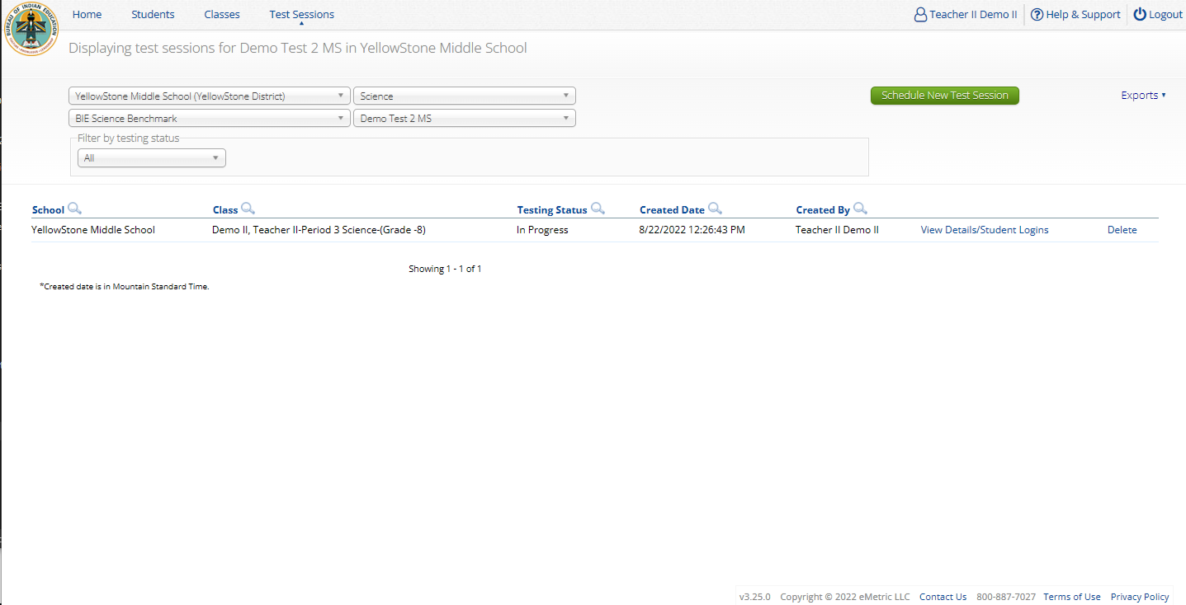
Managing Test Sessions – 1 of 4
https://bie.cognia.org

Slide 68
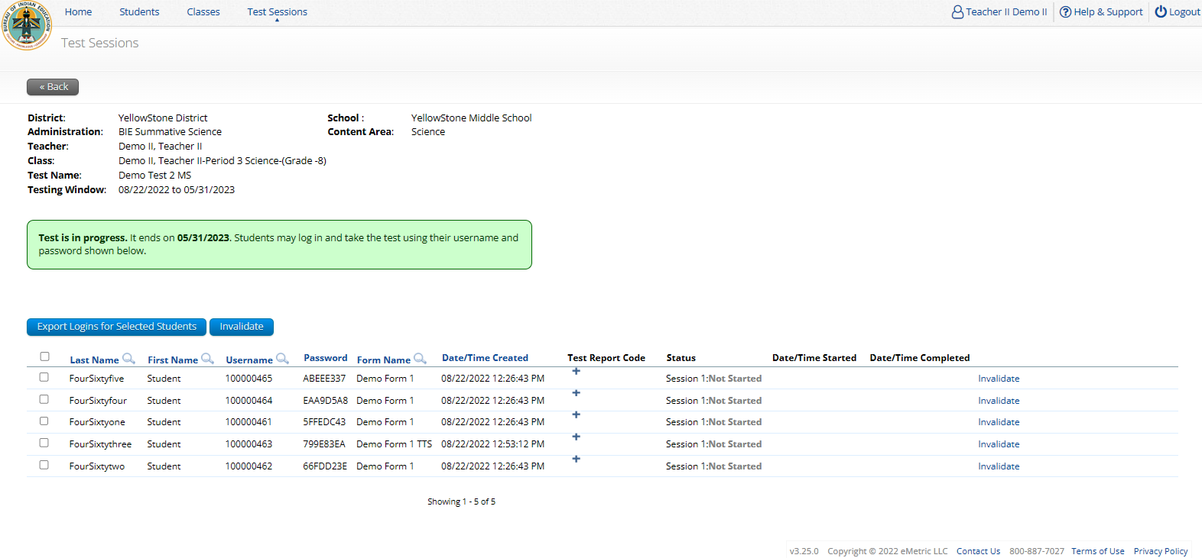
Managing Test Sessions – 2 of 4
Icon | Description
1 | Test session information
2 | Test window status
3 | Students in test session
4 | Student Test Status (Not started, In Progress, Finished)
1
2
4
3
https://bie.cognia.org

Slide 69
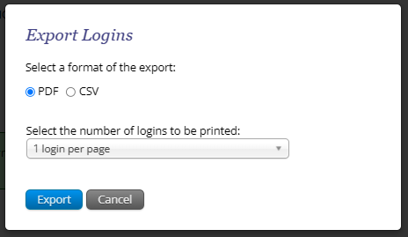
Managing Test Sessions – 3 of 4
https://bie.cognia.org

Slide 70
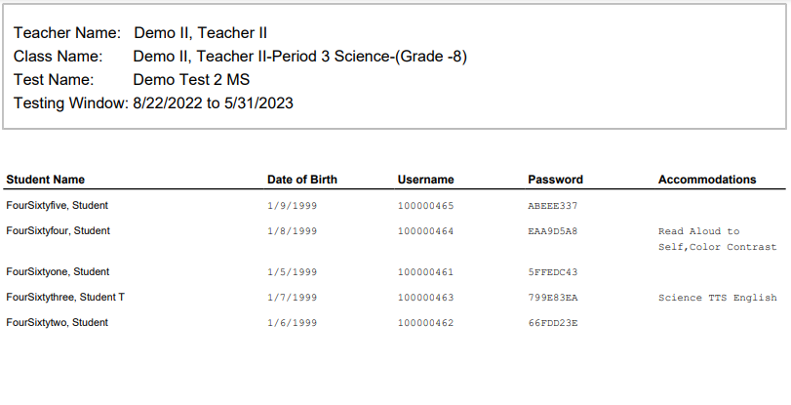
Managing Test Sessions – 4 of 4
https://bie.cognia.org

Slide 71
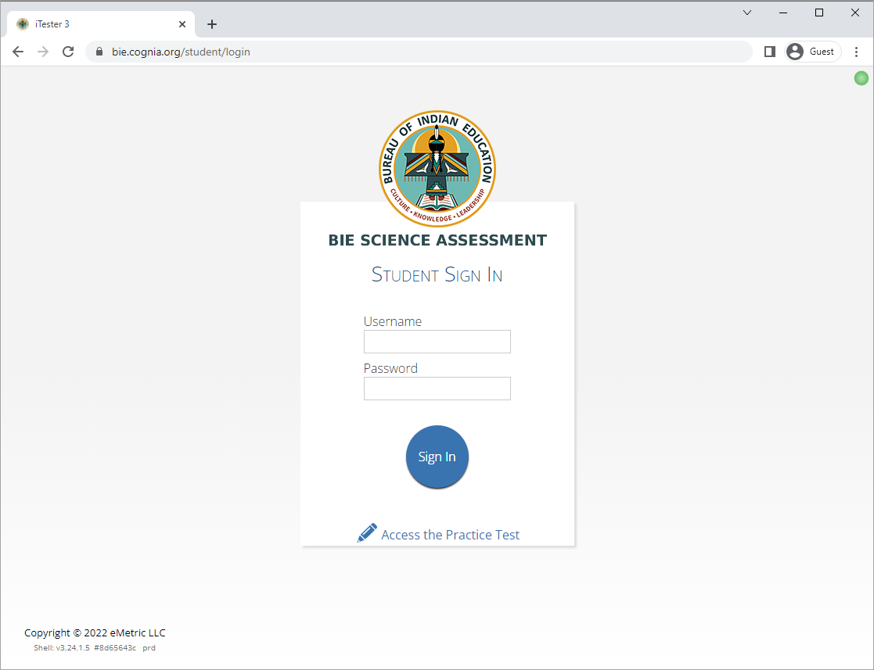
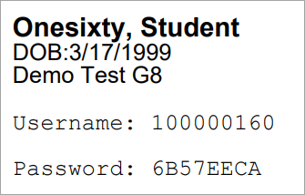
Logging in to a Test
Launch web browser (or Kiosk)
Navigate to https://bie.cognia.org/student
Login using the username and password from the student test ticket

Slide 72
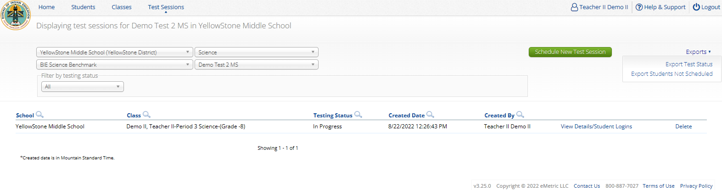
Monitoring Testing
Check student test status for tests “not started” or “in progress”
  If test is “not started” or “in progress”, student can log in and finish it anytime during test window if they have log-in information unless the test has been invalidated
  Once test in “finished”, student cannot log in to test
The teacher (TA) can re-open any test that was inadvertently turned-in
Use the “Export Test Status” download under “Exports” on the Test Session screen to download a list of student test sessions and their status
Use the “Export Students Not Scheduled” download under “Exports” on the Test Session screen to download a list of students not scheduled for a test
https://bie.cognia.org

Slide 73
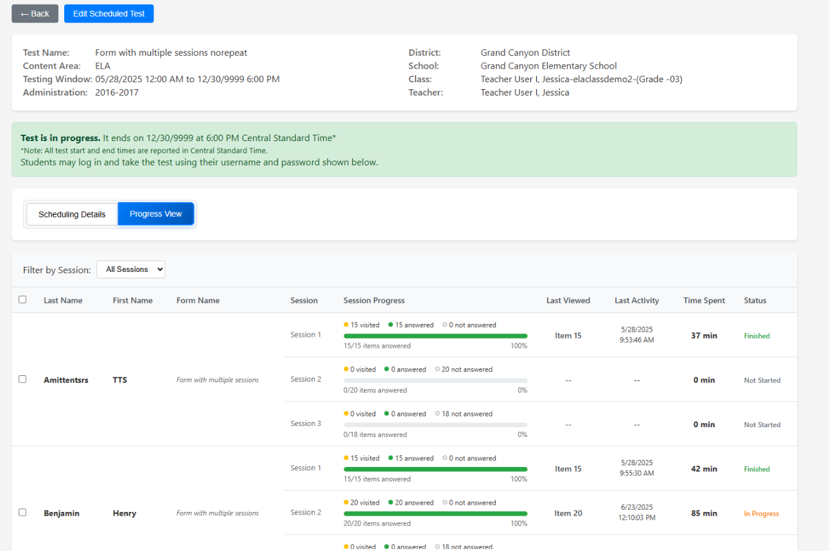
Session Progress
New feature coming this year is Test administrators will now be able to view Progress of student's test sessions.
New!
https://bie.cognia.org

Slide 74
Test Report Codes
For students who cannot complete the test, invalidate using two-step process:
    Enter a test report code
    Select “invalidate” for each test session to prevent the student form logging in
Test invalidation: not reported in Benchmark science reports
Test report code assigned: student will be listed in report with NO SCORE
Student not started or in progress: will not be reported unless they have test report code assigned in which case they will be reported with no score
https://bie.cognia.org

Slide 75

Test Report Codes/Re-activating test
Icon | Description
1 | Click on ”Reactivate” to re-open the session; the student can then log in and access the session
2 | Click on the “+” to add a test report code
3 | Click on the “Invalidate” to invalidate the session
Note | Only STCs can re-validate (i.e., undo) an invalidated session
2
1
3
https://bie.cognia.org

Slide 76


Test Report Codes
https://bie.cognia.org

Slide 77
Scoring and Reporting

Slide 78
Scoring the Test – 1 of 4
https://bie.cognia.org
Notes:
Remind the audience that if the student takes the paper version of the benchmark assessments, scoring will not be available online; teachers will have to manually score the students’ responses so that they show up in Data Interaction. And for the online students, teachers will have to score the open responses.

Slide 79

Scoring the Test – 2 of 4
1
Human scored item(s)
Icon | Description
1 | Tests ready to score
2 | Select the test and class
3 | Each response to score is listed in this table
4 | When all items have been scored, submit them from scoring here
2
3
4
https://bie.cognia.org

Slide 80

Scoring the Test – 3 of 4
Icon | Description
1 | Prompt
2 | Student response
3 | Student and item information
4 | Score menu Drop down to choose points Cognia score guide
5 | Submit score or print copy of student response
6 | View item as student would see it in the test
1
3
2
4
5
6
https://bie.cognia.org

Slide 81

Scoring the Test – 4 of 4
https://bie.cognia.org

Slide 82
Viewing Scores in Reporting (Data Interaction)
Wait 10-15 Minutes!
https://bie.cognia.org

Slide 83

Benchmark Reporting (Data Interaction)
1
Icon | Description
1 | Program
2 | Report type: Student List Data Analysis
3 | School
4 | Test
2
4
3
https://bie.cognia.org

Slide 84

Benchmark Reporting (STC View) – 1 of 2
1. Student’s total points earned in test
4. Each MC item in the test with student’s response
2. Maximum number of points in test
5. Open ended item and points awarded
3. Student’s percent correct for test
1
2
3
5
4
https://bie.cognia.org

Slide 85

Benchmark Reporting (STC View) – 2 of 2
Switch between Roster (“Student List”) and ISR
3
2
1
4
1 - Select student’s last name to view Individual Student Report (ISR)
2 - Click on Score for data summary options
3 – Hover over Item for item standards. Click on Item to see the summary statistics (response analysis) and item preview.
4 - Select item response (letters in color) to view item and student’s response. The color of the response is determined as follows: black = correct response, red = incorrect response, pink = partially correct response.
https://bie.cognia.org

Slide 86

Benchmark Reporting – 1 of 6
https://bie.cognia.org

Slide 87

Benchmark Reporting – 2 of 6
https://bie.cognia.org

Slide 88

Benchmark Reporting – 3 of 6
https://bie.cognia.org

Slide 89


Benchmark Reporting – 4 of 6
https://bie.cognia.org

Slide 90

Benchmark Reporting – 5 of 6
https://bie.cognia.org

Slide 91

Benchmark Reporting – 6 of 6
https://bie.cognia.org

Slide 92
Rescoring

Slide 93
Rescoring – 1 of 2
You can score student(s) who did not finish after submitting a test for scoring
You can change a student score
You can retest a sub-set of a class’s students
Retesting, rescoring ONLY applies to benchmark assessments
https://bie.cognia.org

Slide 94

Rescoring – 2 of 2
https://bie.cognia.org

Slide 95
Re-testing

Slide 96

Re-testing in Student Groups
https://bie.cognia.org

Slide 97

Re-testing with Student Subgroups – 1 of 4
https://bie.cognia.org

Slide 98

Re-testing with Student Subgroups – 2 of 4
https://bie.cognia.org

Slide 99

Re-testing with Student Subgroups – 3 of 4
https://bie.cognia.org

Slide 100

Re-testing with Student Subgroups – 4 of 4
https://bie.cognia.org

Slide 101

Scoring Student Subgroups
https://bie.cognia.org

Slide 102

Benchmark Reporting
To view test group only:
1. Click on Score
2. Summarize by
3. Class Name
4. Click on number in Population column
5. Select Drill to Roster, Student List
https://bie.cognia.org

Slide 103

DEMO

Slide 104
Using Benchmark Student Results
Jill Stepanek, Manager Content Development

Slide 105
Using Benchmark Data
Supporting Instruction
  How does performance on this assessment compare to performance on ongoing classroom assessments?
  Look at means, range of scores – overall level of understanding for the class? for specific students?
  Look at performance across the assessed standards – patterns in SEPs, DCIs, CCCs?
  Particular items that most students got right, most students got wrong – patterns in item type, complexity, standard?
Are there core ideas and practices that I want to emphasize and/or incorporate in my next unit of instruction to support mastery?
Notes:
Now that you’ve seen all the kinds of information you can get in DI, we want to give you a few examples of what kinds of things you might think about to interpret your students’ results and consider next steps in instruction, as well as talk about how the benchmark forms have coherence in BIE’s assessment system.
When you look at your benchmark results, one of the first things to consider would be how students’ performance on the benchmark assessment compares to what kind of performance you have been seeing on classroom tests. Is the performance what you would expect?
You could start by looking at the score totals – looking at the summary information about mean and min. and max. scores, as well as looking across your student list and the range of scores you see across your students. How does this compare to what you were expecting? Was classroom assessment performance high and the benchmark results are generally also high?
If the results were not as you expected or at the level of performance you wanted for your students, then you could dig into comparing the standards assessed on the benchmark form and the possible points to see if that emphasis was similar to or different than what you had done in your instruction for the unit. Did the benchmark form have more emphasis on certain DCIs or SEPs or CCCs that were not the same as what you had emphasized in teaching? Were there standards included that you did not teach or emphasize because they come up in a different unit for your school’s scope and sequence?
You can also drill into some particular items, either based on your analysis of performance on various standards, or patterns of items that a lot of students got right or got wrong. For example, are scores on the machine-scored items generally good (not a lot of blank, red incorrect, or pink/purple partial) but the scores on the open-ended items are a lot of 0s or 1s? Perhaps students need more practice with written responses. Or if there are three items in the listing that most students got incorrect, when you click on and look at those specific items, maybe they are all 2-part items that require inference or evidence and high order thinking? Or they all involve reading a graph and you may need to have students work on that skill more?
By drilling into score totals and patterns of answers and standards and then looking at the content of some of the items, you can consider if your class seems to have adequate mastery of the standards they’ve just been taught, or if there are certain core ideas and practices or even response types to demonstrate their understanding that you may want to emphasize as you move into your next unit of instruction – and perhaps even if you want to consider some differentiated instruction based on variation in students’ performance.

Slide 106
Using Benchmark Data
(EOY)
Summative
Benchmark
Formative
Coherence Value with Summative Assessment
  Monitor performance on application of learned content
  Familiarity with item types on the summative assessment – clusters, open-ended items
Notes:
In addition to helping monitor student learning throughout the year, the benchmark assessments have coherence in the system of assessments available for BIE schools.
Standards assessed on the benchmark assessment forms are also eligible to be assessed on the summative assessment. In monitoring progress toward mastery, it is helpful to see if students can apply the core ideas, practices, and crosscutting concepts they have learned to new phenomena and problems that may not be quite as familiar to them – just like they will do on the summative assessment.
And by design, the benchmark assessments contain item types that are used on the summative assessment. The item cluster format and the open-ended item format comprise a large portion of the summative test design. The benchmark forms set up similar expectations between benchmark and summative testing for how students demonstrate their science learning.

Slide 107

Questions?

Slide 108

Student Test Interface

Slide 109


BIE Science Assessment
BIE Science Assessment Student Test Interface:
Student Test Delivery System

Slide 110










Universal Tools
Name | Tool Icon
Sketch Tool (not available for constructed response items)
Text Highlighter
Note Pad
Line Reader
Answer Eliminator
Reference Sheet
Pop-up Glossary
https://bie.cognia.org

Slide 111






Universal Tools
Name | Tool Icon
Zoom View (magnifier)
Bookmark
Expand Passage & Item
Answer Masking
Custom Masking
Reverse Contrast
https://bie.cognia.org

Slide 112

Accessibility Features
Must be pre-identified before testing, but student does not need a legal plan to have accessibility features assigned to them for testing
Name | Tool Icon
Color Contrast
https://bie.cognia.org

Slide 113





Accommodations
Accommodations
Must be pre-identified before testing and be apart of the students 504/IEP plan
Name | Tool Icon
Science Text-to-Speech
Word Prediction (embedded)
Allow Accessibility Mode Testing
https://bie.cognia.org

Slide 114
Logging in to a Test - 1 of 4
Launch web browser (or Kiosk)
Navigate to https://bie.cognia.org/student
Login using the username and password from the student test ticket

Slide 115

Logging in to a Test – 2 of 4
https://bie.cognia.org/student

Slide 116


Logging in to a Test - 3 of 4
https://bie.cognia.org/student

Slide 117

Logging in to a Test – 4 of 4
https://bie.cognia.org/student

Slide 118


Test Navigation – 1 of 4
https://bie.cognia.org/student

Slide 119


Test Navigation – 2 of 4
https://bie.cognia.org/student

Slide 120

Test Navigation – 3 of 4
https://bie.cognia.org/student
Pause and inactivity timeout is 45 min
Notes:
Reminder for the participants: Ensure students use the practice test which is available throughout the year for students to get familiarized and used to the online test navigation.

Slide 121
Test Navigation – 4 of 4
New!
New for 2025-2026: students will receive inactivity timeout warning
  Students will be given a warning before timing out of a test.
  This will be especially useful for students that are planning/drafting a response to a constructive response question outside of the platform (for example, on a scratch piece of paper) before entering their response in the Open-Ended answer box.
  The inactivity time out is set to 45 minutes
  This feature becomes available as of September 19, 2025, in time for the start of the science benchmark administration window
https://bie.cognia.org/student

Slide 122



Test Turn In
Steps | Button to Click
On the last item, students click Finish.
On the test review screen, students click Turn In.
Below the confirmation question, students click Turn In.
Student returns to profile page and may select the next section or click Exit to exit the kiosk.
https://bie.cognia.org/student

Slide 123
Technology Requirements
Important Reminders
  The BIE Science Benchmark Assessment can be taken with a browser or by using the kiosk
  Students testing on devices that do not meet the Student Workstation Specifications are likely to encounter performance-related issues during testing.
  Technology Guidelines may be updated throughout the test administration window as new operating systems are released and tested.
  Do not update your test device OS until the Technology Guidelines have been updated.
BIE Science Assessments Technology Guidelines

Slide 124



Browser Requirements
Do not use browser in private or incognito mode
Do not delete browsing history or browser cache
BIE Science Assessments Technology Guidelines
Notes:
The first step for conducting Site Readiness testing is to download and install the Kiosks and Mobile Apps onto the devices that will be used for testing at your school.
Once you’ve downloaded and installed your Kiosks and Mobile Apps, log in to the Portal to retrieve the site readiness login credentials for your school.
Launch the kiosk or the app and login using the site readiness credentials.
Run the test on a handful of devices for each configuration.
Once you’ve successfully completed your Site Readiness testing, log back into the Portal and navigate to the Site Readiness tab within the Administration component. Here, you can view the details of the devices that you used for Site Readiness testing.
Finally, you’ll certify your site as ready for testing.
Each site has it’s own login credentials for Site Readiness. Each school needs to be certified as ready for testing.

Slide 125
Browser & Kiosk Requirements (network)
Beginning of Test:
Authenticate login
Download test content
End of Test:
1. Submit responses for scoring
BIE Science Assessments Technology Guidelines
Notes:
The first step for conducting Site Readiness testing is to download and install the Kiosks and Mobile Apps onto the devices that will be used for testing at your school.
Once you’ve downloaded and installed your Kiosks and Mobile Apps, log in to the Portal to retrieve the site readiness login credentials for your school.
Launch the kiosk or the app and login using the site readiness credentials.
Run the test on a handful of devices for each configuration.
Once you’ve successfully completed your Site Readiness testing, log back into the Portal and navigate to the Site Readiness tab within the Administration component. Here, you can view the details of the devices that you used for Site Readiness testing.
Finally, you’ll certify your site as ready for testing.
Each site has it’s own login credentials for Site Readiness. Each school needs to be certified as ready for testing.

Slide 126




Browser & Kiosk Test Integrity
What happens if a student loses network connection in the middle of a test?
A
C
D
B
45-90sec
A
C
Browser Cache
Stored Response Folder (kiosk)
D
B

Slide 127



Browser & Kiosk Test Integrity
What if a student finishes a test but has no network connection?
A
C
A
B
C
D
B
C
D
A
B
C
D
A
B
C
D
A
B
D
Turn In
A
C
C
A
B
D
D
B
C
A
B
C
D
A
B
C
D
A
B
D

Slide 128
Browser & Kiosk Test Integrity
Loss of Network Connectivity Procedure Summary
If a student loses network connectivity in the middle of a test:
  Keep testing on that device
  Test content and responses are stored securely on the test device, either in the browser cache or the stored response folder
  Responses will be sent when network is restored
If student finishes and is ready to turn in test prior to network being restored:
  Allow student to turn in test
  Student will see offline message, acknowledge offline message and exit
  Student will be taken back to login page or receive no internet connection message
  Restore network
  Return to that exact device and relaunch the browser or relaunch the kiosk
    (student can log-in to confirm session is done (session button will be greyed out)
If you are unsure of the status of the student responses, call the help desk
BIE Science Assessments Kiosk Installation Guide

Slide 129
Practice Test Options
1. Use a web browser
Best option for:
  Practice testing with browser or on devices that do not have a testing kiosk installed
  Note: all accommodations except allow accessibility mode and screen zoom are available
To access the practice test in web browser:
  Launch Browser
  Go to https://biepracticetest.cognia.org
  Use the drop-down menu to select the practice test and click the “Go” button
2. Use a student kiosk
Best option for:
  Realistic practice testing in secure kiosk
  Note: all accommodations except allow accessibility mode are available
To access the practice test in kiosk:
  Launch BIE Science Kiosk
  Click on the “Access Practice Test” link
  Use the drop-down menu to select the practice test and click the “Go” button
Notes:
REMINDER for participants: the practice test is available all year round; ensure the students get a chance to use the practice test to help them with navigating the system and being more familiarized ahead of when testing happens.

Slide 130

Practice Test
https://biepracticetest.cognia.org

Slide 131
DEMO

Slide 132
Reminders
Deactivate unused accounts
Students can take the BIE Science Benchmark using a Browser
New Kiosks do need to be downloaded and apps installed for school year 2025-2026
  Schools which participate in the science benchmark assessments before the summative testing administration will NOT need to download another kiosk – they will use the same kiosk, or re-install the apps
Check student demographics and add accommodations
Make sure network management tools don’t delete stored response folder
Communicate with Proctors/Test Administrators
  Are there limits to number of students who should log in simultaneously?
  Do they know the procedure for recovering stored responses?
  Do they have basic information required by the support center if they call in?
Ensure students have TTS accommodation/form assigned BEFORE they log in to the test
https://bie.cognia.org

Slide 133
Additional Training Resources
Help Guides
Quick Starts: Creating Classes, Scheduling Tests, Printing Logins, Student Interface
Browser Testing User Guide
Kiosk Installation Guide
Portal User Guide
Kiosk User Guide
Testing with Third Party Accessibility Software
Online System Tutorial Videos
  https://bie.onlinehelp.cognia.org/resources
  Example: BIE Data Interaction Reporting Basics

Slide 134
What’s New for SY2025-2026?

Slide 135


Administration Dashboard
For the Administration Dashboard, the following user roles will have access:
Admin
Partner
State User
District Test Coordinator (DTC)
School Test Coordinator (STC)
These User Roles DO NOT have access:
Reports Access Only
IT Coordinator (ITC)
Test Administrator (TA)
Within the Administration module, click “Dashboard” at the top of the screen. There will be several tabs at the top of the Dashboard to display the testing data. Be sure to select the correct Program and Organization.

Slide 136
Questions?

Slide 137
Cognia Help & Support Page

Slide 138


Help & Support Site
General Education Science Page
A page specifically dedicated to BIE Science Summative Assessment
https://bie.onlinehelp.cognia.org/science/
Key Dates
Testing Accommodations
Online System Tutorials
Practice Tests
Paper (PBT)
Online (CBT)
Resources
Training Materials
Manuals, Online User Guides, Quickstart Guides, Technical Report. Reporting Resources, Forms, Score Interpretation Guides, etc.
Webinars Recordings and Slides
Quick video tutorials explaining specific tasks
Paper based testing braille, large print, & human reader kits special instructions sheets
High level important dates for 2024-25SY
Online based testing universal tools, accessibility features & accommodations chart
https://bie.onlinehelp.cognia.org/science/

Slide 139


Help & Support Site
Science Benchmark Page
A page specifically dedicated to Science Benchmark Administration
Key Dates
Scoring Guides
Online System Tutorials
Resources
Training Materials
https://bie.onlinehelp.cognia.org/benchmark-administration/

Slide 140
BIE Science Help Desk/Client Care Center
Hours
Monday–Friday from 9:00 a.m.–6:00 p.m. (ET)
Contact information
Phone: 800-887-7027
Email: BIETechSupport@cognia.org
Live Chat Link (available from the Help & Support site)

Slide 141



Thank you.
Cognia is a global nonprofit that has the knowledge to help schools improve outcomes for all learners.

Slide 142







Stay connected.
Learn more at cognia.org
Notes:
.

