Slide 1

Welcome!
The training will begin shortly.

Slide 2

BIE Science Benchmark Assessments - ITCs
September 18, 2025
Notes:
REMINDER TO AUDIENCE: Mention at the beginning this presentation for the Information Technology Coordinators (ITCs) only. The training for STCs is next week.

Slide 3
Table of Contents
Housekeeping Tips
Welcome and Introductions
Online Testing Portal Presentation for ITCs
Overview
Key Dates
System and Testing Process
Questions
Help and Support Site
Science page
Benchmark page

Slide 4
Housekeeping Tips
All participants should remain on mute with their video off.
Post all questions to the chat.
Questions will be addressed throughout.
Please add your name, email, and school to the chat.
This training will be recorded.
The recording will be posted to the Help & Support page, https://bie.onlinehelp.cognia.org/training.

Slide 5


Welcome & Introductions

Slide 6
Bureau of Indian Education (BIE)
Dr. Carmelia Becenti, Chief Academic Officer
Donald Griffin, Section 504 Program Coordinator, MSAA Project Manager
Aurela Shorty, Education Program Specialist (Assessment & Accountability)

Slide 7
Cognia
Mara Allaire, Program Manager
Sarah McCain, IT Project Manager II

Slide 8
eMetric
Kaelee Harper, Senior Support Center Manager
Gerry Retzloff, Project Manager

Slide 9
Online Testing Portal Presentation for ITCs

Slide 10

Bureau of Indian Education Science Benchmark Assessments Fall 2025 ITC Training
Gerry Retzloff, eMetric
Kaelee Harper, eMetric

Slide 11
Agenda
Science Benchmark Assessments Overview
Key Dates
Overview of System and Testing Process
User Management
Site Technology Preparation and Network Requirements
Technology Requirements
Features for Reliable and Secure Testing
Site Readiness Procedure
Additional Training Resources
Reminders

Slide 12
Science Benchmark Assessments Overview

Slide 13
Overview
Three grade band levels – elementary school, middle school, high school
Elementary School: grades 3-5
Middle School: grades 6-8
High School: grades 9-12
12 forms per grade level
Each form covers different content/standards
For available forms indicating their content topic/focus, tested Performance Expectations (PEs), and by NGSS standards visit https://bie.onlinehelp.cognia.org/benchmark-administration/ on the BIE Science Help & Support site
12–14 items per form
10–12 selected response
2 open-ended response
Aligned to Next Generation Science Standards (NGSS)
Administer based on curriculum and pacing

Slide 14
Format
Available through eMetric Portal
Online
Students assess in kiosk or browser
Paper
PDFs available for download from portal STC’s administration home page, https://bie.Cognia.org
https://bie.cognia.org

Slide 15

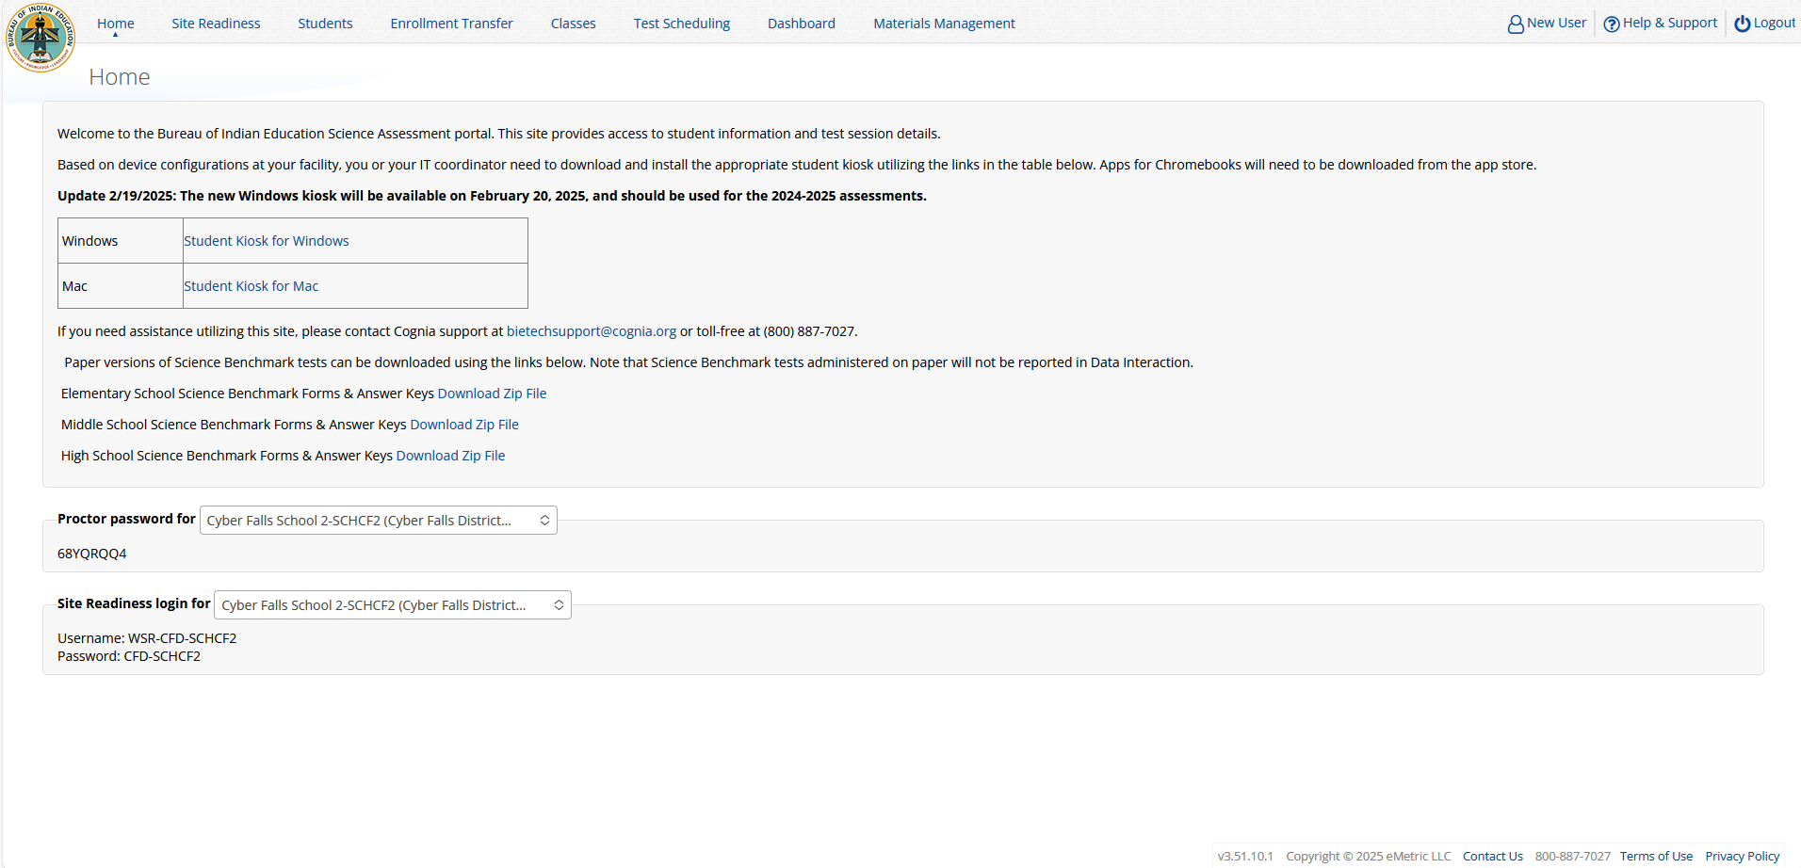
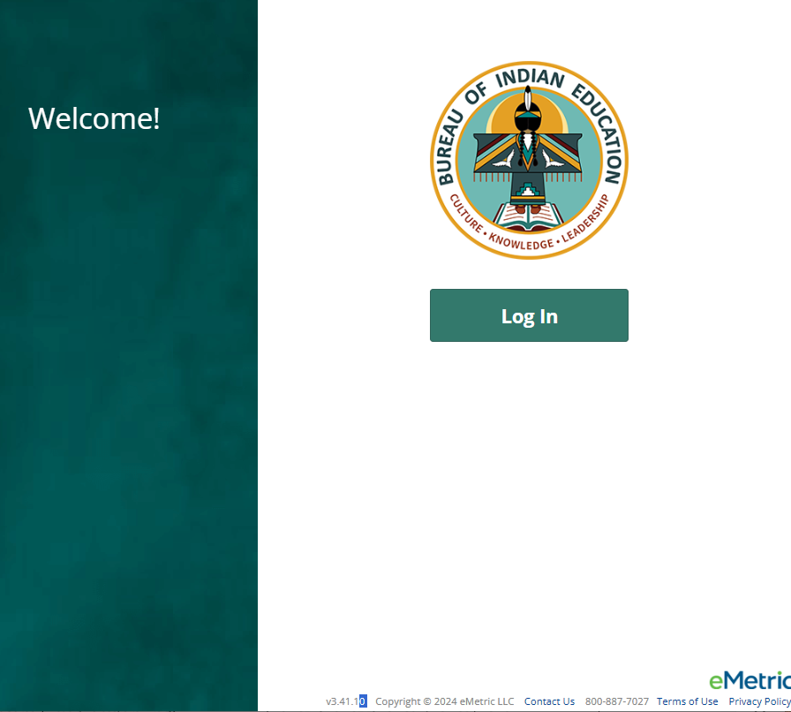
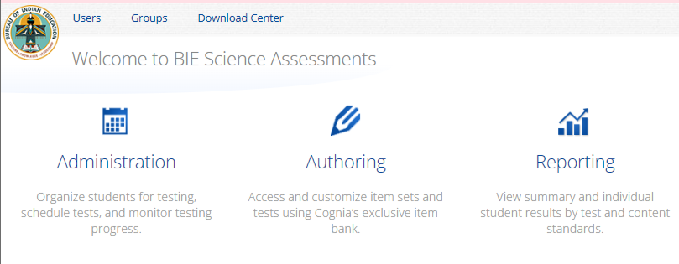
Downloading the PBT forms from the Portal
Log in to the Portal
From the Homepage, select the Administration icon
There you will see the links for downloading the paper-based test forms by grade level
You must download Elementary School, Middle School and High School tests separately
The “Download Zip File” links will be enabled by the start of Benchmark administration.
Click the links to start the file downloads.
After the file downloads, you may need to unzip the files to view the forms. Right-clicking on the file and select “Extract All…”
https://bie.cognia.org/
Notes:
Note/Reminder: remind participants that if they take the paper version, no reporting will be available in Data Interaction; therefore, they should keep track of those testers and scores on their own.

Slide 16
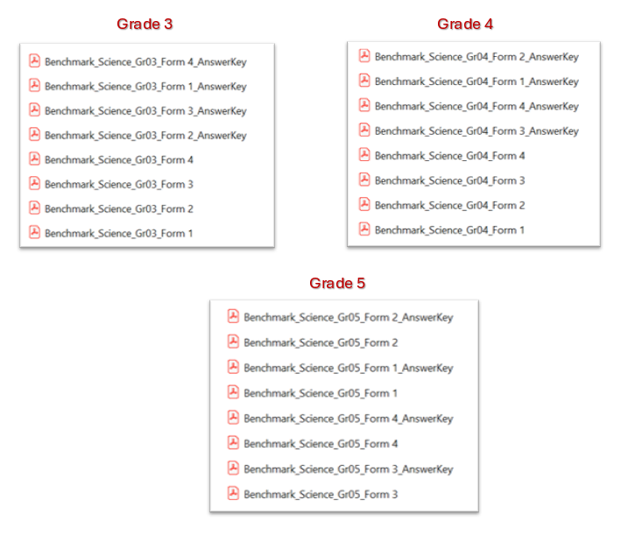
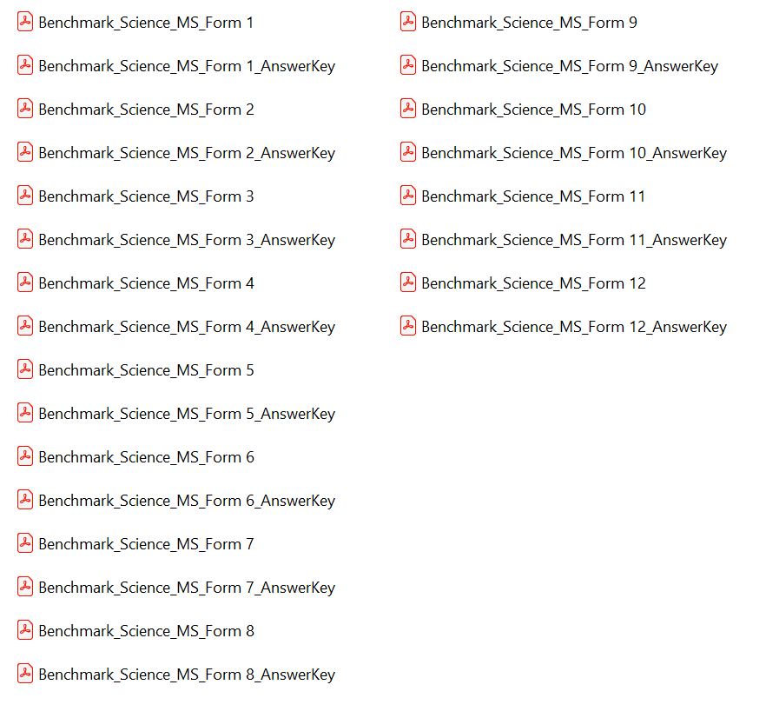
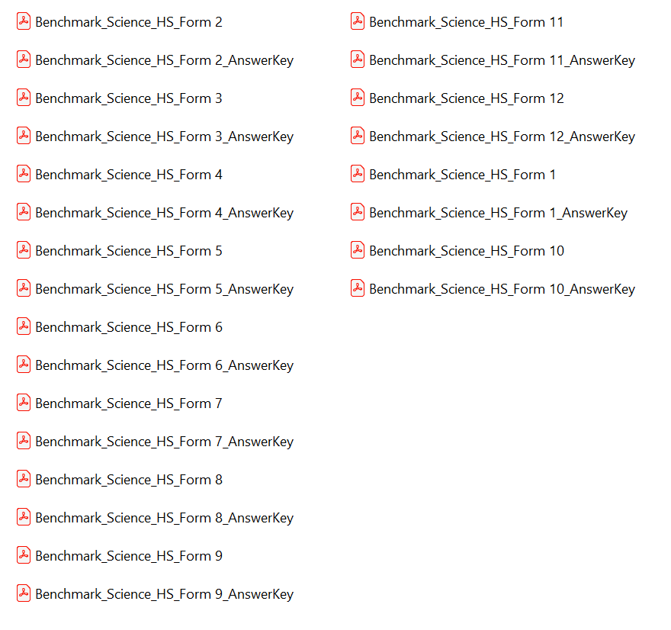
Downloading the PBT forms from the Portal
You must download Elementary School, Middle School and High School tests separately
Elementary School (Grades 3-5)
Middle School (Grades 6-8)
High School (Grades 9-12)
https://bie.Cognia.org
Notes:
Reminder: The science benchmark assessments cover grades 3-12
Note/Reminder: remind participants that if they take the paper version, no reporting will be available in Data Interaction; therefore, they should keep track of those testers and scores on their own.

Slide 17
Science Benchmark Assessments Key Dates

Slide 18
Key Dates
Test Preparation Key Dates
Student Roster Upload by BIE (only 5th, 8th, 11th grade students, field can manually add off-grade students as desired) | August 20, 2025
Portal Open & Kiosks available for download | Sep 8, 2025
Tests available for scheduling in Portal | Sep 22, 2025
Science Benchmark Test Window Opens | Sep 22, 2025
Science Benchmark Test Window Closes | Mar 6, 2026

Slide 19
Science Benchmark Assessments Overview of System & Testing Process

Slide 20



BIE Science Assessment
BIE Science Assessment Portal:
Online Test Administration System
https://bie.cognia.org
BIE Science Assessment Student Test Interface:
Student Test Delivery System

Slide 21
BIE Science Assessment Online System
Online System
Portal
Users
Administration
Test Delivery
Kiosk
Site Setup
Students
Classes
Test Sessions
Dashboard
Browser

Slide 22


Test Preparation Process
STC
Create user accounts
Add/edit/transfer students
Assign accessibility features & accommodations
ITC
Download and install kiosks/apps
Complete Site Readiness Test
STC or TA
Create classes
Schedule classes for test
Print/distribute log-in tickets
Students
Launch kiosk or browser
Log-in and test
TA
Score human scored items on tests
View results in Data Interaction
After testing…

Slide 23

Portal Access
Access
http://bie.cognia.org
Open all year, previous accounts can be used
If you are a new School Test Coordinator, please contact BIE. Upon account creation, a welcome email will be sent from the portal.
STCs will create all new portal user accounts
Usernames must be unique
Your email address controls your account
New users will receive two automated emails, one with username and one with temporary password from bietechsupport@cognia.org
New users will soon be receiving only one automated email, (starting Sept. 19)
When an account is deactivated or reactivated, the user will receive an email
STCs should periodically audit and deactivate user accounts
New

Slide 24
User Roles
User Role | Responsibilities
School Test Coordinator (STC) | Manage Users (add, edit, or deactivate) Access proctor password Edit student information & assign student accommodations Create, edit, and delete classes Schedule test sessions & print logins Manage & monitor test sessions Prepare IT network for student testing if there is no IT Coordinator
IT Coordinator (ITC) | Prepare IT network for student testing Conduct Site Readiness testing
Test Administrator (TA) | Create classes Create test sessions View their students and test sessions Print student login tickets for their test sessions Manage & monitor test sessions Assign test report codes Score human scored items for Benchmark tests View Benchmark results in Data Interaction
Report Access Only (RAO) | View Reports

Slide 25
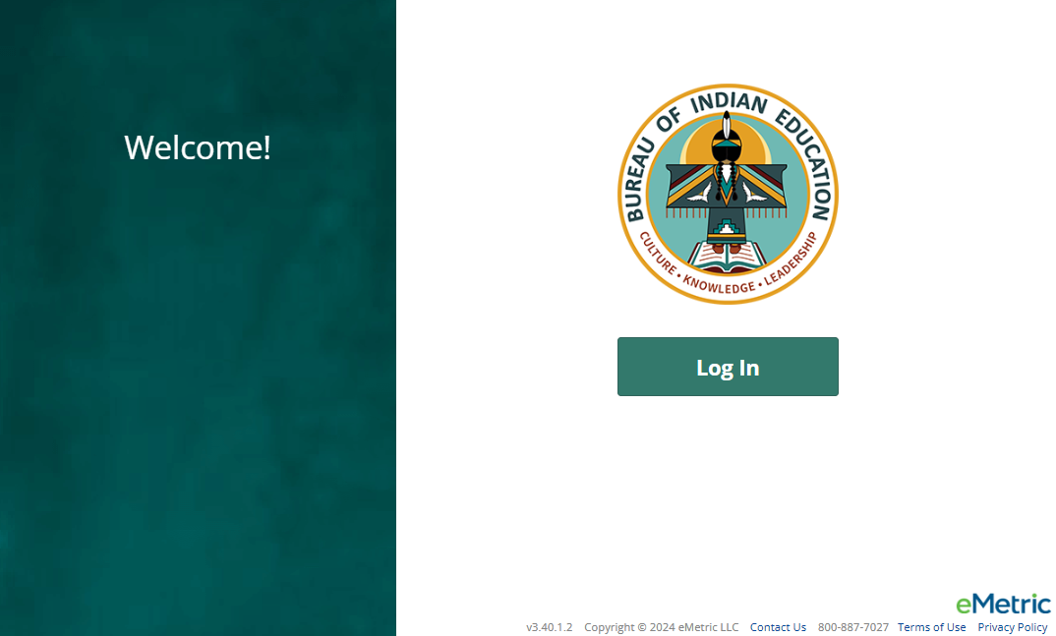
Portal Log-in
Portal URL: https://bie.cognia.org/

Slide 26
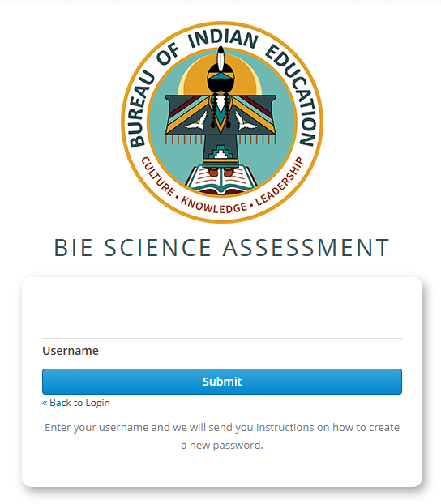
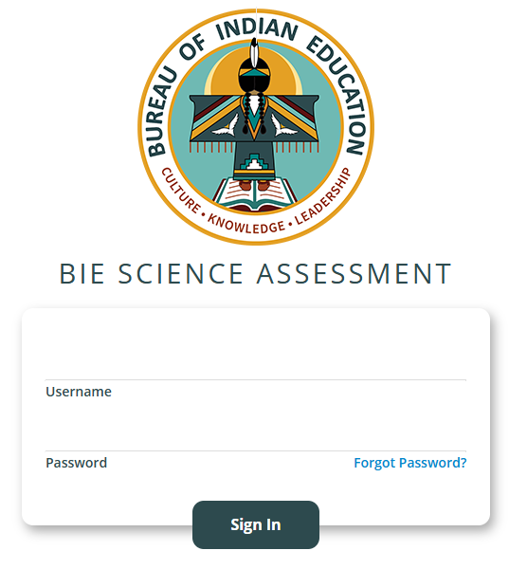
Forgot Password
REMINDER
Type in your Username and Password as indicated in the screenshot below and click the Sign In button to enter the portal.
If you have forgotten your password, select Forgot Password? and enter your Username as indicated in the screenshot below. Click the Submit button. The system will send an email to the email address associated with the account, providing instructions to reset your password.

Slide 27
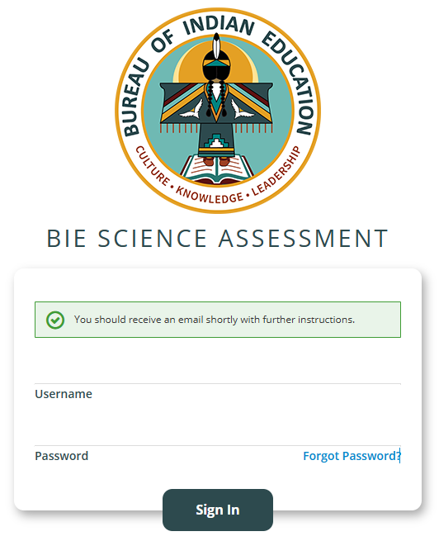
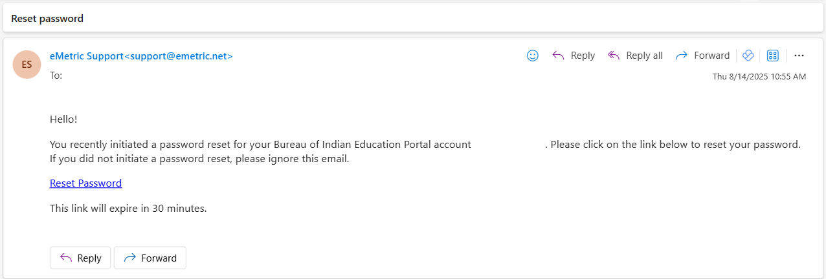
Reset Password
REMINDER
When you submit your Username into the Forgot Password tool, you will be prompted with a green massage to check your email for further instructions. Please check your spam or junk folder if you do not see the email in your inbox.
The email will come from eMetric Support<support@emetric.net>

Slide 28
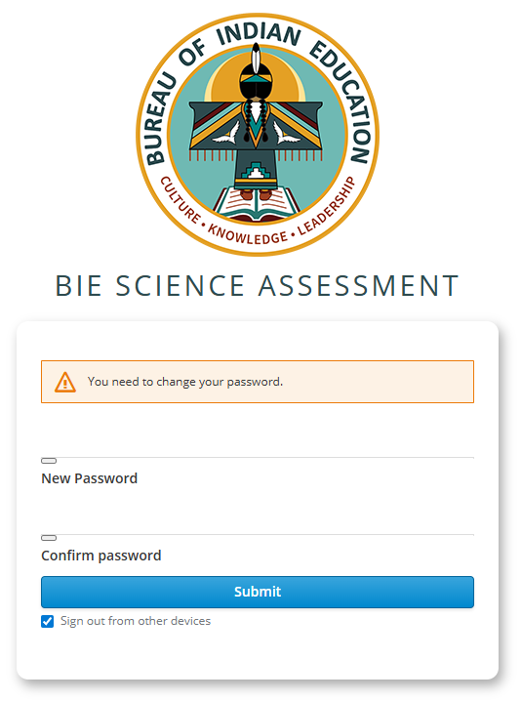
Reset Password
REMINDER
When you click the Reset Password link from the email, you will see this screen to create a New Password and to Confirm password, the click Submit.
(Note: This will sign you out of other devices).

Slide 29
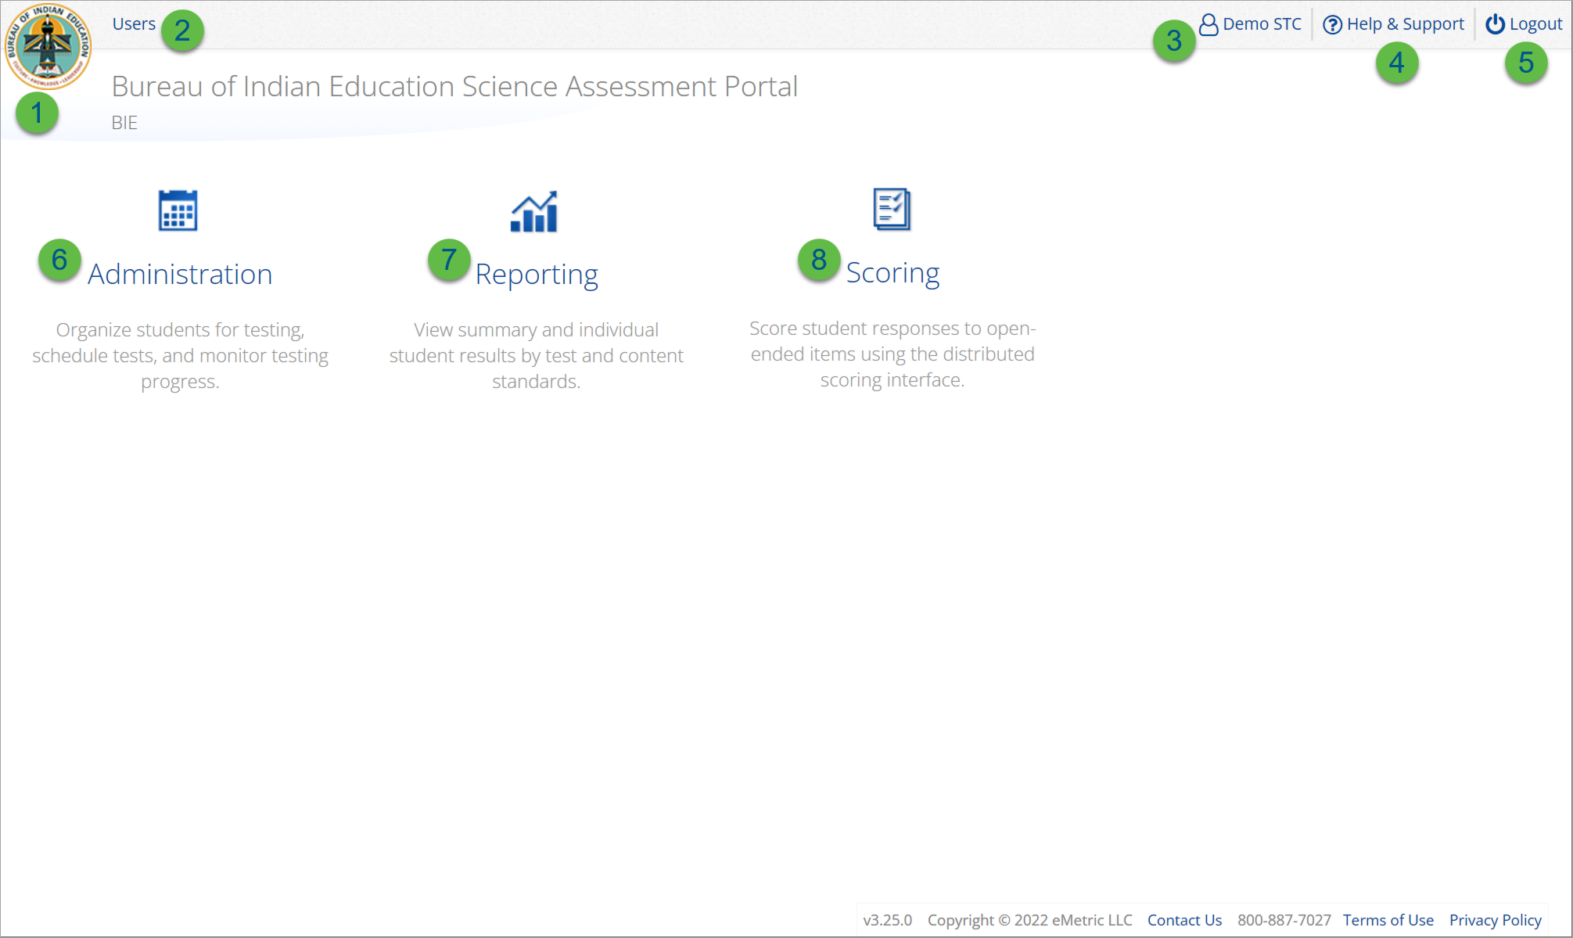
User Accounts & Access
Icon | Description
1 | BIE logo returns to portal home page
2 | Access User Management
3 | View & Edit user profile
4 | Access the BIE Help & Support Site
5 | Logout of the portal
6 | Access Administration Component
7 | Access Reporting
8 | Access Scoring (ONLY the TA Role will have access)
TA Only!

Slide 30
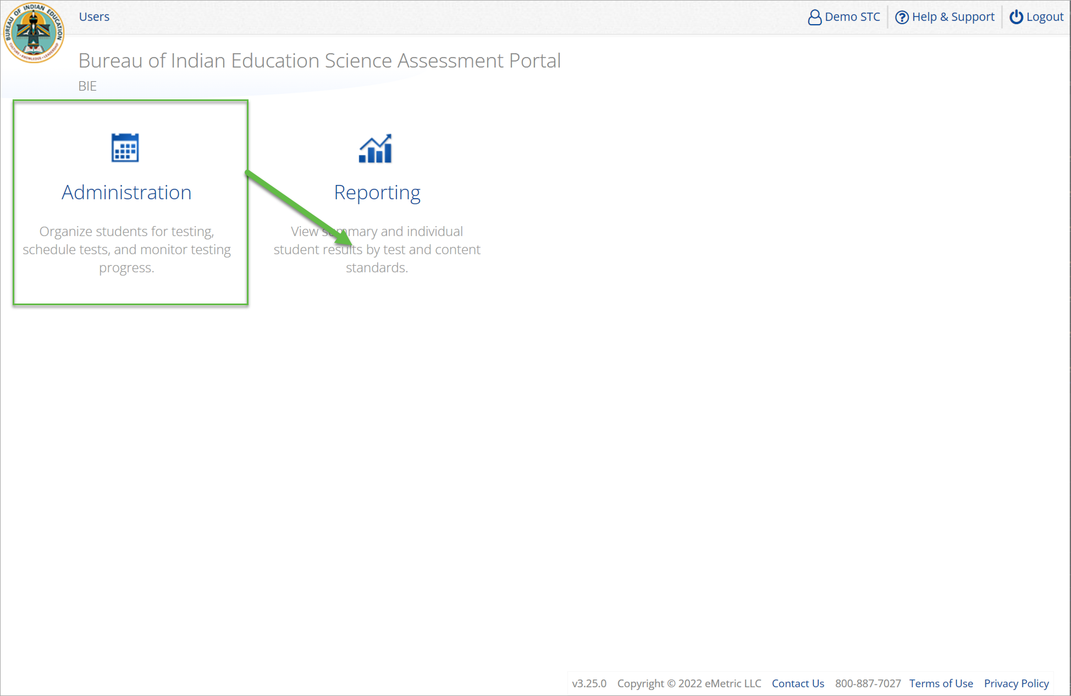
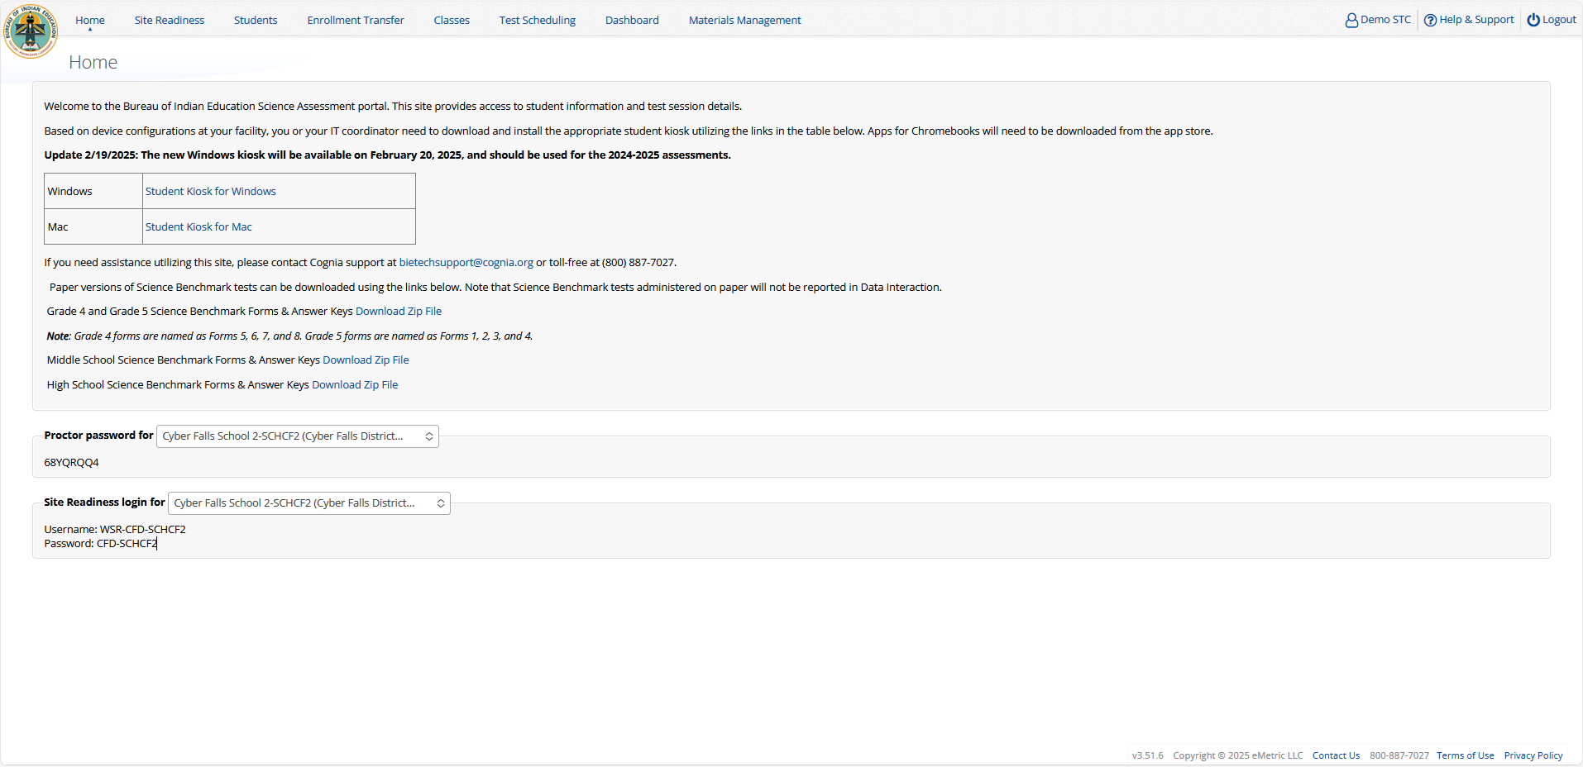
Administration

Slide 31
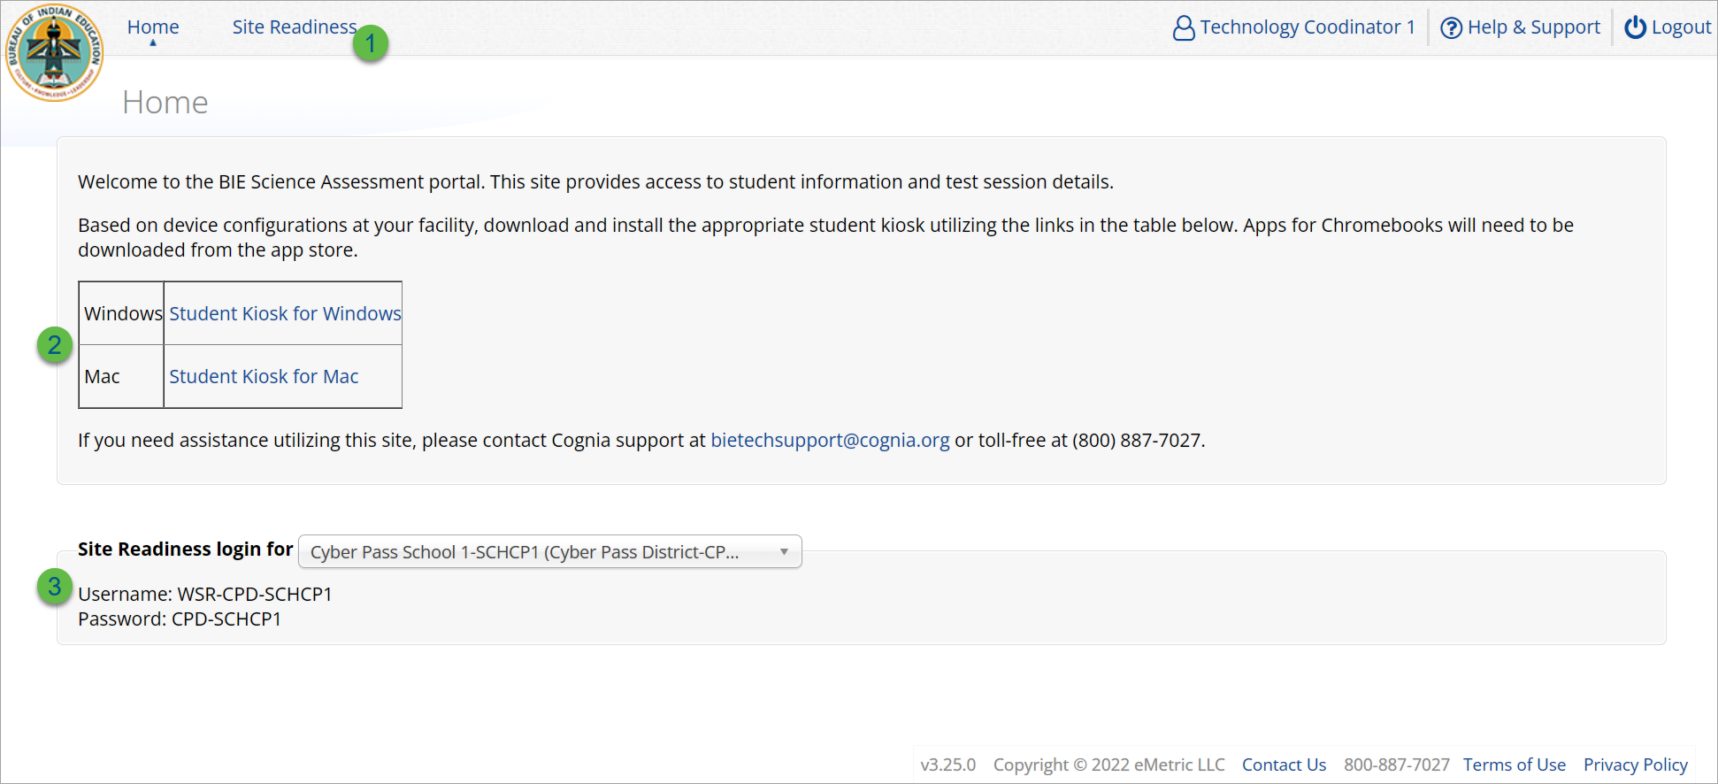
Administration: ITC Account
Icon | Description
1 | Site Readiness tab allows users to view devices that have been tested for site readiness and Site Certification information.
2 | Kiosk installers for Mac and Windows devices are available here.
3 | Site Readiness login credentials are available for each school.

Slide 32
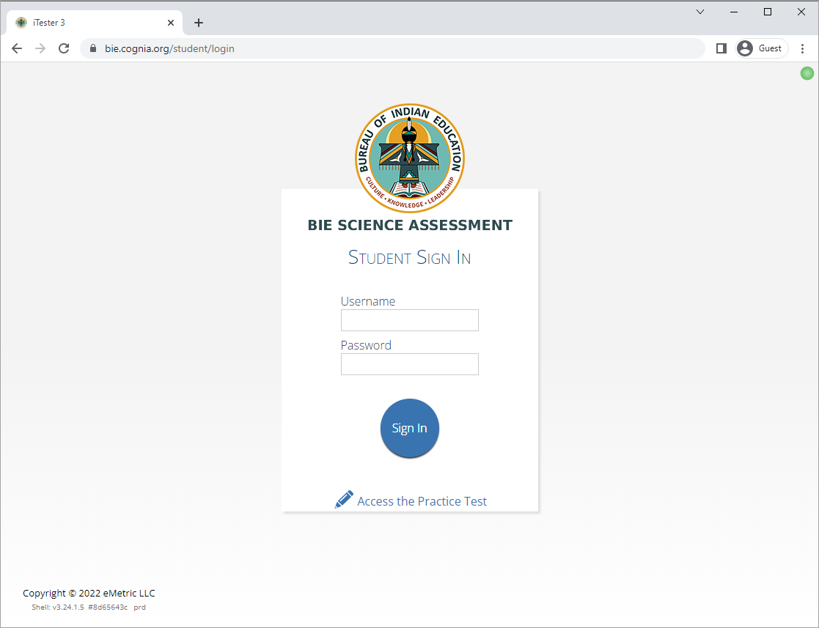
Site Technology Preparation
Browser Requirements
BIE Science Benchmark Assessment & Practice Tests
Available on Chrome, Safari, Firefox, and Microsoft Edge
Browser Student Testing Interface: https://bie.cognia.org/student
Ensure no network settings enforce private browsing or history/cache delete
Do not need to run Site Readiness

Slide 33
Site Technology Preparation
Kiosk Requirements
Windows and Mac Applications
Available to download in the Portal on September 8, 2025
Chromebook Application
Available in the Chrome Webstore
BIE Science Assessment
Add to Google Admin through App Store
Chrome App will update upon launch of the kiosk
URL Link: Kiosk Installation Guide

Slide 34
Site Technology Preparation
System Requirements
System Requirements – All hardware
Connectivity | Student devices must be able to connect to the internet via wired or wireless networks.
Screen Size | 9.7” screen size or larger/ “10-inch class” tablets or larger
Screen Resolution | 1024 x 768 or larger
Headphones/Earphones/Ear Buds | Headphones/earphones/ear buds are required for students who have a text-to-speech accessibility feature
Browser Requirements (Portal & Practice Tests)
Chrome™ 138 or newer Firefox® 140 or newer Microsoft Edge™ 138 or newer Safari® 18 or newer
https://bie.cognia.org/

Slide 35

Site Technology Preparation
Student Device Requirements Desktop & Laptop
CPU | 1.3 GHz
Memory | 2 GB (4 GB is strongly recommended for best performance)
Input Device | Keyboard (wired or wireless)/Bluetooth mouse or touchpad
Windows® | 11 (23H2; 24H2)
Mac OS® | 13.4, 14.6 (64-bit only)
Chromebook Specific Requirements
Chromebook™ notebook computer* | Chrome OS™ LTS 132+ Stable Channel 138+
Updated Sep. 4th, 2025. Check the Cognia help and support site for more recent updates.
https://bie.onlinehelp.cognia.org/resources/

Slide 36

Technology Requirements
Important Reminders
The BIE Science Benchmark Assessment can be taken with a browser or by using the kiosk.
Students testing on devices that do not meet the Student Workstation Specifications are likely to encounter performance-related issues during testing.
Technology Guidelines may be updated throughout the test administration window as new operating systems are released and tested.
Do not update your test device OS until the Technology Guidelines have been updated.
BIE Science Assessments Technology Guidelines

Slide 37
Technology Requirements
Chrome
Students should launch app from App tray, they should NOT log in to the Chromebook
For managed Chromebooks, ensure “Do not erase all local data” is selected in Device Settings/User Data
For managed Chromebooks, ensure “Allow App to manage power” is disabled in Device Settings/App Management
Non-managed Chromebooks manufactured after 2017 will not run-in kiosk mode, you must use as managed device to test
BIE Science Assessments Technology Guidelines

Slide 38
Technology Requirements
Firewalls
Allow traffic through ports 80 and 443
Proxy and Content Filters Servers
List of URLs to whitelist on ports 80 and 443 available in Kiosk Installation Guide
Sandboxing Applications (e.g. Deep Freeze)
Choose network folder or local folder that is not touched by the sandboxing applications
Applicable for both stored response and kiosk installation folders
Thin Clients
Ensure there is enough memory, CPU, and bandwidth on the server to accommodate multiple student test sessions.
Client requires a minimum of 80 MB per Client session.
BIE Science Assessments Technology Guidelines

Slide 39
Administration Workflow
Students
Classes
Site Readiness
Test Sessions
Dashboard
Home
Notes:
The next component of the BIE Science Portal that we are going to go over is the Administration component.
The Administration component consists of 5-6 tabs depending on your account type.
Home – this is where you can view important announcements, access links for downloading the Kiosks, and attain the Proctor Password and Site Readiness log in credentials.
Site Readiness – this is where you can certify your site as ready for testing.
Students – this is where you can assign student accommodations.
Classes – this is where you can verify your rosters for testing.
Test Sessions – this is where you will schedule your classes for test sessions.
And, the Dashboard – this is where you can view helpful charts and data at the district level.

Slide 40
Site Readiness
1. Review the Kiosk Installation Guide
https://bie.onlinehelp.cognia.org/resources/
2. Download & Install Kiosks
Download Windows or Mac kiosks from BIE Science Assessment Portal
Download Chrome app from appropriate app store
3. Conduct Site Readiness Testing
Run both tests on each device configuration
4. Certify Site
Certify your site as “Ready for Testing” in the Portal

Slide 41
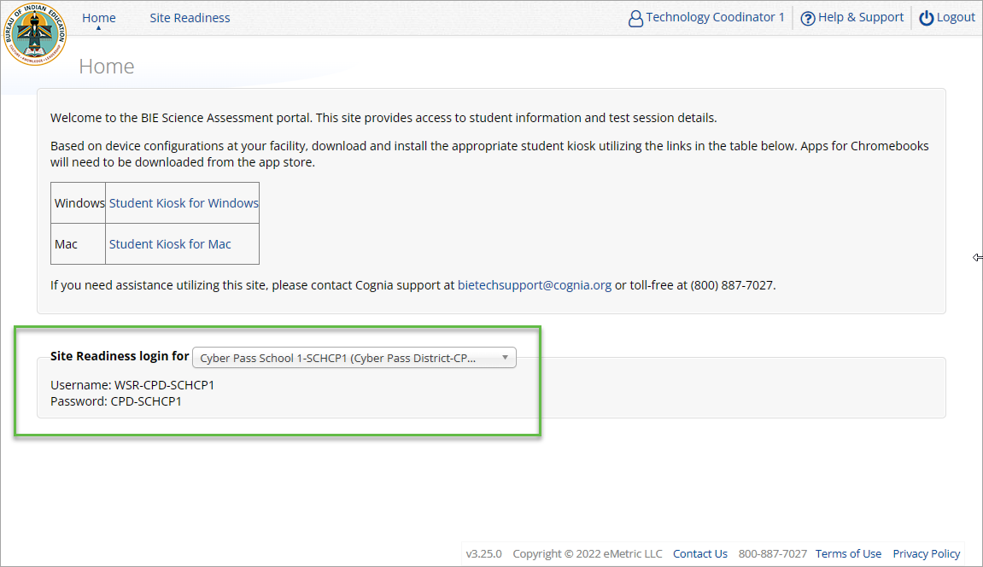
Site Readiness
Notes:
The first step for conducting Site Readiness testing is to download and install the Kiosks and Mobile Apps onto the devices that will be used for testing at your school.
Once you’ve downloaded and installed your Kiosks and Mobile Apps, log in to the Portal to retrieve the site readiness login credentials for your school.
Launch the kiosk or the app and login using the site readiness credentials.
Run the test on a handful of devices for each configuration.
Once you’ve successfully completed your Site Readiness testing, log back into the Portal and navigate to the Site Readiness tab within the Administration component. Here, you can view the details of the devices that you used for Site Readiness testing.
Finally, you’ll certify your site as ready for testing.
Each site has it’s own login credentials for Site Readiness. Each school needs to be certified as ready for testing.

Slide 42
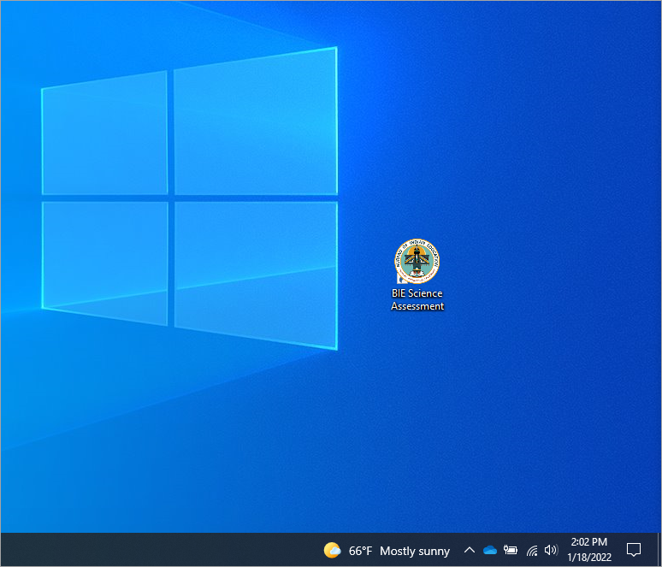
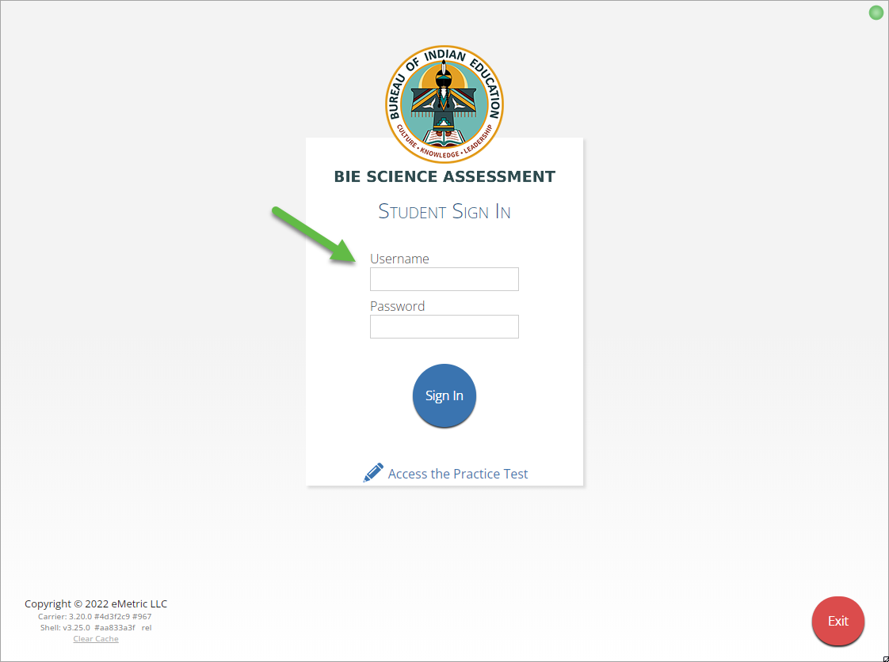
Site Readiness
Notes:
The first step for conducting Site Readiness testing is to download and install the Kiosks and Mobile Apps onto the devices that will be used for testing at your school.
Once you’ve downloaded and installed your Kiosks and Mobile Apps, log in to the Portal to retrieve the site readiness login credentials for your school.
Launch the kiosk or the app and login using the site readiness credentials.
Run the test on a handful of devices for each configuration.
Once you’ve successfully completed your Site Readiness testing, log back into the Portal and navigate to the Site Readiness tab within the Administration component. Here, you can view the details of the devices that you used for Site Readiness testing.
Finally, you’ll certify your site as ready for testing.
Each site has it’s own login credentials for Site Readiness. Each school needs to be certified as ready for testing.

Slide 43
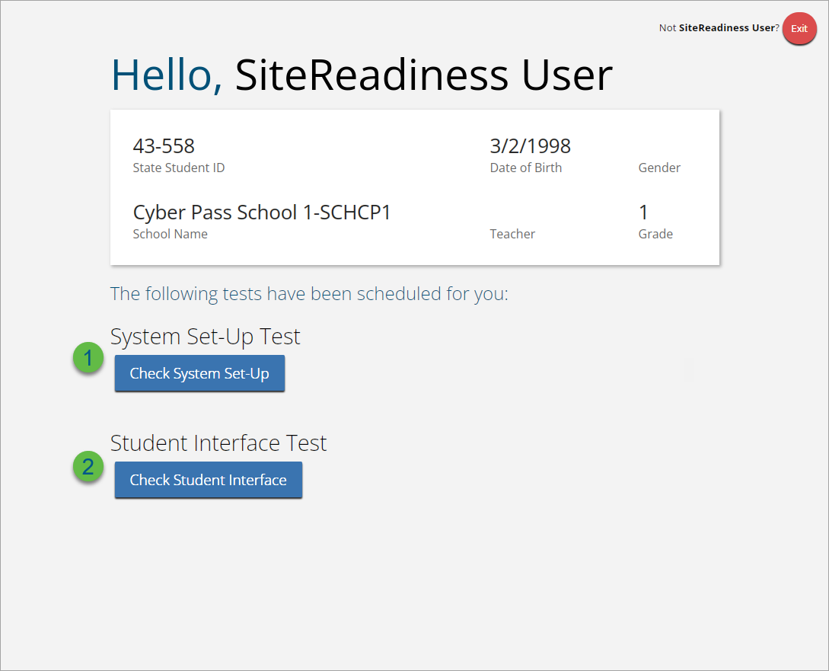
Site Readiness

Slide 44
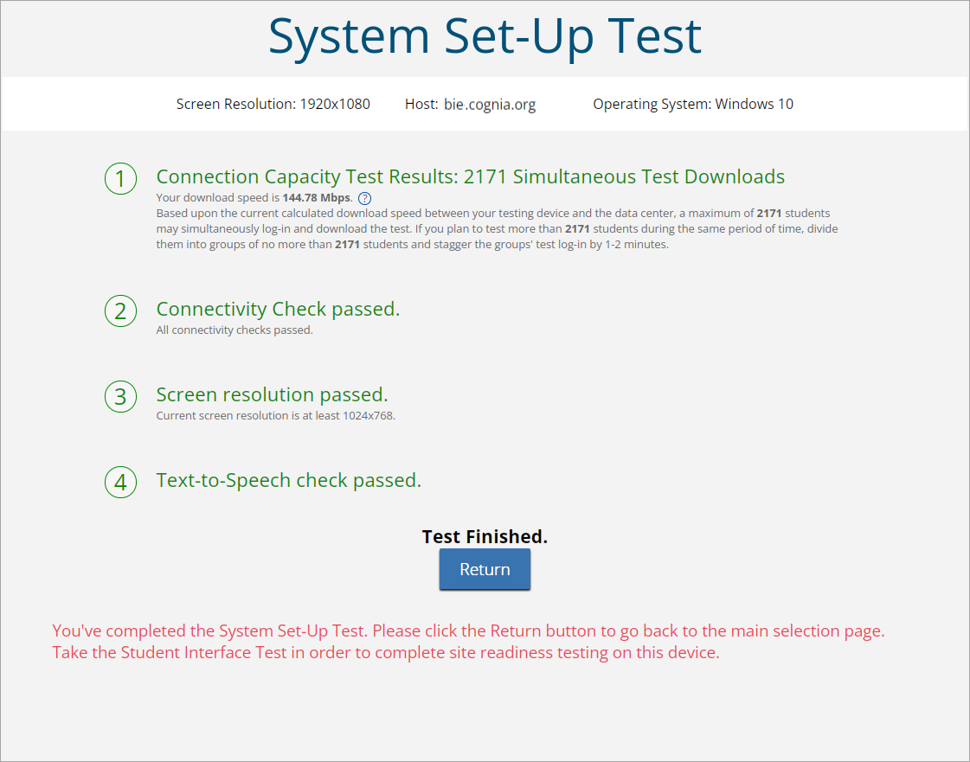
Site Readiness

Slide 45
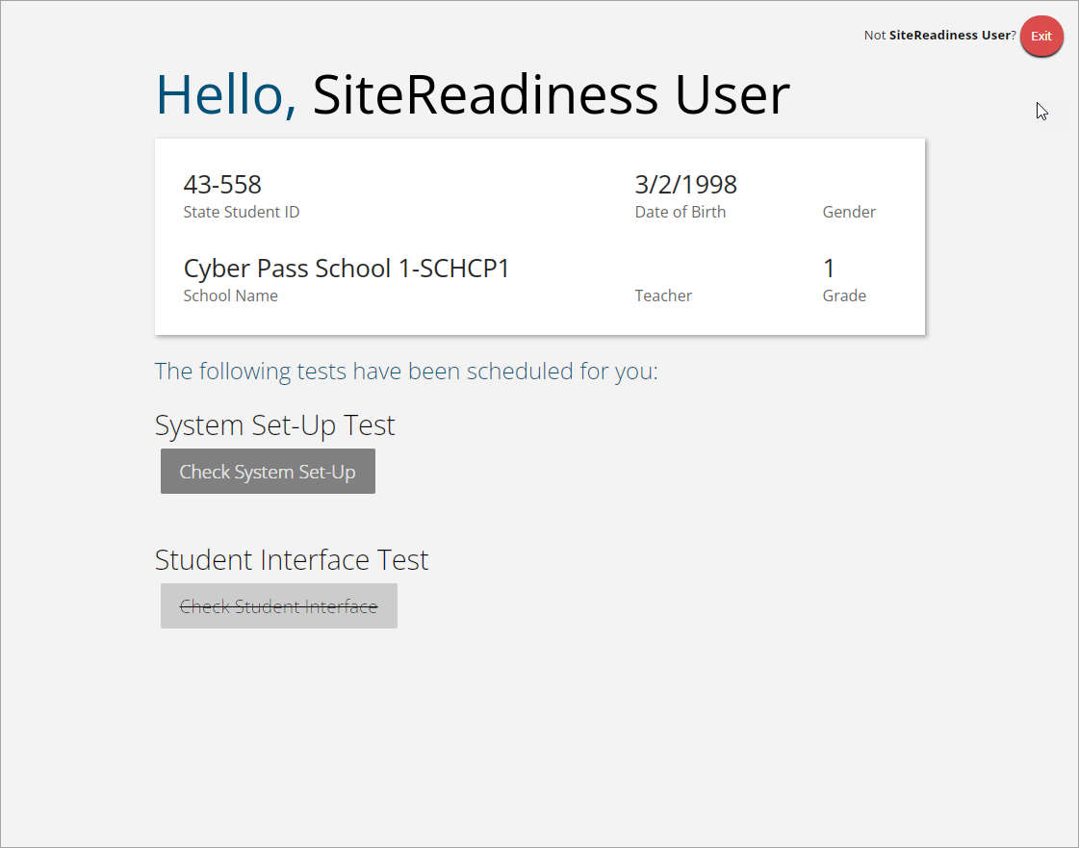
Site Readiness
Student Interface Test must be completed to log complete site readiness results in the portal.

Slide 46
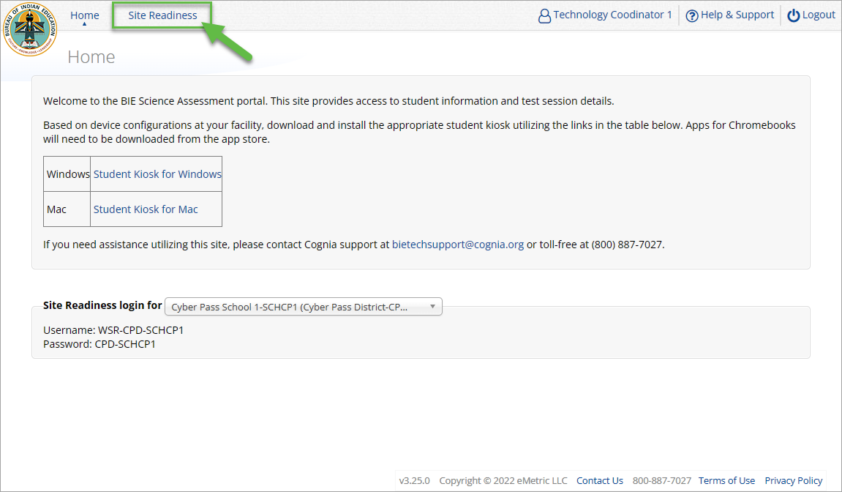
Site Readiness
Notes:
The first step for conducting Site Readiness testing is to download and install the Kiosks and Mobile Apps onto the devices that will be used for testing at your school.
Once you’ve downloaded and installed your Kiosks and Mobile Apps, log in to the Portal to retrieve the site readiness login credentials for your school.
Launch the kiosk or the app and login using the site readiness credentials.
Run the test on a handful of devices for each configuration.
Once you’ve successfully completed your Site Readiness testing, log back into the Portal and navigate to the Site Readiness tab within the Administration component. Here, you can view the details of the devices that you used for Site Readiness testing.
Finally, you’ll certify your site as ready for testing.
Each site has it’s own login credentials for Site Readiness. Each school needs to be certified as ready for testing.

Slide 47
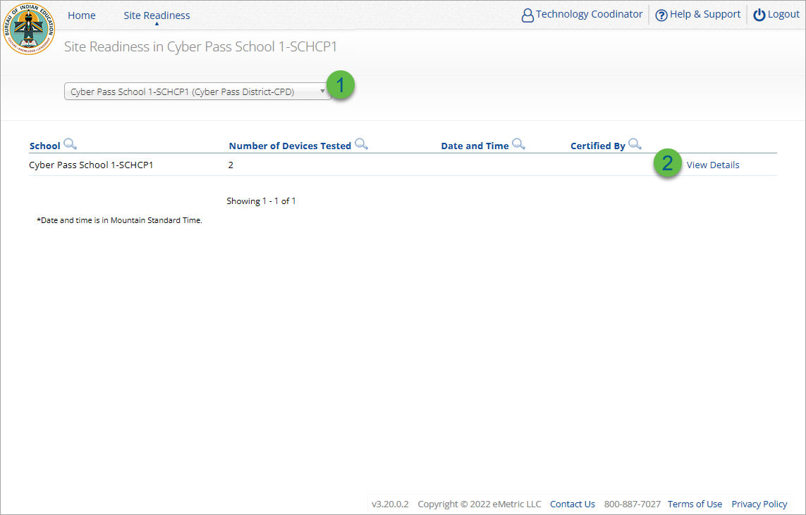
Site Readiness
Step | Description
1 | Select the organization.
2 | Click View Details to view the devices at the school.
Notes:
The first step for conducting Site Readiness testing is to download and install the Kiosks and Mobile Apps onto the devices that will be used for testing at your school.
Once you’ve downloaded and installed your Kiosks and Mobile Apps, log in to the Portal to retrieve the site readiness login credentials for your school.
Launch the kiosk or the app and login using the site readiness credentials.
Run the test on a handful of devices for each configuration.
Once you’ve successfully completed your Site Readiness testing, log back into the Portal and navigate to the Site Readiness tab within the Administration component. Here, you can view the details of the devices that you used for Site Readiness testing.
Finally, you’ll certify your site as ready for testing.
Each site has it’s own login credentials for Site Readiness. Each school needs to be certified as ready for testing.

Slide 48
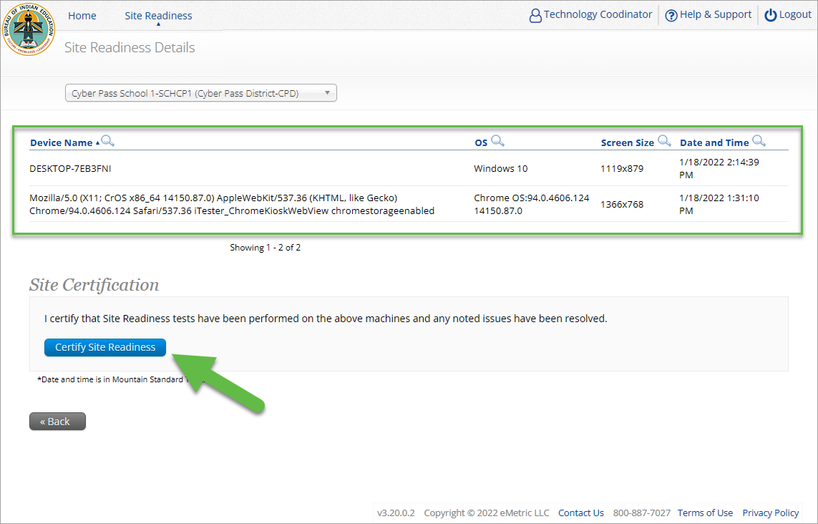
Site Readiness
Notes:
The first step for conducting Site Readiness testing is to download and install the Kiosks and Mobile Apps onto the devices that will be used for testing at your school.
Once you’ve downloaded and installed your Kiosks and Mobile Apps, log in to the Portal to retrieve the site readiness login credentials for your school.
Launch the kiosk or the app and login using the site readiness credentials.
Run the test on a handful of devices for each configuration.
Once you’ve successfully completed your Site Readiness testing, log back into the Portal and navigate to the Site Readiness tab within the Administration component. Here, you can view the details of the devices that you used for Site Readiness testing.
Finally, you’ll certify your site as ready for testing.
Each site has it’s own login credentials for Site Readiness. Each school needs to be certified as ready for testing.

Slide 49
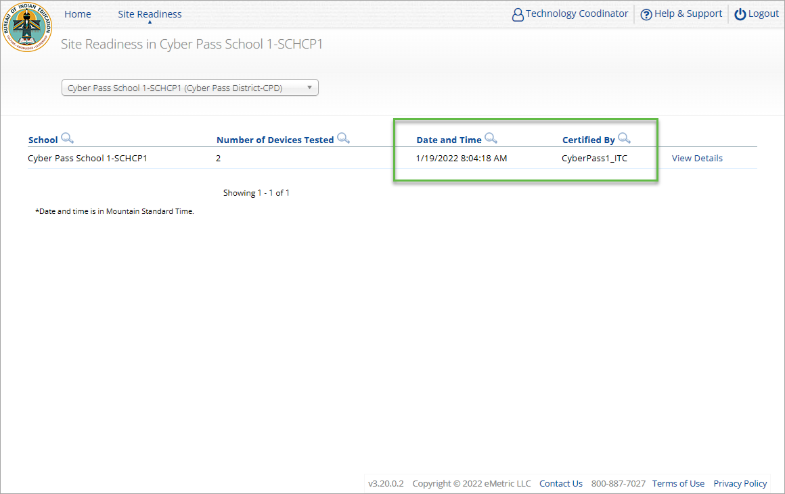
Site Readiness
Notes:
The first step for conducting Site Readiness testing is to download and install the Kiosks and Mobile Apps onto the devices that will be used for testing at your school.
Once you’ve downloaded and installed your Kiosks and Mobile Apps, log in to the Portal to retrieve the site readiness login credentials for your school.
Launch the kiosk or the app and login using the site readiness credentials.
Run the test on a handful of devices for each configuration.
Once you’ve successfully completed your Site Readiness testing, log back into the Portal and navigate to the Site Readiness tab within the Administration component. Here, you can view the details of the devices that you used for Site Readiness testing.
Finally, you’ll certify your site as ready for testing.
Each site has it’s own login credentials for Site Readiness. Each school needs to be certified as ready for testing.

Slide 50



Browser Requirements
Do not use browser in private or incognito mode
Do not delete browsing history or browser cache
Notes:
The first step for conducting Site Readiness testing is to download and install the Kiosks and Mobile Apps onto the devices that will be used for testing at your school.
Once you’ve downloaded and installed your Kiosks and Mobile Apps, log in to the Portal to retrieve the site readiness login credentials for your school.
Launch the kiosk or the app and login using the site readiness credentials.
Run the test on a handful of devices for each configuration.
Once you’ve successfully completed your Site Readiness testing, log back into the Portal and navigate to the Site Readiness tab within the Administration component. Here, you can view the details of the devices that you used for Site Readiness testing.
Finally, you’ll certify your site as ready for testing.
Each site has it’s own login credentials for Site Readiness. Each school needs to be certified as ready for testing.

Slide 51
Browser & Kiosk Requirements (network)
Beginning of Test:
Authenticate login
Download test content
End of Test:
1. Submit responses for scoring
Notes:
The first step for conducting Site Readiness testing is to download and install the Kiosks and Mobile Apps onto the devices that will be used for testing at your school.
Once you’ve downloaded and installed your Kiosks and Mobile Apps, log in to the Portal to retrieve the site readiness login credentials for your school.
Launch the kiosk or the app and login using the site readiness credentials.
Run the test on a handful of devices for each configuration.
Once you’ve successfully completed your Site Readiness testing, log back into the Portal and navigate to the Site Readiness tab within the Administration component. Here, you can view the details of the devices that you used for Site Readiness testing.
Finally, you’ll certify your site as ready for testing.
Each site has it’s own login credentials for Site Readiness. Each school needs to be certified as ready for testing.

Slide 52

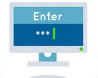


Browser & Kiosk Test Integrity
What happens if a student loses network connection in the middle of a test?
A
C
D
B
45-90sec
A
C
Browser Cache
Stored Response Folder (kiosk)
D
B

Slide 53
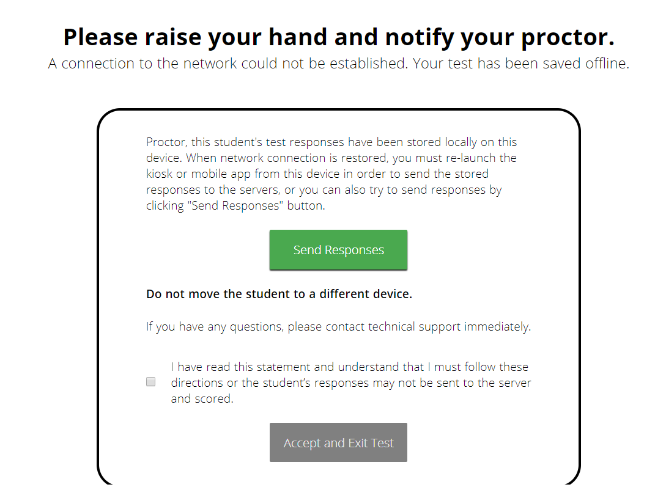
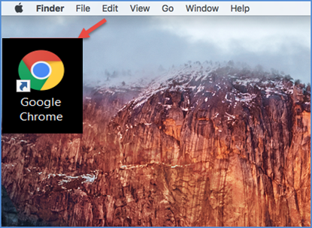

Browser & Kiosk Test Integrity
What if a student finishes a test but has no network connection?
A
C
A
B
C
D
B
C
D
A
B
C
D
A
B
C
D
A
B
D
Turn In
A
C
C
A
B
D
D
B
C
A
B
C
D
A
B
C
D
A
B
D

Slide 54
Browser & Kiosk Test Integrity
Loss of Network Connectivity Procedure Summary
If a student loses network connectivity in the middle of a test:
Keep testing on that device
Test content and responses are stored securely on the test device, either in the browser cache or the stored response folder
Responses will be sent when network is restored
If student finishes and is ready to turn in test prior to network being restored:
Allow student to turn in test
Student will see offline message, acknowledge offline message and exit
Student will be taken back to login page or receive no internet connection message
Restore network
Return to that exact device and relaunch the browser or relaunch the kiosk
(student can log-in to confirm session is done (session button will be greyed out)
If you are unsure of the status of the student responses, call the help desk

Slide 55
Additional Training Resources
Help Guides
Browser Testing User Guide
Kiosk Installation Guide
Portal User Guide
Kiosk User Guide
Technology Guidelines
Testing with Third Party Accessibility Software
Quick Start Guides & Online System Tutorial Videos
https://bie.onlinehelp.cognia.org/resources/

Slide 56
Reminders
ITCs:
Students can take the BIE Science Benchmark using a browser.
If using Kiosks, they do need to be downloaded, and apps installed.
Make sure network management tools don’t delete stored response folder.
Communicate with Proctors/Test Administrators
Are there limits to number of students who should log in simultaneously?
Do they know the procedure for recovering stored responses?
Do they have basic information required by the support center if they call in?
https://bie.cognia.org/

Slide 57
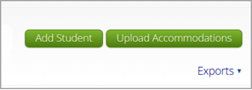
Managing Students
To manually Add a Student, follow the steps below:
From the Students page, click the Add New Student button above the student table on the right.
The Student Information tab will be displayed. Fill in the student’s demographic information, fields with a red asterisk are required. Take care when filling in the State ID Number, Last Name, First Name, Middle Initial, Grade, and Date of Birth. Once the form is saved, you cannot edit the State Student ID.
https://bie.cognia.org/

Slide 58
Questions?

Slide 59
Cognia Help & Support Site

Slide 60
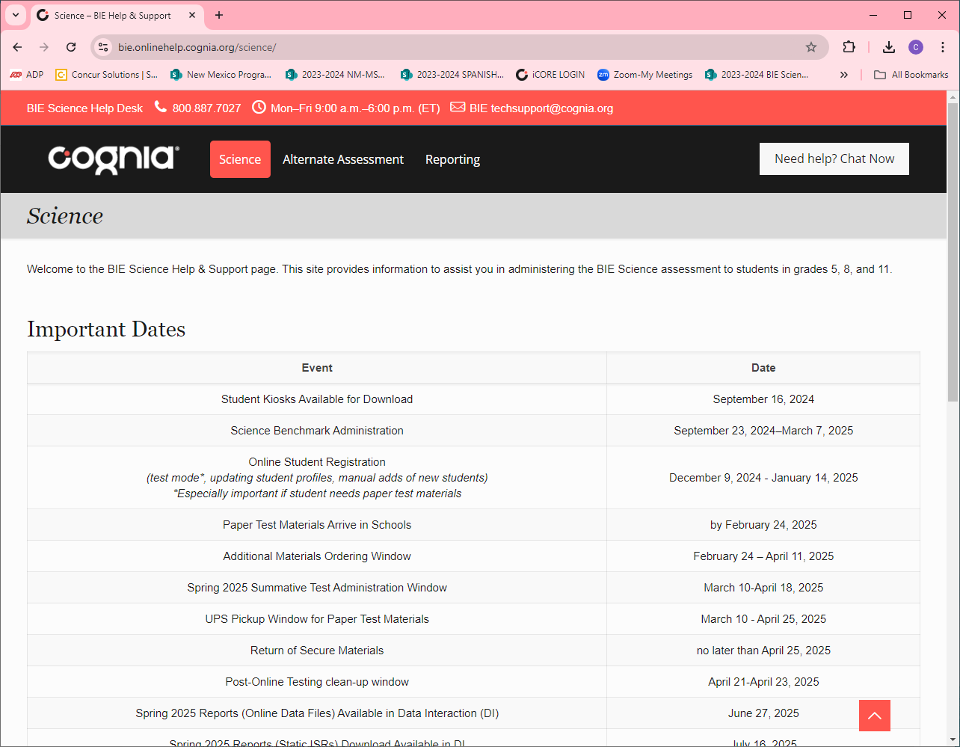
Help & Support Site General Education Science Page
A page specifically dedicated to BIE Science Summative Assessment
https://bie.onlinehelp.cognia.org/science/
Key Dates
Testing Accommodations
Online System Tutorials
Practice Tests
Paper (PBT)
Online (CBT)
Resources
Training
Manuals, Online User Guides, Quickstart Guides, Technical Report. Reporting Resources, Forms, Score Interpretation Guides, etc.
Webinars Recordings and Slides
Quick video tutorials explaining specific tasks
Paper based testing braille, large print, & human reader kits special instructions sheets
High level important dates for 2024-25SY
Online based testing universal tools, accessibility features & accommodations chart
https://bie.onlinehelp.cognia.org/science/

Slide 61
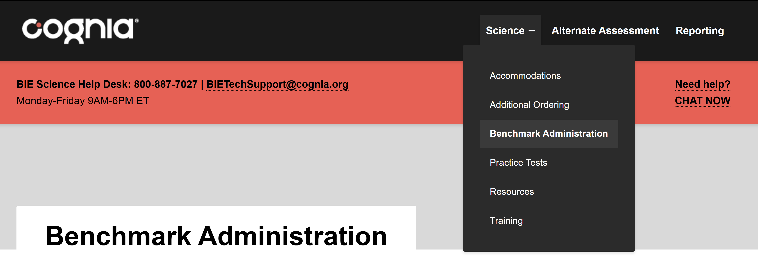
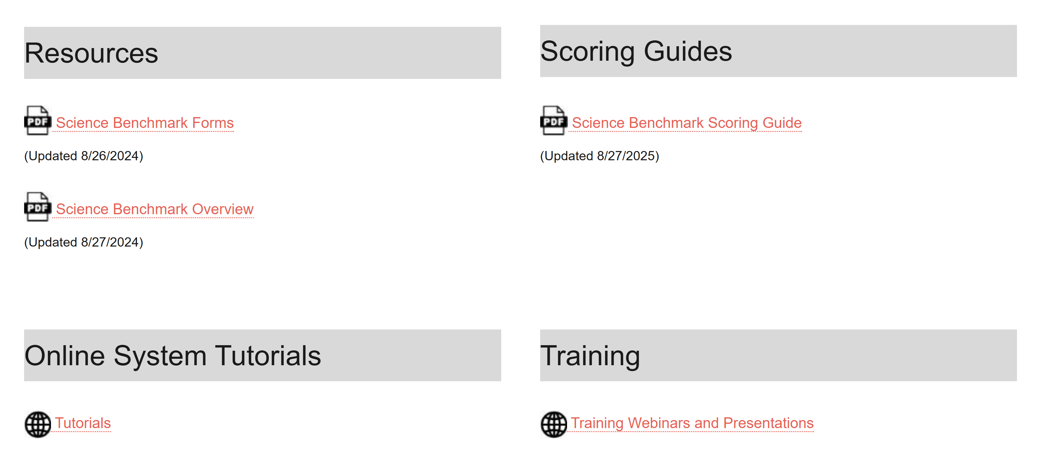
Help & Support Site Science Benchmark Page
A page specifically dedicated to Science Benchmark Administration:
https://bie.onlinehelp.cognia.org/benchmark-administration/
Key Dates
Scoring Guides
Online System Tutorials
https://bie.onlinehelp.cognia.org/benchmark-administration/

Slide 62
BIE Science Help Desk/Client Care Center
Hours
Monday–Friday from 9:00 a.m.–6:00 p.m. (ET)
Contact information
Phone: 800-887-7027
Email: BIETechSupport@cognia.org
Live Chat Link (available from the Help & Support site)

Slide 63






Thank you
Learn more at cognia.org

Slide 64


Knowledge is Opportunity.
Cognia is a global nonprofit that has the knowledge to help schools improve outcomes for all learners.

