Slide 1

Welcome!
The training will begin shortly.

Slide 2

Spring 2025 BIE Science Data Interaction Reporting Training
Friday, September 12, 2025

Slide 3
Table of Contents
Welcome & Introductions
Housekeeping Tips
BIE Science and MSAA Data Interaction Reporting Presentation
Demo
Questions
Cognia Help & Support Site
What’s New for SY 2025-2026?

Slide 4
Housekeeping
All participants should remain on mute with their video off.
Post all questions to the chat.
Questions will be addressed at each section break.
Please add your name, email, and school to the chat.
This training will be recorded.
The recording will be posted to the Help & Support site.

Slide 5

Welcome & Introductions

Slide 6
Who’s Who
BIE
Aurelia Shorty, Education Program Specialist (Assessment & Accountability)
Cognia
Mara Allaire, Program Manager
eMetric
Gerry Retzloff, Project Manager
Donald Griffin, Section 504 Program Coordinator, MSAA Project Manager
Sarah McCain, IT Project Manager II
Kaelee Harper, Senior Support Center Manager
Dr. Carmelia Becenti, Chief Academic Officer

Slide 7

BIE Science and MSAA Assessments Reporting in Data Interaction
Gerry Retzloff, eMetric
Kaelee Harper, eMetric

Slide 8
Agenda
Terms and Acronyms
What Kind of Information is Available in Data Interaction?
Key Dates
Account Types and Accessing Data Interaction Reports in the Portal
Generating Reports and Using Tools in Data Interaction
Student List
Summary Reports
Data Tools
Other features
Demo
Additional Training Resources

Slide 9
Terms and Definitions
BIE Science Assessments Portal (aka “Portal”): website serving as entry point for online testing and reporting for BIE Science assessments and MSAA reporting
bie.cognia.org (viewable on desktop and mobile device)
iTester: eMetric online test administration system used with BIE Science assessments (Summative and Benchmark Science), accessed via the Portal
Data Interaction: eMetric reporting system for educators, accessed via the Portal

Slide 10
BIE Science Assessment Online System
Online System
Administration and Reporting Portal
https://bie.cognia.org
Users
Administration
Test Delivery
Student Test Interface
Kiosk
Site Setup
Students
Browser
Reporting
Classes
Test Sessions
Scoring
Enrollment Transfer
Reporting Portal for BIE Science Assessment and MSAA Alternate Assessment, both!

Slide 11
Key Dates
Key Reporting Dates
Spring 2025 BIE General Science reports in DI | Jun 27, 2025
Spring 2025 MSAA (Alternate) ELA, Math, & Science reports in DI (includes ISR PDFs) | Jul 14, 2025
Spring 2025 BIE General Science ISRs PDFs in DI | Jul 16, 2025
Spring 2025 BIE General Science Print Reports in Schools | August 6, 2025
Benchmark Science administration window opens | Sep 22, 2025
Benchmark Science administration window closes | Mar 6, 2026
Benchmark Science reports in DI | After test is completed

Slide 12

Portal Access
Access
http://bie.cognia.org
Open all year, previous accounts can be used this year
If you are a new School Test Coordinator, please contact BIE. Upon account creation, a welcome email will be sent from the portal.
STCs will create all new portal user accounts
Usernames must be unique
Your email address controls your account
New users will receive two automated emails, one with username and one with temporary password from bietechsupport@cognia.org
New users will soon be receiving only one automated email, (starting Sept. 19)
When an account is deactivated or reactivated, the user will receive an email
STCs should periodically audit and deactivate user accounts

Slide 13
User Roles
User Role | Responsibilities
School Test Coordinator (STC) | Manage Users (add, edit, or deactivate) Access proctor password Edit student information & assign student accommodations Create, edit, and delete classes Schedule test sessions & print logins Manage & monitor test sessions Assign test report code Prepare IT network for student testing if there is no IT Coordinator View Science, MSAA, and Science Benchmark results in Data Interaction
IT Coordinator (ITC) | Prepare IT network for student testing Conduct Site Readiness testing
Test Administrator (TA) | Create classes Create test sessions View their students and test sessions Print student login tickets for their test sessions Manage & monitor test sessions Assign test report codes Score human scored items for Benchmark tests View Science Benchmark results in Data Interaction
Report Access Only (RAO) | View Science, MSAA, and Science Benchmark results in Data Interaction

Slide 14
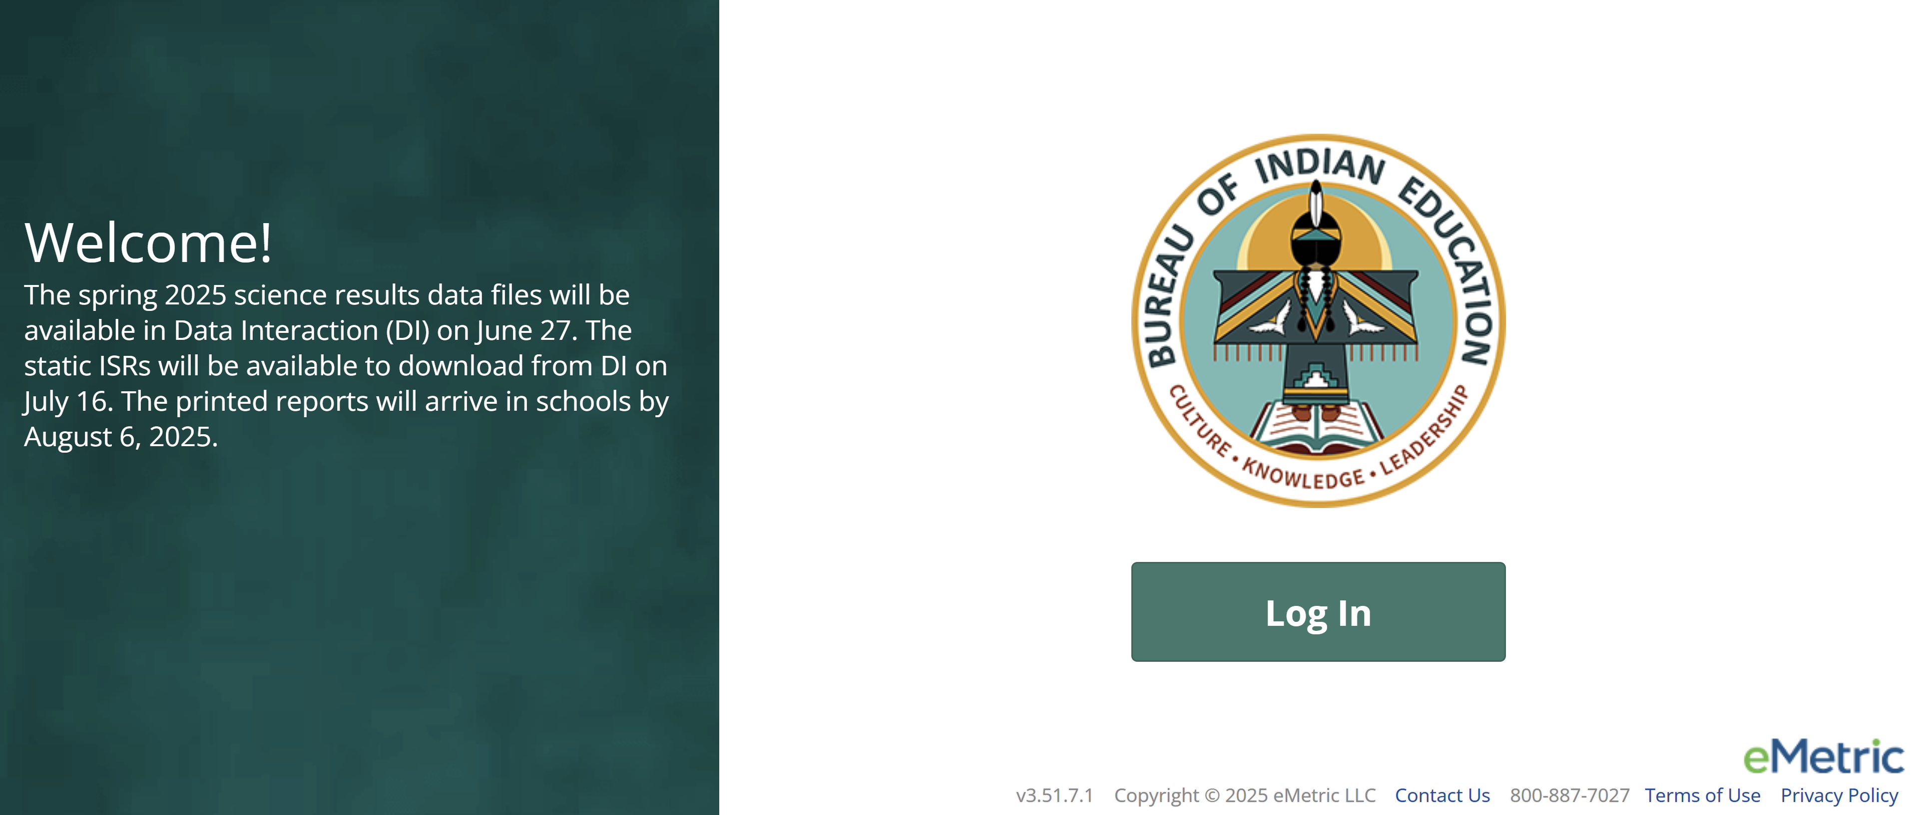
Portal Log-in
Portal URL: https://bie.cognia.org/

Slide 15
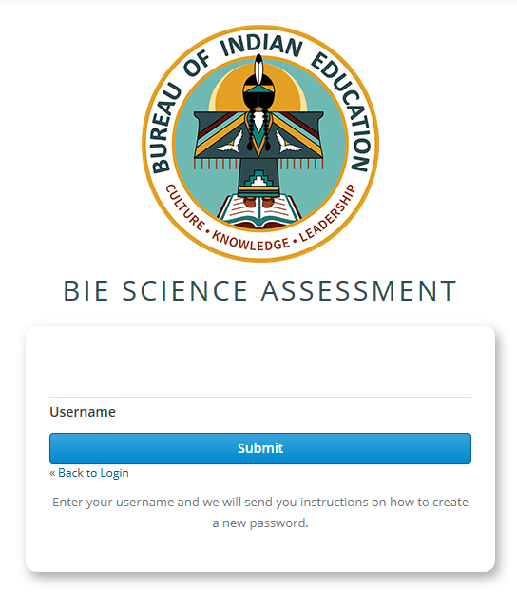
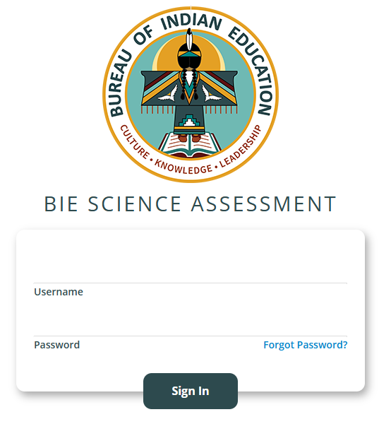
Forgot Password
Type in your Username and Password as indicated in the screenshot below and click the Sign In button to enter the portal.
If you have forgotten your password, select the Forgot Password? link and enter your Username as indicated in the screenshot below. Click the Submit button. The system will send an email to the email address associated with the account, providing instructions to reset your password.
REMINDER

Slide 16
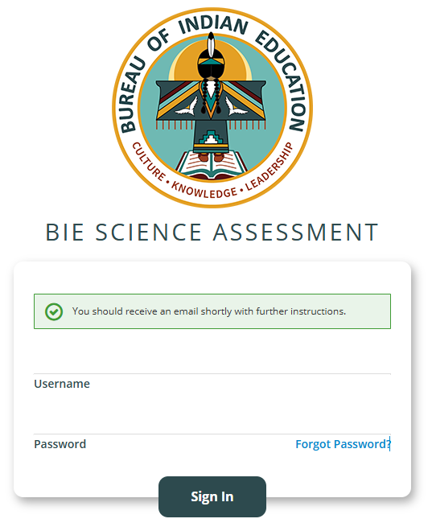
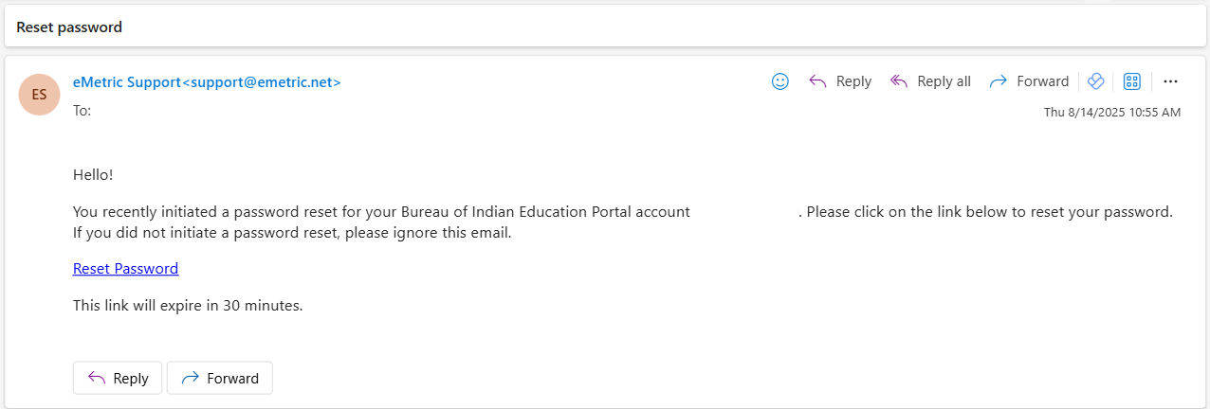
Reset Password
eMetric Support<support@emetric.net>
eMetric Support<support@emetric.net>
When you submit your Username into the Forgot Password tool, you will be prompted with a green massage to check your email for further instructions. Please check your spam folder if you do not see the email in your inbox.
The email will come from eMetric Support<support@emetric.net>
REMINDER

Slide 17
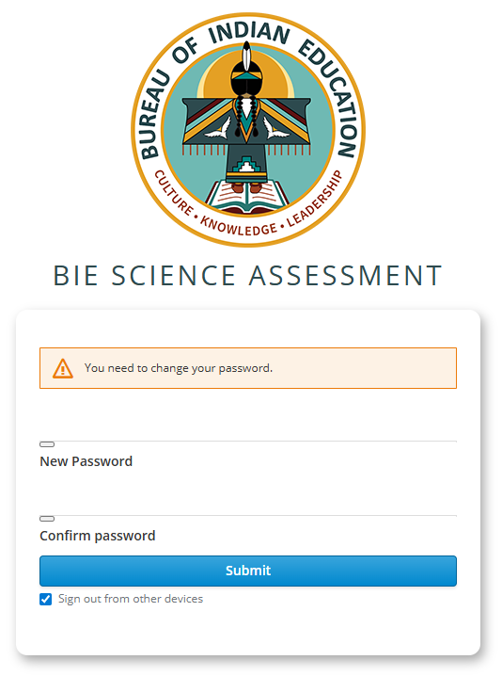
Reset Password
When you click the Reset Password link from the email, you will see this screen to create a New Password and to Confirm password, the click Submit.
(Note: This will sign you out of other devices).

Slide 18
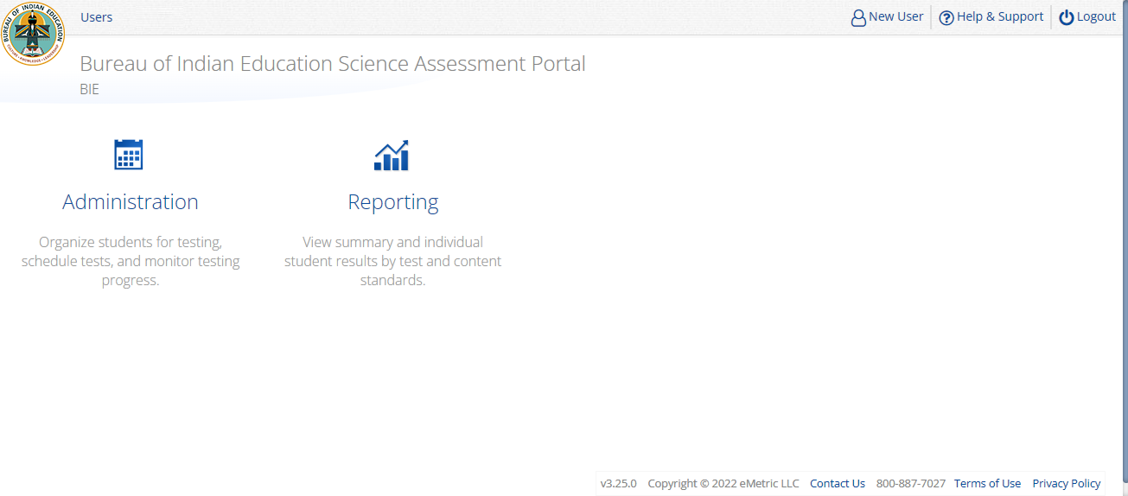
Portal Main Page (STC View)
1
2
3
4
5
Icon | Description
1 | BIE logo returns to portal home page
2 | Access User Management
3 | View & Edit user profile
4 | Access the BIE Help & Support Site
5 | Logout of the portal
6 | Access Administration Component
7 | Access Reporting
6
7

Slide 19
What is Available in Data Interaction?
Reports available:
Roster (with customizable fields that vary with program)
Individual Student Report (the layout is different from the Cognia paper ISR)
Summary reports
Data tools
Summary
Distribution
Cross-Tab
Scatter plot (MSAA only)
Filters
User Tools:
Student search
Save reports
Share reports
Download reports
Download paper ISR in pdf file
User activity log
Help guide

Slide 20
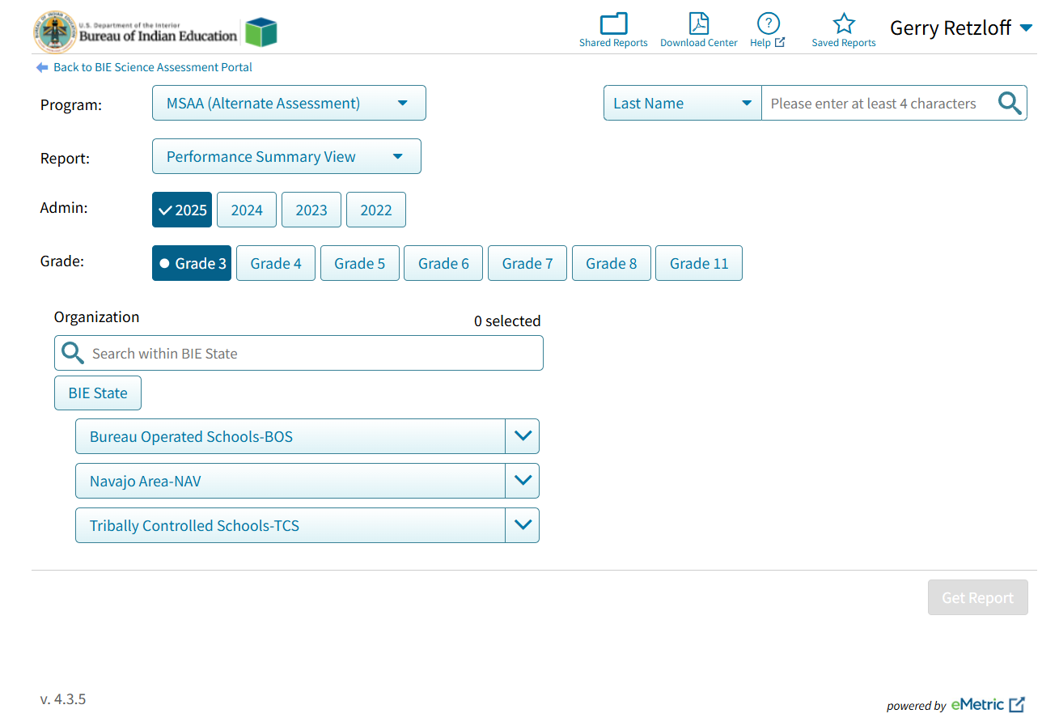
Data Interaction Main Page (MSAA View)
Select Program:
MSAA (Alternate Assessment)
Science (General Education)
Science Benchmark
Select Report:
Performance Summary
Roster
Data Tools
Select Organization:
BIE State: BIE summary level data only
BOS, TCS or NAV: summary level data only
School name: school summary data and any student in school

Slide 21
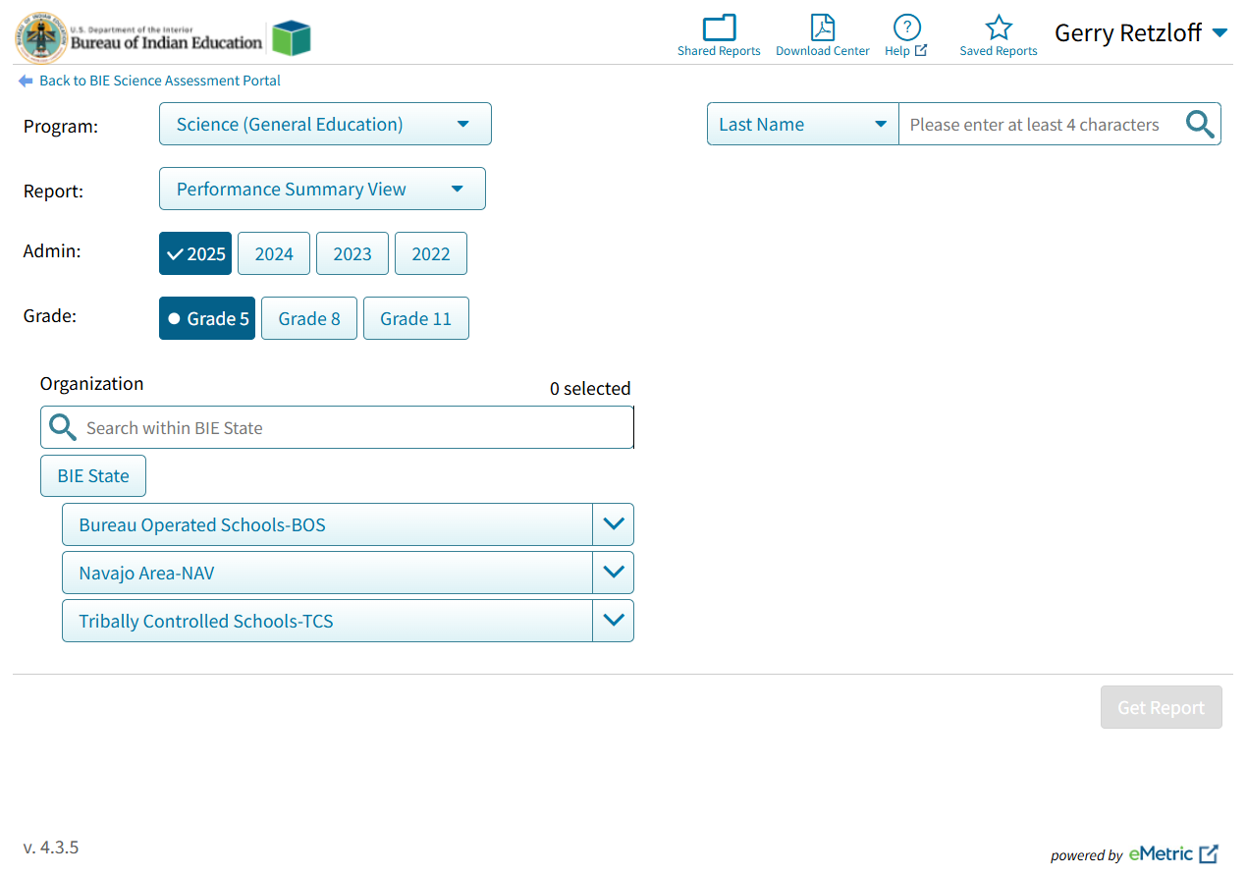
Data Interaction Main Page (Science View)
Select Program:
MSAA (Alternate Assessment)
Science (General Education)
Science Benchmark
Select Report:
Performance Summary
Roster
Data Tools
Select Organization:
BIE State: BIE summary level data only
BOS, TCS or NAV: summary level data only
School name: school summary data and any student in school

Slide 22
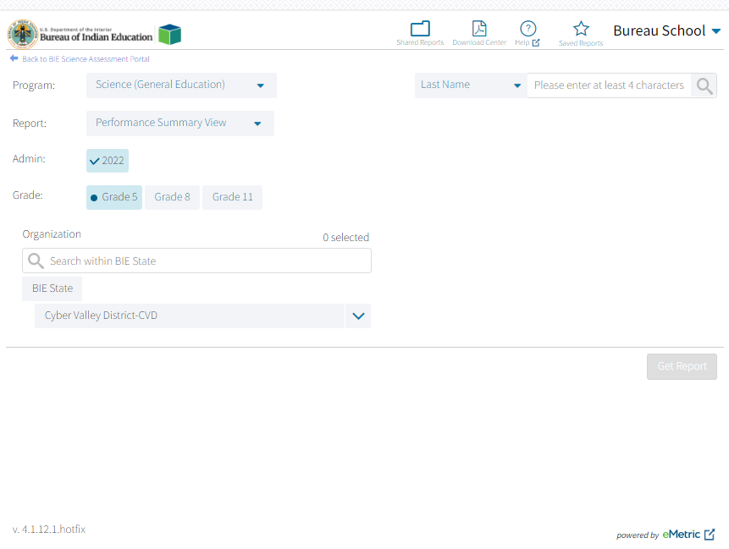
Data Interaction Main Page
Other Tools:
Shared Reports: Reports shared by other users
Download Center: retrieve large file downloads here (i.e., 100+ ISR PDFs) or zip files with paper ISRs in PDF files
Help guide
Save report: Reports you saved
Search for specific student by name or student ID (NASIS ID)

Slide 23
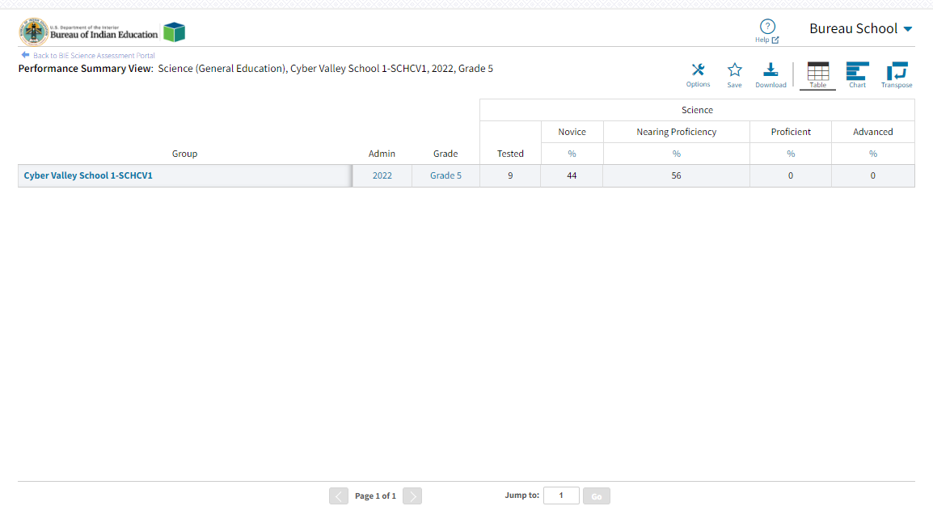
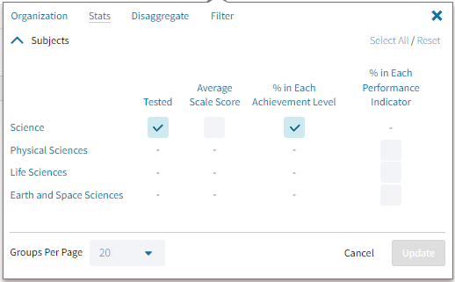
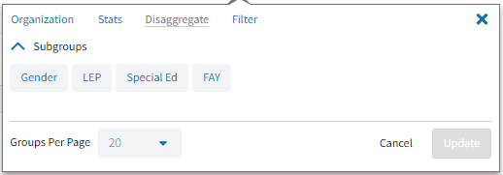
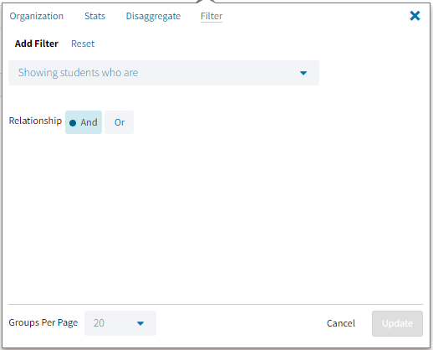
Performance Summary - Table

Slide 24
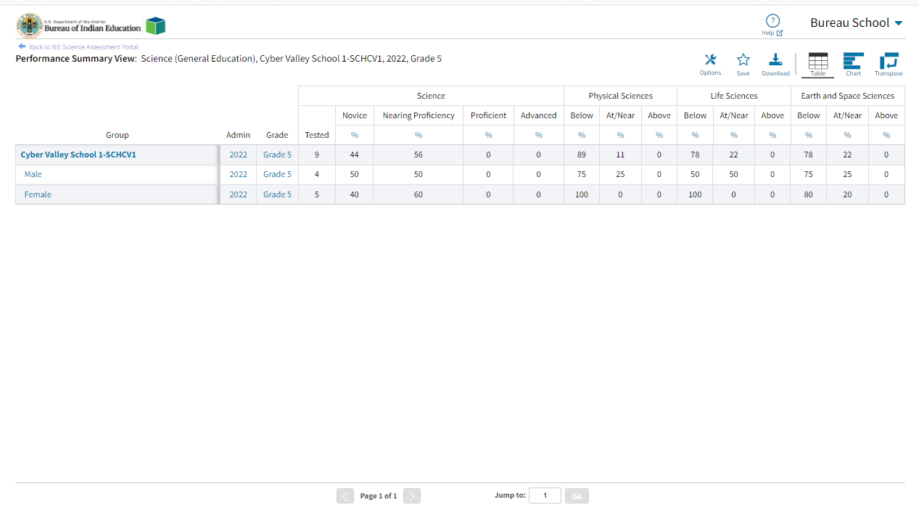
Performance Summary - Table
Disaggregated by Gender and show % of students in each Performance Indicator
Click on the blue text to disaggregate or drill to roster

Slide 25
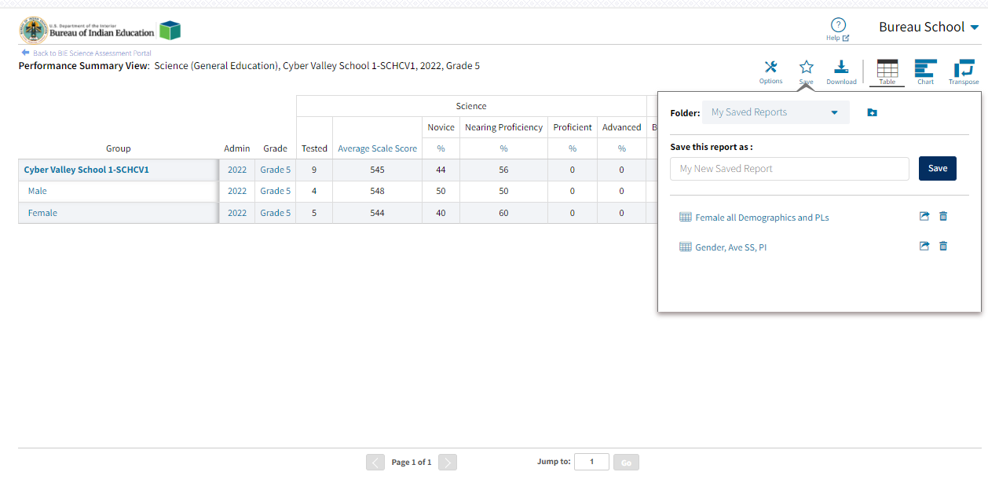
Save Report

Slide 26
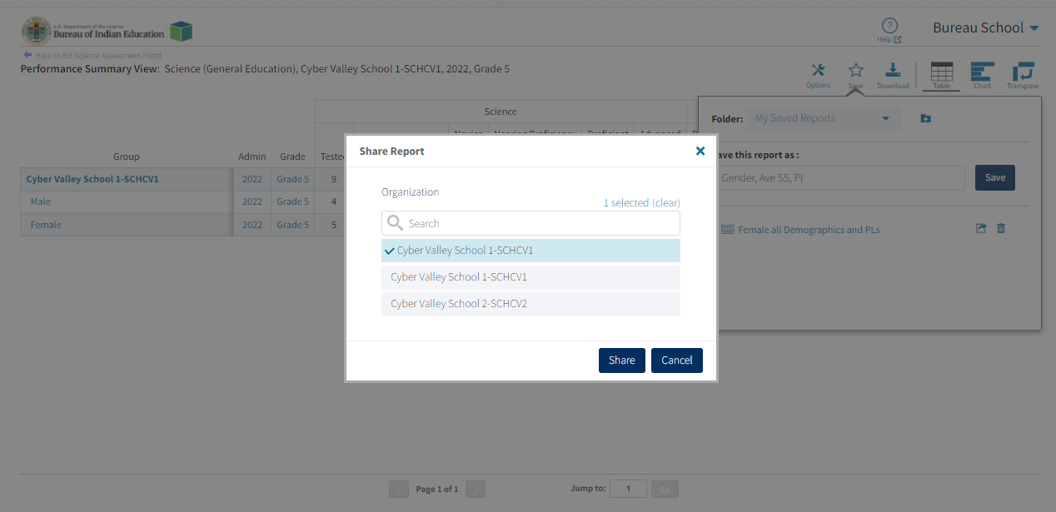
Share Report

Slide 27
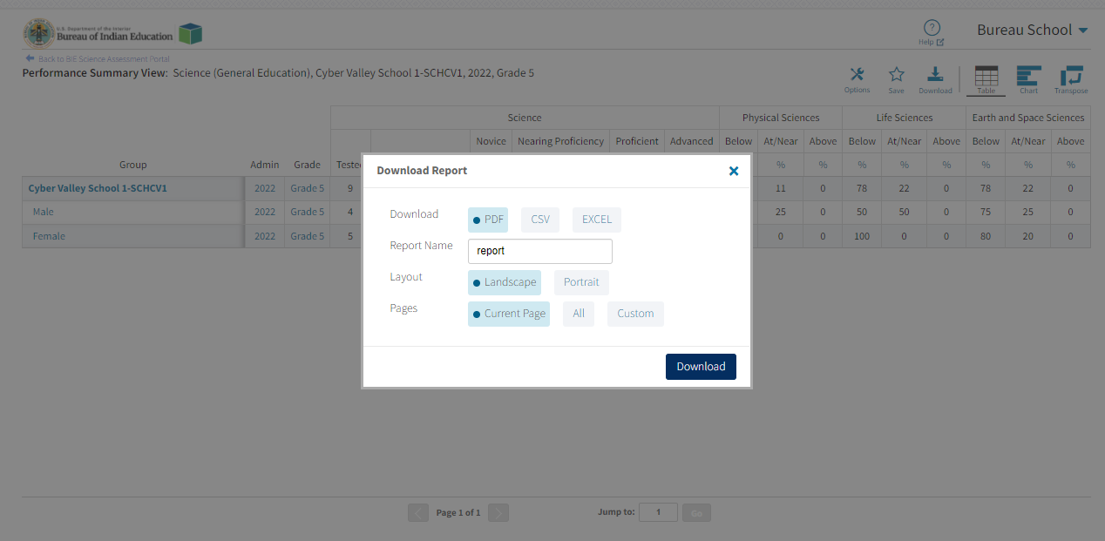
Download Report

Slide 28
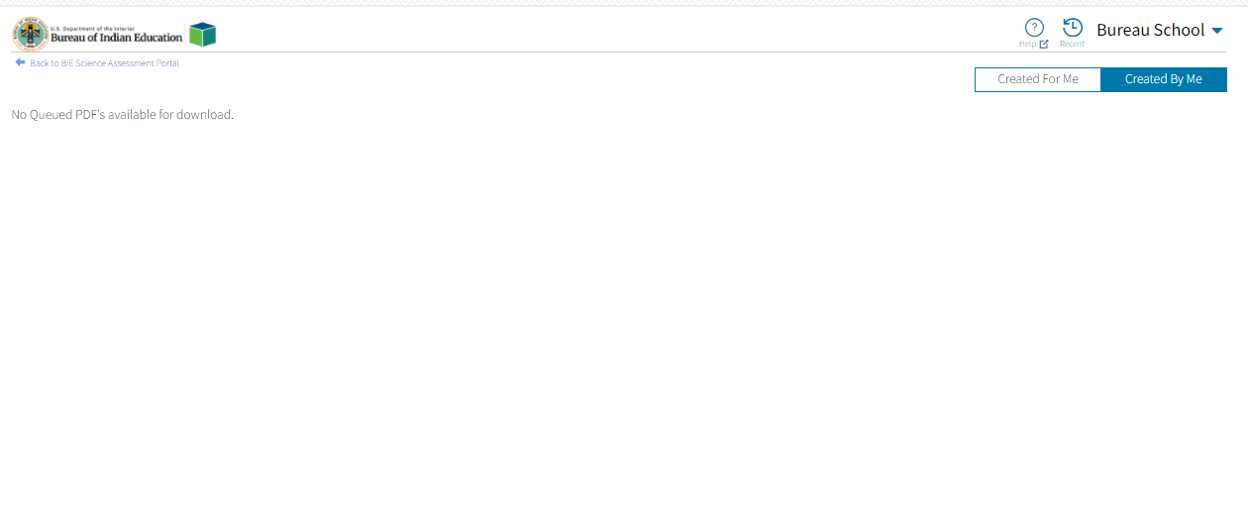
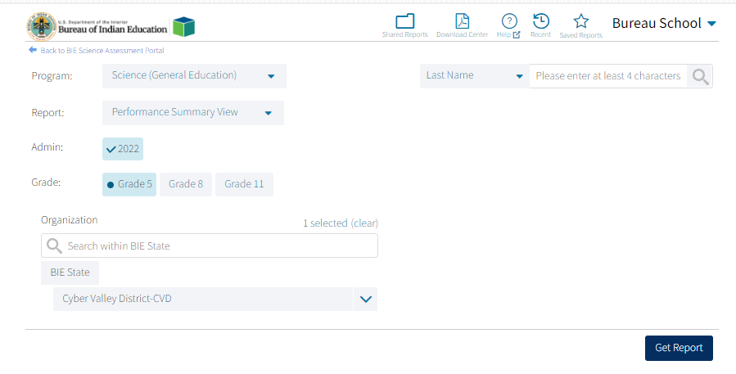
Download Center

Slide 29
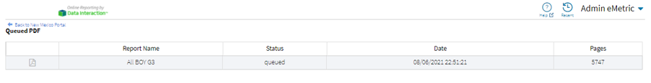
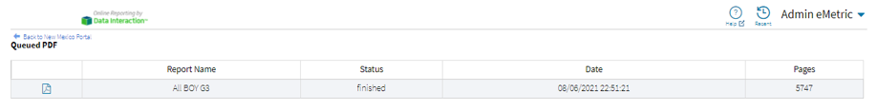
Download Center
File is being generated
File is complete and ready for download

Slide 30
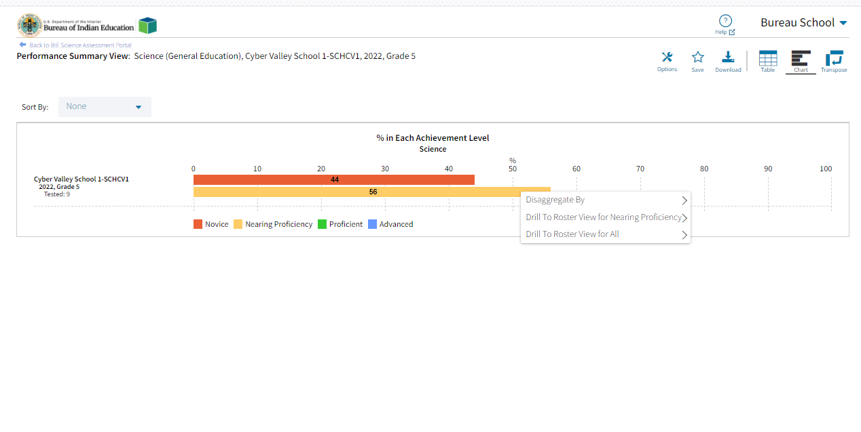
Performance Summary – Chart

Slide 31
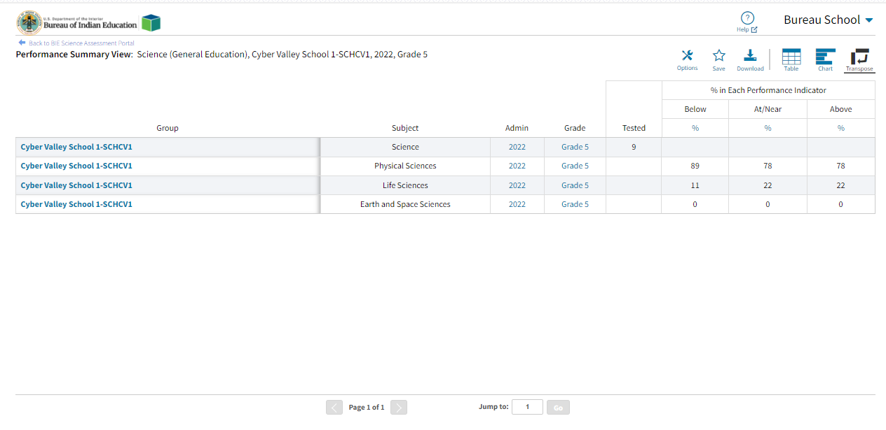
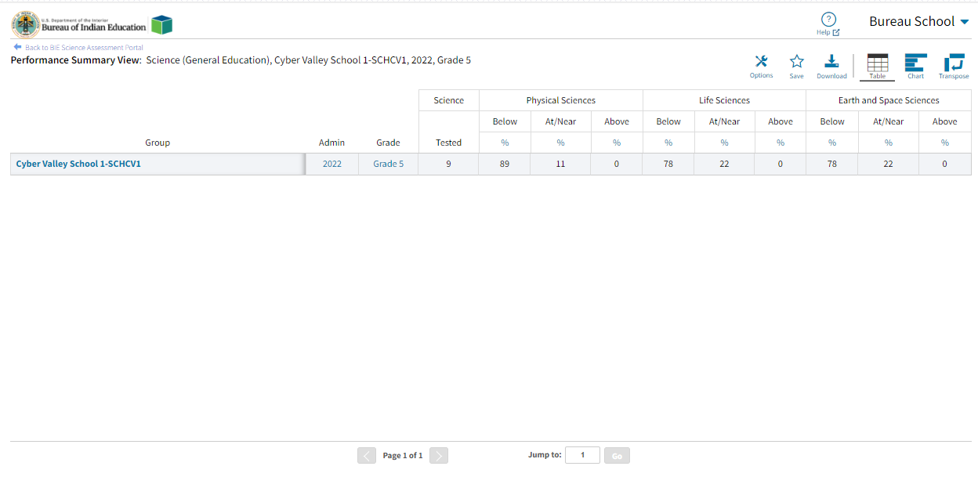
Performance Summary – Transpose

Slide 32
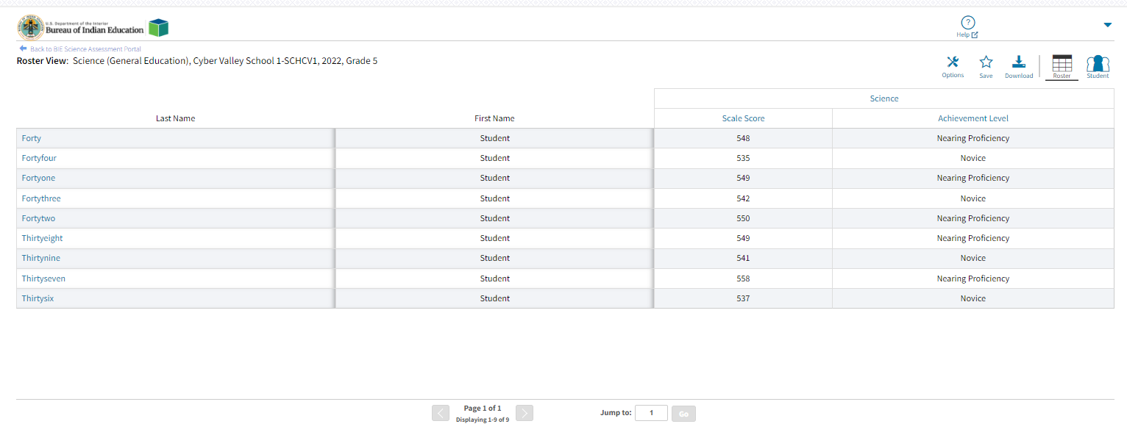
Roster
Options: choose fields and score data you want to view (demographic data, test data, reporting categories, etc.)
Save: save the report to retrieve it later without having to add or remove fields and sorting
Download: download the data you are looking at in excel, csv or PDF
Student: view the student’s ISRs

Slide 33
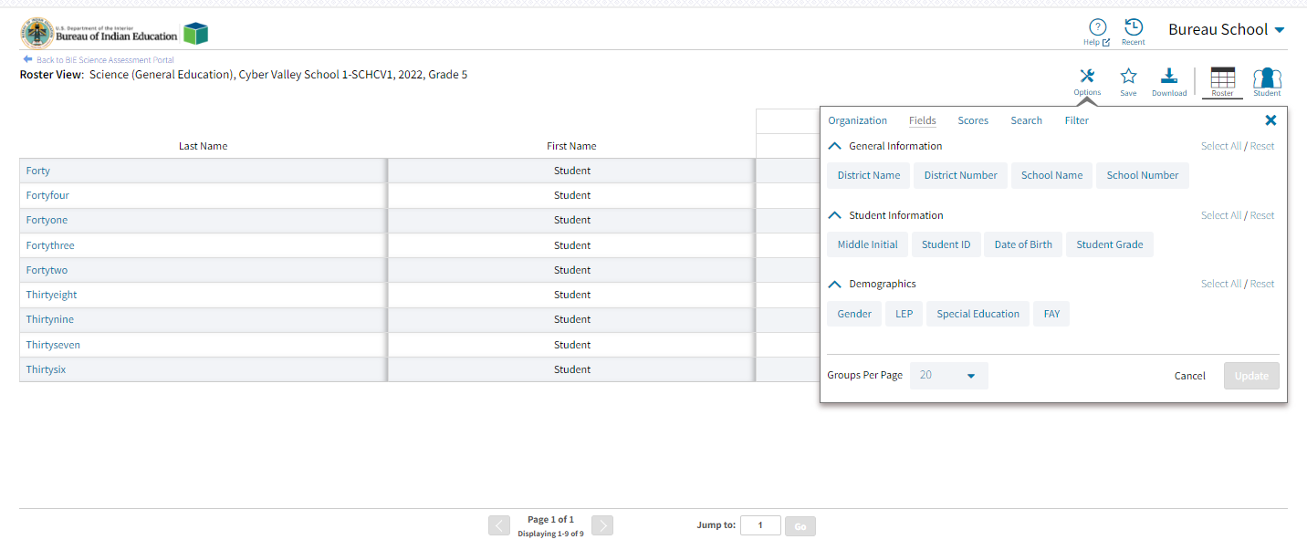
Roster

Slide 34
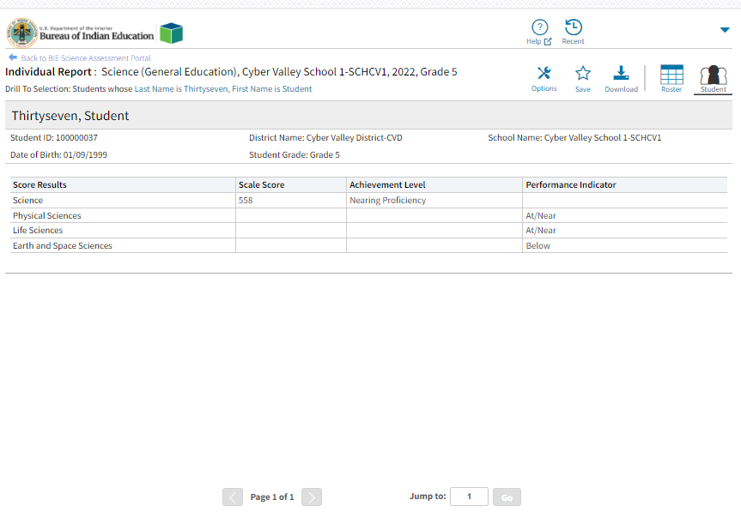
Individual Student Report

Slide 35
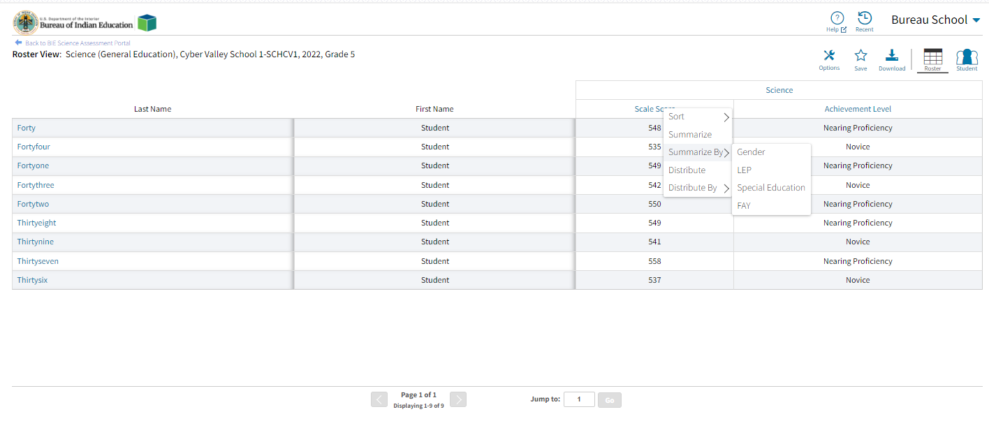
Roster Summarize and Distribute Options

Slide 36
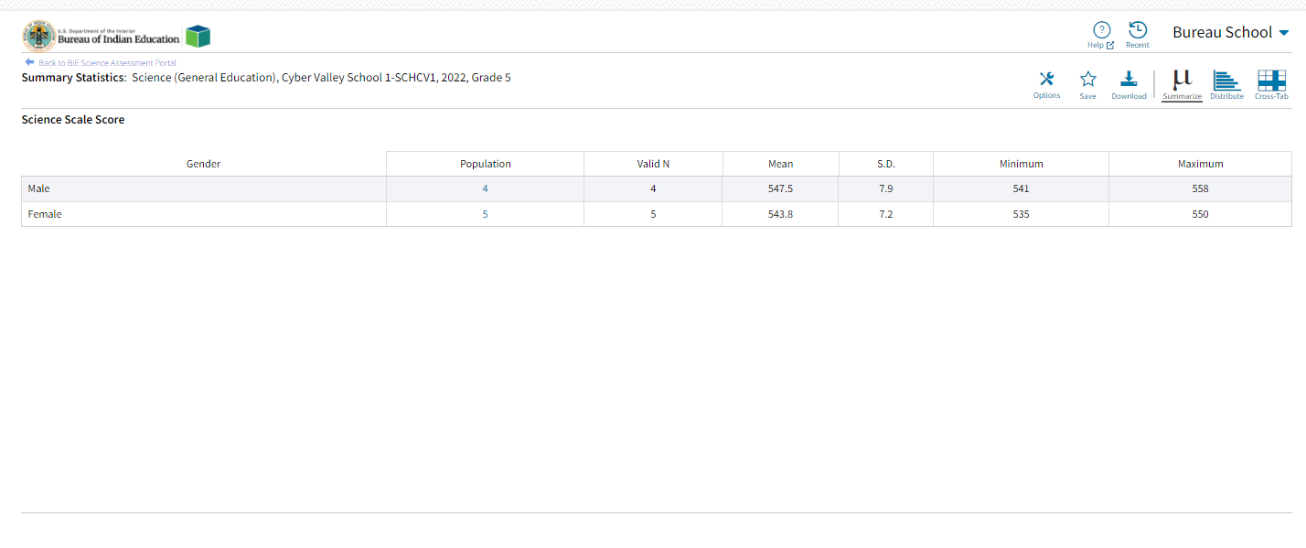
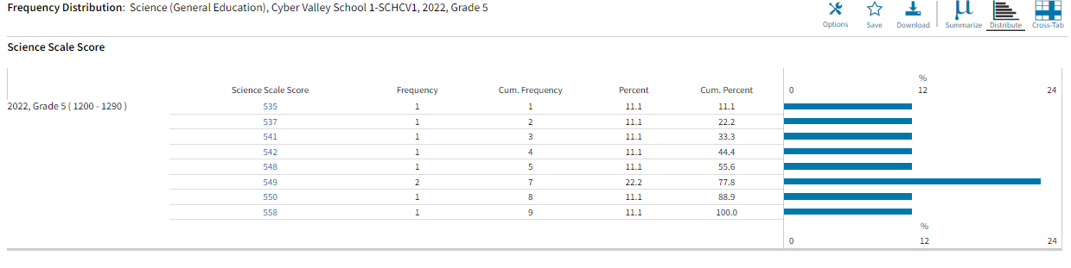
Roster Summarize and Distribute Options

Slide 37
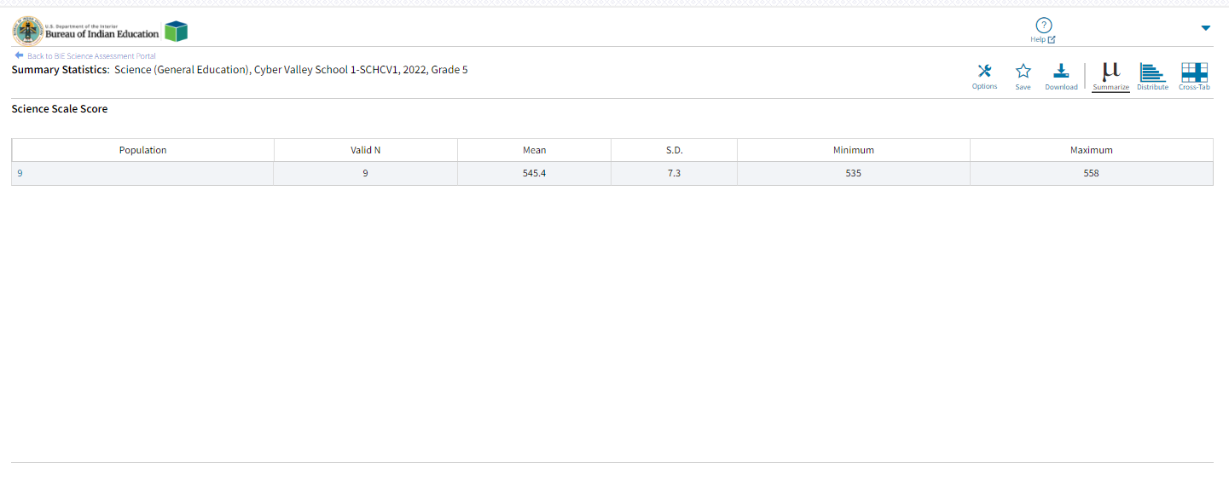
Data Tools - Summarize

Slide 38
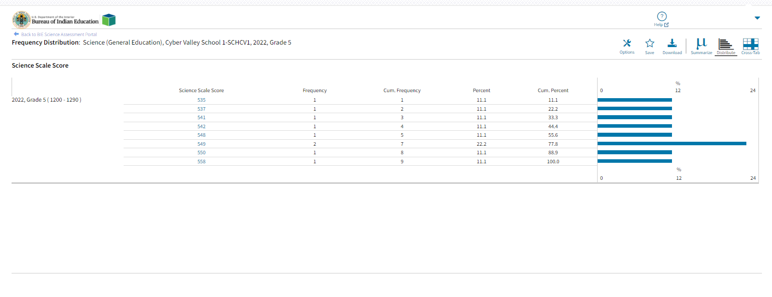
Data Tools - Distribute

Slide 39
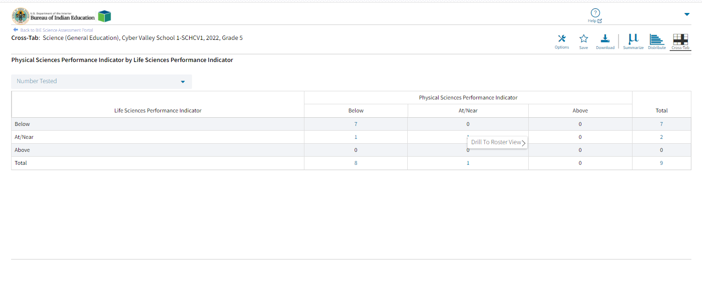
Data Tools – Cross Tab

Slide 40
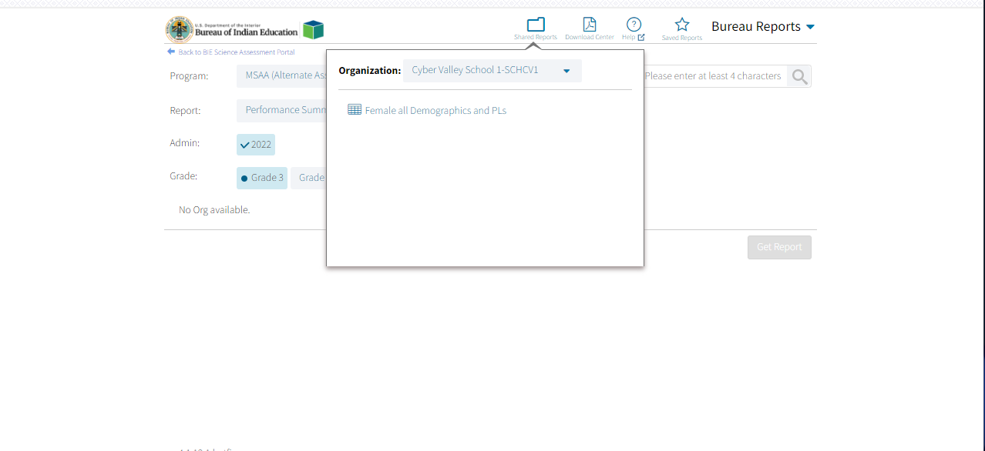
Shared Reports

Slide 41
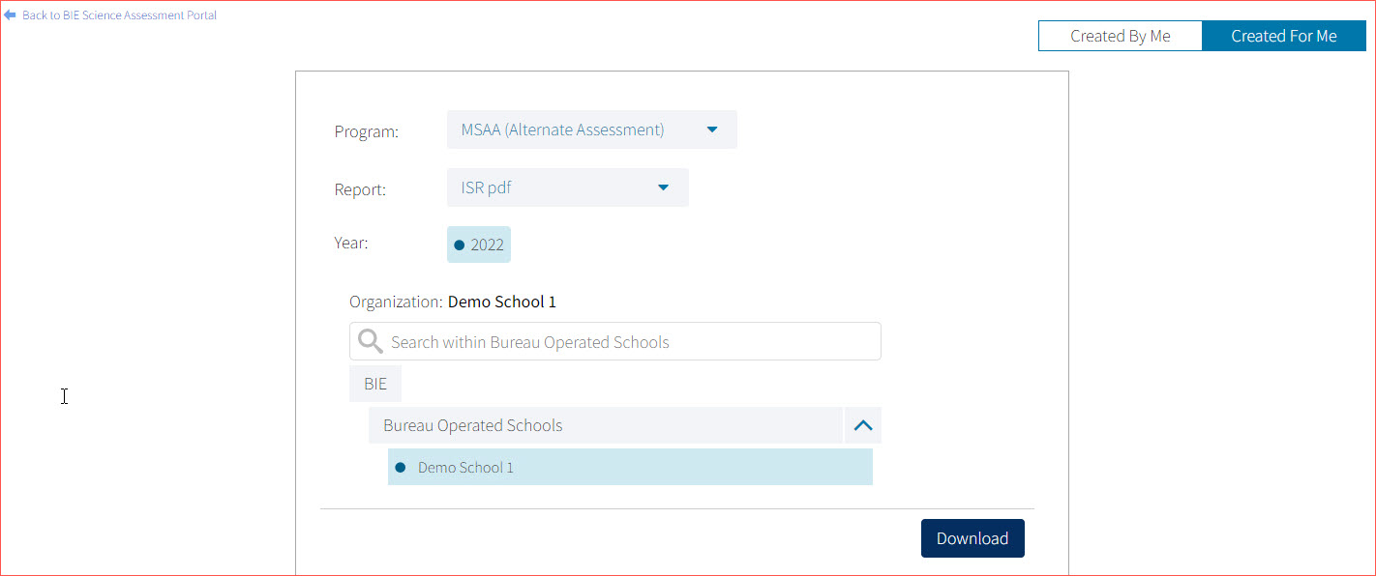
Downloading the Paper ISR in a PDF File
In the Download Center, Created For Me menu, you can download a zip file containing pdf files of the paper ISR!

Slide 42
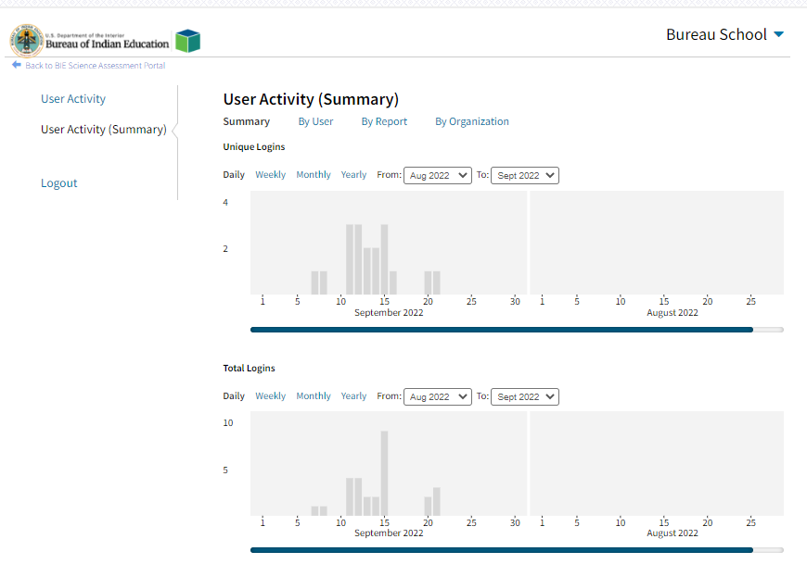

User Activity

Slide 43
Demo

Slide 44
WHAT’S NEW FOR 2025-2026?

Slide 45
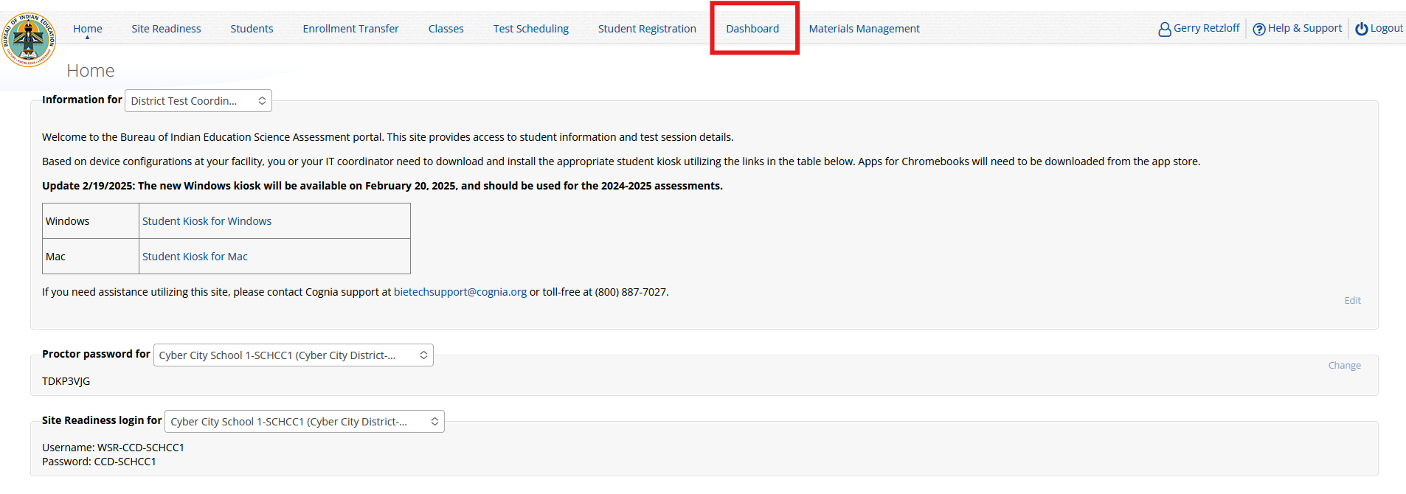
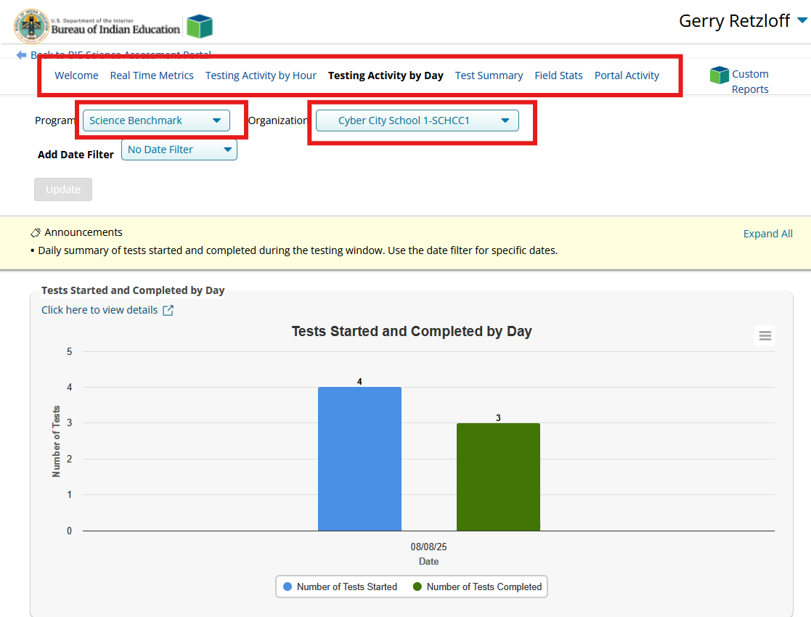
Administration Dashboard
For the Administration Dashboard, the following user roles will have access:
Admin
Partner
State User
District Test Coordinator (DTC)
School Test Coordinator (STC)
These User Roles DO NOT have access:
Reports Access Only
IT Coordinator (ITC)
Test Administrator (TA)
Within the Administration module, click “Dashboard” at the top of the screen.
There will be several tabs at the top of the Dashboard to display the testing data. Be sure to select the correct Program and Organization.

Slide 46
Questions?

Slide 47
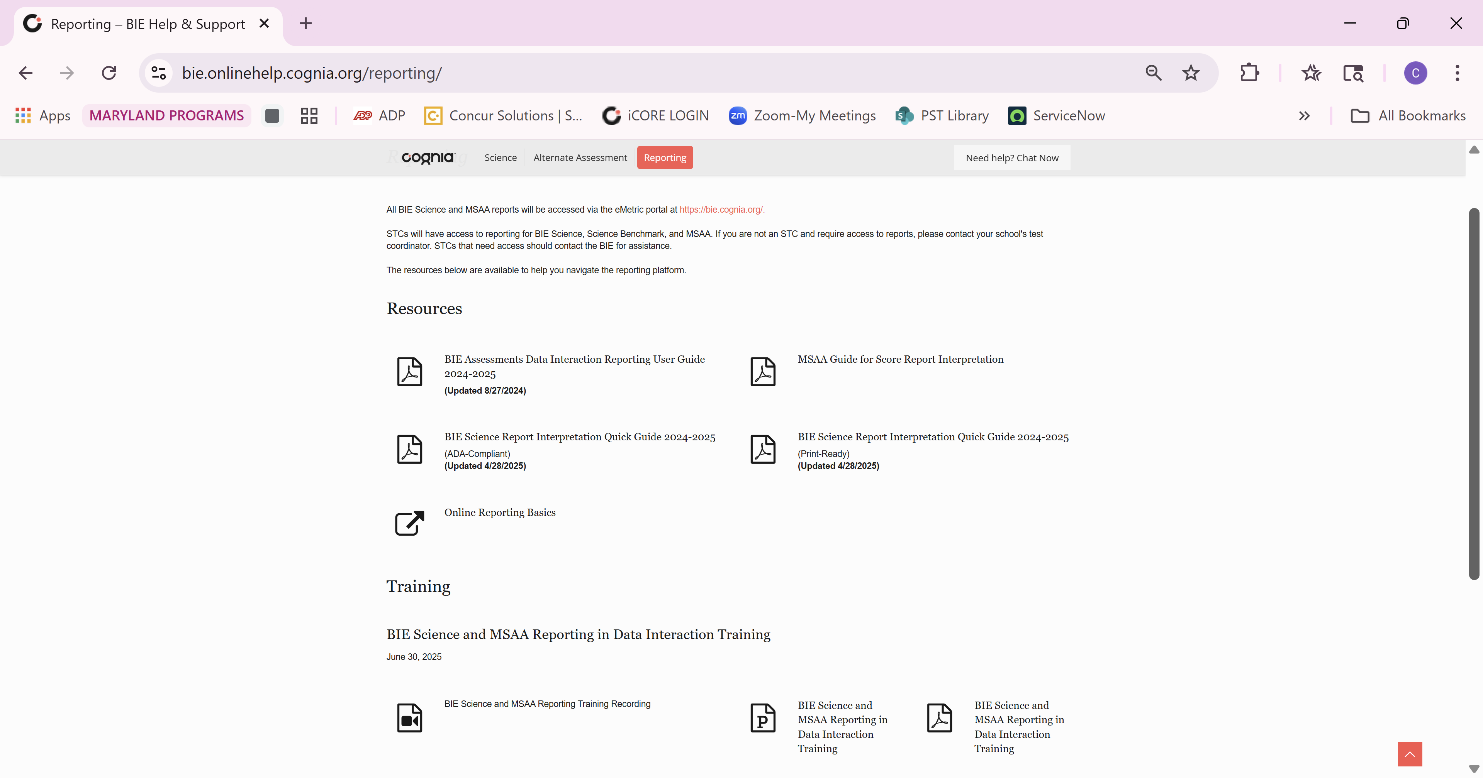
Help & Support Site
Reporting Resources
What you will find in this site
Reporting Resources will be Posted Throughout the Year
Data Interaction Reporting User Guide
BIE Science Report Interpretation Quick Guide
Print-Ready version
ADA-compliant version
MSAA Guide for Score Report Interpretation
Online Reporting Basics Video Tutorial
Reporting Training Materials
Recordings
Presentation Slides
URL: https://bie.onlinehelp.cognia.org/reporting

Slide 48
Help Desk
Hours
Monday–Friday
Contact information
Phone: 800-887-7027
Email: BIETechSupport@cognia.org
Chat (accessible from the BIE Help & Support site)
9:00 a.m.–6:00 p.m. (ET)
7:00 a.m.-4:00 p.m. (MT)
6:00 a.m.-3:00 p.m. (PT)

Slide 49
Thank you!
Notes:
Speaker Notes:
Thank you for what you do to improve learning for all BIE students.

Slide 50



Cognia is a global nonprofit that has the knowledge to help schools improve outcomes for all learners.

