Slide 1

Bureau of Indian Education Science Assessment
Spring 2026 Portal and Kiosk Training

Slide 2
Agenda
Key Dates
Overview of system and testing process
Portal Access
Administration Workflow
  IT Coordinator User Activities
    Download and install kiosks/apps
    Conduct site readiness
  STC and TA User Activities
    Managing students and accommodations
    Creating classes
    Creating test sessions
    Monitoring and completing testing
  Student Testing Platform
    Tools and accommodations
    Launching the testing kiosk application and logging in
    Navigating through the test and turning-in the test
    Technology considerations
Additional training resources
Questions

Slide 3
Key Dates
Test Preparation Key Dates
Practice tests live | All year
Portal opens & kiosks available for download | September 8, 2025
Science Benchmark administration window | September 22, 2025 – March 6, 2026
Student Registration Window (online & paper) | December 8, 2025 – January 16, 2026
Tests available for scheduling in Portal | March 2, 2026
Science Summative test administration window | March 9 – April 17, 2026
STC Post-test data clean up window in portal | April 20 – 22, 2026

Slide 4
The BIE Science Assessment Portal
Single portal (https://bie.cognia.org) used for
  Science Summative assessment
  Science Benchmark assessments (optional)
  Access to Science Summative and Benchmark reports
Two student uploads: one at Benchmark start, another in December 2025 before Summative online registration
Summative | Benchmark (Formative)
School Test Coordinators (STC) manage testing | Teachers (TA) can manage testing using TA account
Students must use kiosk to access test | Students can access tests using a web browser or kiosk
Session access codes are used | Session access codes are NOT used
Machine or professionally scored tests with later reporting | Teachers score human scored items and receive near-real-time results

Slide 5
BIE Science Assessment Online System
Online System
Administration and Reporting Portal
https://bie.cognia.org
Users
Administration
Student Testing Platform
Kiosks/Apps
Site Setup
Students
Browser
Reporting
Classes
Test Sessions
Scoring
Enrollment Transfer

Slide 6


Test Preparation Process
STC
Create user accounts
Add/edit/transfer students
Assign accessibility features & accommodations
ITC
Download and install kiosks/apps
Complete Site Readiness Test
STC/TA
Create classes
Schedule classes for test
Print/distribute log-in tickets
Students
Launch kiosk or browser
Log-in and test
STC
Update test report codes and student records as needed
View results in Data Interaction (later this year)
After testing…

Slide 7

Portal Access
http://bie.cognia.org
Open all year, previous accounts can be used this year
For new School Test Coordinators (STCs), accounts will be created by BIE (Aurelia Shorty will create accounts for STCs).
  STCs will create all new portal user accounts
  Usernames must be unique
  Your email address controls your account
  New users will receive one automated email containing your username and a link to access the portal site and set your password from support@emetric.net
When an account is deactivated or reactivated, the user will receive an email
STCs should periodically audit and deactivate user accounts that are no longer applicable

Slide 8
User Roles
User Role | Responsibilities
School Test Coordinator (STC) | Manage Users (add, edit, or deactivate) Access proctor password Edit student information & assign student accommodations Create, edit, and delete classes Schedule test sessions & print logins Manage & monitor test sessions Assign test report code Prepare IT network for student testing if there is no IT Coordinator
IT Coordinator (ITC) | Prepare IT network for student testing Conduct Site Readiness testing
Test Administrator (TA) Note: TA must have access to the BIE Science program to work on Summative assessments | Create classes Create test sessions View their students and test sessions Print student login tickets for their test sessions Manage & monitor test sessions Assign test report codes
Report Access Only (RAO) | View Reports

Slide 9
Test Administrator (TA) Permissions
A TA can add any student in their school to their class
A TA can only view the student record for any student in one of their classes
  A TA cannot edit the student record
A TA can view, edit, or delete any class to which they have been designated the TA
A TA can schedule their class to any program that they have access to
  Programs: BIE Science Benchmark, BIE Science Assessment
A TA can view, edit, or delete a test session if they are the TA for the class in the test session and they have access to the program (BIE Science Benchmark and/or BIE Science Assessment)
Only a TA can score the human-scored items in Benchmark assessments
A TA can view Benchmark test results in Reporting for any class they are assigned to

Slide 10
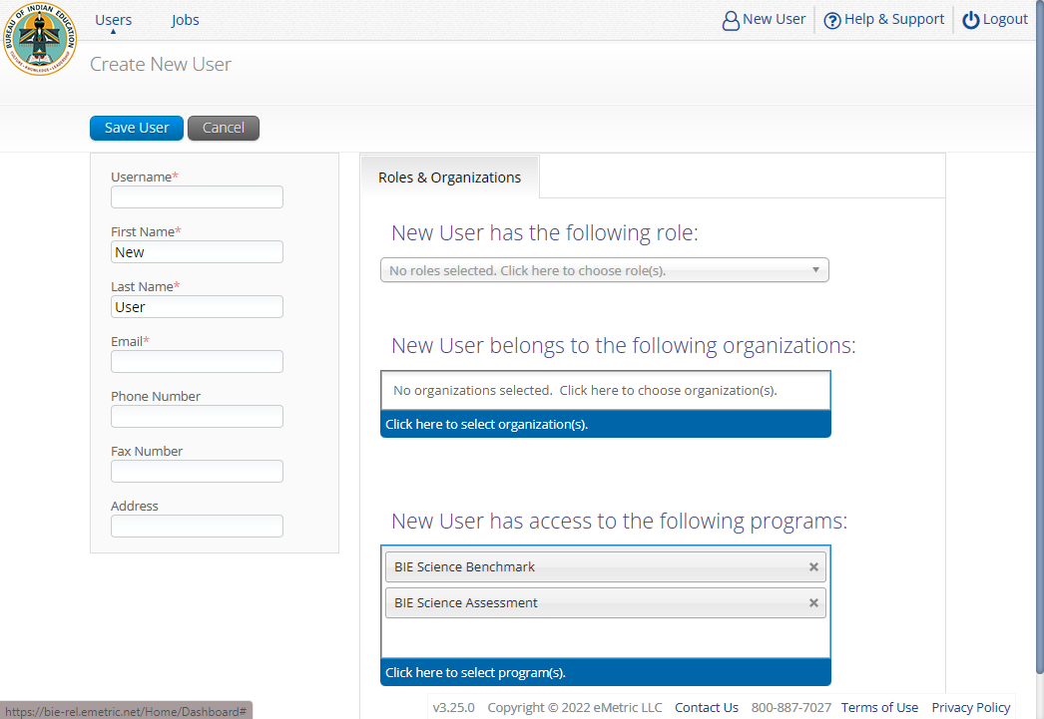
Program Access

Slide 11

Portal Log-in
Portal URL: https://bie.cognia.org

Slide 12
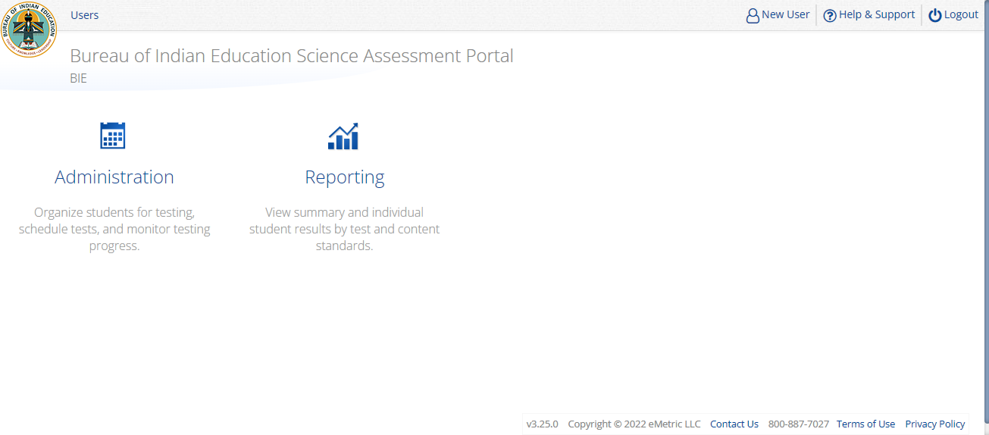
Portal Main Page (STC View)
1
2
3
4
5
Icon | Description
1 | BIE logo returns to portal home page
2 | Access User Management
3 | View & Edit user profile
4 | Access the BIE Help & Support Site
5 | Logout of the portal
6 | Access Administration Component
7 | Access Reporting
6
7

Slide 13
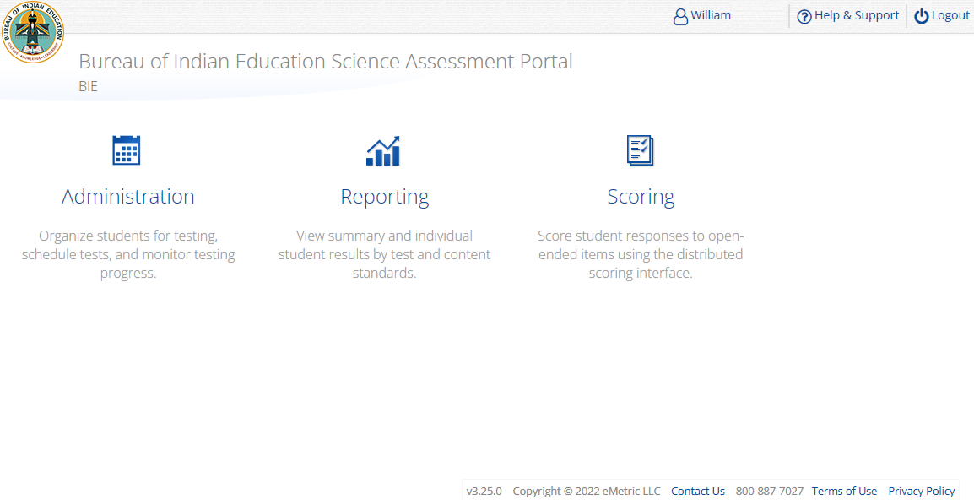
Portal Main Page (TA view)
1
2
3
4
Icon | Description
1 | BIE logo returns to portal home page
2 | View & Edit user profile
3 | Access the BIE Help & Support Site
4 | Logout of the portal
5 | Access Administration Component
6 | Access Reporting
7 | Access Scoring – TA user role for Benchmark program ONLY!
TA Only!
5
6
7

Slide 14
Administration Workflow
IT Coordinator User Activities

Slide 15
Administration Workflow
Students
Classes
Site Readiness
Test Sessions
Score and Report
Home
ITC: install kiosk, perform site readiness, and certify site as ready for testing

Slide 16
Site Technology Preparation
Windows Kiosk
  Available to download in the Portal on August 18, 2025
Mac Kiosk
  Available to download in the Portal on August 18, 2025
Chromebook App
  Available in the Chrome Webstore
  BIE Science Assessment
  Add to Google Admin through App Store
  Chrome App will update upon launch of the kiosk

Slide 17
Site Technology Preparation
System Requirements – All hardware
Connectivity | Student devices must be able to connect to the internet via wired or wireless networks.
Screen Size | 9.7” screen size or larger/ “10-inch class” tablets or larger
Screen Resolution | 1024 x 768 or larger
Headphones/Earphones/Ear Buds | Headphones/earphones/ear buds are required for students who have a text-to-speech accessibility feature
Browser Requirements (Portal & Practice Tests)
Chrome™ 138 or newer Firefox® 140 or newer Microsoft Edge™ 138 or newer Safari® 18.5 or newer

Slide 18

Site Technology Preparation
Student Device Requirements Desktop & Laptop
CPU | 1.3 GHz
Memory | 2 GB (4 GB is strongly recommended for best performance)
Input Device | Keyboard (wired or wireless)/Bluetooth mouse or touchpad
Windows® | 11 (23H2; 24H2)
macOS® | 14.7, 15.5, 26ª (64-bit only)
Chromebook Specific Requirements
Chromebook™ notebook computer* | Chrome OS™ LTS 132+ Chrome OS™ Stable Channel 138+ *Google releases new versions to the stable channel every four weeks and new versions to the Long-term Support (LTS) channel every six months. eMetric strongly recommends the use of the LTS channel. Devices on the LTS channel continue to receive frequent security fixes. See https://support.google.com/chrome/a/answer/11333726 for additional information..
Updated August 14th, 2025. Check the Cognia help and support site for the recent updates.

Slide 19

Technology Requirements
Important Reminders
  The BIE Science Assessment must be taken using the BIE Science Assessment Kiosk
  Students testing on devices that do not meet the Student Workstation Specifications are likely to encounter performance-related issues during testing.
  Do not update your test device OS until the Technology Guidelines have been updated.

Slide 20
Site Readiness
1. Review the Kiosk Installation Guide
  https://bie.onlinehelp.cognia.org/
2. Download & Install Kiosks
  Download Windows or Mac kiosks from BIE Science Assessment Portal
  Download Chrome app from appropriate app store
3. Conduct Site Readiness Testing
  Run both tests on each device configuration
4. Certify Site
  Certify your site as “Ready for Testing” in the Portal

Slide 21
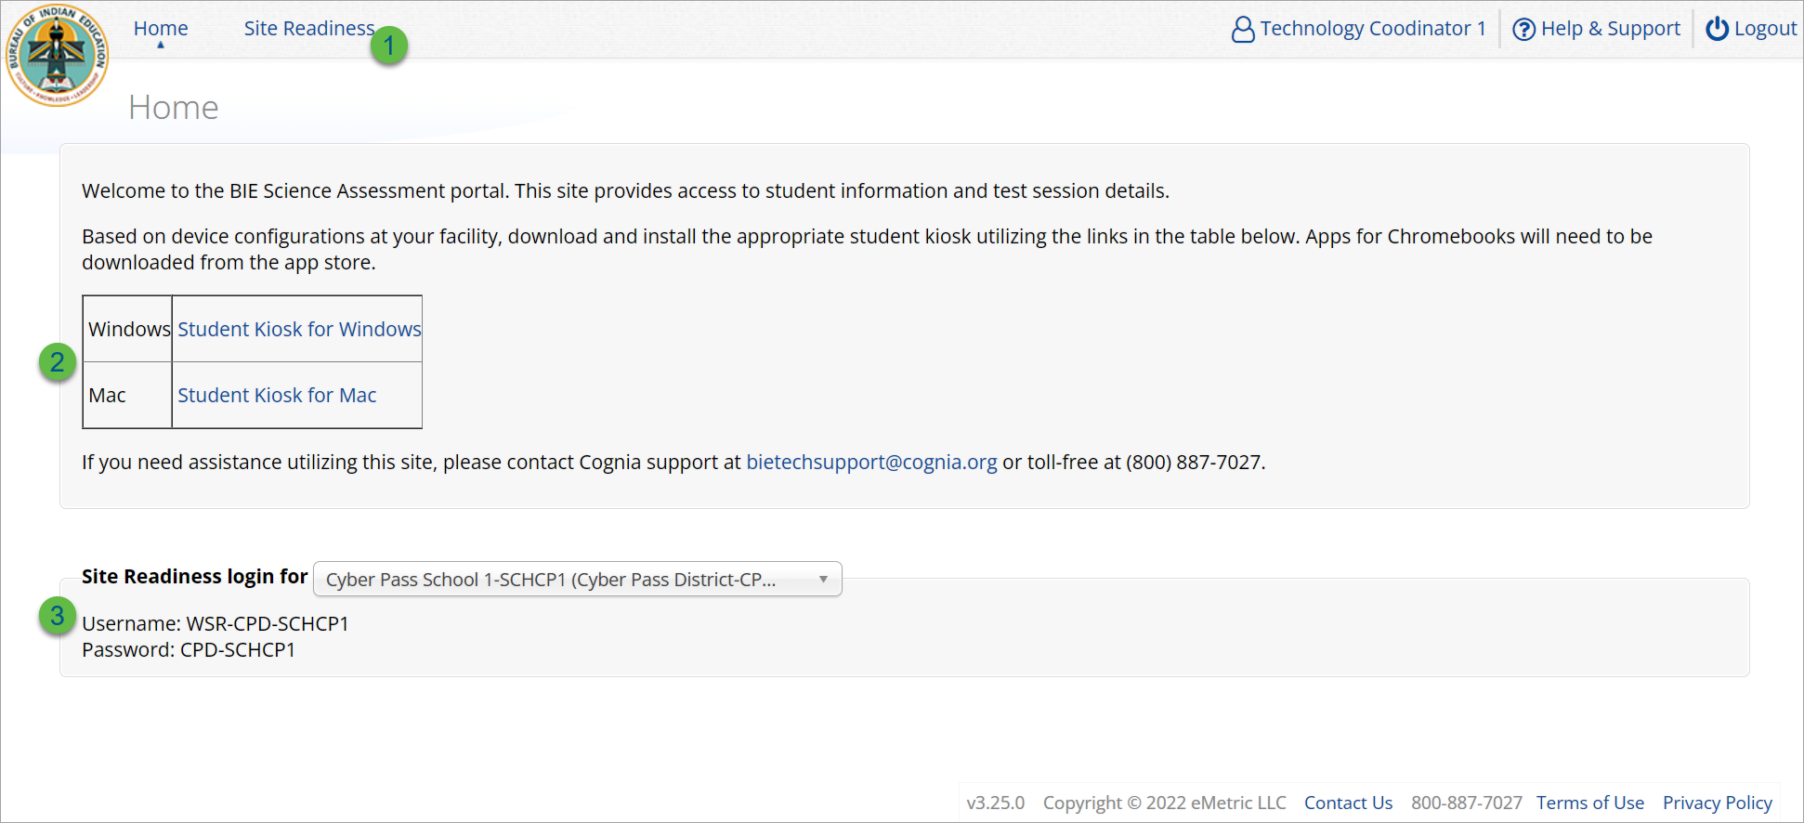
Site Readiness
Icon | Description
1 | Site Readiness tab allows users to view devices that have been tested for site readiness and Site Certification information.
2 | Kiosk installers for Mac and Windows devices are available here.
3 | Site Readiness login credentials are available for each school.
Notes:
The first step for conducting Site Readiness testing is to download and install the Kiosks and Mobile Apps onto the devices that will be used for testing at your school.
Once you’ve downloaded and installed your Kiosks and Mobile Apps, log in to the Portal to retrieve the site readiness login credentials for your school.
Launch the kiosk or the app and login using the site readiness credentials.
Run the test on a handful of devices for each configuration.
Once you’ve successfully completed your Site Readiness testing, log back into the Portal and navigate to the Site Readiness tab within the Administration component. Here, you can view the details of the devices that you used for Site Readiness testing.
Finally, you’ll certify your site as ready for testing.
Each site has it’s own login credentials for Site Readiness. Each school needs to be certified as ready for testing.

Slide 22
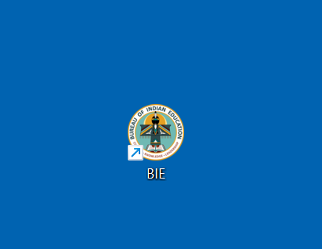
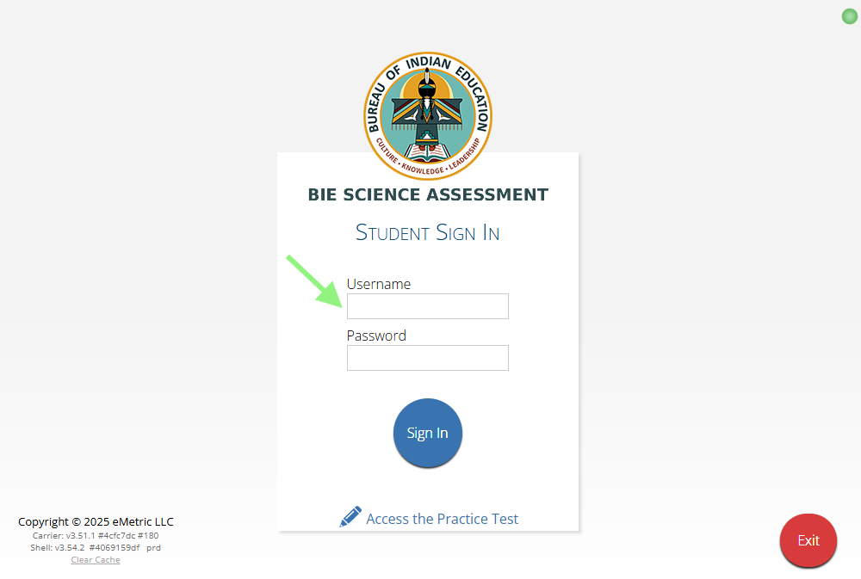
Site Readiness

Slide 23
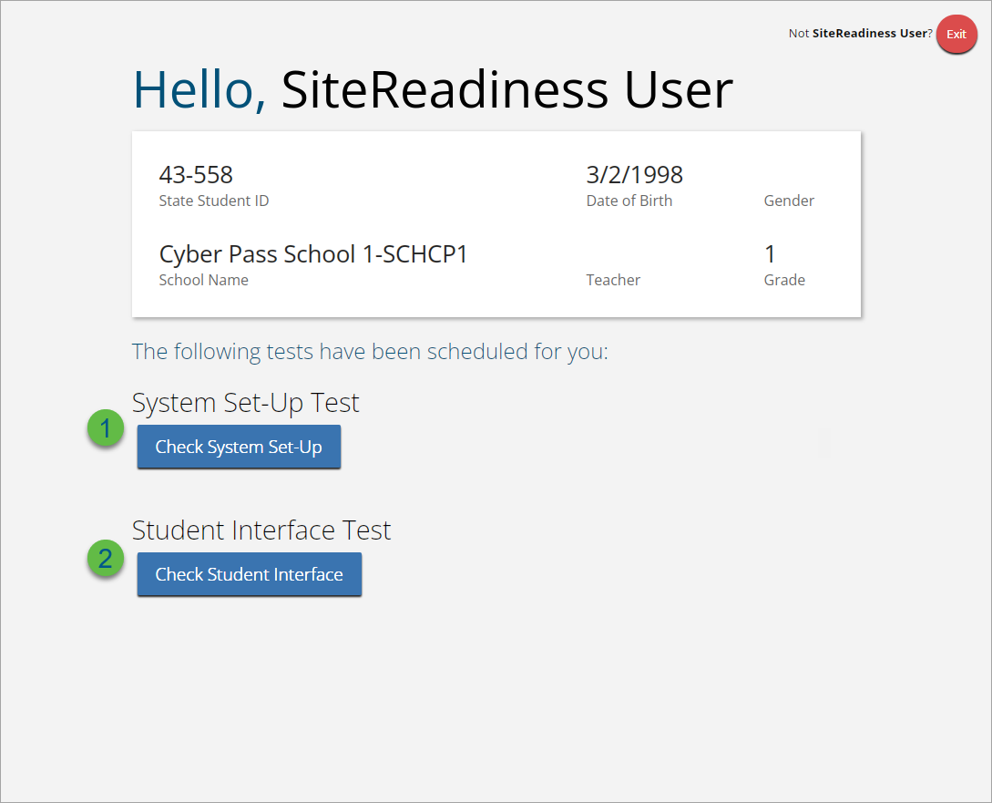
Site Readiness

Slide 24
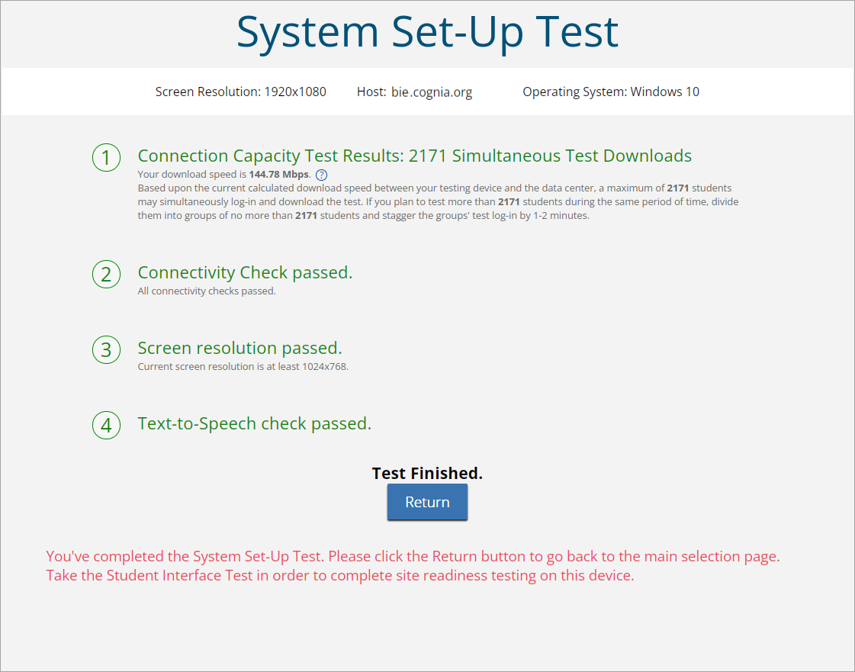
Site Readiness

Slide 25
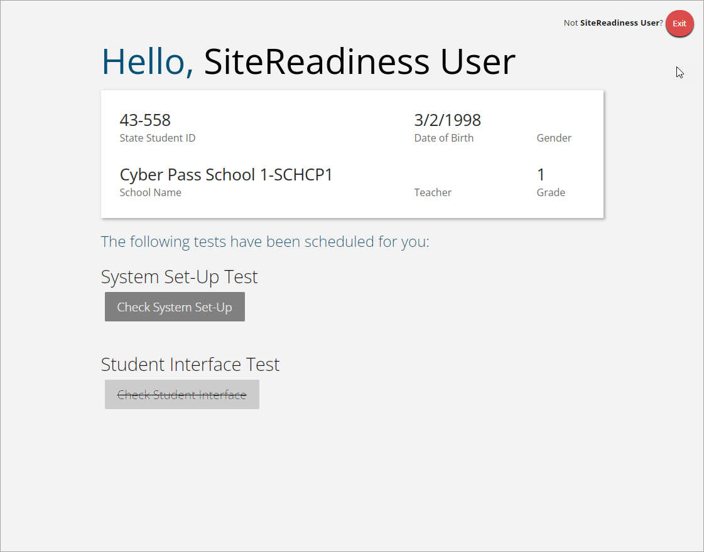
Site Readiness
Student Interface Test must be completed to log complete site readiness results in the portal.

Slide 26
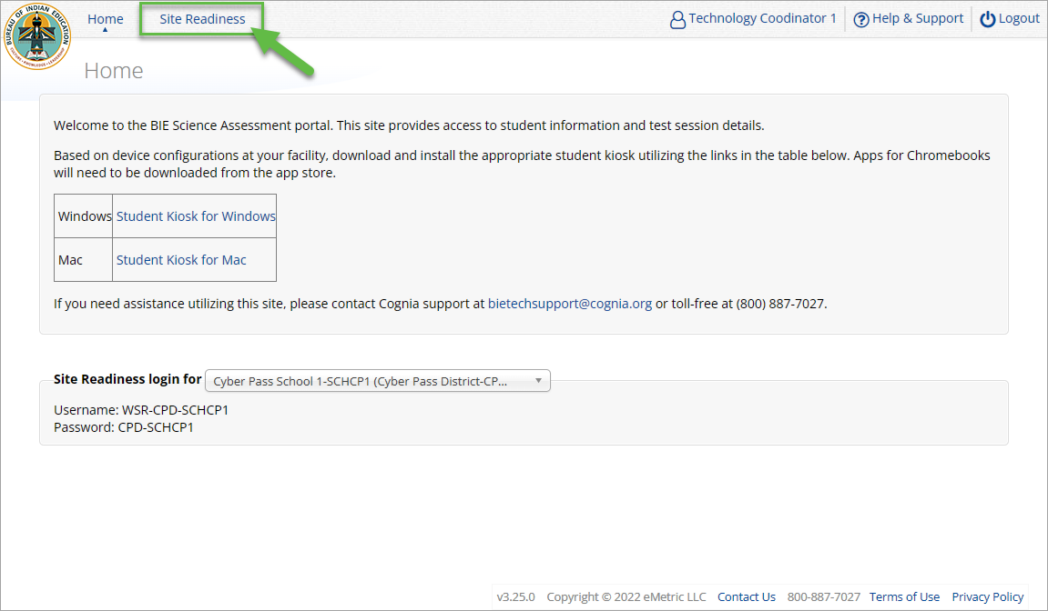
Site Readiness

Slide 27
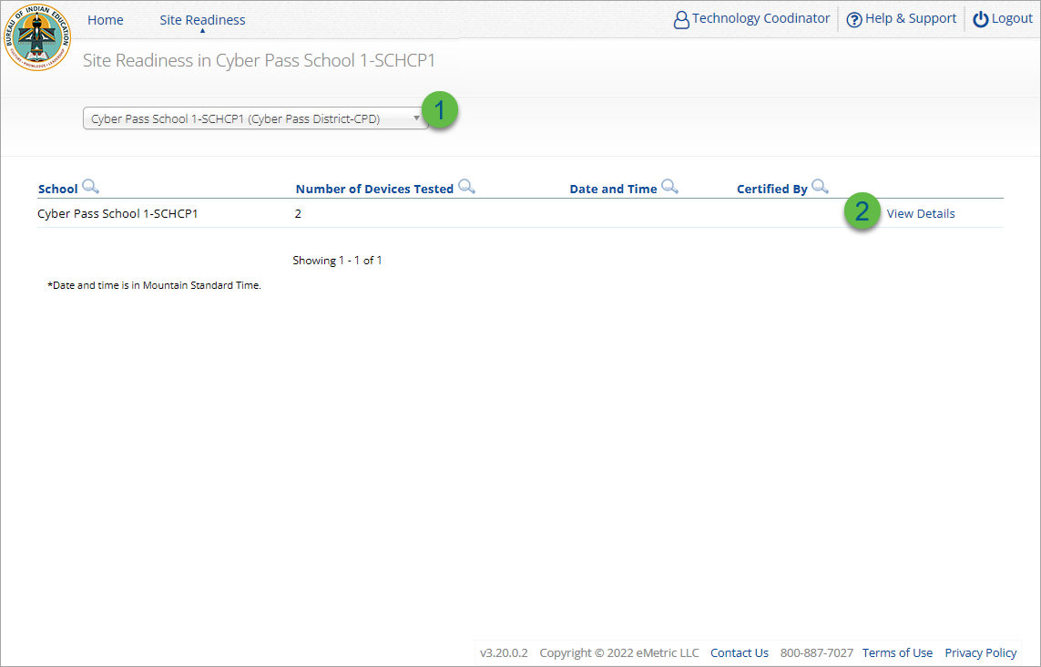
Site Readiness
Step | Description
1 | Select the organization.
2 | Click View Details to view the devices at the school.

Slide 28
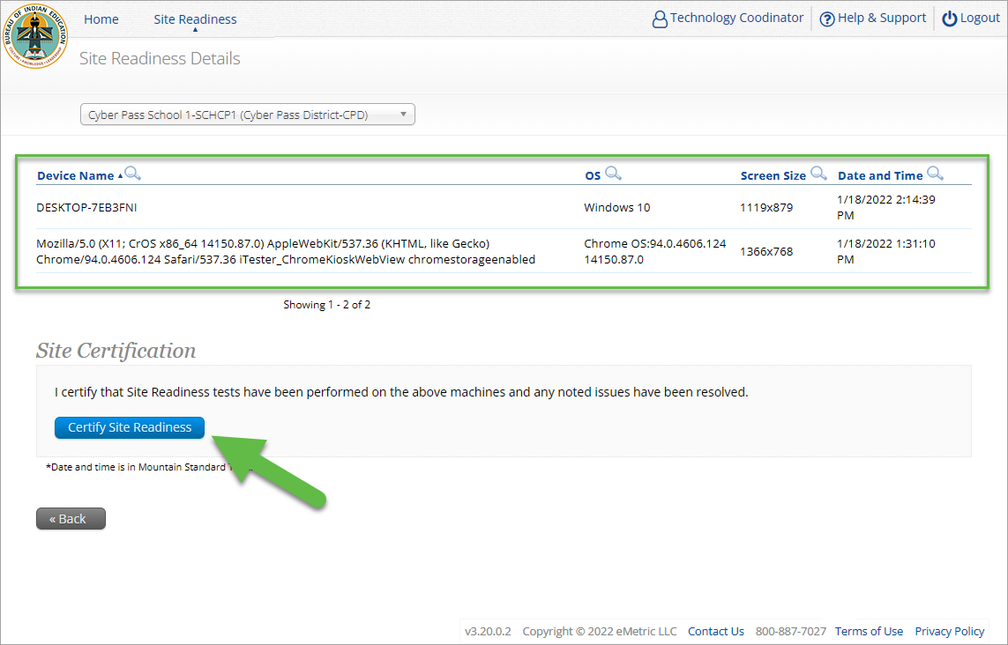
Site Readiness

Slide 29
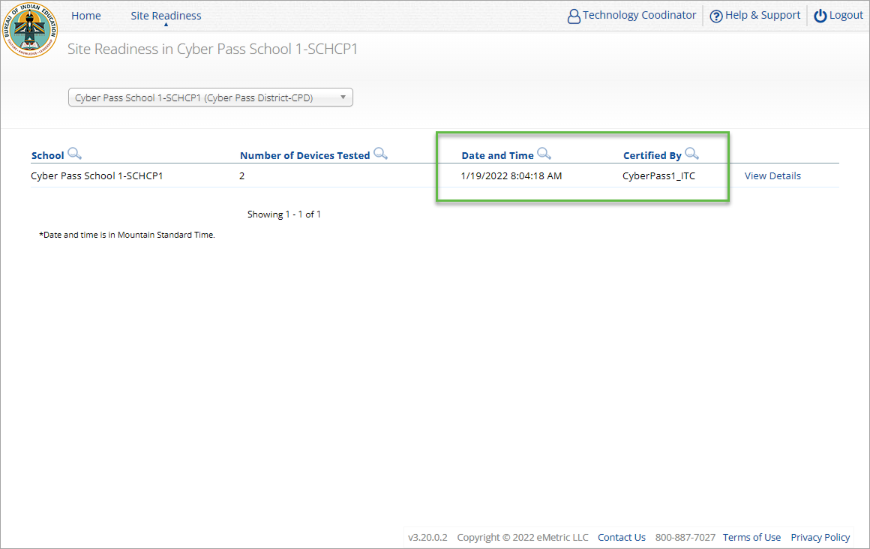
Site Readiness

Slide 30
Administration Workflow
STC and TA User Activities

Slide 31
Administration Workflow
Students
Classes
Site Readiness
Test Sessions
Score and Report
Home
STC: update roster and student information, assign accommodations and accessibility features
STC or TA: make classes and test sessions
TA: score tests
STC and TA: view reports

Slide 32

Managing Students
  BIE first student import: September 18, 2025.
    Grades 5, 8 and 11 only
  View your current student roster in the Student tab
  Update rosters
    STCs may request student transfer for students enrolled in other schools at any time
    STCs may unenroll students from school at any time
    STCs can add student individually at any time
  Check/update individual student records
    Demographic data
    Add/remove accommodations and access to accessibility features
  Tips:
    State Student ID = NASIS ID
    On Students tab: Download roster in csv at any time by selecting “Export Roster” under the “Exports” drop down (contains name, NASIS ID and Grade)
    Can’t add student? They may be enrolled in different school – initiate transfer request
    Cognia Customer Care desk can assist with student transfers

Slide 33
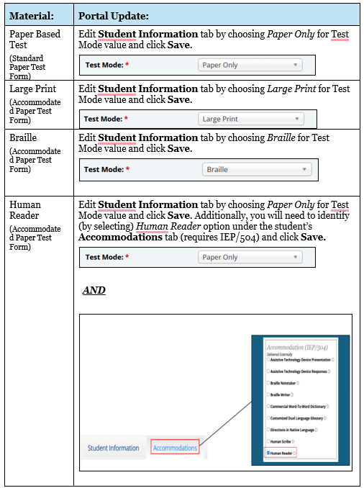
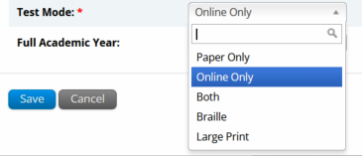
Managing Students
  BIE performed a second supplemental student import in early December 2025 to add any missing students in Grades 5, 8, & 11.
  Following this second student upload to the Portal, schools will have a window (12/8/25-1/16/26) to review student rosters and identify their paper testers.
  Update the “Test Mode” field on the Students Information tab in the BIE Portal.

Slide 34
Student Transfer Request
Request to move student from another school into your school
Approve or reject requests to move students out of your school
  Receive notification of requests by e-mail and in portal
If a student is unenrolled, the help desk will approve the transfer request
Test sessions do not transfer with the student!

Slide 35
Student Accommodations
  Check/edit accommodations
    Accommodations are not included in BIE roster upload
    Edit student accommodations individually or…
    Use Upload Accommodations to edit accommodations on multiple student records at one time
    You can use the Export Accommodations button to download list of all students and their currently assigned accommodations, edit that file and re-upload it using the Upload Accommodations menu
    View the training video, available in the Help & Support site, https://bie.onlinehelp.cognia.org/resources/, for step-by-step instructions

Slide 36
Universal Tools, Accessibility Features, and Accommodations
Universal Tools
(Available to all students)
Platforms tools that are built in and automatically delivered during testing
Accessibility Features
(Available to some without IEP/ 504)
Must be pre-identified by DTC/STC prior to testing
Accommodations
(IEP, 504)

Slide 37
Demo
Add, edit, enroll, and unenroll students
Student transfer requests
Student accommodations

Slide 38
Creating Classes
Groups of one or more students who will take a test
Create grade-level classes
  Maximum number of student allowed in a class: 90
  Class can be deleted if it has not been scheduled for a test
  If test session scheduled and no student has logged in, delete test session, then class
Students can be assigned to more than one class
If any student needs to retake the test, you must:
  Create a new class and put the student(s) in that class and schedule that class for a test in a new test session

Slide 39
Creating Classes
STCs or TAs (Teachers) can create classes
Each class must have a TA assigned to the class
STCs can create classes and assign any TA
STCs can view or edit any class in their school
TAs can only assign themselves as TA for the classes they create
TAs can only view the classes if they are assigned as TA
TAs can put any student in the school in their class
Once a student is assigned to the TA’s class the TA can view the student record but cannot edit it.

Slide 40
Demo
Create, edit, delete classes
Bulk upload classes

Slide 41
Scheduling Test Sessions
Schedule a test session (assign class to test)
  Select test
    Spring 2026 tests will be available for scheduling in the portal from March 2, 2026
    Ensure you select BIE Science Assessment program
  Select class to schedule for that test
    Class must be same grade level as test and must not be previously scheduled for the test
  Save the test session
  Go to the Test Session Details page to:
    Review students in the test session
    Get session access codes (must be provided to the student to log into specific test session)
    Check student forms (students with TTS accommodation should have TTS form)
    Print test tickets with students’ usernames and passwords
    Monitor test status
  Student test tickets:
    Can be downloaded as pdf or csv file
    pdf can be printed with 1, 8 or 27 log-ins per page
    pdf has cover sheet listing students and accommodation/accessibility feature assignments
  Note:
    Students do not have to test at the same time
    Log-ins can be used at anytime during the test window as long as the student has not turned in the test
  Test window is Monday – Friday, 5am – 8pm MST – times are displayed in Mountain time!
  (6am – 9pm CST, 7am – 10pm EST, 4am – 7pm PST)

Slide 42
Scheduling Test Sessions
STCs or TAs (Teachers) can create test sessions from March 2, 2026, for scheduling the Spring 2026 tests
TA’s must have access to the program in their user profile to schedule classes for an assessment in that program
STCs can create test sessions for any TA
STCs can view or edit any test sessions in their school
TAs can only create test sessions for their classes
TAs can only view or edit test sessions for their classes

Slide 43
Demo
Schedule Test Sessions
Manage and Monitor Test Sessions
Test Status Reports

Slide 44
Completing Testing
Check student test status for tests “Not Started” or “In Progress”
Use the “Export Test Status”, “Export Test Status for All Tests”, and “Export Students Not Scheduled” to help check students
Enter Test Report code/invalidations as needed
No other actions are needed to “close” testing
Following the completion of the test administration window, there will be a three-day “data clean-up” period when changes can be made to student demographics and test report codes/invalidations.
  April 20 – 22, 2026 (Monday – Wednesday)
After this window, students and test sessions will still show up in the portal but any further changes will not be reflected in reporting
In June, all students, test session data and tests will be removed from the portal

Slide 45
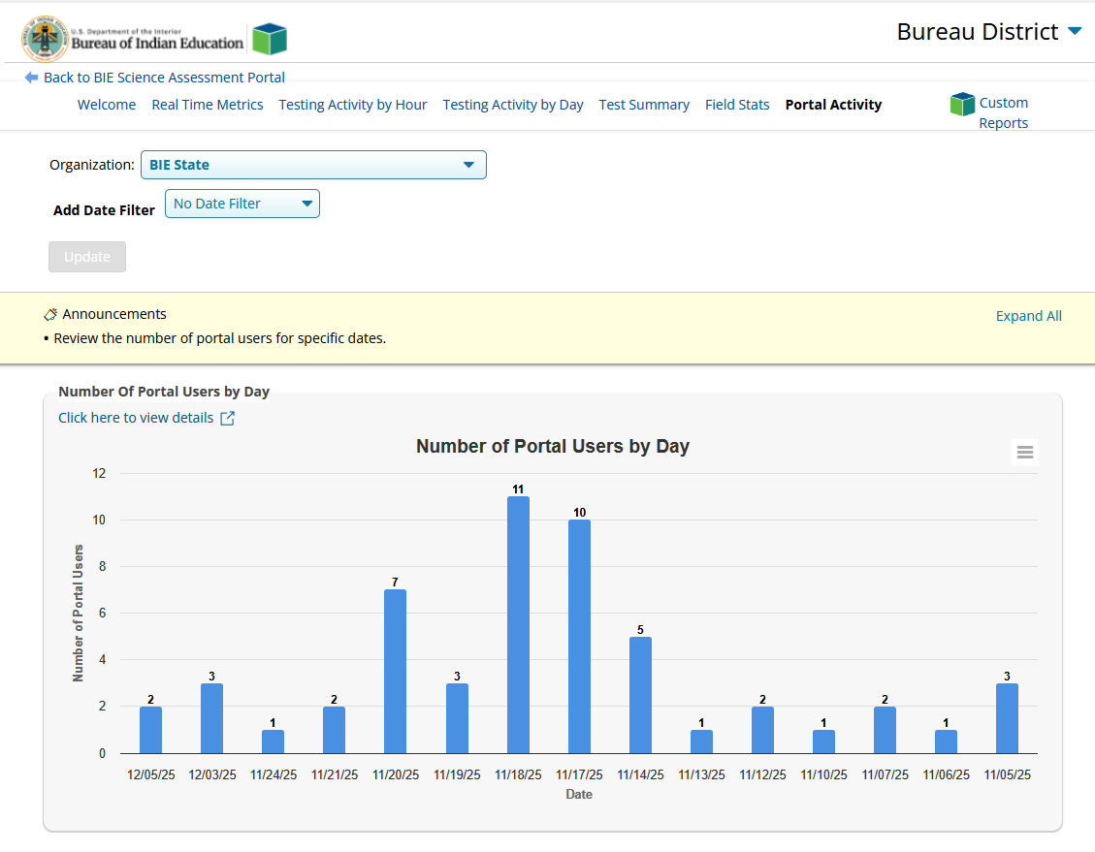
Dashboard
Dashboard will be available at the start of testing
Live data available, will display near real-time statistics
Not to be used for accountability statistics
Statistics are by school
Statistics include
  Number of tests scheduled
  Number of tests in progress
  Number of tests finished
  Tests started by hour
  Tests started by day
  Operating systems used by testers

Slide 46
Demo
Dashboard

Slide 47
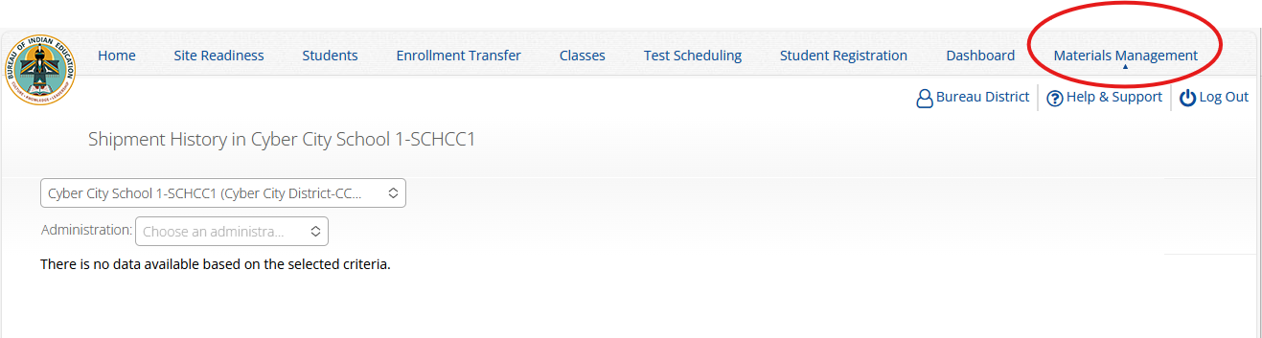
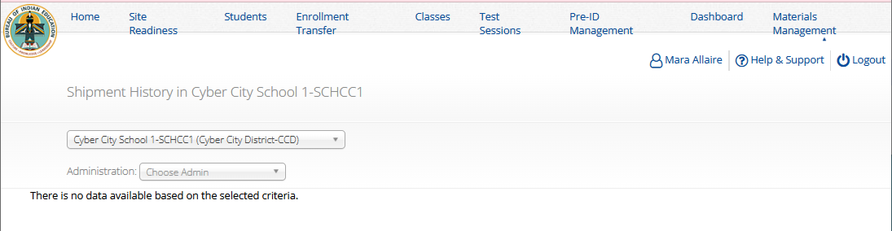
Materials Management
Order additional paper test materials from Cognia
Access to this menu and training on how to use it will be released later when the additional materials window opens

Slide 48
Administration Workflow
Student Testing Platform

Slide 49


BIE Science Assessment
BIE Science Assessment Student Testing Platform

Slide 50











Universal Tools
Name | Tool Icon
Sketch Tool (not available for constructed response items)
Text Highlighter
Note Pad
Line Reader
Answer Eliminator
Reference Sheet
Pop-up Glossary

Slide 51


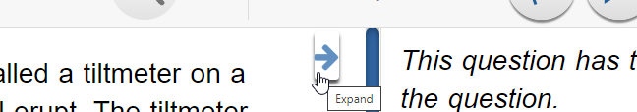



Universal Tools
Name | Tool Icon
Zoom View (magnifier)
Bookmark
Expand Passage/Item
Answer Masking
Custom Masking
Reverse Contrast

Slide 52

Accessibility Features
Must be pre-identified before testing, but student does not need a legal plan to have accessibility features assigned to them for testing
Name | Tool Icon
Color Contrast

Slide 53




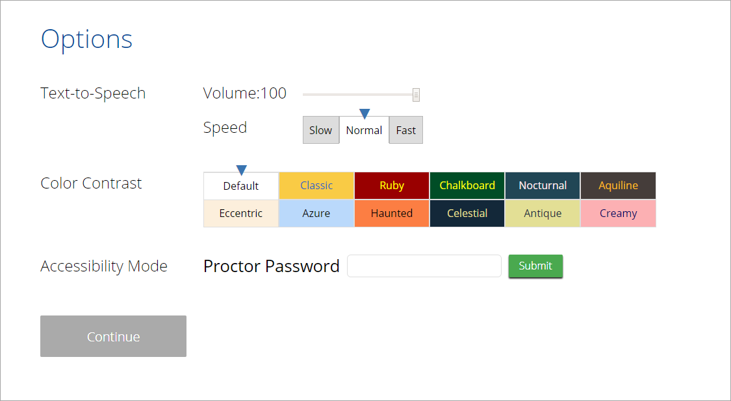
Accommodations
Must be pre-identified before testing and be apart of the students 504/IEP plan
Name | Tool Icon
Science Text-to-Speech English
Word Prediction (Embedded)
Allow Accessibility Mode Testing

Slide 54
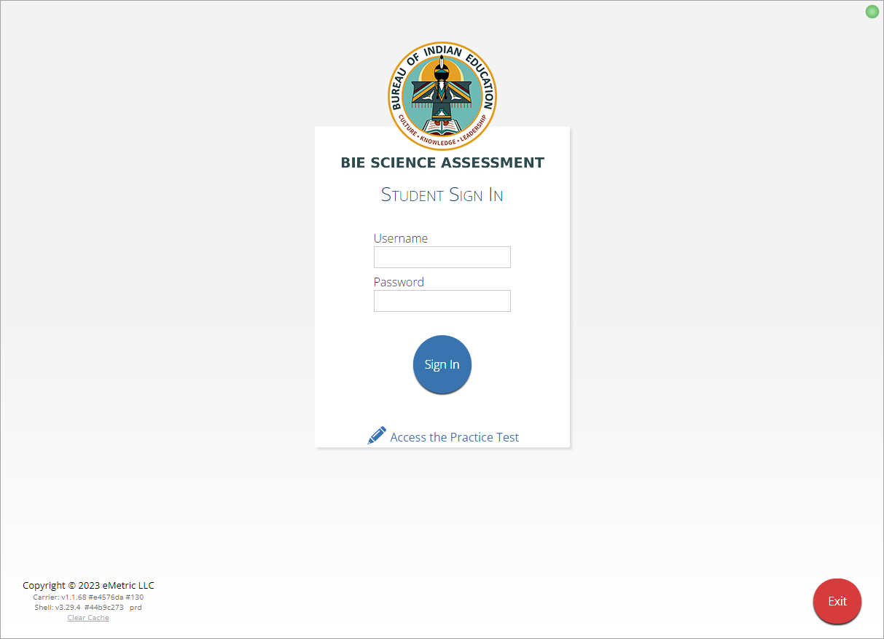
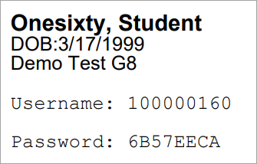

Logging in to a Test
Launch Kiosk
Login using the username and password from the student test ticket

Slide 55
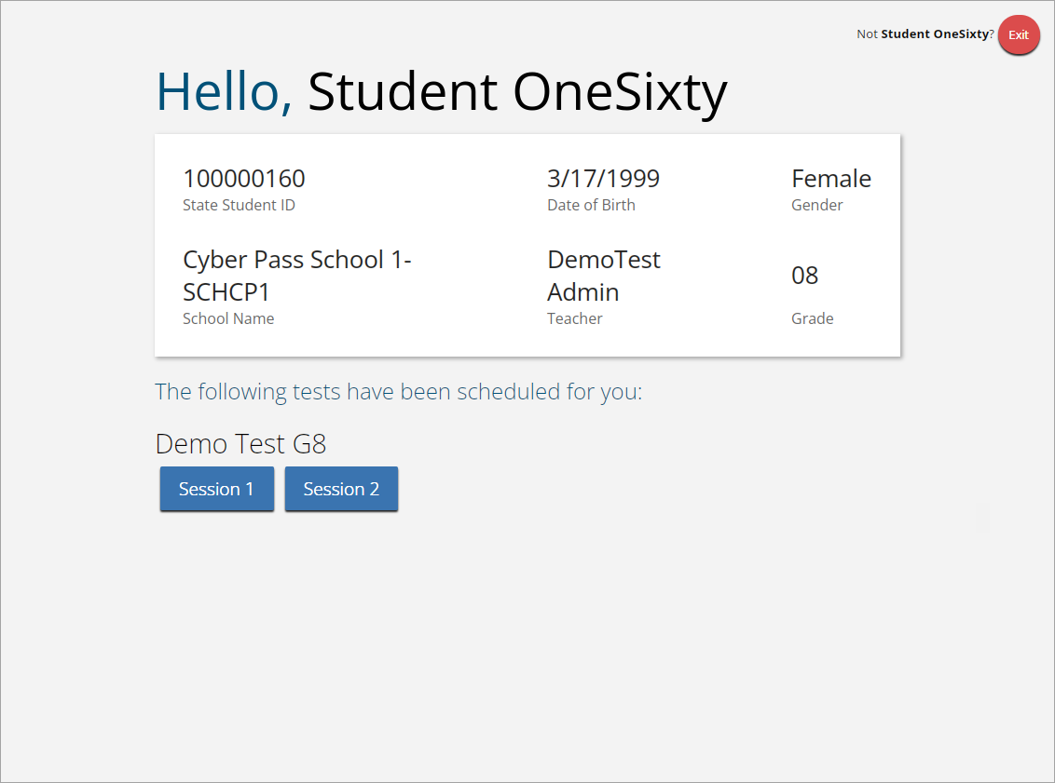
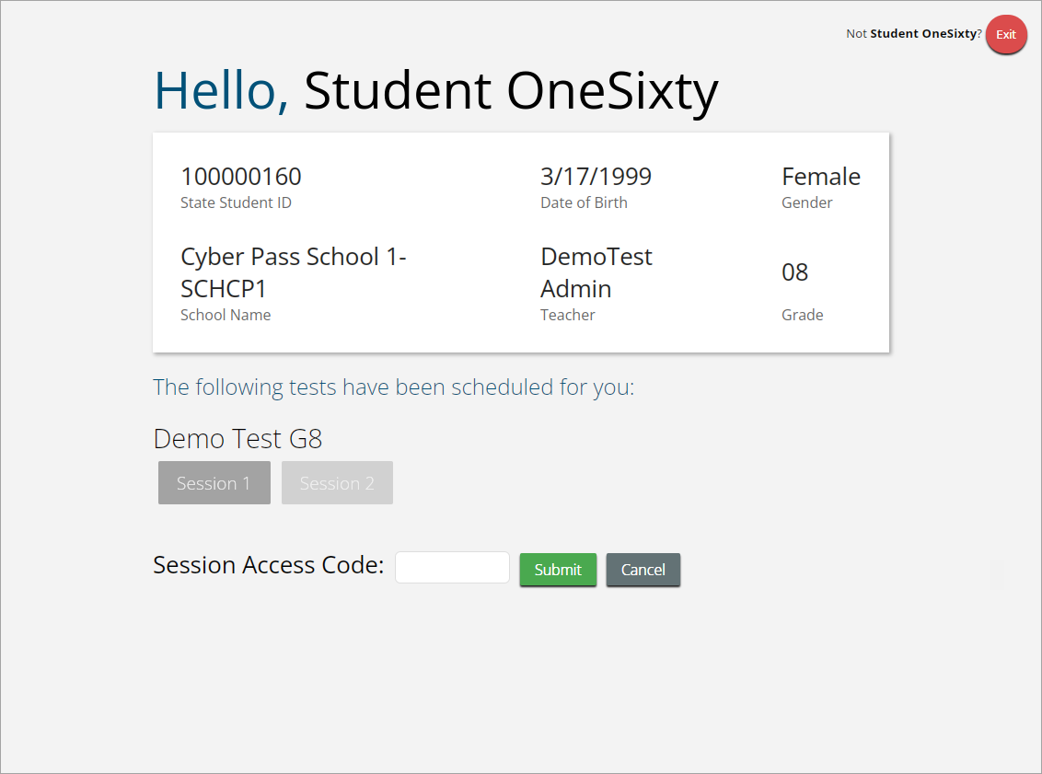
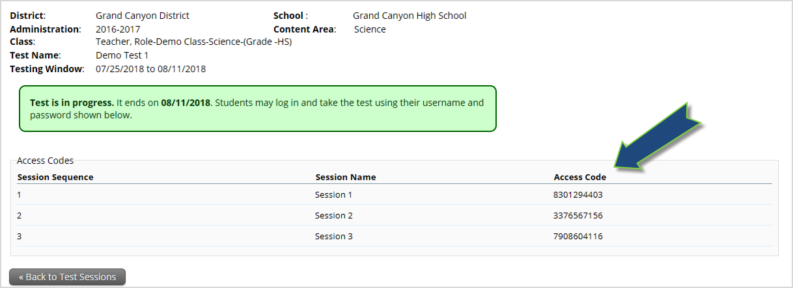
Logging in to a Test

Slide 56
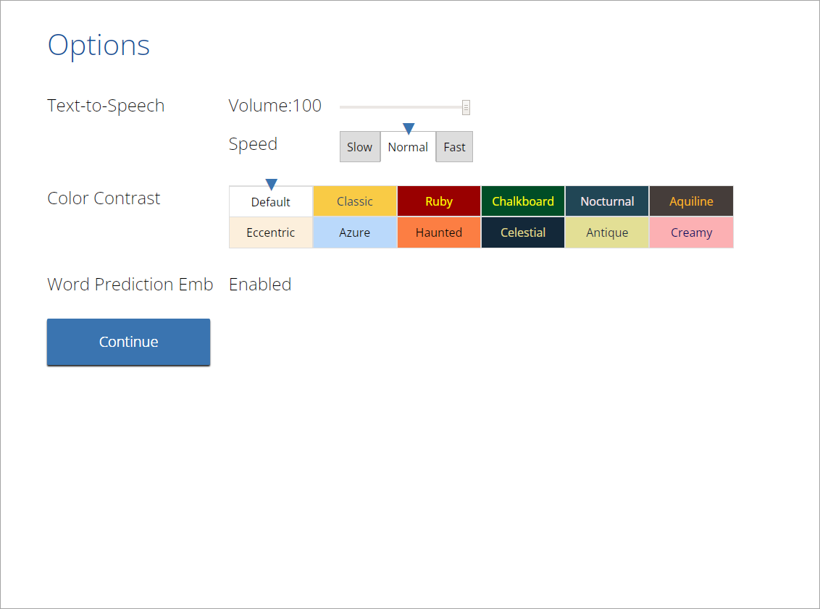
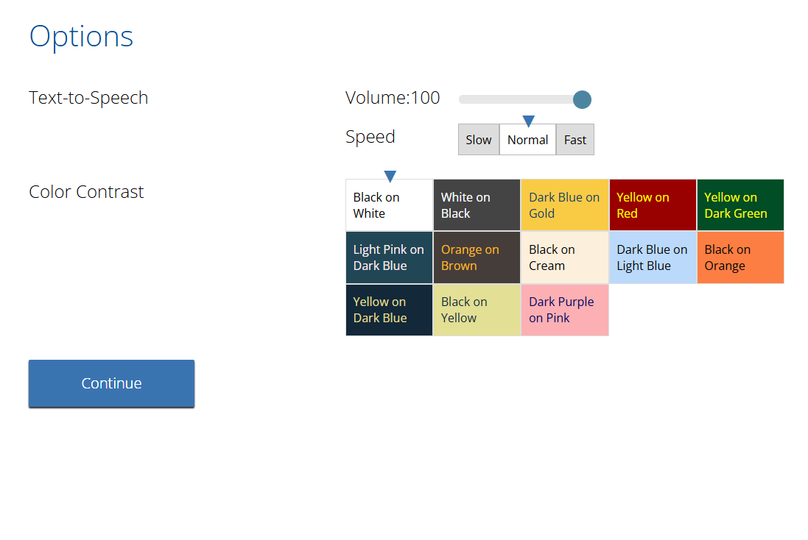
Logging in to a Test

Slide 57
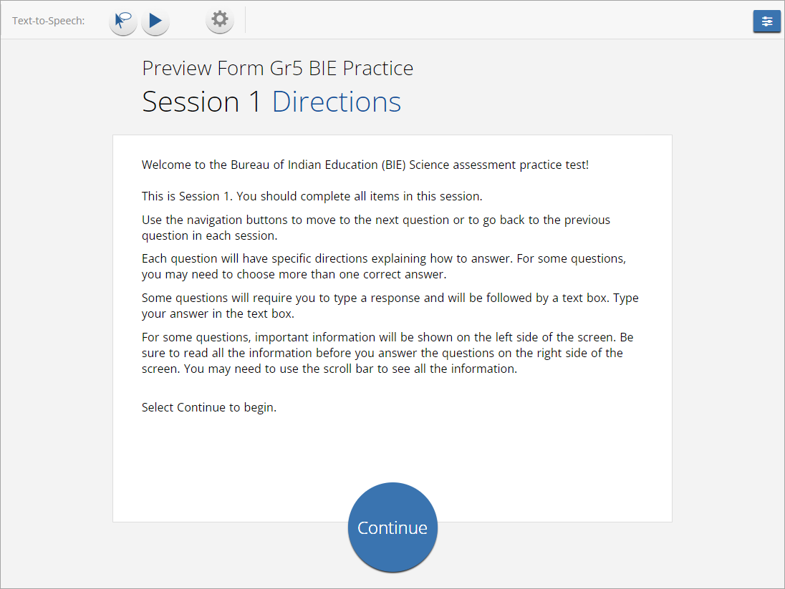
Logging in to a Test

Slide 58
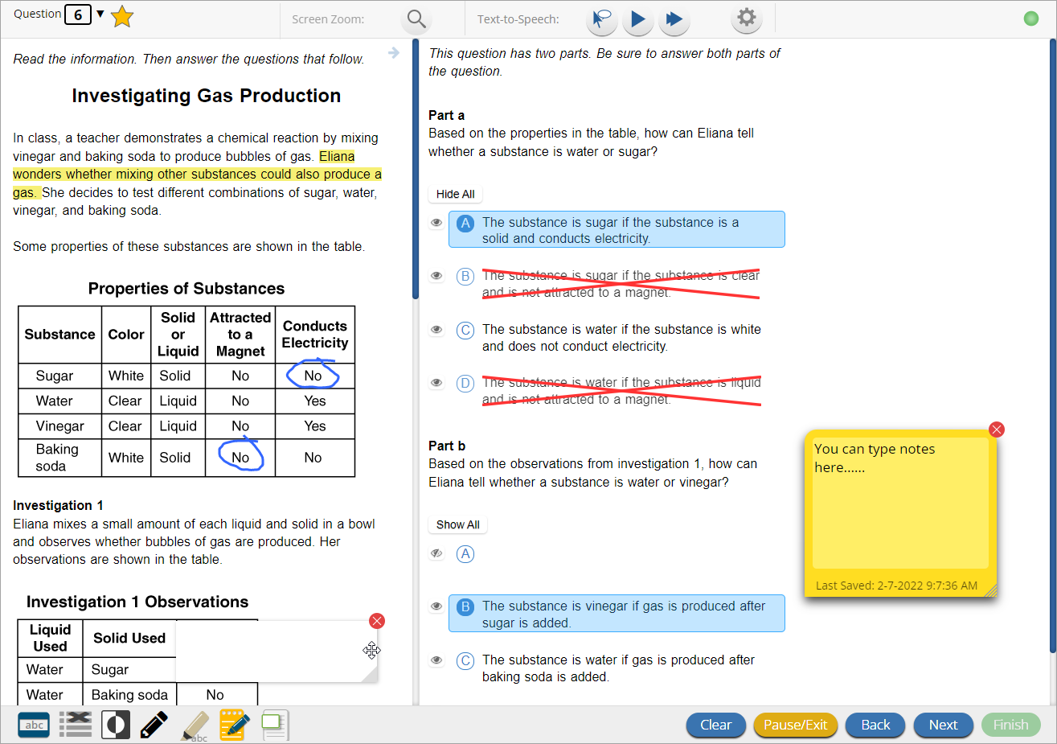

Test Navigation

Slide 59
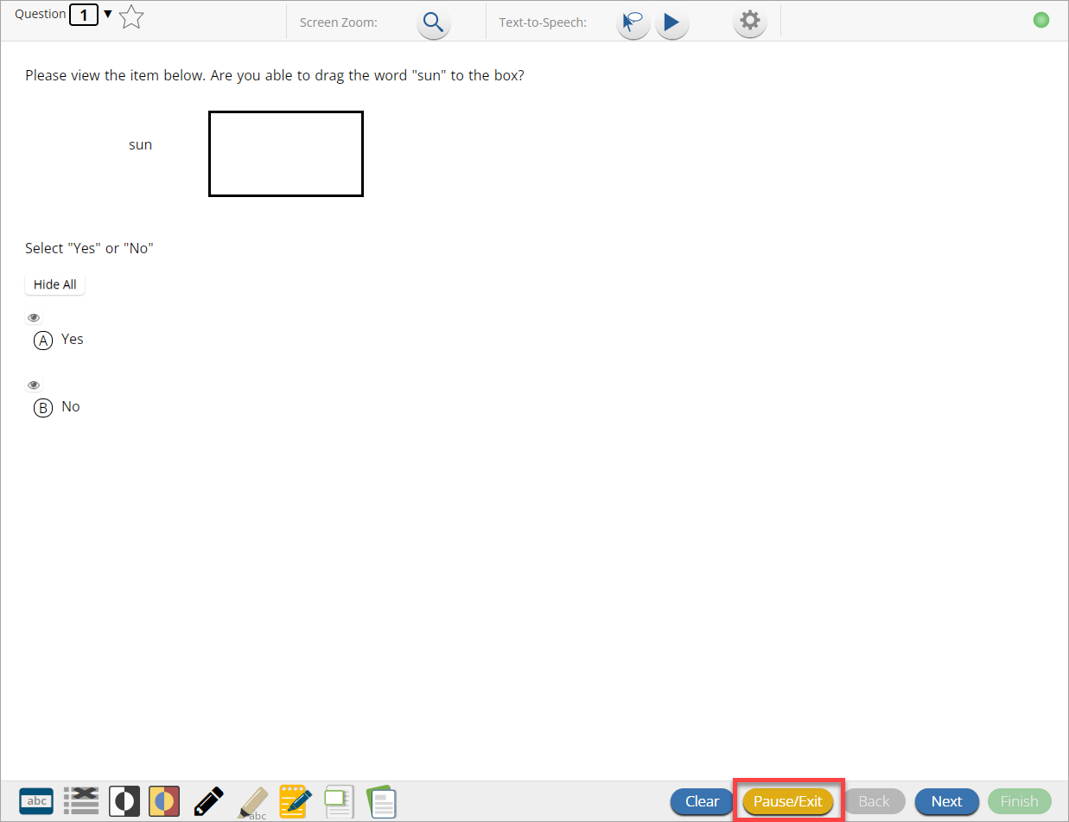
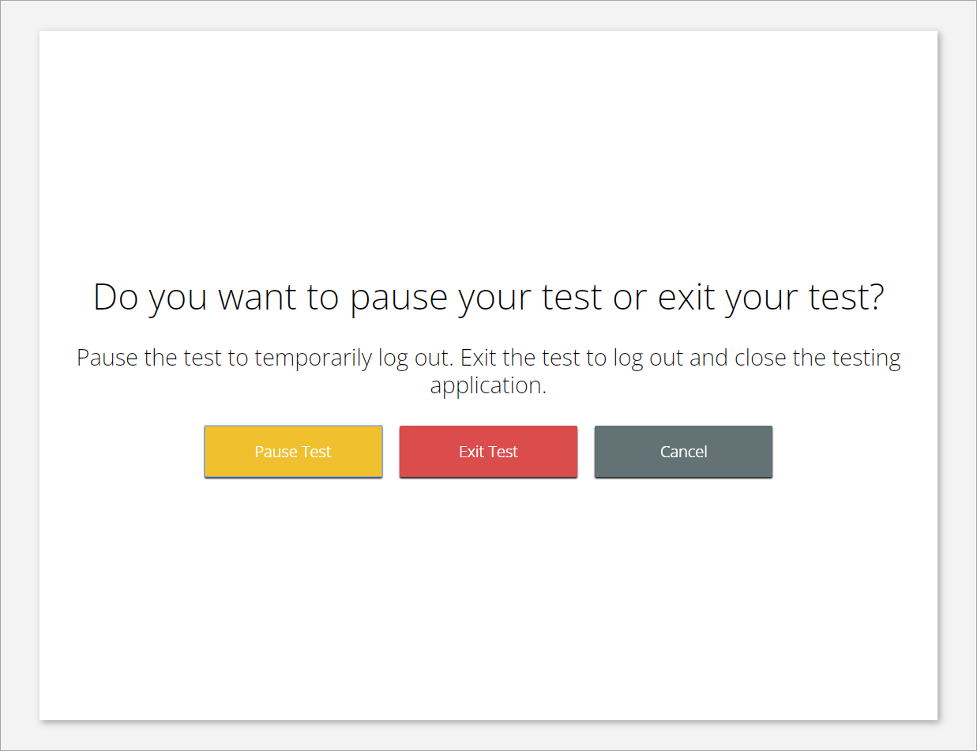


Test Navigation

Slide 60
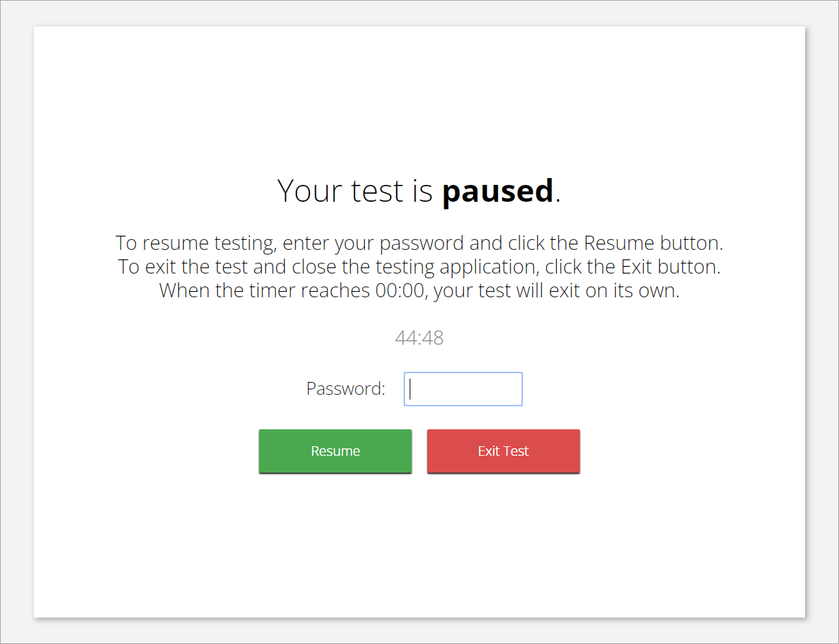
Test Navigation
Pause and inactivity timeout is 45 mins.

Slide 61
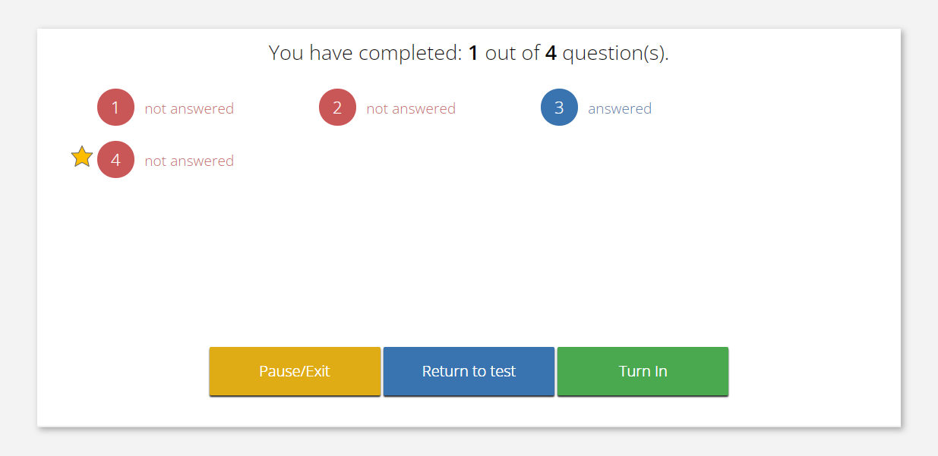

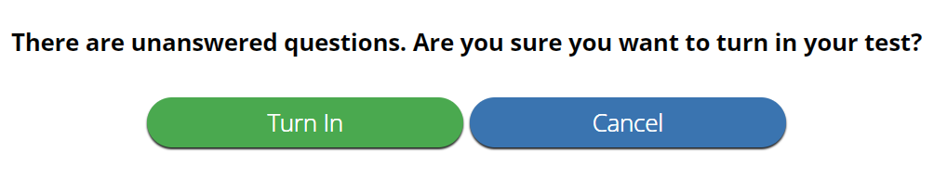
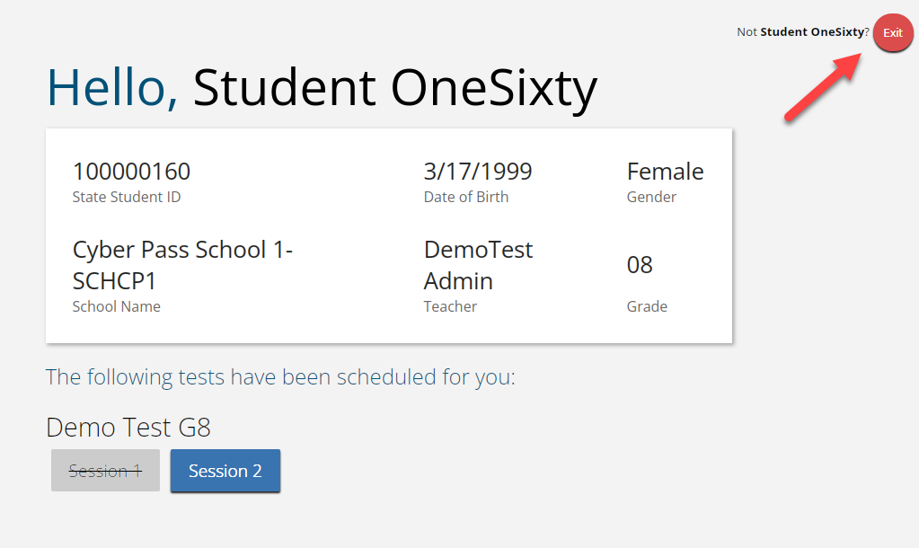
Test Turn In
Steps | Button to Click
On the last item, students click Finish.
On the test review screen, students click Turn In.
Below the confirmation question, students click Turn In.
Student returns to profile page and may select the next section or click Exit to exit the kiosk.

Slide 62



Internet Connectivity
Beginning of Test:
Authenticate login
Download test content
End of Test:
1. Submit responses for scoring

Slide 63

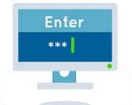


Kiosk Test Integrity
What happens if a student loses network connection in the middle of a test?
A
C
D
B
45-90sec
A
C
Stored Response Folder
D
B

Slide 64
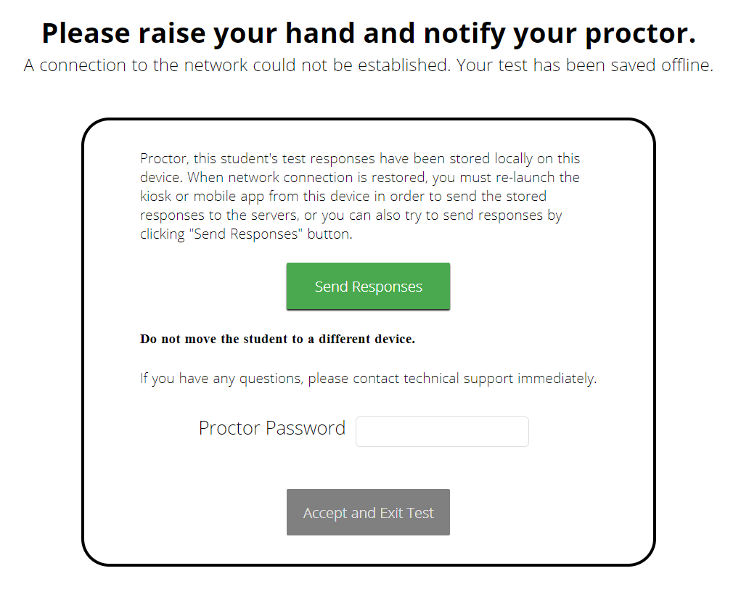

Kiosk Test Integrity
What if a student finishes a test but has no network connection?
A
C
A
B
C
D
B
C
D
A
B
C
D
A
B
C
D
A
B
D
Turn In
A
C
C
A
B
D
D
B
C
A
B
C
D
A
B
C
D
A
B
D

Slide 65
Kiosk Test Integrity
Loss of Network Connectivity Procedure Summary
If a student loses network connectivity in the middle of a test:
  Keep testing on that device
  Test content and responses are stored securely on the test device, either in the browser cache or the stored response folder
  Responses will be sent when network is restored
If student finishes and is ready to turn in test prior to network being restored:
  Allow student to turn in test
  Student will see offline message, acknowledge offline message and exit
  Student will be taken back to login page or receive no internet connection message
  Restore network
  Return to that exact device and relaunch the browser or relaunch the kiosk
    (student can log-in to confirm session is done (session button will be greyed out)
If you are unsure of the status of the student responses, call the help desk

Slide 66
Practice Test Options
1. Via web browser
Best option for:
  Practice testing with browser or on devices that do not have a testing kiosk installed
  Note: all accommodations except allow accessibility mode and screen zoom are available
To access the practice test in web browser:
  Launch Browser
  Go to https://biepracticetest.cognia.org
  Use the drop-down menu to select the practice test and click the “Go” button
2. Via student kiosk
Best option for:
  Realistic practice testing in secure kiosk
  Note: all accommodations except allow accessibility mode are available
To access the practice test in kiosk:
  Launch BIE Science Kiosk
  Click on the “Access Practice Test” link
  Use the drop-down menu to select the practice test and click the “Go” button

Slide 67
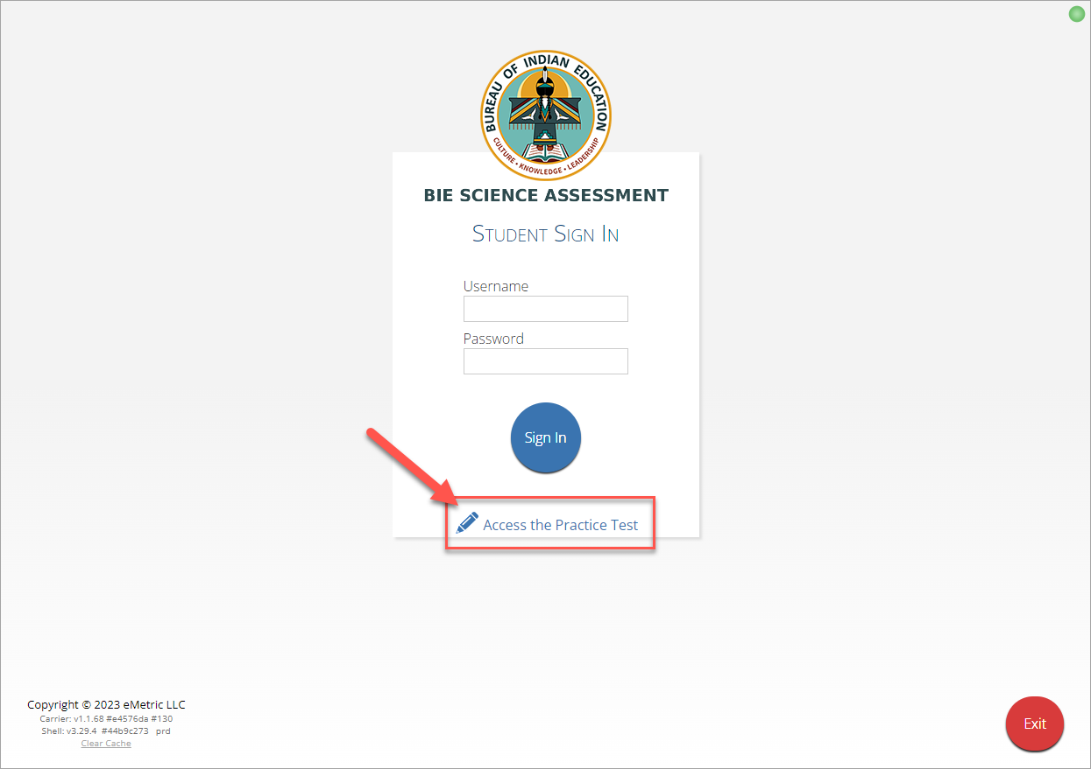

Practice Test

Slide 68
Demo
Practice Tests

Slide 69
New Features (Portal) for 2025-2026
Pre-ID Management tab renamed to Student Registration
Test Sessions tab renamed to Test Scheduling
Display student's session progress metrics such as number of items visited, answered, not answered along with a visual progress bar for portal users (DTC/STC/TA)
Allow exporting student logins in bulk by school
User Import Enhancement: Add a data definitions layout to the UI
Enhancements to new user email and account creation workflow
Transfer test sessions when a student is transferred (coming soon)

Slide 70
New Features (Kiosk) for 2025-2026
Accessibility updates: Contrast enhancements in the student testing interface (for example, change Pause/Exit button color from yellow to blue)
The Color Contrast names will be updated to be reflective of the color options
Provide inactivity timeout warning for students
Four different color options in the Highlighter tool.
Item expansion feature when paired with a stimulus.
Student's name will be displayed to the top right corner of the item and directions pages within a test.
Help feature enabled for practice tests.

Slide 71
Additional Training Resources
Help Guides
Quick Starts: Creating Classes, Scheduling Tests, Printing Logins, Student Interface
Kiosk Installation Guide
Portal User Guide
Kiosk User Guide
Scoring Guide
Reporting Guide
Testing with Third Party Accessibility Software
Tutorial Videos
  https://bie.onlinehelp.cognia.org/
Support Desk
Call-in Information Sheet

Slide 72
Remember
Deactivate unused accounts
Kiosks do need to be downloaded, and apps installed – last year’s kiosks will not work
Check student demographics and add accommodations
Ensure students have TTS accommodation/form BEFORE they log in to the test
Make sure network management tools don’t delete stored response folder
Communicate with Proctors/Test Administrators
  Are there limits to number of students who should log in simultaneously?
  Do they know the procedure for recovering stored responses?
  Do they have basic information required by the support center if they call in?

Slide 73
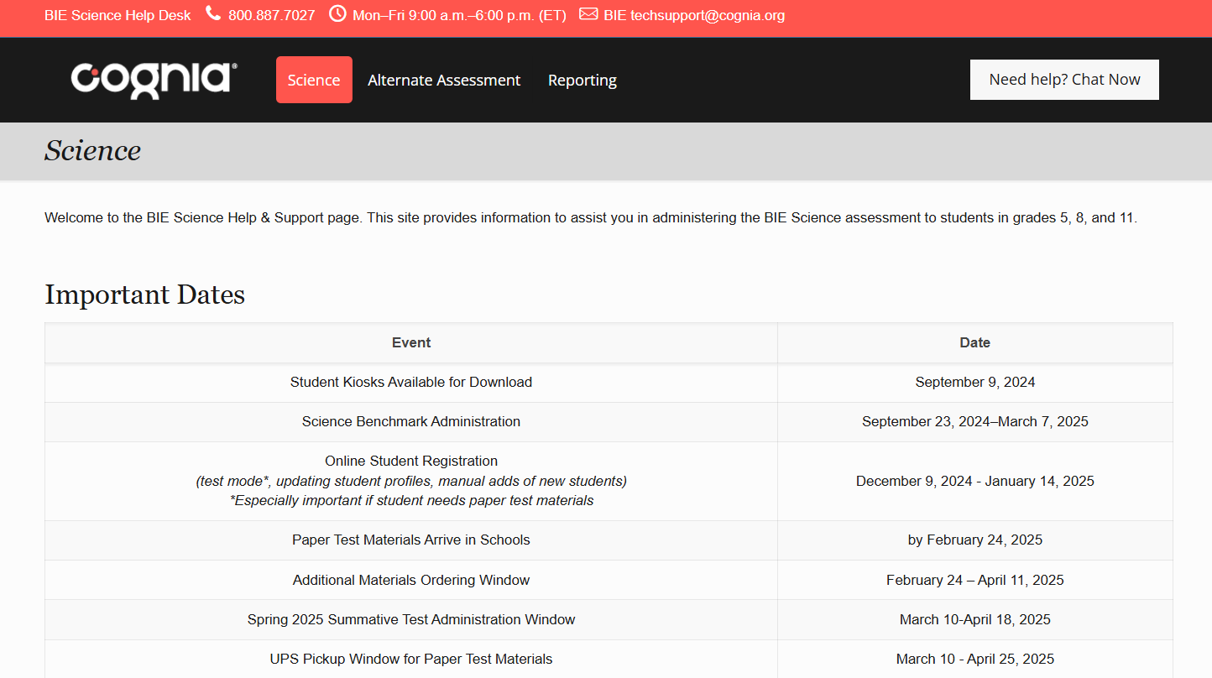
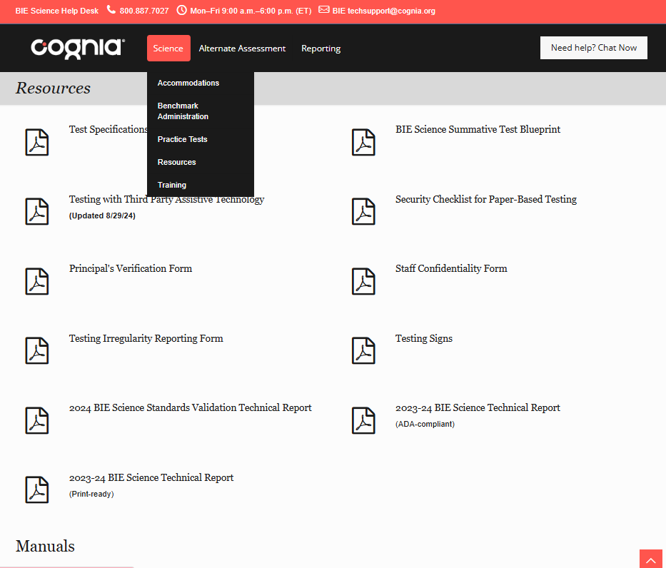
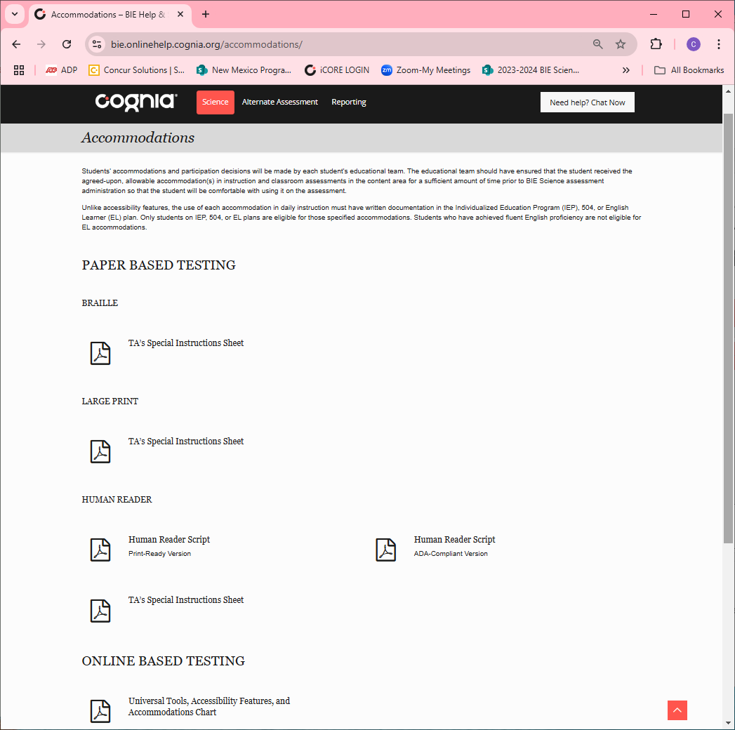
Help & Support Site
Science Assessments
https://bie.onlinehelp.cognia.org/science/
Resources will be posted throughout the year
Key dates
Manuals
Training videos
Practice tests
Access to CBT practice test and answer documents
Downloadable PDFs of the PBT practice test
Reporting resources
Accommodations

Slide 74
BIE Science Help Desk
Hours
Monday–Friday from 9:00 a.m.–6:00 p.m. (ET)
Contact information
Phone: 800-887-7027
Email: BIETechSupport@cognia.org
Chat (accessible from the BIE Science Help & Support site)
Notes:
For any additional questions that come up throughout the administration, please do not hesitate to reach out to the BIE Science Help Desk. They can be reached by phone, email, or live chat and are happy to assist in any way we can.

Slide 75
Questions?

Slide 76

Thank you!
Notes:
Sara close

