Slide 1


Bureau of Indian Education
Spring 2026 Science Assessment
Administration Overview & Policies
January 8, 2026

Slide 2

Agenda
Opening & Orientation
  Housekeeping Reminders
  Welcome & Introductions
  Assessment Overview
Logistics & Scheduling
  Accessing the Online Assessment
  Key Dates
Test Security
  Forms
  Secure Materials
  Irregularities
  User Accounts
What’s new for spring 2026?
Administration Procedures and Accommodations
  Computer-Based Testing (CBT)
  Paper-Based Testing (PBT)
Materials Management
  Ordering Additional Materials
  Returning Paper Materials
  UPS Pickup
Resources & Closing
  Resources
  Help Desk
  Questions

Slide 3
Opening & Orientation

Slide 4
🧹Housekeeping Reminders
Cell phones muted
Questions written down
Slide access link: https://bie.onlinehelp.cognia.org/training
Q&A at end of each segment
Index card for overflow questions

Slide 5
Welcome & Introductions: Bureau of Indian Education (BIE)
Dr. Carmelia Becenti, Chief Academic Officer
Aurela Shorty, Education Program Specialist (Assessment & Accountability)
Donald Griffin, Section 504 Program Coordinator, MSAA Project Manager

Slide 6
Welcome & Introductions: Cognia
MARA ALLAIRE
PROGRAM Manager
SARAH MCCAIN
IT PROJECT MANAGER II

Slide 7
Welcome & Introductions: eMetric
GERRY RETZLOFF, Project Manager
MICHAEL BERNAL, Support Center Manager
Notes:
eMetric introductions

Slide 8
Science Summative Assessment Overview
Test Grades
Test Modes
Number of Test Sessions
Participation Requirements
A signed waiver has been obtained by BIE and USDE
Permission obtained to participate in your local state assessment
5, 8, 11
Computer-based (CBT)
3 per grade
Paper-based (PBT)
Accommodated Test Forms
Online: Text-to-Speech
Paper: Standard print, Large print, braille, human reader
Required for all BIE schools with a few exceptions

Slide 9
Logistics & Scheduling

Slide 10
Accessing the Online Assessment
Portal: https://bie.cognia.org
School Test Coordinators (STCs)
IT Coordinators (ITCs)
Test Administrators (TAs)
Computer testers – BIE Science Assessment Kiosk
Access for students
Must be downloaded on school devices prior to testing
Portal URL Link: https://bie.cognia.org

Slide 11
Key Dates: Before Testing
📅
Sep 8, 2025
Kiosk available for download
Sep 22, 2025 – Mar 6, 2026
Benchmark administration window
Dec 8, 2025 – Jan 16, 2026
Online Student Registration
Feb 23, 2026
Printed testing materials arrive in schools
Feb 23 – Apr 10, 2026
Additional paper materials ordering window
Mar 2, 2026
Online tests available for scheduling in portal

Slide 12
Key Dates: Testing Window & After Testing
Mar 9 – Apr 17, 2026
Test administration window
Apr 20 – Apr 22, 2026
STC post-testing clean-up window
Mar 16 – Apr 24, 2026
UPS pickup window for paper test materials
Apr 24, 2026
Deadline for return of secure paper materials
Jun 26, 2026
Final reports available in Data Interaction (DI)
Jul 15, 2026
Static ISRs download available in DI
Aug 6, 2026
Print reports available for schools
📅

Slide 13
Test Security

Slide 14
Test Security: Forms
Principal’s Verification Form
Completed by the school principal
Used as a checklist and signed at the end of the administration
Staff Confidentiality Form
Completed by all staff handling secure materials
Appendix E of TAM: Forms & Signs
Security Checklist
Used to track paper test materials in/out
Appendix C of TAM and TCM
Both the TAM and the forms are available to download from the Help & Support site, resources section
Testing Irregularity Reporting Form
Completed to document and report the occurrence of a testing irregularity.
Help & Support Site Resources URL Link: https://bie.onlinehelp.cognia.org/resources

Slide 15
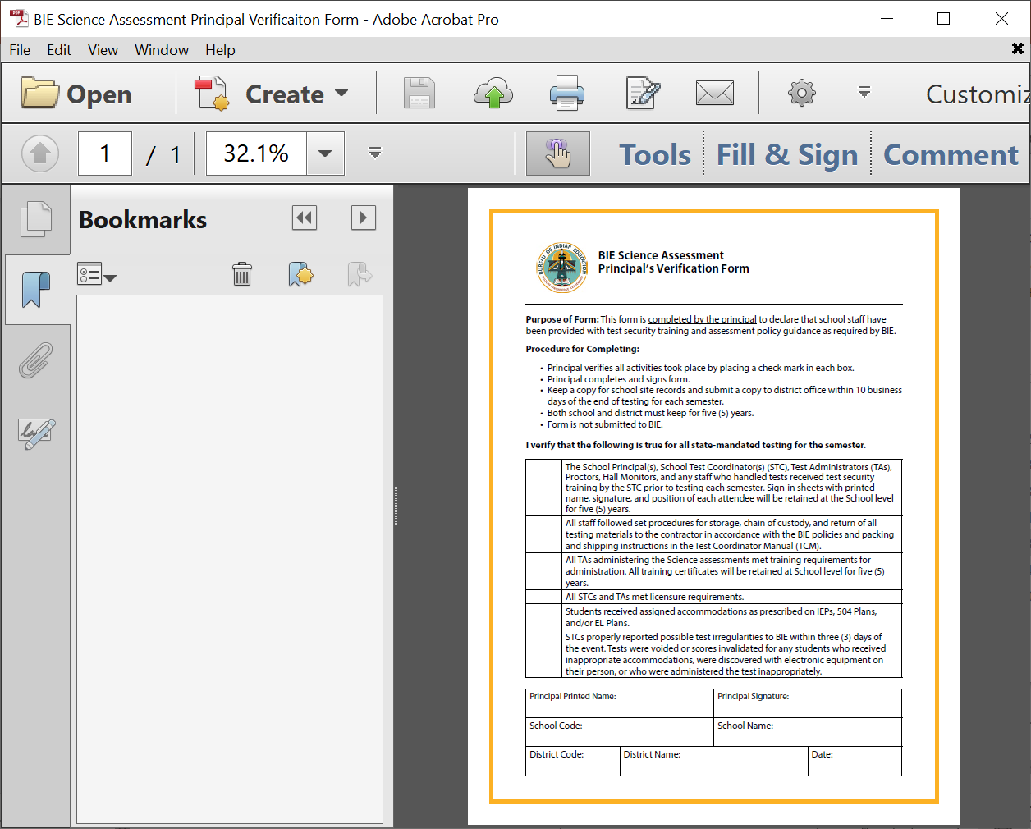
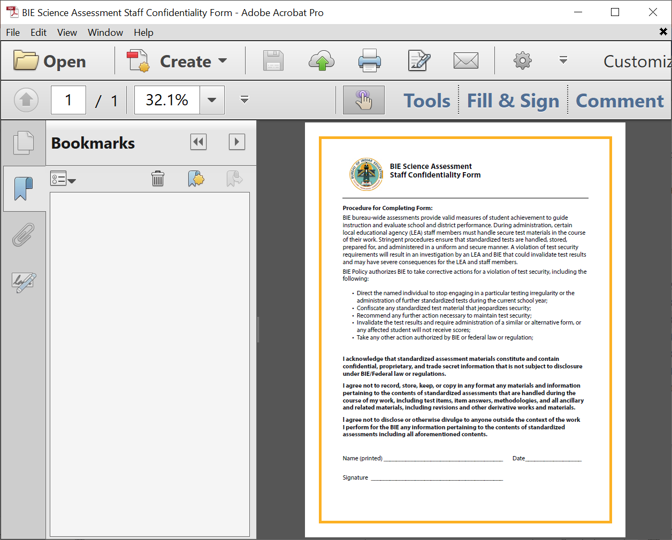
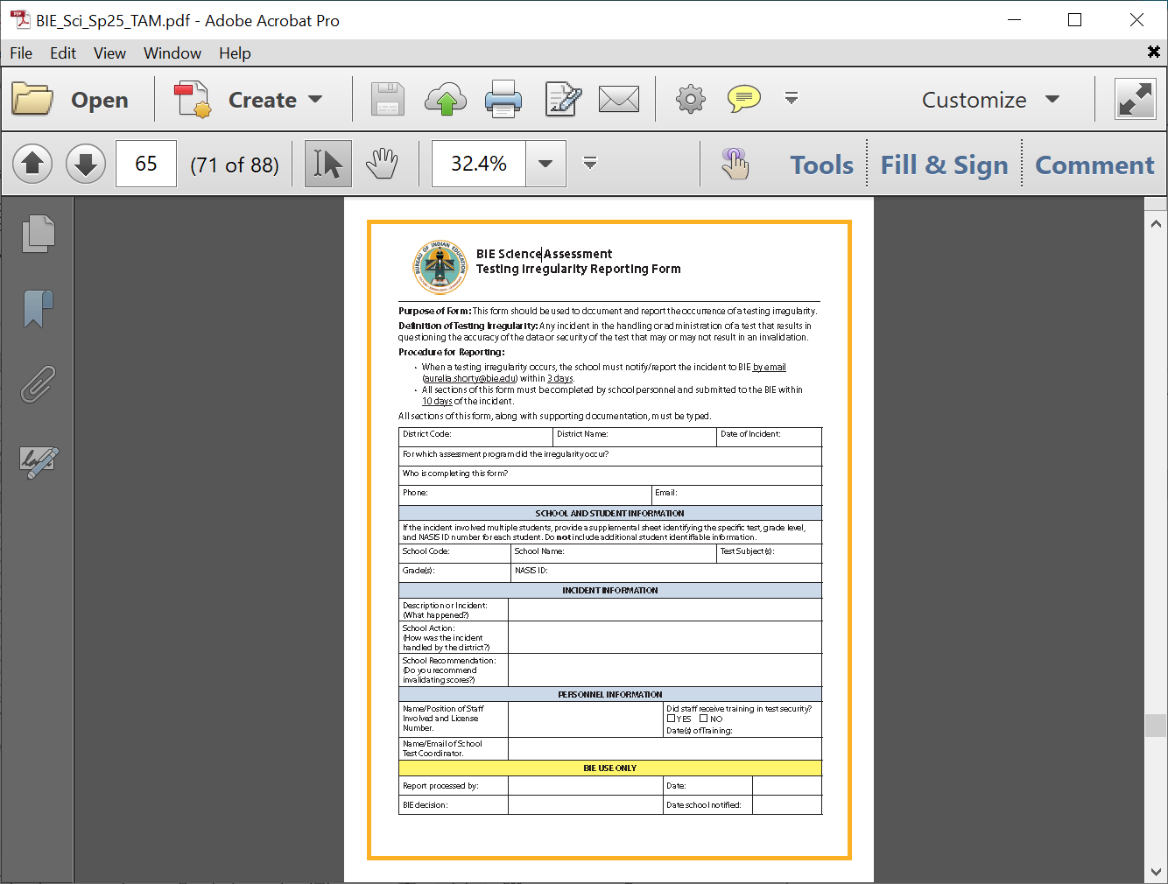
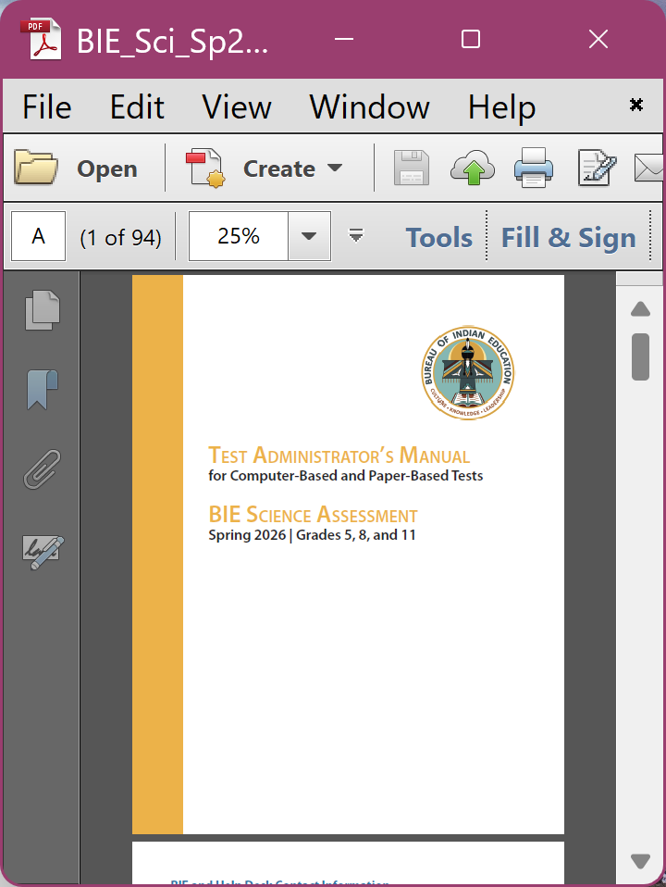
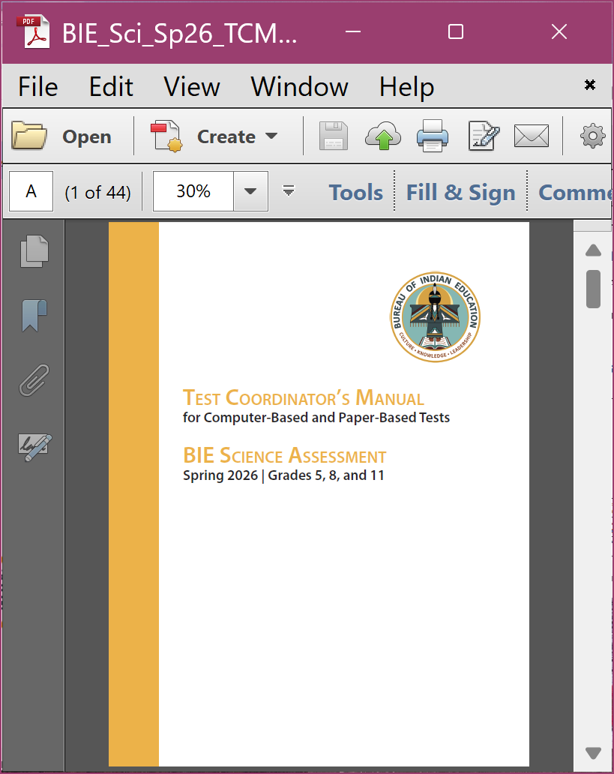
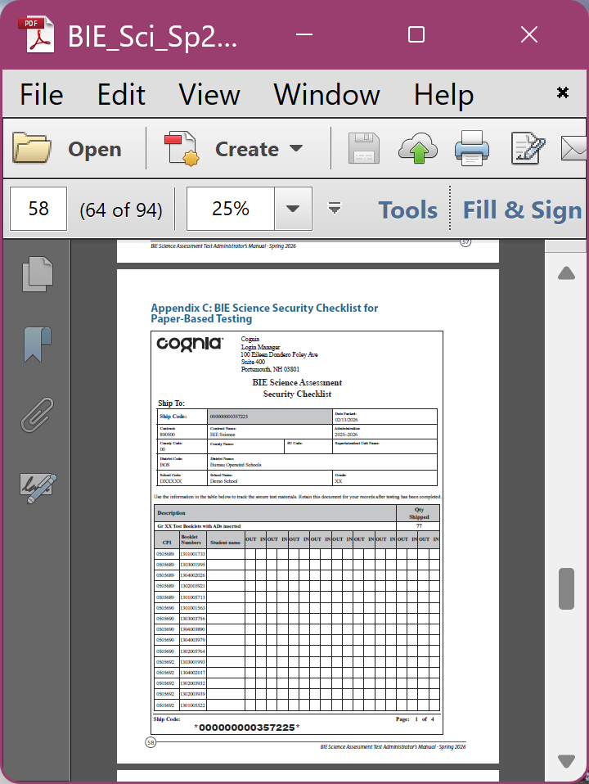
Staff Confidentiality
Testing Irregularity
Principal’s Verification
TAM
TCM
Security Checklist

Slide 16

Test Security: Secure Materials
Security of test materials must be maintained before, during, and after administration.
Secure CBT Test Materials
Student login tickets
Periodic tables written on by students
Scratch paper written on by students
Human reader scripts written on by students (if applicable)
Secure PBT Test Materials
Test booklets (standard print and accommodated test forms (i.e., braille, large print, human reader kits)
Answer documents with student responses
Scratch paper written on by students
Human reader scripts written on by students (if applicable)
Periodic tables written on by students

Slide 17
Test Security: Test Administrators Responsibilities & Restrictions
DO
Be certified educators
Receive training on test security and administration
Complete the Confidentiality Agreement
Follow school’s test schedule
Carry out standard examination procedures
Ensure test materials are returned to a secure location each day
Report any possible security breaches
DON’T
Administer the assessment to a family member
Allow students to use electronic devices
Do not cue students with answers to questions

Slide 18
Test Security: Testing Irregularities
Testing irregularities, such as potential cheating, and any suspected or actual breach of security must be reported immediately by the TA to the STC.
The STC must notify the BIE of a testing irregularity within three business days of the incident.
A Testing Irregularity Reporting Form must be submitted to the BIE within ten business days.

Slide 19
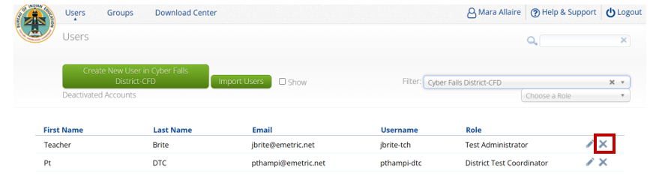
Test Security: User Accounts
Portal URL Link: https://bie.cognia.org
If an educator no longer works at your school or will no longer be involved in the science assessment administration, be sure to deactivate their account in the portal.
Locate the user and click the “X” to the right to deactivate.
Refer to the Portal User Guide for more details

Slide 20
What’s new for 2026?

Slide 21
What’s new for spring 2026?
An accessibility features and accommodations guide to accompany the summative science assessment
Online portal updates included in the eMetric side of the presentation

Slide 22
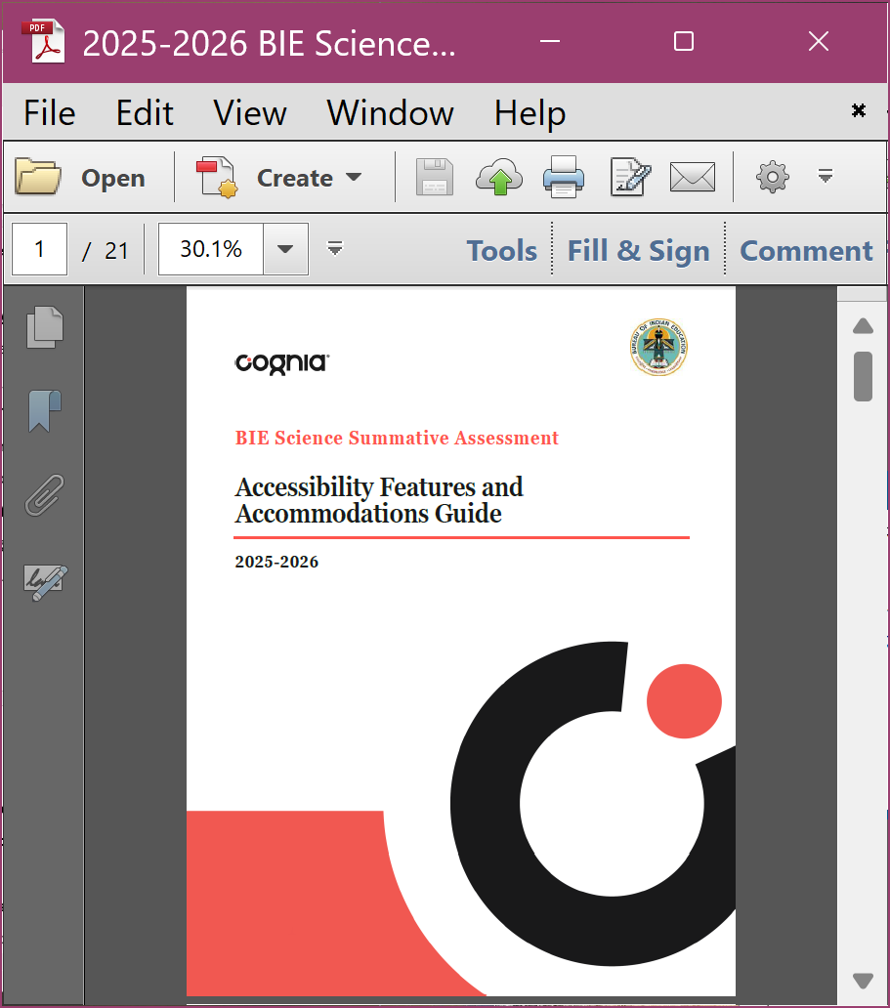
What’s New for Spring 2026: Accessibility Features & Accommodations Guide
New for spring 2026, an Accessibility Features & Accommodations Guide will be available electronically on the Help & Support Site, https://bie.onlinehelp.cognia.org/accommodations

Slide 23
What’s New for Spring 2026: Online Portal Enhancements
Pre-ID Management tab renamed to Student Registration
Test Sessions tab renamed to Test Scheduling
Four different color options in the Highlighter tool.
Item expansion feature when paired with a stimulus.
Student's name will be displayed to the top right corner of the item and directions pages within a test.
Help feature enabled for practice tests.
Student's name will be displayed to the top right corner of the item and directions pages within a test.

Slide 24
What’s New for Spring 2026: Online Portal Enhancements - Continued
Accessibility updates: Contrast enhancements in the student testing interface (for example, change Pause/Exit button color from yellow to blue)
Display student's session progress metrics such as number of items visited, answered, not answered along with a visual progress bar for portal users (DTC/STC/TA)
Allow exporting student logins in bulk by school
Enhancements to new user email and account creation workflow
The Color Contrast names will be updated to be reflective of the color options
Provide inactivity timeout warning for students
User Import Enhancement: Add a data definitions layout to the UI
Transfer test sessions when a student is transferred (coming soon)

Slide 25
Administration Procedures & Accommodations

Slide 26
Computer-Based Testing (CBT)
Procedures, Accessibility Features & Accommodations

Slide 27
CBT: Before Testing
STC Checklist
Setup
Training
Accessibility Features Assignment
Platform
Platform
External accommodations
Scheduling
External features
Accommodations Assignment

Slide 28

STC Checklist
Setup
Training
Scheduling
Assign test mode to students during the online registration window, 12/8/25-1/16/26
Assign accommodations and accessibility features to students before test scheduling
Create TA accounts
Create classes
Train all staff who will be involved in test administration
Establish a testing schedule
There are sample schedules available on the TCM and TAM
Online tests available to schedule one week prior to testing window, March 2, 2026
May use resources available on the help and support site, https://bie.onlinehelp.cognia.org/science
Use the train the trainer model to prepare all staff prior to testing
Portal URL Link: https://bie.cognia.org

Slide 29
Accessibility Features Assignment Online
Accessibility Features
Must be assigned to students before test scheduling
In platform:
Color contrast
Headphones/Noise Buffer
Read aloud to self
Alternative setting
Full list of accommodations and accessibility features in the new Accessibility Features & Accommodations Guide
Outside of platform:
https://bie.onlinehelp.cognia.org/accommodations
Portal URL Link: https://bie.cognia.org

Slide 30
CBT: Accommodations Overview
Accommodations are NOT included in BIE roster upload
Accommodations need to be assigned in the portal BEFORE scheduling the test
Use Upload Accommodations to edit accommodations on multiple student records at one time
Use the Export Accommodations button to download list of all students and their currently assigned accommodations, edit that file and re-upload it using the Upload Accommodations menu
Refer to the training video available in the Help & Support site online system tutorials section for step-by-step instructions: https://bie.onlinehelp.cognia.org/resources
Online Testing Portal URL Link: https://bie.cognia.org
The Portal User Guide has specific steps to help you with assigning accommodations
For more details on CBT accommodations, refer to the Accessibility Features & Accommodations Guide in the Accommodations section of the Help & Support site

Slide 31
Accommodations Assignment Online
Accommodations
Must be assigned to student before online test scheduling
Only for students with IEP/504 Plan
In platform:
Text-to-Speech
Allow accessibility mode testing
Word prediction (embedded with the questions)
Outside of platform:
Assistive Technology device
Word-to-word dictionary
Dual language glossary
Directions in native language
Extended time
Human reader
Human scribe
Human signer
Picture dictionary
Word-to-word translator
Small group
Speech-to-text
Tactile graphics
Refer to the new Accessibility Features & Accommodations Guide available online in the Help & Support site, https://bie.onlinehelp.cognia.org/accommodations

Slide 32
Appendix
GLOSSARY OF TERMS FOR ACCOMMODATIONS (IEP/504)
DELIVERED EXTERNALLY (OUTSIDE THE TEST PLATFORM)

Slide 33
Glossary of Terms
Accommodations (IEP/504) Delivered Externally
Assistive Technology Device Presentation
Students may use a range of assistive technologies including devices that are compatible with the online testing platform (i.e., JAWS and NVDA (screen readers), Cowriter (Predictive Text), Read&Write (Speech-to-text)), and those that are used externally on a separate computer. Assistive technology devices apply to students with a wide range of disabilities, including those with visual, physical, and cognitive challenges, and use special devices for instruction.
Assistive Technology Device Responses
Students may use a range of assistive technologies including devices that are compatible with the online testing platform (i.e., JAWS and NVDA (screen readers), Cowriter (Predictive Text), Read&Write (Speech-to-text)), and those that are used externally on a separate computer. This accommodation applies to students with visual, hearing, fine motor, writing, or motor impairments who use special devices for instruction.
Braille Notetaker
A student who is blind or has a visual impairment may use a braille writer.
Braille Writer
Assigned per student’s IEP. A student who is blind or has a visual impairment may use an electronic braille note-taker.

Slide 34
Glossary of Terms - Continued
Accommodations (IEP/504) Delivered Externally
Commercial Word-To-Word Dictionary
Commercially available dictionary gives work in English and desired language. No definitions are provided.
Customized Dual Language Glossary
Displays pre-identified words, customized for BIE school students, in English and desired language. No definitions are provided.
Directions in Native Language
TA reads test directions in student’s native language.
Human Scribe
Student's response is captured by a scribe and entered into the online testing platform. Requires a one-on-one administration.

Slide 35
Glossary of Terms - Continued
Accommodations (IEP/504) Delivered Externally
Human Reader
TA reads the content in English. (English form must be assigned). Requires a one-on-one administration or small group with the same test form.
Human Signer
TA signs the content. Requires a one-on-one administration or small group with the same form.
Picture Dictionary
Dictionary that provides picture definitions of English words.
Speech-To-Text
External device with voice recognition software that converts student responses to printed text. Student speaks into computer microphone, and the computer enters the response. Use with human scribe.

Slide 36
Glossary of Terms - Continued
Accommodations (IEP/504) Delivered Externally
Tactile Graphics
A student who is blind or has a visual impairment who uses a screen reader or refreshable braille will also need a tactile graphics booklet, consisting only of the graphics portion of test questions, and visual descriptions of pictures and multimedia, where applicable.
Word Prediction
External device that provides frequently- or recently-used words on-screen after the student enters the first few letters of a word. Use with human scribe.
Pocket Word-To-Word Translator
Commercially available pocket word-to-word electronic translator allows user to enter word in English and displays corresponding word in desired language.
Extended Time
Student may test for an extended period of time.
Small Group
Student will test independently in a small group setting. If combined with other accommodations, follow guidelines for administering those accommodations in a small group setting.

Slide 37
CBT: During Testing
TA Ratios
Ensure there is at least one trained TA for every 25 students in a testing room
Secure Materials
Monitor testing progress and completion
Monitoring
Ensure any TA or proctor is not assigned to a testing room in which a relative is being tested
Track all secure materials and ensure they are returned to a central, secure location each day

Slide 38
CBT: After Testing
Invalidation
Invalidate test sessions and assign Test Report Codes as needed
Destruction of Secure Materials
There is a post-online admin window to audit student rosters and assign any applicable test report codes: April 20 – April 22, 2026
Test Report Codes
Collect all secure materials (including used scratch paper and student login tickets) and securely destroy them at the school

Slide 39
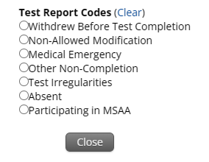
Test Report Codes - Invalidating Tests
Absent
Medical Emergency
Non-Allowed Modification
Other Non-Completion
Participating in MSAA
Test Irregularities
Withdrew Before Test Completion

Slide 40
Paper-Based Testing (PBT)
Procedures & Accommodations

Slide 41
PBT: Before Testing
STC Checklist
Setup
Training
Materials
Test Administrator’s Manual (TAM)
Ensure you follow the student’s IEP/504 plan to provide with proper paper accommodations
Scheduling
Accommodations
Testing signs
Security checklist
Secure test materials (test booklet)

Slide 42
STC Checklist
Setup
Training
Scheduling
Assign paper test mode to students needing the paper accommodation during the online registration window, 12/8/25-1/16/26, via the portal, https://bie.cognia.org
Order additional paper materials during the additional ordering window as needed
Train all staff who will be involved in test administration
Establish a testing schedule
There are sample schedules available on the TCM and TAM
May use resources available on the help and support site, https://bie.onlinehelp.cognia.org/science
Use the train the trainer model to prepare all staff prior to testing
Unlike the online testing scheduling which can start a week before the testing window starts, for the paper testing you can start scheduling them as soon as the testing window starts

Slide 43
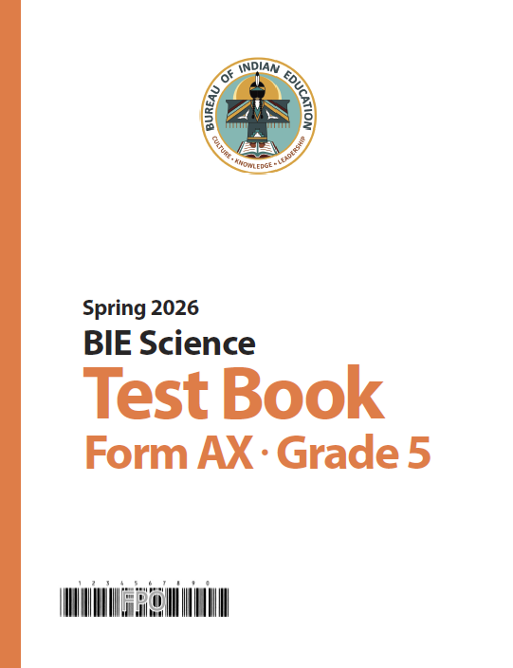
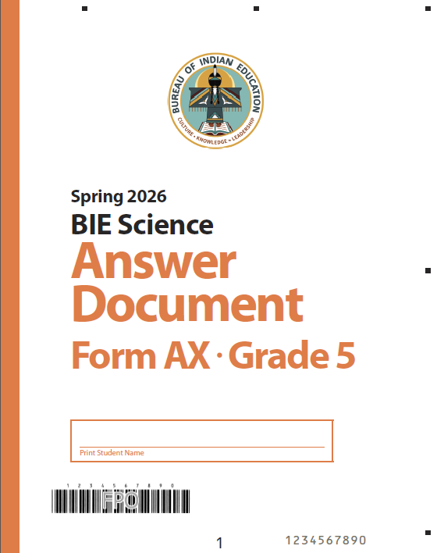
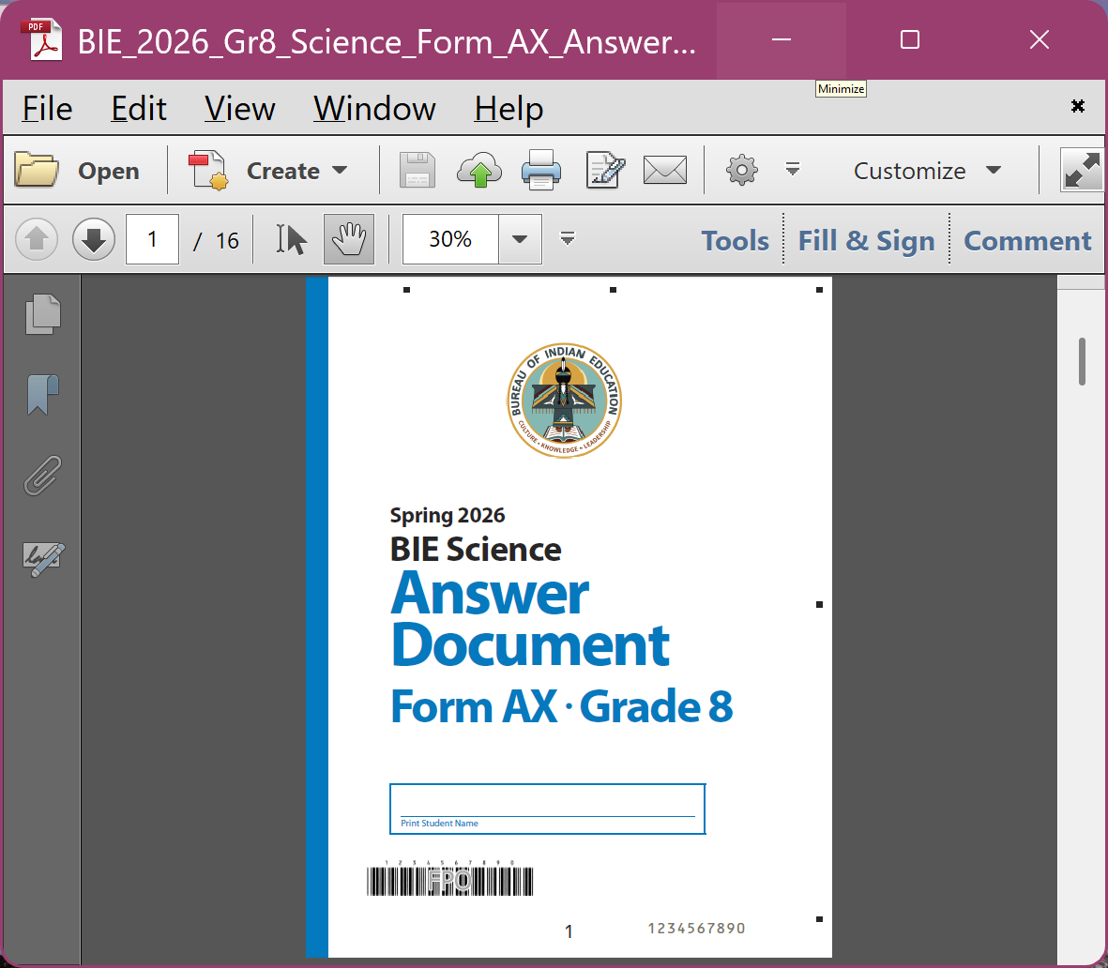
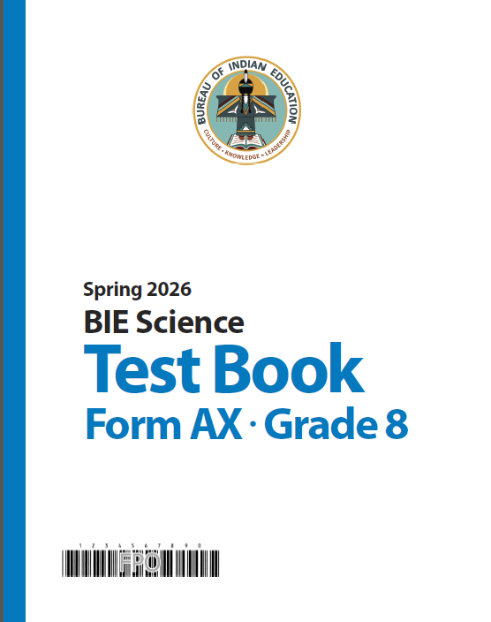
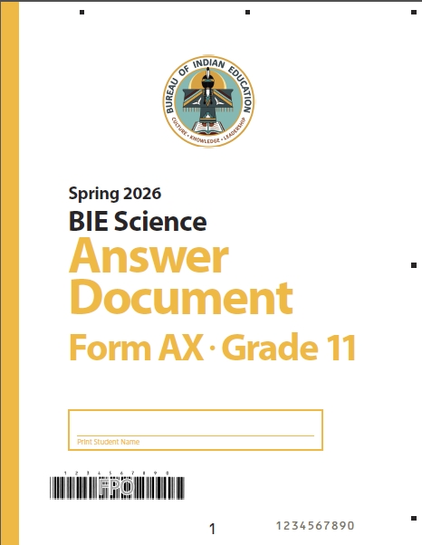
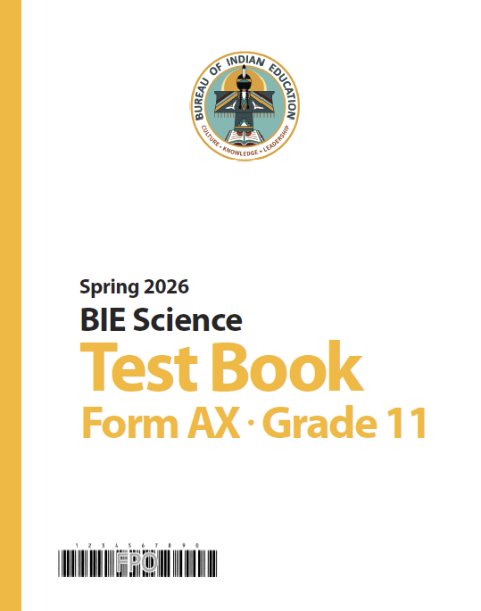
PBT Materials
Standard Print
For all grades
Special Forms
For all grades
Large Print
Braille
Manuals
TCM
TAM
Accessibility Features & Accommodations Guide

Slide 44
PBT Accommodations Overview
Accommodations Available
Braille
Assistive Technology Device
Human Reader
Alternative setting
Full list of accommodations and accessibility features in the new Accessibility Features & Accommodations Guide
External Accommodations
https://bie.onlinehelp.cognia.org/accommodations
Large Print
Human Reader
Read aloud to self
Human Scribe
Headphones/Noise Buffer

Slide 45
PBT: During Testing
TA Ratios
Ensure there is at least one trained TA for every 25 students in a testing room
Secure Materials
Monitor testing progress and completion
Monitoring
Ensure any TA or proctor is not assigned to a testing room in which a relative is being tested
Track all secure materials and ensure they are returned to a central, secure location each day

Slide 46
PBT: After Testing
Voiding
Displayed on the next-to-last page (inside cover) of the PBT answer document on box J
Packing
Displayed on the next-to-last page (inside cover) of the PBT answer document on box G
Fill in the bubble for the applicable test report code(s) found on box G
Test Report Codes
Pack the voided document with the used test materials
Collect all secure materials (including used scratch paper and pack materials based on instructions found on the TCM, pages 17-19
Write VOID in large, dark print on the front cover
Fill in box J of the student biogrid

Slide 47
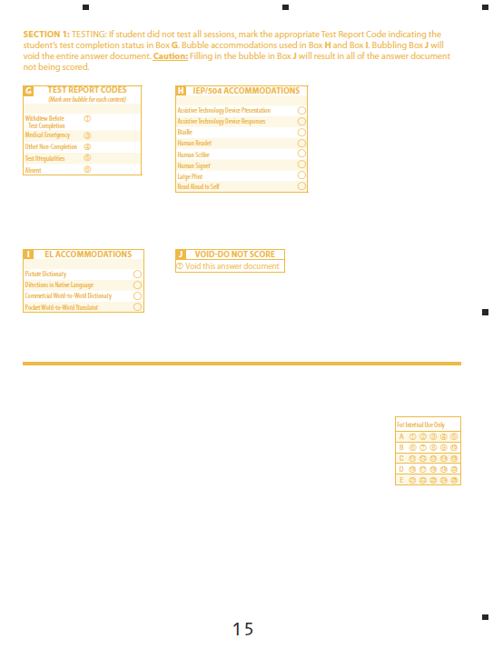
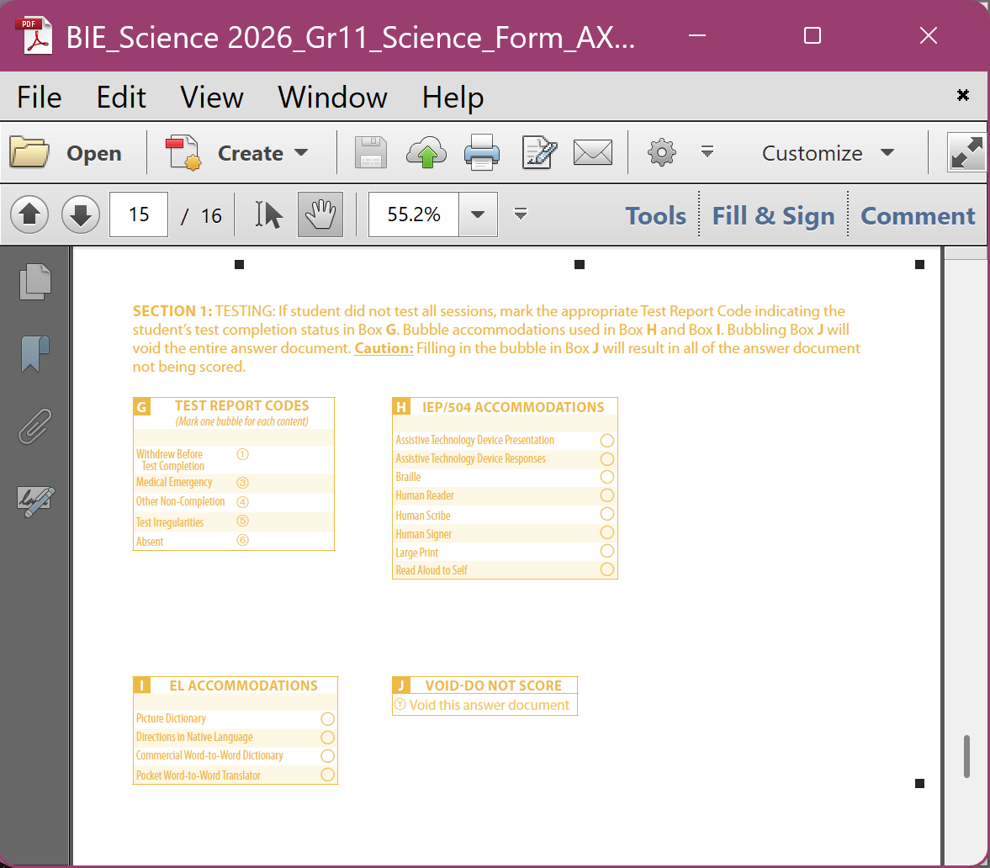
Test Report Codes & Void Bubbles

Slide 48
Materials Management

Slide 49
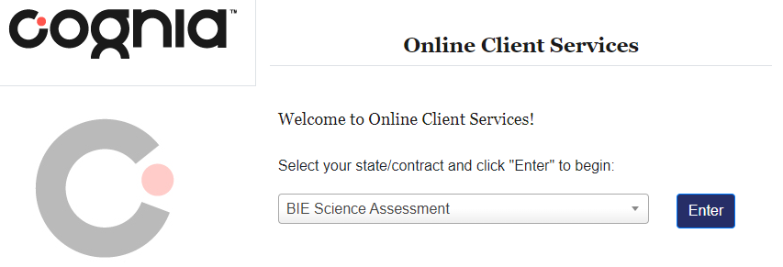
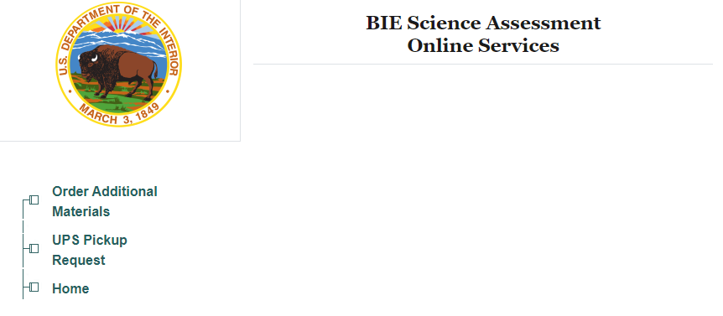

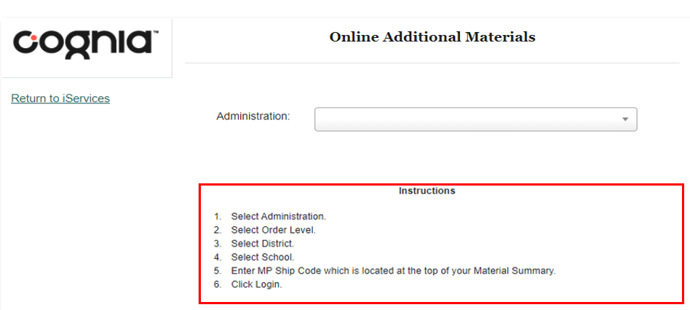
Ordering Additional Paper Test Materials
Additional Ordering Window: Feb 23 – Apr 10, 2026
Order directly from iServices, https://iservices.cognia.org, or via the online portal materials management tab
MP Shipcode** is required for placing an additional order
**The MP Shipcode is found on the top or bottom of the Material Summary sheet included in the initial shipment
If you did not receive an initial shipment, contact the Help Desk to obtain the MP Shipcode

Slide 50
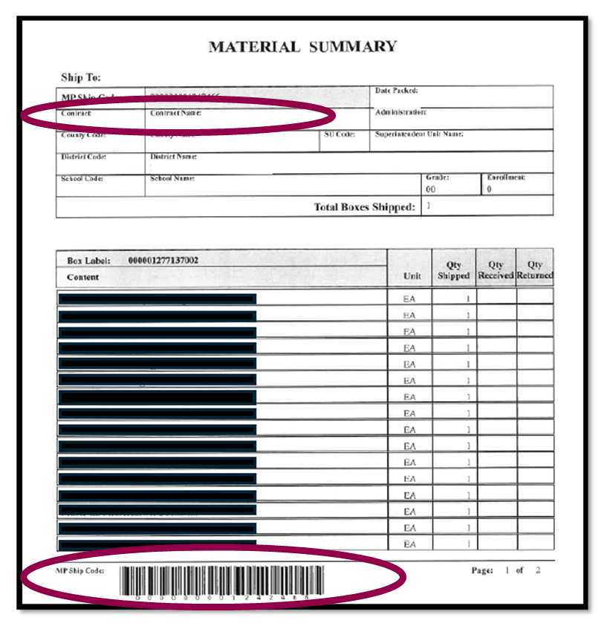
Where do you find your MP Shipcode?
MP Shipcode

Slide 51
Returning Paper Test Materials
Student Pre-ID Labeling
Special Handling
Packing
Shipping

Slide 52
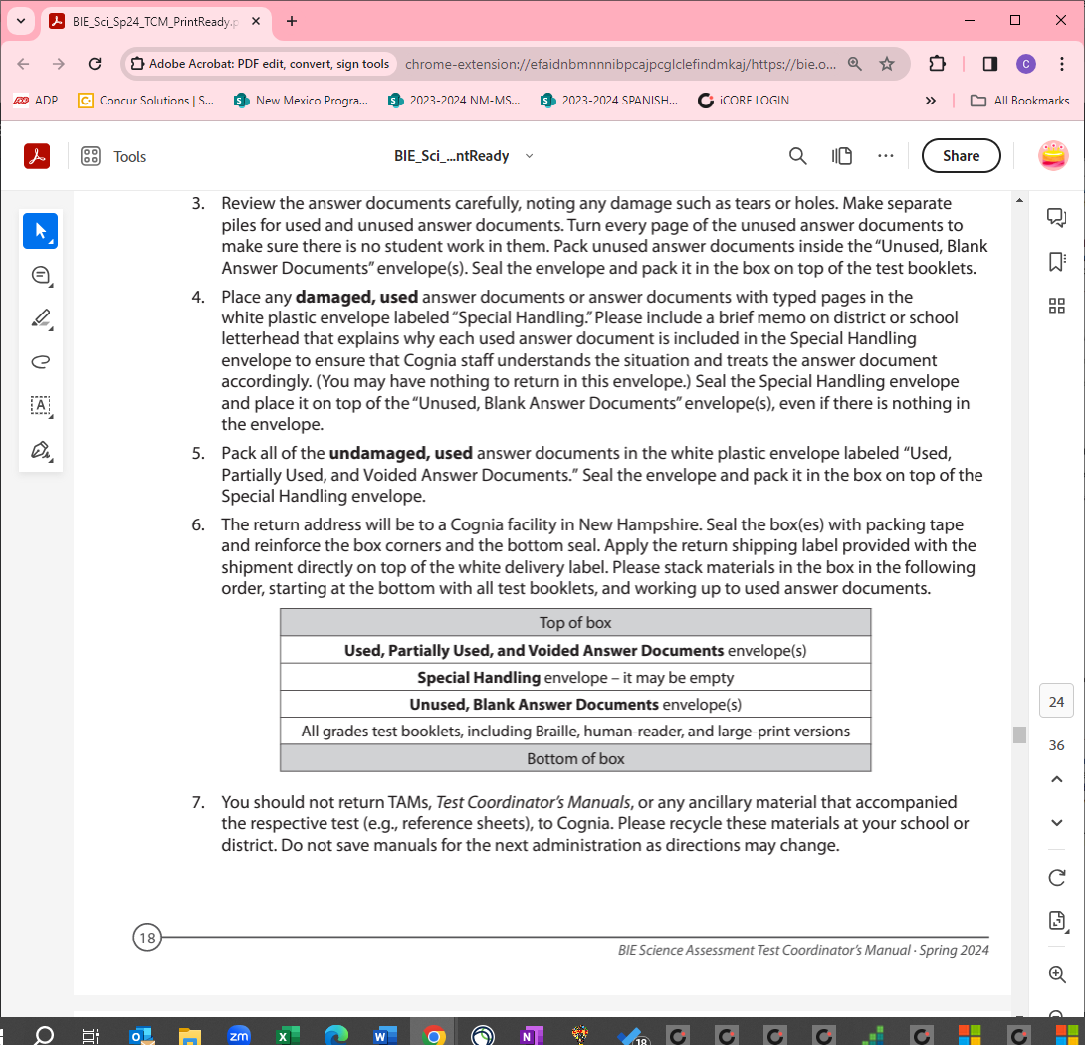
Pre-ID Labels, Packing, Special Handling
Pre-ID labels
Confirm student information is accurate
Match the label with the name on the front cover
Apply to the bottom right corner on the back cover
If there is no label, ensure boxes A–F on the back cover are completed accurately
Checking answer documents
Follow instructions provided on pages 17-19 of the TCM.
Special Handling
Include a brief explanation
Order of the paper materials placed in the box for return

Slide 53
Shipping
Return materials in the same Cognia box they were received
Contact the BIE Science Help Desk if any materials are contaminated with biohazardous materials
Seal the box and add the return shipping label provided with the shipment
Schedule the UPS pickup via iServices
Or handoff box to your regular UPS driver
UPS Pickup Window
March 16 – April 24, 2026

Slide 54
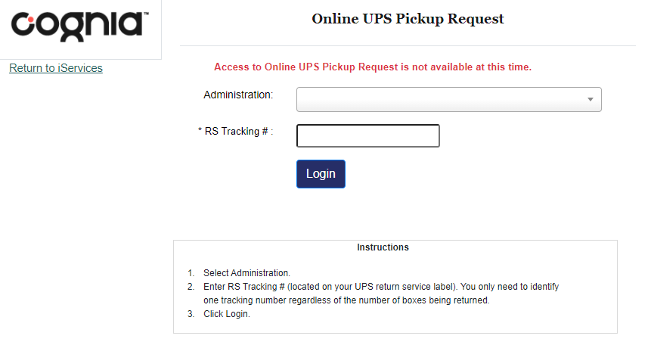
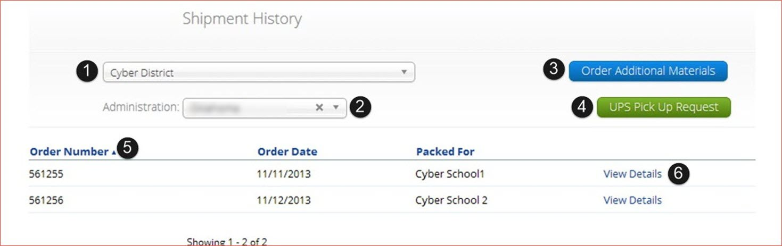
Requesting UPS Pickup
Schedule a UPS pickup between March 16 and April 24, 2026
UPS Return Service (RS) Tracking# is required for scheduling the pickup
If you do not have the RS Tracking#, contact the Help Desk for assistance
Schedule UPS pickup directly from iServices, https://iservices.cognia.org, or via the online portal materials management tab
Must return materials no later than April 24, 2026

Slide 55
Resources
&
Closing

Slide 56
Resources: Help & Support Site
https://bie.onlinehelp.cognia.org/science
Resources posted throughout the year
Key dates
Manuals
Training videos
Practice tests
CBT practice test
Downloadable PDFs of the PBT practice test
Accommodations
Benchmark administration
Reporting resources

Slide 57
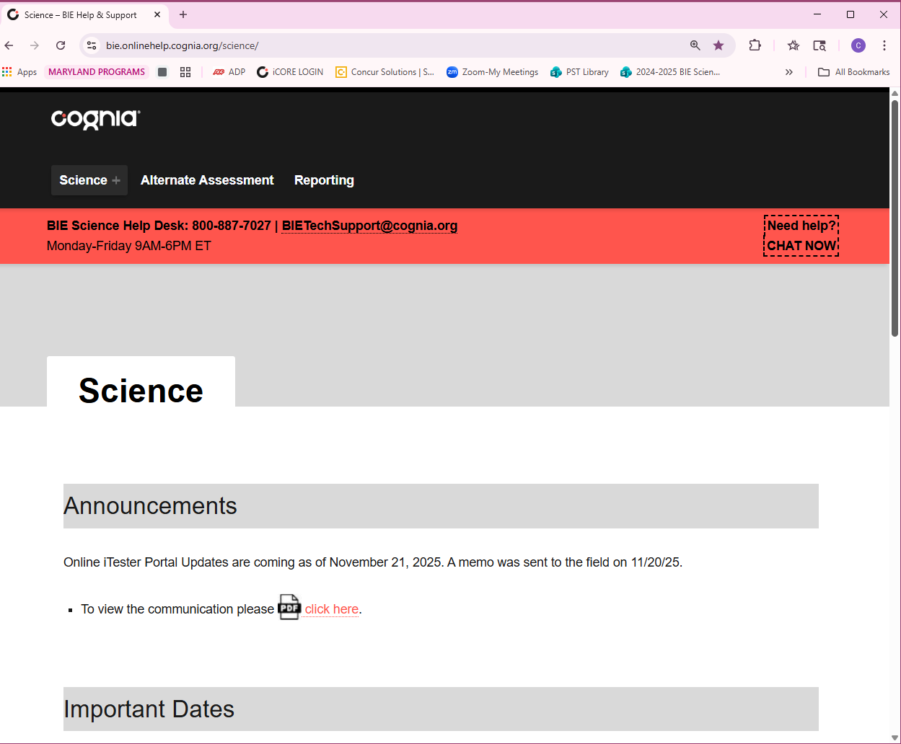
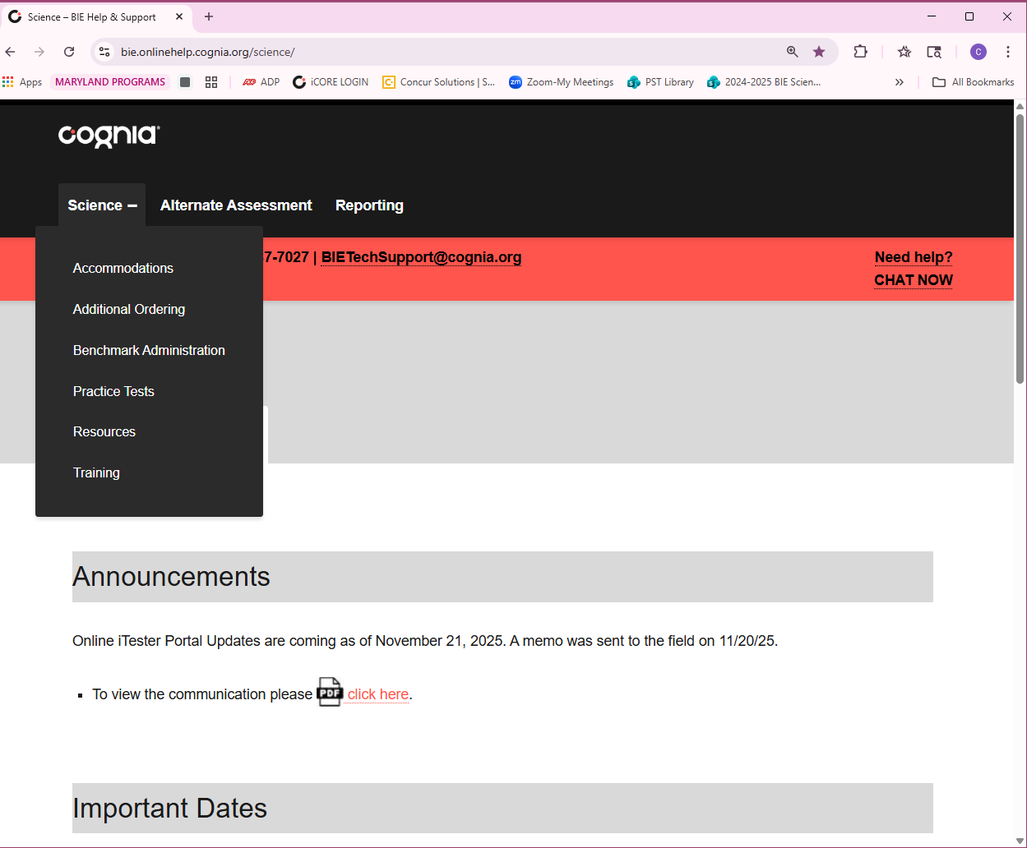
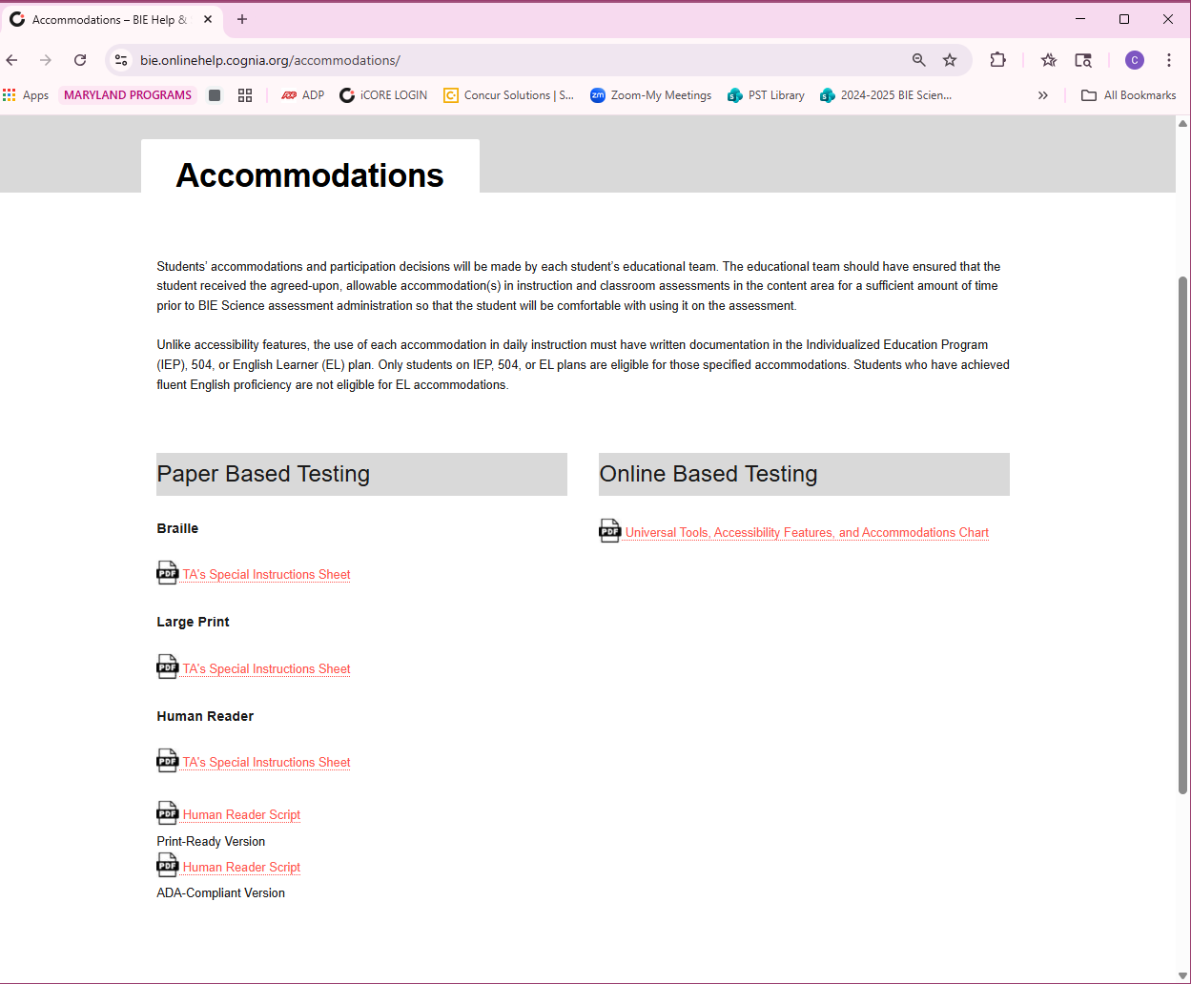
Resources: Help & Support Site

Slide 58
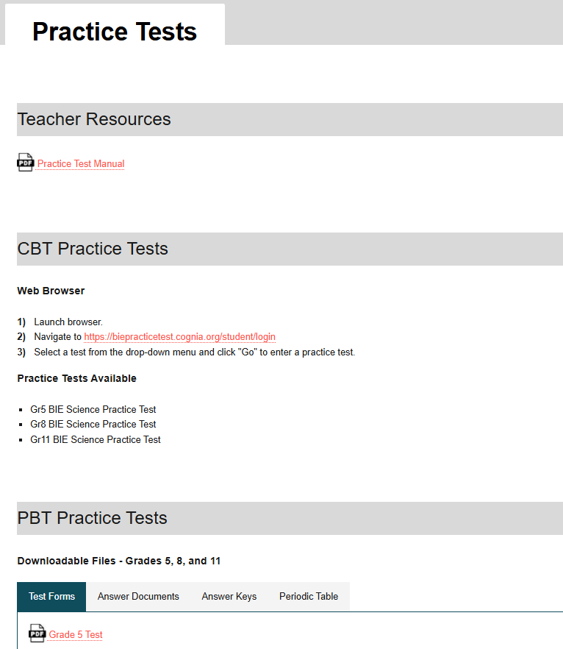
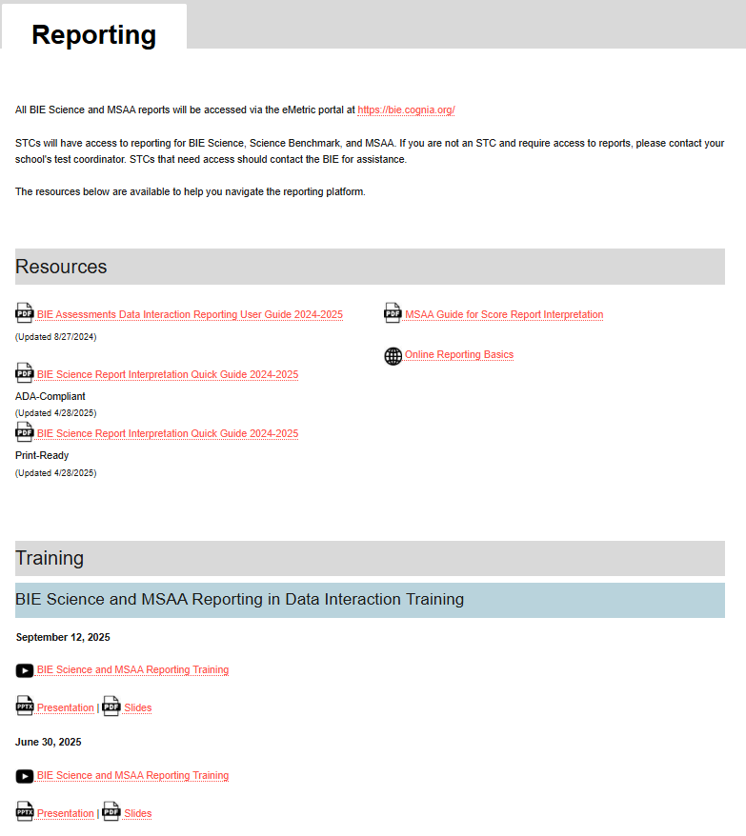
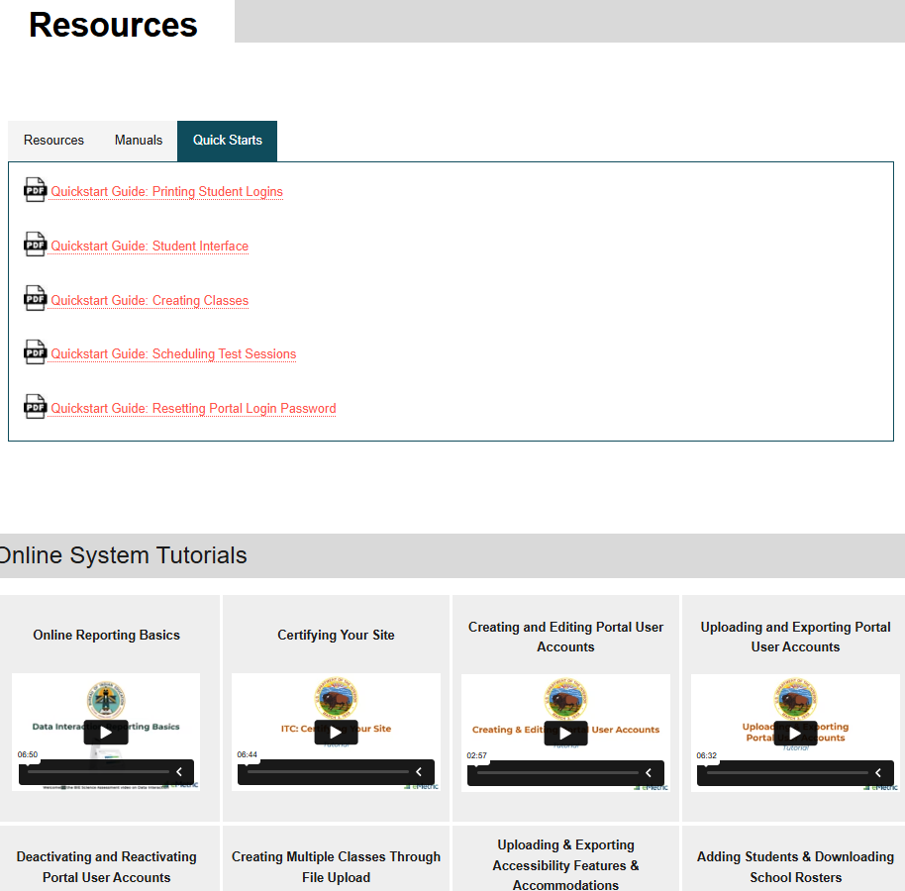
Resources: Training Videos, Practice Tests, Reporting Tools

Slide 59
Help Desk Contact Info
Hours
Monday–Friday from 9:00 a.m.–6:00 p.m. (ET)
Contact information
Phone: 800-887-7027
Email: BIETechSupport@cognia.org
Chat (accessible from the BIE Science Help & Support site)

Slide 60







Questions?
Learn more at Cognia.org

Slide 61
Questions
Open Q&A
Index card reminder

Slide 62
Staff Contact Information
BIE
Aurelia Shorty
aurelia.shorty@bie.edu
Cognia
Mara Allaire
mara.allaire@cognia.org

Slide 63


Thank you!
Cognia is a global nonprofit that has the knowledge to help schools improve outcomes for all learners.

