Slide 1

BIE Benchmark Assessments
January 13, 2026

Slide 2
Agenda
Why use science benchmark assessments?
Science benchmark assessments
Questions?
Testing time, testing mode, and scoring
Science benchmark form design

Slide 3
Science benchmark assessments
BIE’s optional interim assessment for science
Administered periodically now through March 6th
Often used at the end of a grading period or unit of instruction
Measure students’ proficiency with Next Generation Science Standards (NGSS)

Slide 4
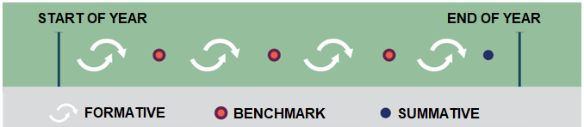
Science benchmark assessments (cont’d)
Identify students’ learning gaps of science content and skills while learning is still taking place and interventions can be made
Benchmark assessments are part of the BIE’s comprehensive assessment program.
Notes:
As a learning feedback loop, formative assessments help educators adjust teaching in real time by revealing student understanding and needed support. Examples of formative assessments are screeners, diagnostics, exit tickets, peer feedback, and quizzes.
Interim assessments are administered multiple times yearly to track student progress towards end-of-year goals and identify trends, helping with instructional planning and identifying curriculum gaps.
A summative assessment evaluates student achievement at the end of a specific instructional period. End-of-unit, mid-term, or end-of-year tests are examples of summative assessments. They are essential for accountability, understanding performance across student subgroups, monitoring year-over-year growth, and identifying longitudinal trends.

Slide 5

Why use science benchmark assessments?
Quick and easy way to provide key checkpoints on students’ progress toward end-of-year learning goals and standards mastery
The science benchmark assessment items are similar in format to items on the end-of-year summative assessment.
Teachers can PICK AND CHOOSE which test forms (and which standards) to assign.
Provides EXCELLENT practice in the classroom setting as the item types in the benchmark forms are also included in the summative end-of-year science assessment.

Slide 6

Form design & administration - General
Each form is composed of two clusters and two 4-point open-ended items.
No set administration sequence or timing between now and March 6th.
Notes:
Each cluster is a set of 5-6 items aligned to two NGSS Performance Expectations (PEs), and all items are associated to an introductory passage, or “stimulus.” The stimulus typically contains both text and graphics such as diagrams, tables, or graphs.
Open-ended items are standalone items aligned to one NGSS PE that require students to provide a written response to a prompt or question.

Slide 7

Form design & administration - General
Forms should be administered at the time that best aligns with the specific content being covered in the classroom.
Testing is not restricted to only those students in the summative testing grades of 5, 8, and 11, and there are no restrictions on the grade at which a particular form may be administered.
Notes:
Each cluster is a set of 5-6 items aligned to two NGSS Performance Expectations (PEs), and all items are associated to an introductory passage, or “stimulus.” The stimulus typically contains both text and graphics such as diagrams, tables, or graphs.
Open-ended items are standalone items aligned to one NGSS PE that require students to provide a written response to a prompt or question.

Slide 8
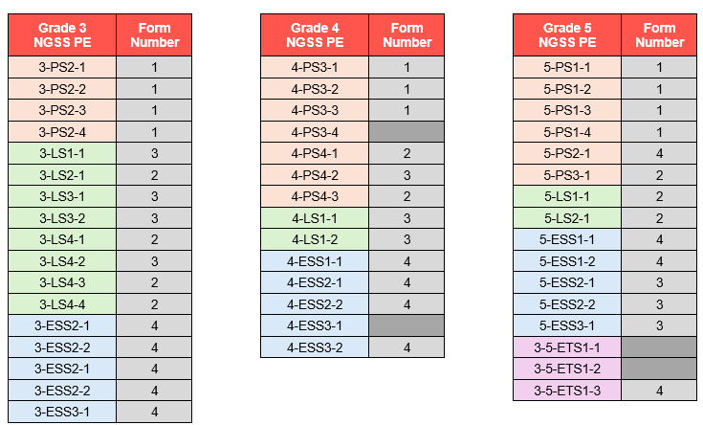
Form design – Grades 3, 4, 5
4 forms each for grade 3, grade 4, and grade 5
Notes:
Testing is not restricted to only those students in the summative testing grades (5, 8, 11). Can use across grades 3, 4, 5.

Slide 9
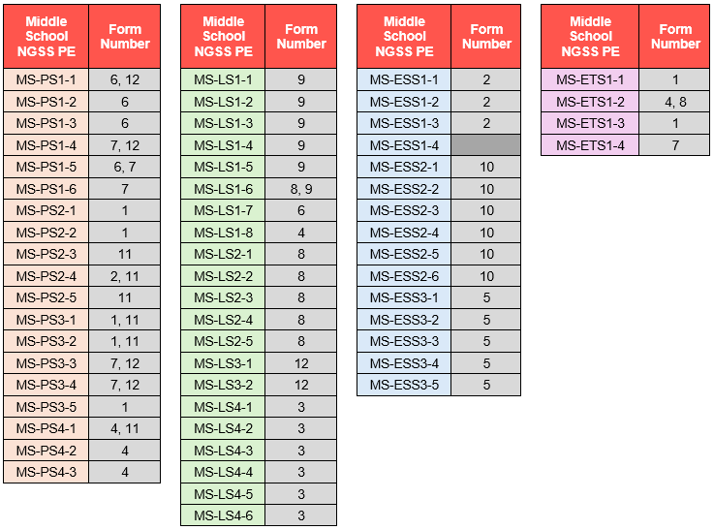
Form design – Middle school
12 forms for middle school grades 6-8
Notes:
Testing is not restricted to only those students in the summative testing grades (5, 8, 11). Can use across grades 6, 7, 8.

Slide 10
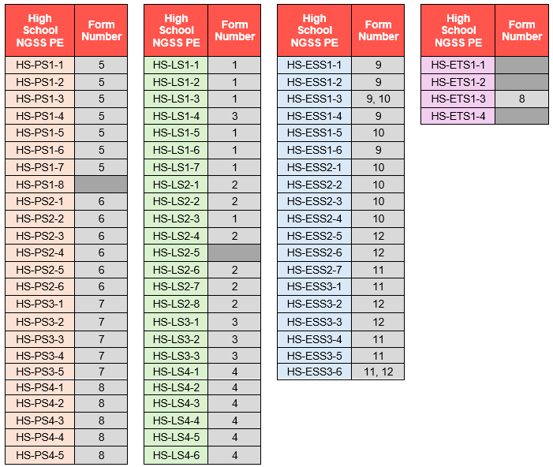
Form design – High school
12 forms for high school grades 9-12
Notes:
Testing is not restricted to only those students in the summative testing grades (5, 8, 11). Can use across grades 9, 10, 11, 12.

Slide 11
Testing time, mode, and scoring
Science Benchmarks are untimed, but each form is designed to be completed in approximately 45-50 minutes (1 class period).
The test is divided into two sessions and could be administered across two class periods if needed or desired.
Science Benchmark forms are available both online and for printing at BIE schools so that students can take benchmark assessments using the same testing mode they will use for the summative assessment.
The online version is accessed through the same BIE Portal used for summative testing. Within this portal, there are also print-ready PDFs of each form available for printing.

Slide 12

Questions?
Jill.Stepanek@cognia.org
For support in scheduling students into testing sessions, refer to the guides on the Resources page of the BIE Science Help & Support site (https://bie.onlinehelp.cognia.org/resources/).

