Slide 1



Welcome!
The training will begin shortly

Slide 2

BIE Data Interaction Reporting
Summer 2026

Slide 3
Housekeeping
All participants should remain on mute with their video off.
Post all questions to the chat.
  Questions will be addressed at each section break.
Please add your name, email, and school to the chat.
This training will be recorded.
The recording will be posted to the Help & Support site.

Slide 4

Welcome & Introductions

Slide 5
Bureau of Indian Education (BIE)
Aurelia Shorty, Education Program Specialist, Project Manager for Science
Carmelia Becenti, Chief Academic Officer
Donald Griffin, Section 504 Program Coordinator, Project Manager for MSAA
Cognia
Sarah Parker, Senior Program Manager
Sarah McCain, IT Project Manager II
eMetric
Gerry Retzloff, Project Manager
Michael Bernal, Support Center Manager

Slide 6

BIE Science and MSAA Assessment Reporting in Data Interaction
Gerry Retzloff, eMetric

Slide 7
Agenda
Terms and Acronyms
What Kind of Information is Available in Data Interaction?
Key Dates
Account Types and Accessing Data Interaction Reports in the Portal
Generating Reports and Using Tools in Data Interaction
  Student List
  Summary Reports
  Data Tools
  Other features
Demo
Additional Training Resources

Slide 8
Terms and Definitions
BIE Science Assessments Portal (aka “Portal”): website serving as entry point for online testing and reporting for BIE Science assessments and MSAA reporting
  bie.cognia.org (viewable on desktop and mobile device)
iTester: eMetric online test administration system used with BIE Science assessments (Summative and Benchmark Science), accessed via the Portal
Data Interaction: eMetric reporting system for educators, accessed via the Portal

Slide 9
BIE Science Assessment Online System
Online System
Administration and Reporting Portal
https://bie.cognia.org
Users
Administration
Test Delivery
Student Test Interface
Kiosk
Site Setup
Students
Browser
Reporting
Classes
Test Sessions
Scoring
Enrollment Transfer
Reporting Portal for BIE Science Assessment and MSAA Alternate Assessment, both!

Slide 10
Key Dates
Key Reporting Dates
Spring 2026 BIE General Science reports in DI | Jun 26, 2026
Spring 2026 MSAA (Alternate) ELA, Math, & Science reports in DI (includes ISR PDFs) | Jul 13, 2026
Spring 2026 BIE General Science ISRs PDFs in DI | Jul 15, 2026
Spring 2026 BIE General Science Print Reports in Schools | August 5, 2026

Slide 11

Portal Access
Access
http://bie.cognia.org
Open all year, previous accounts can be used this year
If you are a new School Test Coordinator, please contact BIE. Upon account creation, a welcome email will be sent from the portal.
  STCs will create all new portal user accounts
  Usernames must be unique
  Your email address controls your account
  New users will receive an automated email with username and link to update account from bietechsupport@cognia.org
When an account is deactivated or reactivated, the user will receive an email
STCs should periodically audit and deactivate user accounts

Slide 12
User Roles
User Role | Responsibilities
School Test Coordinator (STC) | Manage Users (add, edit, or deactivate) Access proctor password Edit student information & assign student accommodations Create, edit, and delete classes Schedule test sessions & print logins Manage & monitor test sessions Assign test report code Prepare IT network for student testing if there is no IT Coordinator View Science, MSAA, and Science Benchmark results in Data Interaction
IT Coordinator (ITC) | Prepare IT network for student testing Conduct Site Readiness testing
Test Administrator (TA) | Create classes Create test sessions View their students and test sessions Print student login tickets for their test sessions Manage & monitor test sessions Assign test report codes Score human scored items for Benchmark tests View Science Benchmark results in Data Interaction
Report Access Only (RAO) | View Science, MSAA, and Science Benchmark results in Data Interaction

Slide 13
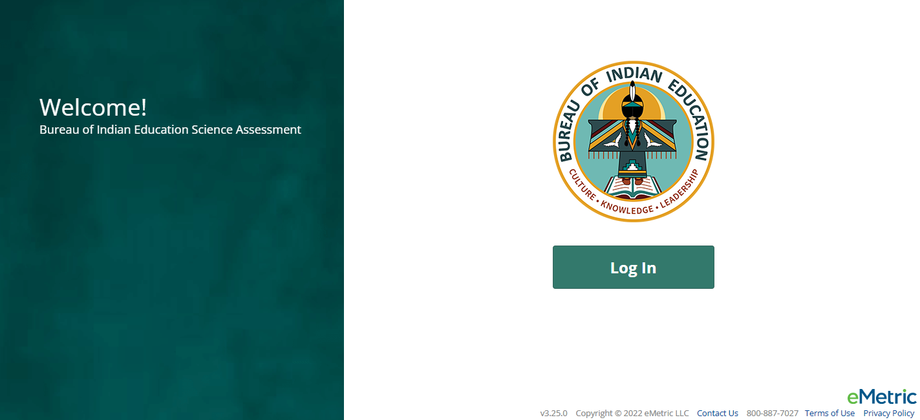
Portal Log-in
Portal URL: https://bie.cognia.org/

Slide 14
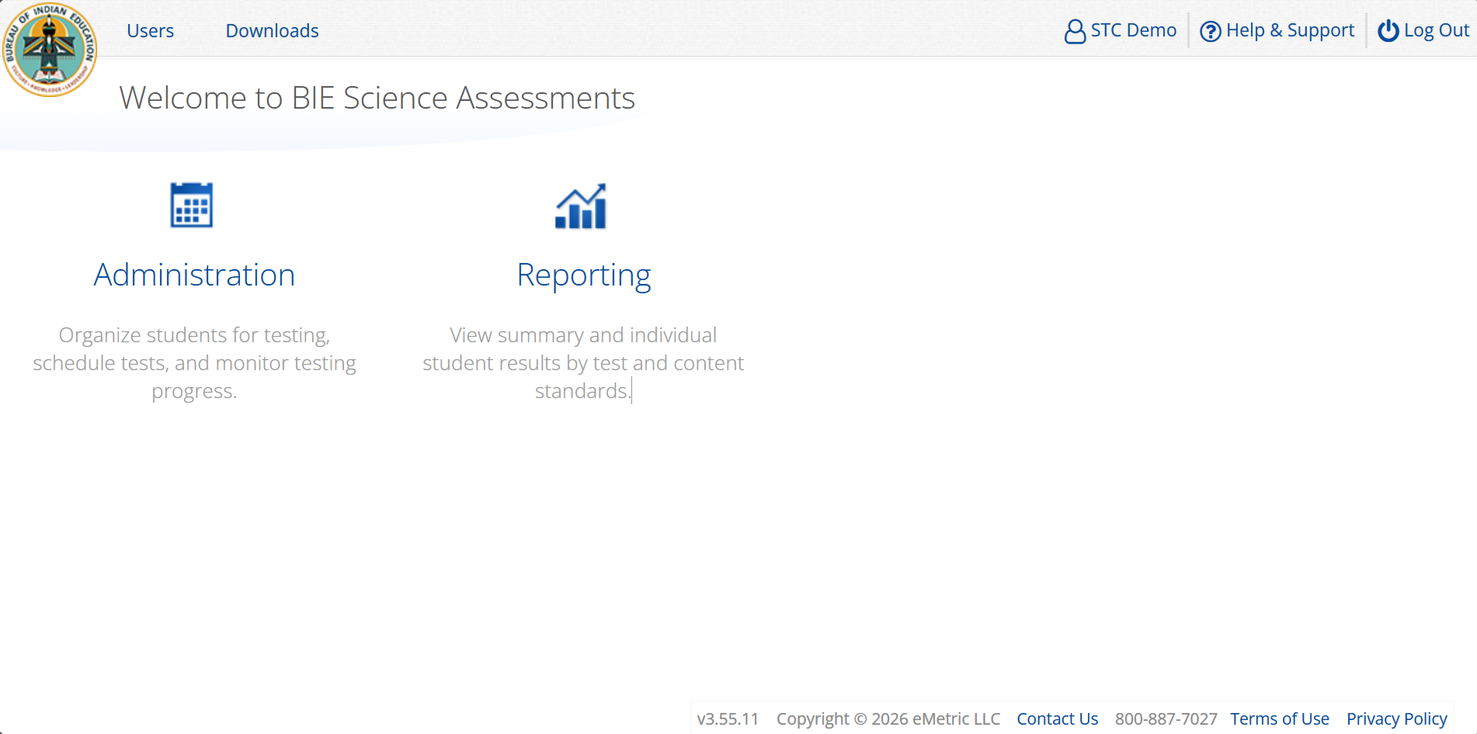
Portal Main Page (STC View)
1
2
3
4
5
Icon | Description
1 | BIE logo returns to portal home page
2 | Access User Management
3 | View & Edit user profile
4 | Access the BIE Help & Support Site
5 | Logout of the portal
6 | Access Administration Component
7 | Access Reporting
6
7

Slide 15
What is Available in Data Interaction?
Reports available:
  Roster (with customizable fields that vary with program)
  Individual Student Report (the layout is different from the Cognia paper ISR)
  Summary reports
  Data tools
    Summary
    Distribution
    Cross-Tab
    Scatter plot (MSAA only)
    Filters
User Tools:
  Student search
  Save reports
  Share reports
  Download reports
  Download paper ISR in pdf file
  User activity log
  Help guide

Slide 16
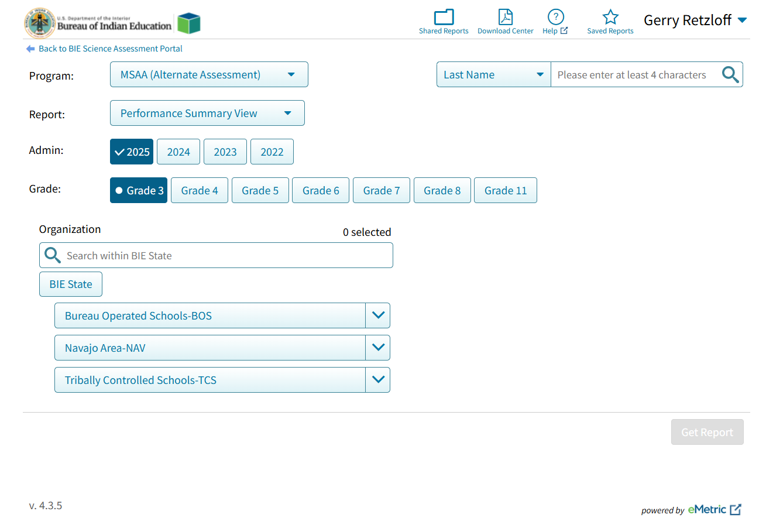
Data Interaction Main Page (MSAA View)
Select Program:
MSAA (Alternate Assessment)
Science (General Education)
Science Benchmark
Select Report:
Performance Summary
Roster
Data Tools
Select Organization:
BIE State: BIE summary level data only
BOS, TCS or NAV: summary level data only
School name: school summary data and any student in school

Slide 17
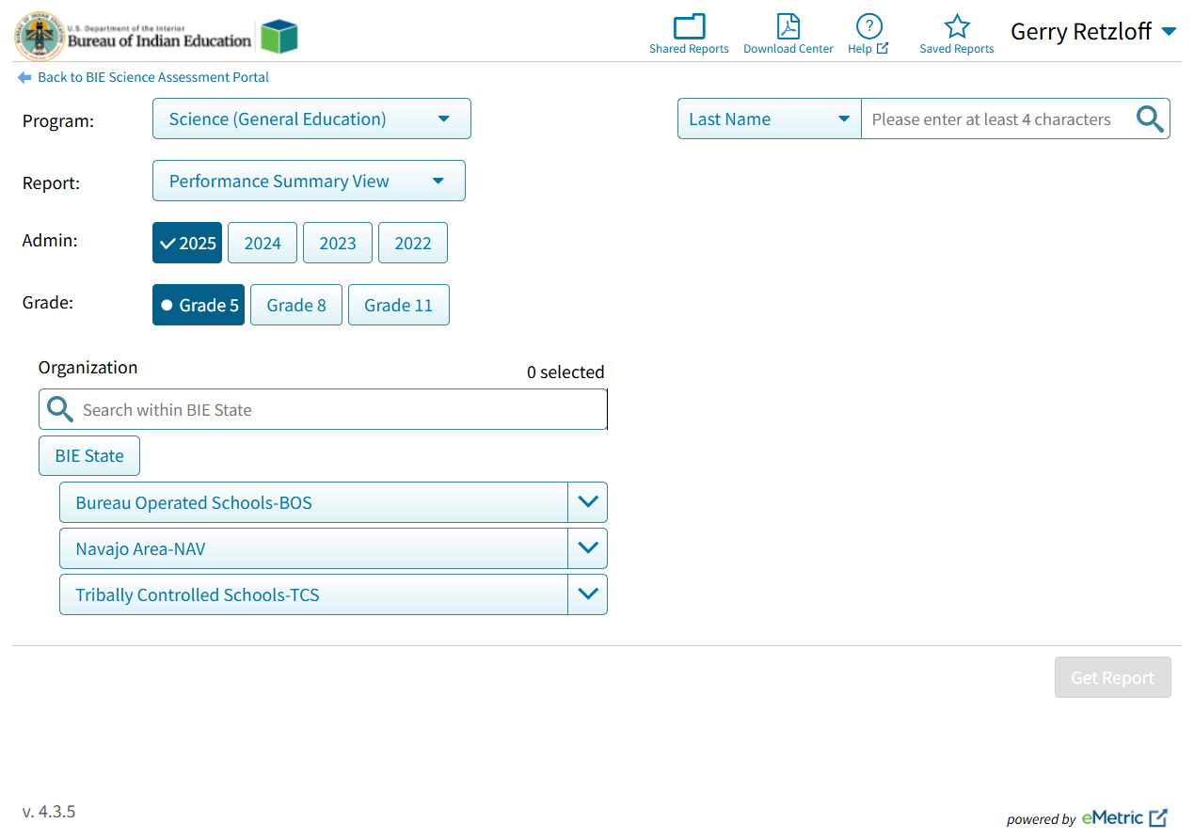
Data Interaction Main Page (Science View)
Select Program:
MSAA (Alternate Assessment)
Science (General Education)
Science Benchmark
Select Report:
Performance Summary
Roster
Data Tools
Select Organization:
BIE State: BIE summary level data only
BOS, TCS or NAV: summary level data only
School name: school summary data and any student in school

Slide 18
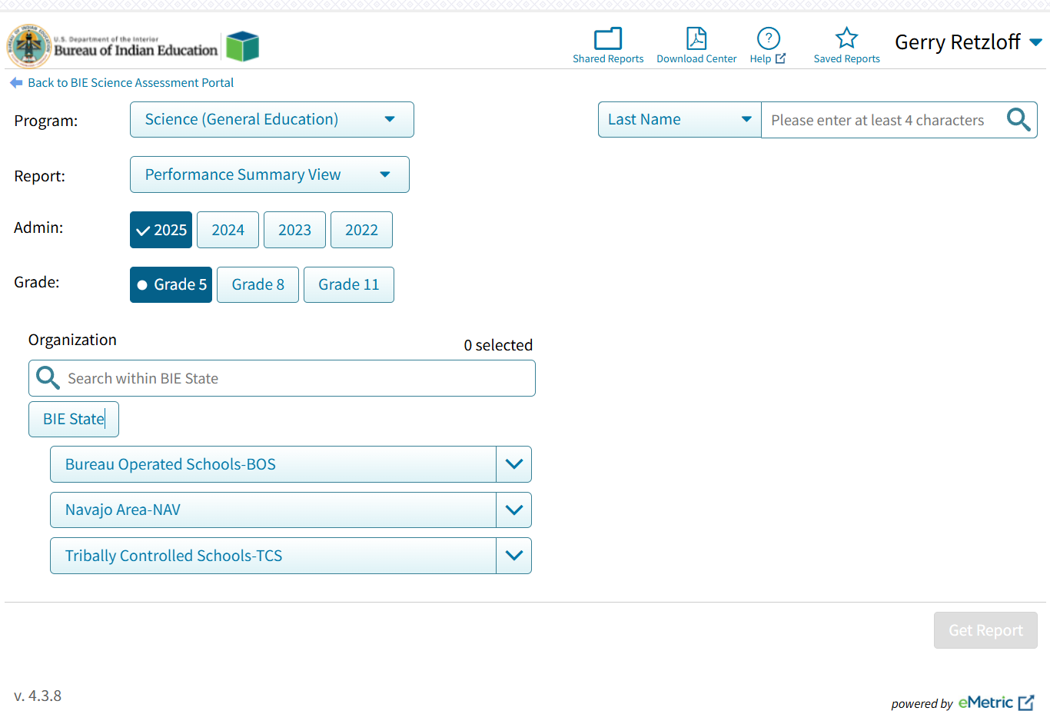
Data Interaction Main Page
Other Tools:
Shared Reports: Reports shared by other users
Download Center: retrieve large file downloads here (i.e., 100+ ISR PDFs) or zip files with paper ISRs in PDF files
Help guide
Save report: Reports you saved
Search for specific student by name or student ID (NASIS ID)

Slide 19
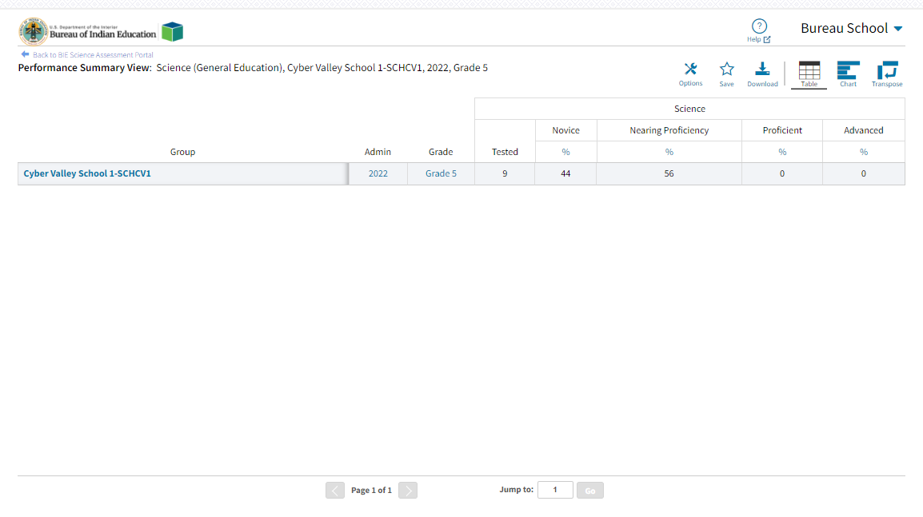
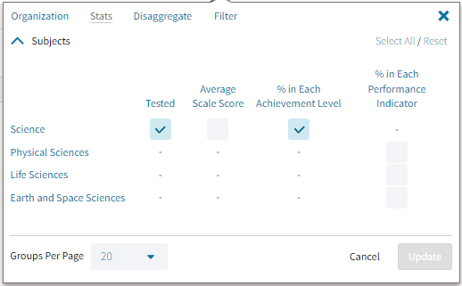
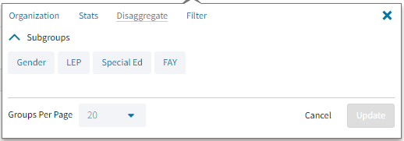
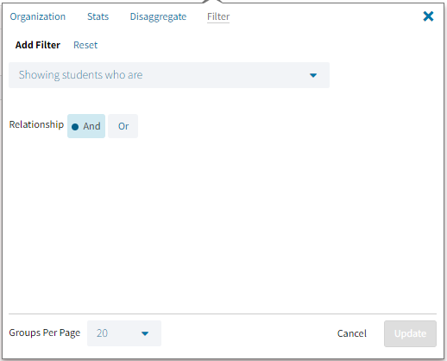
Performance Summary - Table

Slide 20
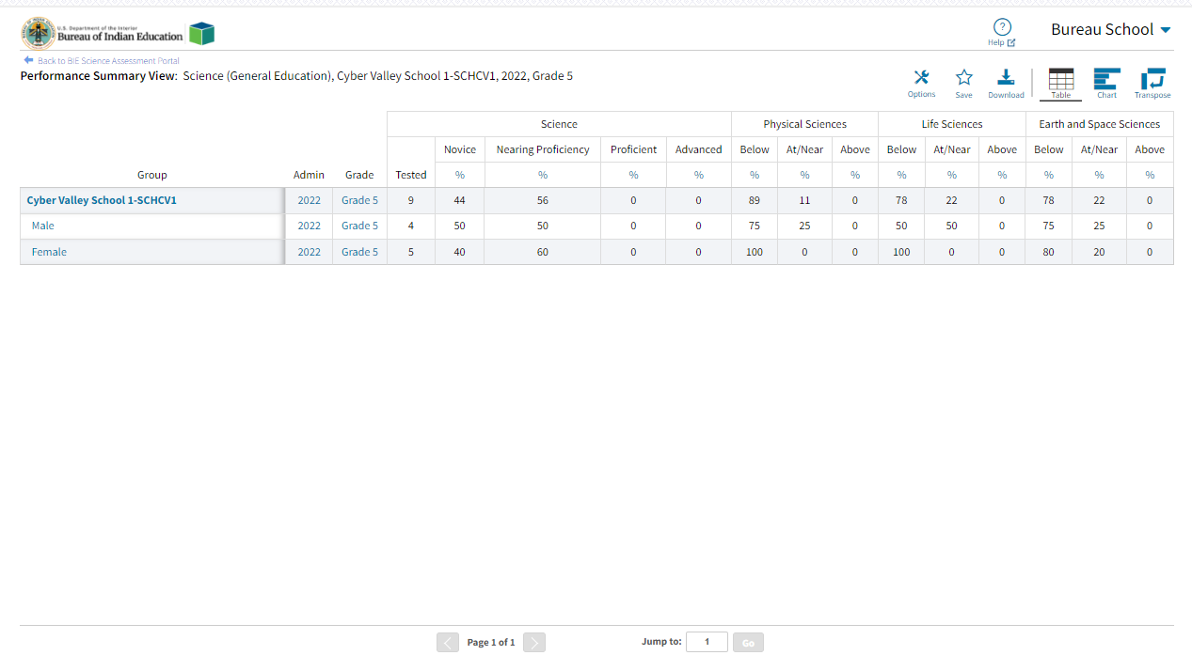
Performance Summary - Table
Disaggregated by Gender and show % of students in each Performance Indicator
Click on the blue text to disaggregate or drill to roster

Slide 21
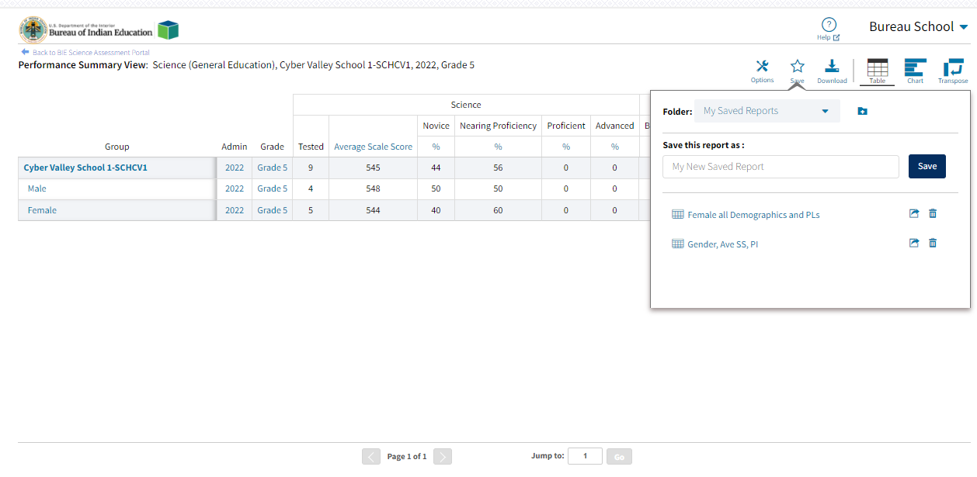
Save Report

Slide 22
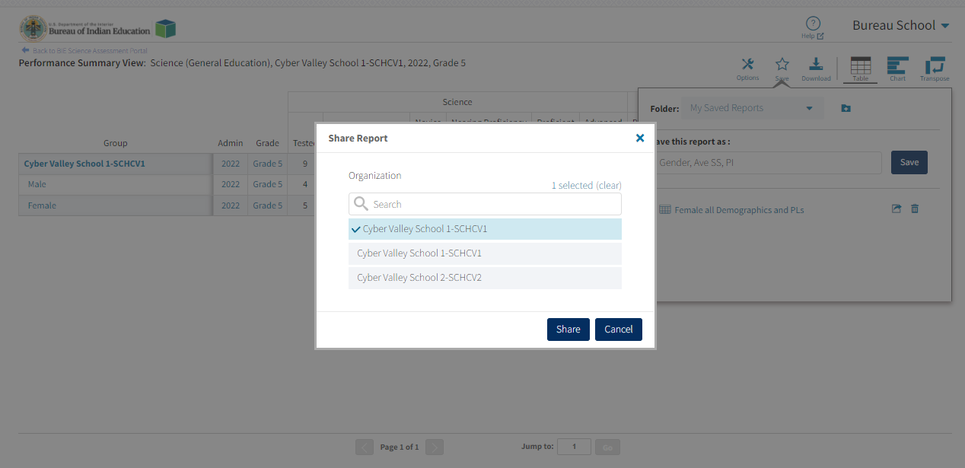
Share Report

Slide 23
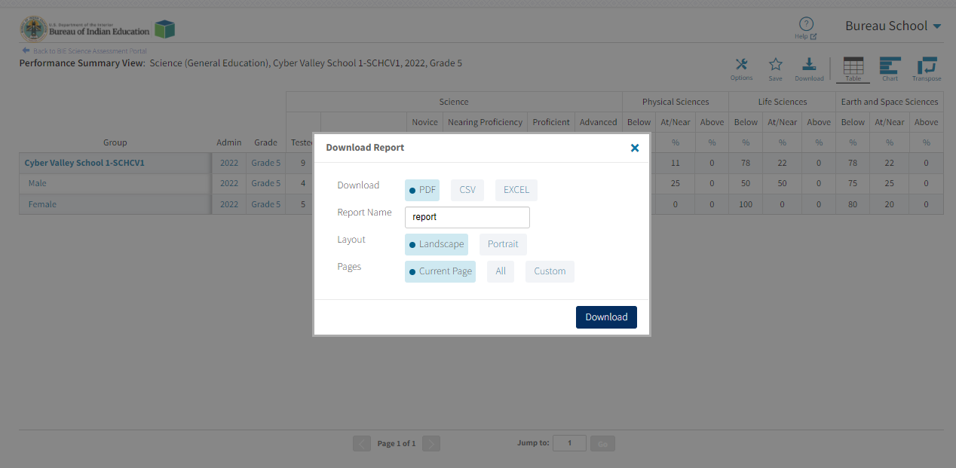
Download Report

Slide 24
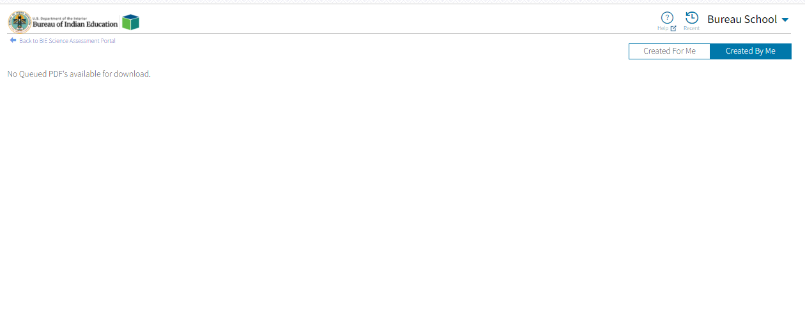
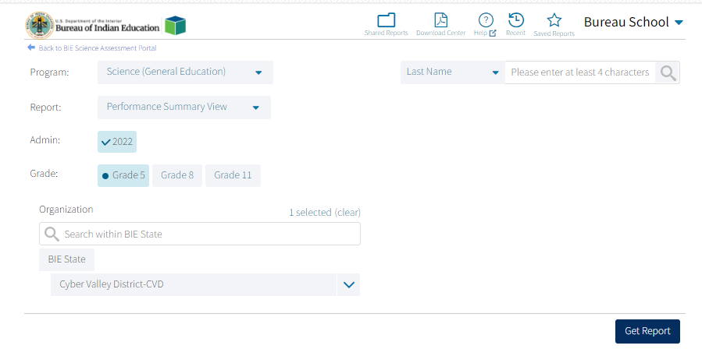
Download Center

Slide 25
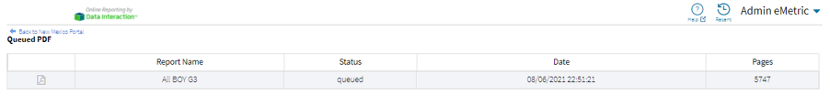
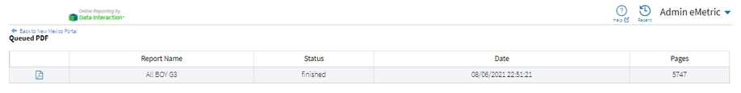
Download Center
File is being generated
File is complete and ready for download

Slide 26
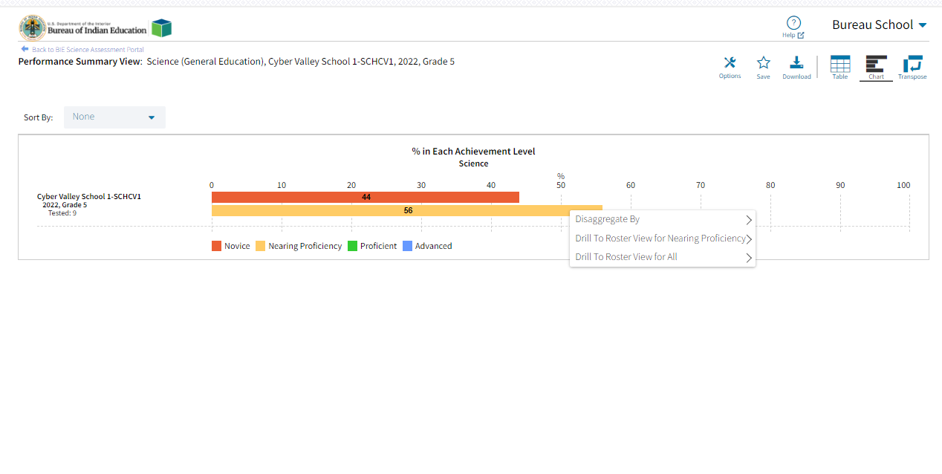
Performance Summary – Chart

Slide 27
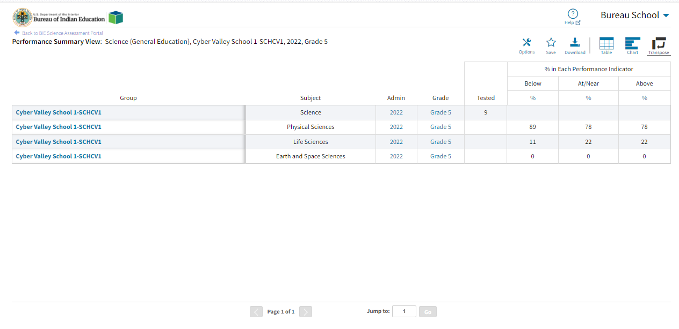
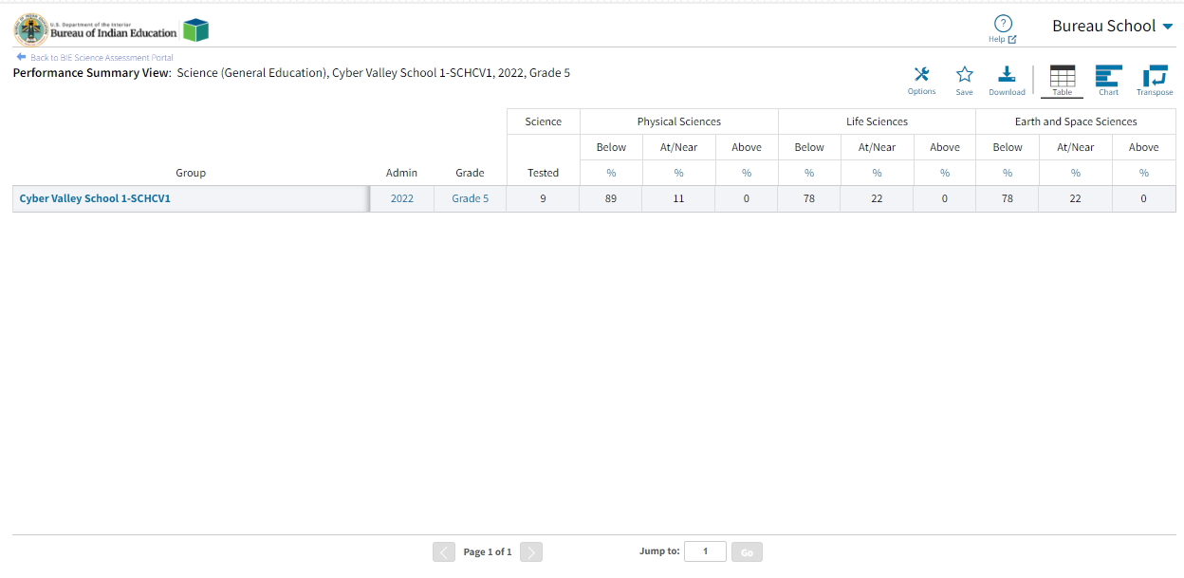
Performance Summary – Transpose

Slide 28
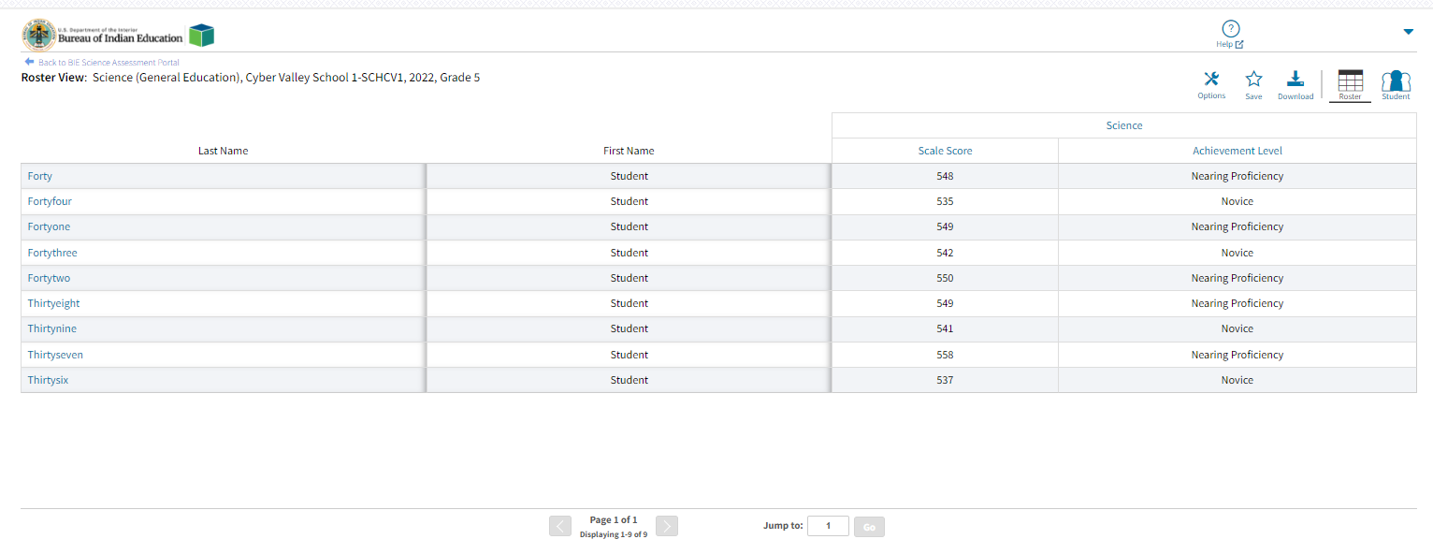
Roster
Options: choose fields and score data you want to view (demographic data, test data, reporting categories, etc.)
Save: save the report to retrieve it later without having to add or remove fields and sorting
Download: download the data you are looking at in excel, csv or PDF
Student: view the student’s ISRs

Slide 29
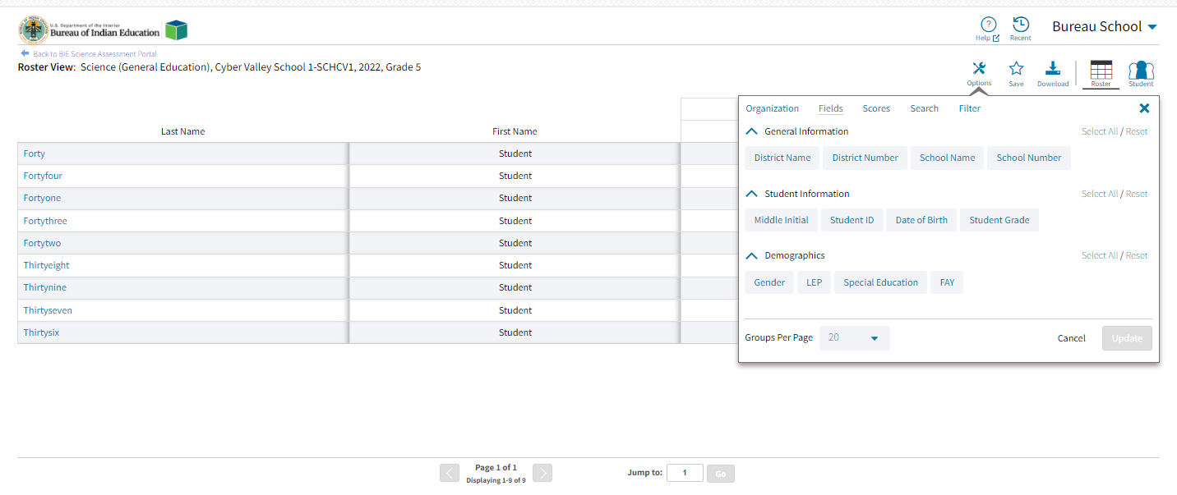
Roster

Slide 30
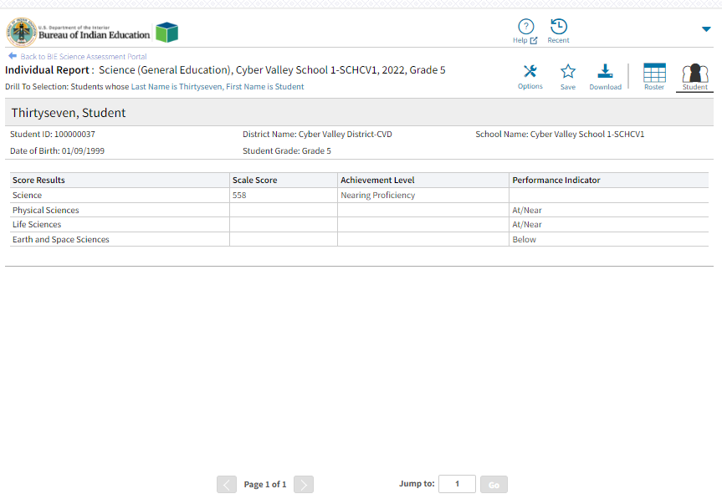
Individual Student Report

Slide 31
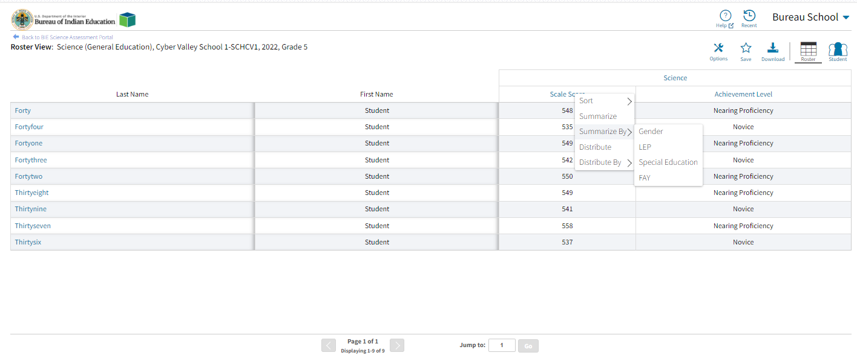
Roster Summarize and Distribute Options

Slide 32
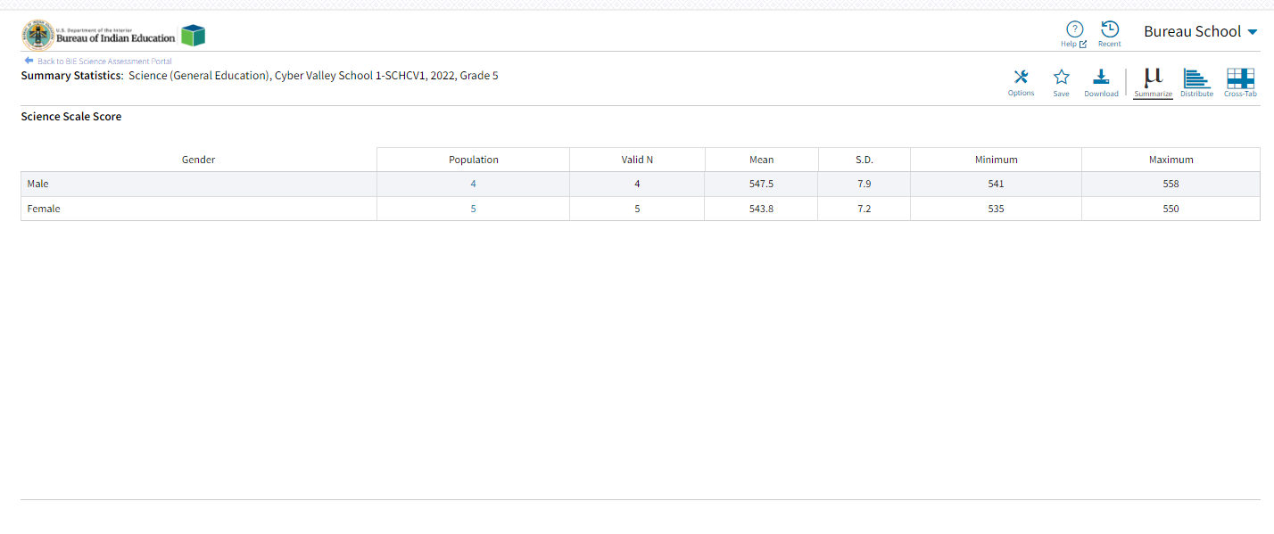
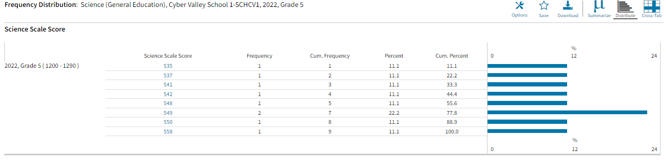
Roster Summarize and Distribute Options

Slide 33
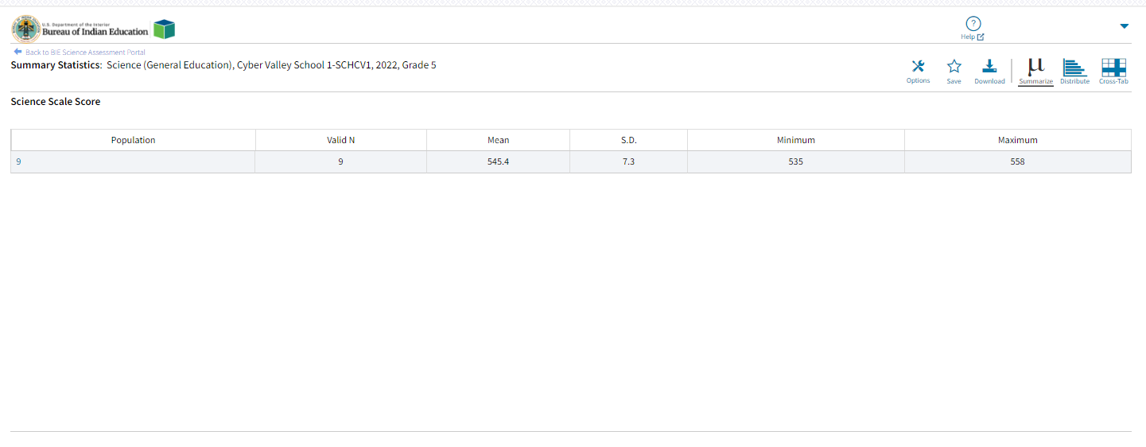
Data Tools - Summarize

Slide 34
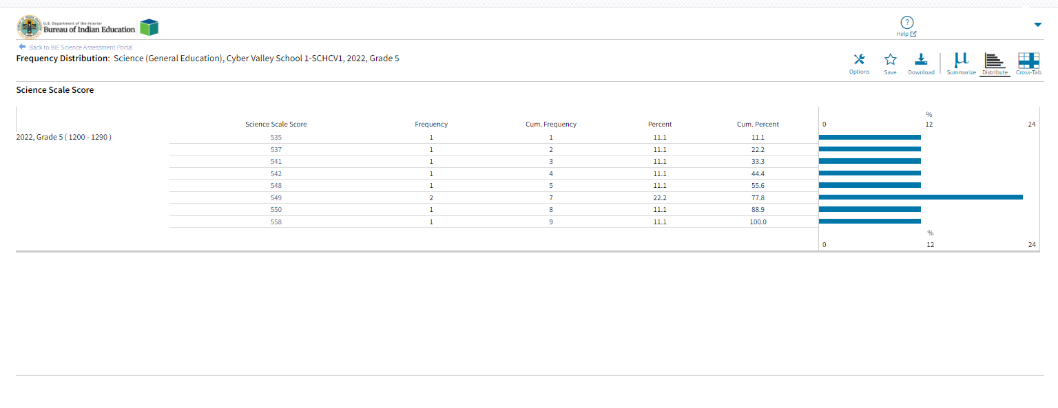
Data Tools - Distribute

Slide 35
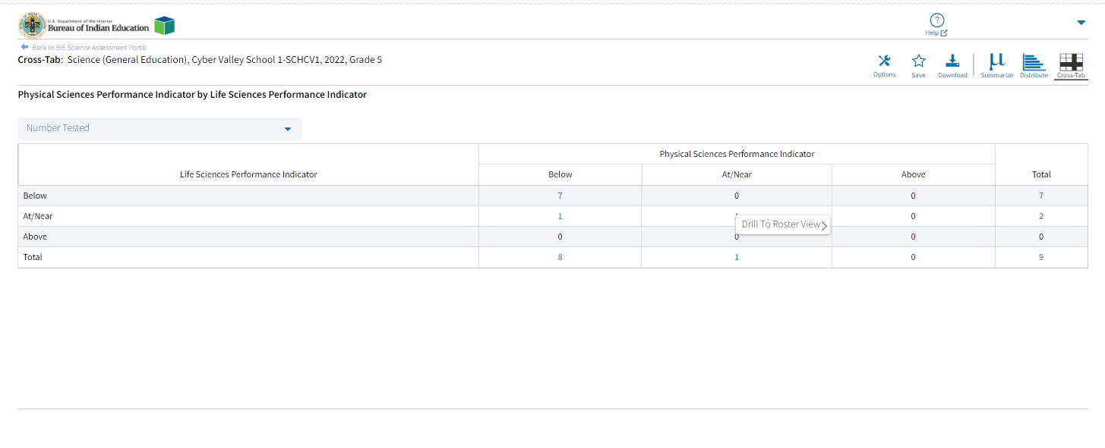
Data Tools – Cross Tab

Slide 36
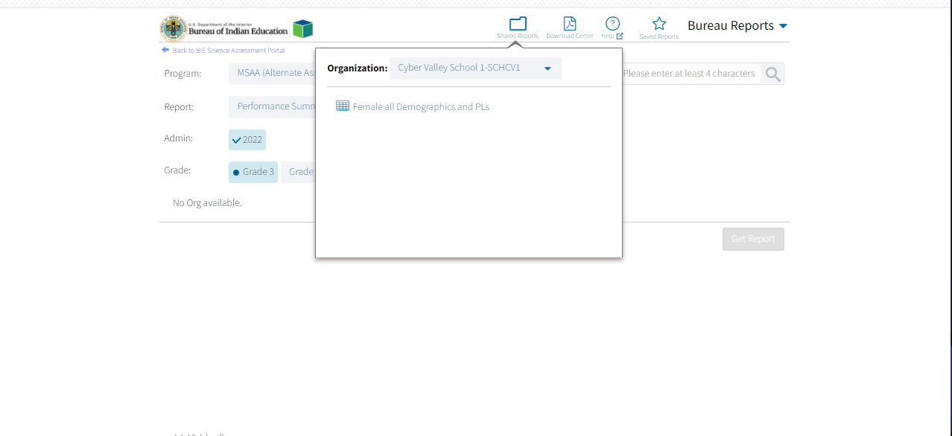
Shared Reports

Slide 37
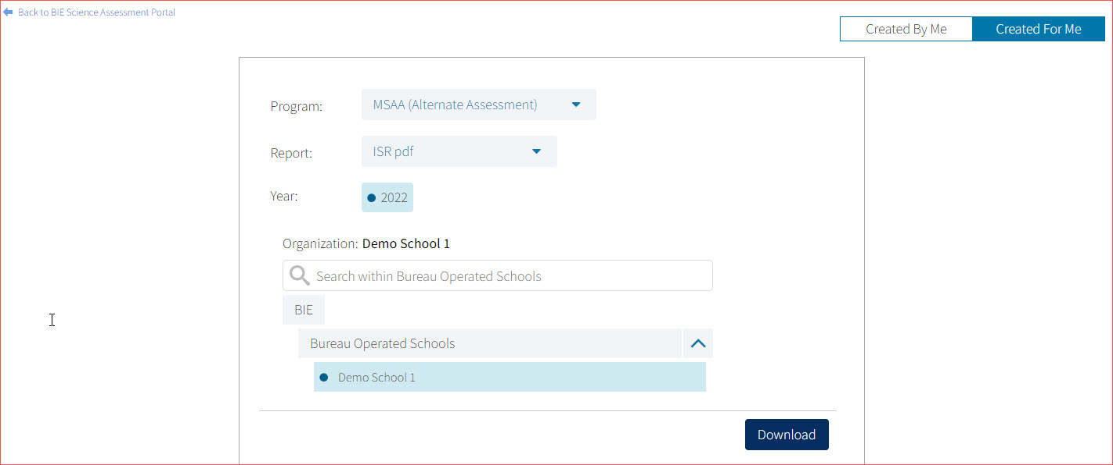
Downloading the Paper ISR in a .PDF File
In the Download Center, Created For Me menu, you can download a zip file containing pdf files of the paper ISR!

Slide 38
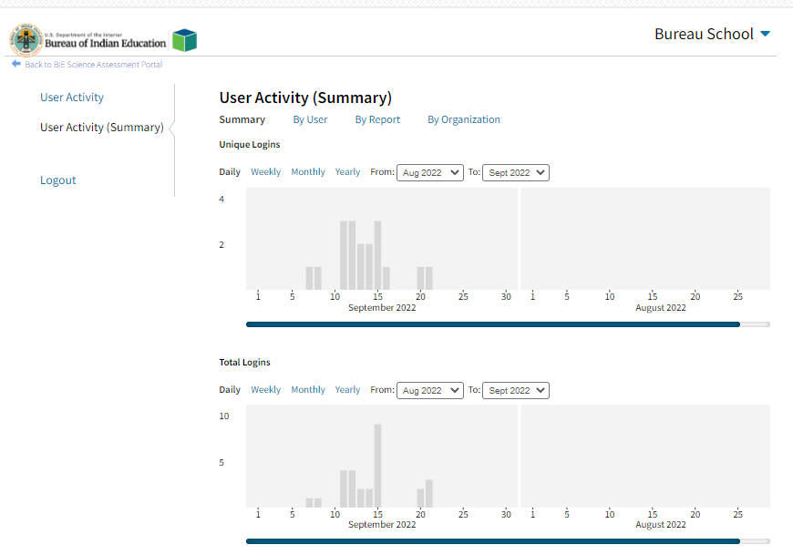

User Activity

Slide 39
Demo

Slide 40
Questions?

Slide 41
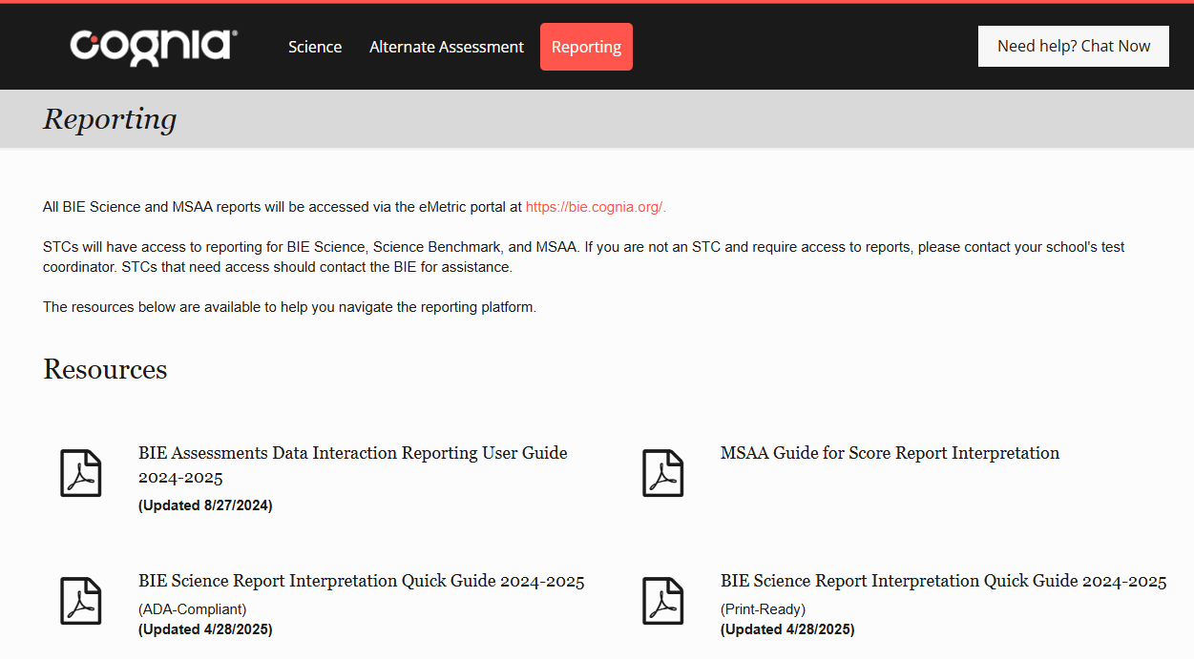
Help & Support Site
Reporting Resources
https://bie.onlinehelp.cognia.org/
Resources will be posted throughout the year
  Key dates
  Manuals
  Training videos
  Practice tests
    Access to CBT practice test and answer documents
    Downloadable PDFs of the practice test
  Reporting resources
    https://bie.onlinehelp.cognia.org/reporting/

Slide 42
Help Desk
Hours
Monday–Friday from 9:00 a.m.–6:00 p.m. (ET)
Contact information
Phone: 800-887-7027
Email: BIETechSupport@cognia.org
Chat (accessible from the BIE Help & Support site)

Slide 43
Thank you!

Slide 44


Knowledge is Opportunity
Cognia is a global nonprofit that has the knowledge to help schools improve outcomes for all learners.

